Slide 1


Slide 2

1
Unit
FAMILY LIFE
REVIEW 4
LESSON 2
SKILL 1_LISTENING AND SPEAKING

Slide 3

Unit
1
1
FAMILY LIFE
Family Life
Unit
OBJECTIVES
Practice listening for general and specific information about a day trip ;
Practice talking about the plan of a day trip.

Slide 4
LESSON 2
SKILL 1_ LISTENING AND SPEAKING
Unit
GETTING STARTED
Video watching: Travel plans
WARM-UP
LISTENING
Task 1: Listen and choose the best title for the talk. (p. 122) Task 2: Listen again and complete the notes with no more than TWO words. (p. 122)
SPEAKING
Task 1: Imagine that you are going on a day trip. Work in pairs. Discuss and plan your trip. Use the following points to help you. (p. 122)
CONSOLIDATION
Wrap up
Homework

Slide 5
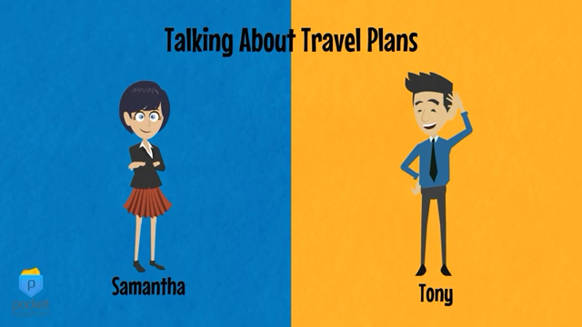
LESSON 2
SKILL 1_ LISTENING AND SPEAKING
Unit
GETTING STARTED
WARM-UP
Video watching: Travel plans

Slide 6

LESSON 2
SKILL 1_ LISTENING AND SPEAKING
Unit
GETTING STARTED
Video watching: Travel plans
WARM-UP
LISTENING
Task 1: Listen and choose the best title for the talk. (p. 122) Task 2: Listen again and complete the notes with no more than TWO words. (p. 122)

Slide 7

LISTENING
1
Listen and choose the best title for the talk. (p. 122)
A. Information about a day trip
B. What we should do during a trip
C. Reviews of a day trip

Slide 8
LISTENING
1
Listen and choose the best title for the talk. (p. 122)
A. Information about a day trip

Slide 9
LISTENING
2
Listen again and complete the notes with no more than TWO words. (p. 122)
Day trip
Time to leave: 8.30 a.m.
Trip will take: (1) _________ hours
Activities:
- Visiting an ancient (2) _________ built 600 years ago
- Having lunch with a(n) (3) _________ and learning about local food
- Seeing the oldest and biggest (4) _________ in the country
Do not:
drop (5) _________ or pick flowers on the roadside
8
house
local family
pagoda
litter

Slide 10
LISTENING
2
Audio script – Track 80 + 81:
Hello everybody. This Saturday we're all going on a trip to an ancient village just outside the city and I'd just like to give you some information about the trip. We're leaving from here at 8.30 in the morning. It's an 8-hour trip so we'll probably be back at 4.30 p.m. We're going to visit three of the most famous attractions in the village. The first one is a large ancient house. It was built 600 years ago and its architecture is very impressive. After that we're going to have lunch with a local family. The family is going to prepare the most delicious locally made food for us and I'm sure we'll enjoy it. I think we'll stay there about 45 minutes. Then we're going to walk to the third attraction – the village pagoda. It's one of the oldest and biggest pagodas in the country and is surrounded by different types of trees. We can walk around the pagoda and learn about its interesting history. The pagoda is very beautiful so you can take some excellent photographs there. So don't forget to bring your camera with you. And remember: Don't drop litter or pick flowers on the roadside while you are visiting the places.

Slide 11
LESSON 2
SKILL 1_ LISTENING AND SPEAKING
Unit
GETTING STARTED
Video watching: Travel plans
WARM-UP
LISTENING
Task 1: Listen and choose the best title for the talk. (p. 122) Task 2: Listen again and complete the notes with no more than TWO words. (p. 122)
SPEAKING
Task 1: Imagine that you are going on a day trip. Work in pairs. Discuss and plan your trip. Use the following points to help you. (p. 122)

Slide 12
SPEAKING
1
Imagine that you are going on a day trip. Work in pairs. Discuss and plan your trip. Use the following points to help you. (p. 122)
- Where you will go
- When you will leave
- Which attractions you will visit
- Things you should avoid doing on the trip to protect the environment

Slide 13
LESSON 2
SKILL 1_ LISTENING AND SPEAKING
Unit
GETTING STARTED
Video watching: Travel plans
WARM-UP
LISTENING
Task 1: Listen and choose the best title for the talk. (p. 122) Task 2: Listen again and complete the notes with no more than TWO words. (p. 122)
SPEAKING
Task 1: Imagine that you are going on a day trip. Work in pairs. Discuss and plan your trip. Use the following points to help you. (p. 122)
CONSOLIDATION
Wrap up
Homework

Slide 14
CONSOLIDATION
1
Wrap-up
Practice listening for general and specific information about a day trip ;
Practice talking about the plan of a day trip.

Slide 15
CONSOLIDATION
2
Homework
Prepare for Review 4 – Skills 2_ Reading and writing.

Slide 16


