Slide 1

UNIT 5: GENDER EQUALITY
Lesson 1 – Grammar
Page 39

Slide 2




Lesson 1.1
LESSSON OUTLINE
Consolidation

Slide 3

By the end of this lesson,
students will be able to:
- know the forms of infinitives.
- know when infinitives are used.
- use infinitives in a sentence.

Slide 4



Slide 5
Fill in the blanks with the words in the brackets.
I’d like ______ (go) to Moscow.
I can’t _____ (sing) very well.
I learn English ______ (talk) to foreigners.

Slide 6


Slide 7

Presentation

Slide 8

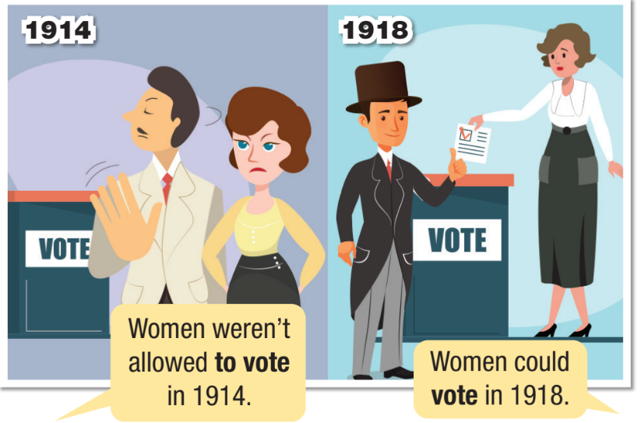
a. Listen and repeat

Slide 9
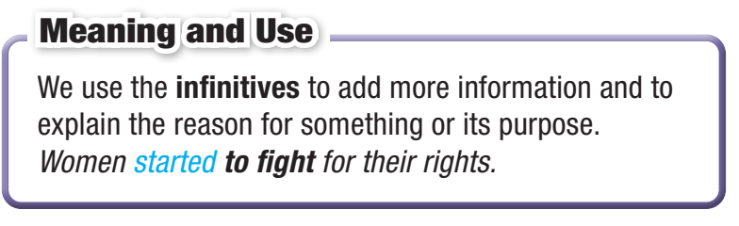
INFINITIVES

Slide 10

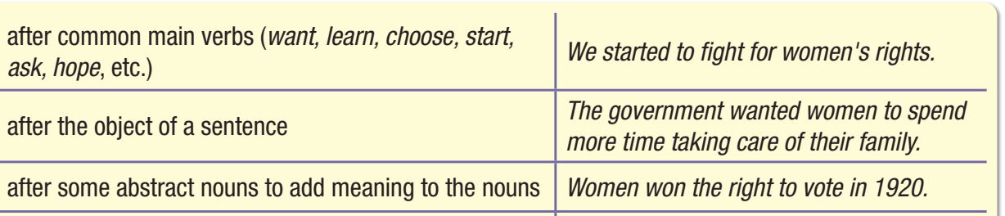
An infinitive with to is called to-infinitive.
We use these...

Slide 11
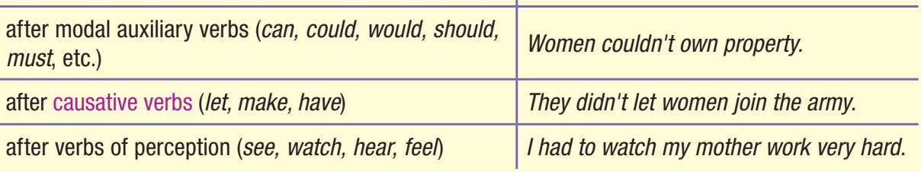
An infinitive without to is called bare infinitive.
We use these...

Slide 12

Practice

Slide 13
b. Fill in the blanks using the verb in the box in the to-infinitive or bare infinitive form.
become (x2) fight vote (x2) clean earn
to vote
1. Women were not allowed ____________ until 1920.
2. English women started _________ for gender equality in 1903.
3. The government let women _________ combat soldiers in 1994.
4. Today women can __________ the same pay as men.
5. Victorian women campaigned for the right ___________.
6. In 1979, people in Britain saw a woman ___________ Prime Minister for the first time.
to fight
become
earn
to vote
become

Slide 14

c. Match the sentences in Task b. with the rules for using to-infinitives and bare infinitives listed below. Write the numbers of 1-6 to the blanks.
____ after modal auxiliary verbs
____ after some abstract nouns
____ after verbs of perception
____ after causative verbs
____ after the object of a sentence
____ after a common main verb

Slide 15
c. Match the sentences in Task b. with the rules for using to-infinitives and and bare infinitives listed below. Write the numbers of 1-6 to the blanks.
1. Women were not allowed to vote until 1920.
2. English women started to fight for gender equality in 1903.
=> after the object of a sentence
(Government did not allow women to vote until 1920)
=> after a common main verb

Slide 16
c. Match the sentences in Task b. with the rules for using to-infinitives and and bare infinitives listed below. Write the numbers of 1-6 to the blanks.
3. The government let women become combat soldiers in 1994.
4. Today women can earn the same pay as men.
=> after causative verbs
=> after modal auxiliary verbs

Slide 17
c. Match the sentences in Task b. with the rules for using to-infinitives and and bare infinitives listed below. Write the numbers of 1-6 to the blanks.
5. Victorian women campaigned for the right to vote.
6. In 1979, people in Britain saw a woman become Prime Minister for the first time.
=> after some abstract nouns
=> after verbs of perception

Slide 18
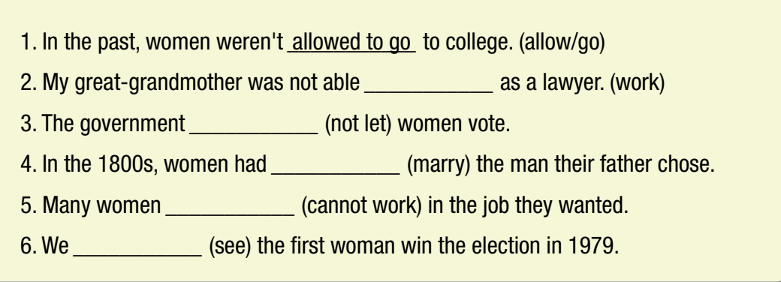
Extra Practice
WB, page 27
a. Fill in the blanks with the correct form of the verbs. Practice saying the sentences.
to work
didn’t let
to marry
couldn’t work
saw

Slide 19
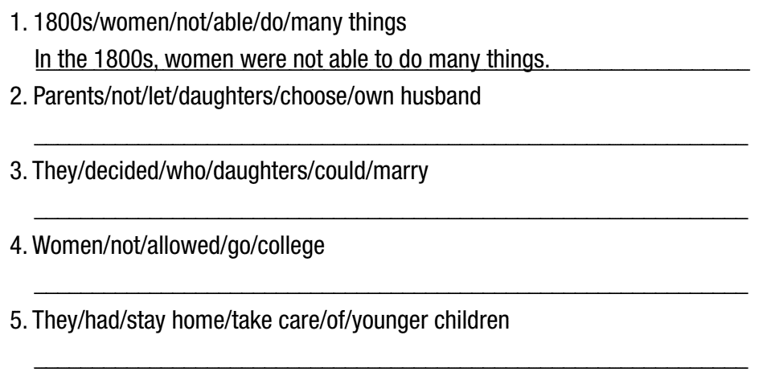
b. Rewrite the sentences using to-infinitive or bare infinitive.
Extra Practice
WB, page 27
Parents did not let their daughters choose their own husband.
They decided who their daughters could marry.
Women were not allowed to go to college.
They had to stay home to take care of their younger children.

Slide 20

Production

Slide 21

Work in pairs.
d. Make sentences to say what women can do today. Use to-infinitives or bare infinitives.
Today, women can have the same careers as men.
Today, women also go to work to earn money.
Today, women are allowed to vote.

Slide 22

Consolidation

Slide 23
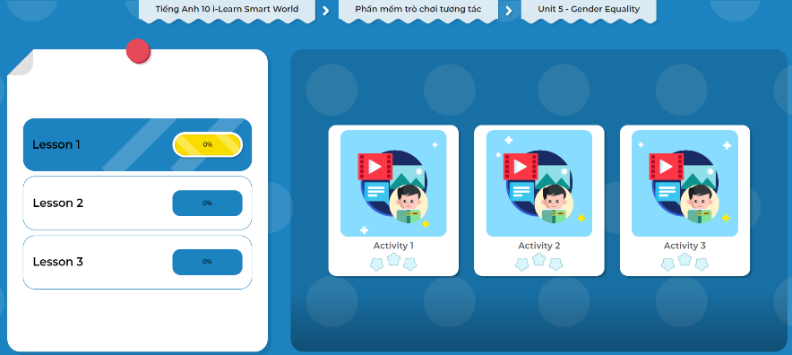
Let’s play!
Click here to play the games!

Slide 24
Wrap-up
Today’s lesson
Grammar: To-infinitives and Bare infinitives
+ Meaning and use
+ Form

Slide 25

Make sentences with to-infinitives and bare infinitives about yourself.
Prepare the next lesson - on page 40 in SB.
Complete the grammar notes in Tiếng Anh 10 i-Learn Smart World Notebook (page 29)
Play the consolidation games in Tiếng Anh 10 i-Learn Smart World DHA App on www.eduhome.com.vn

Slide 26

Have a nice day!

