Slide 1
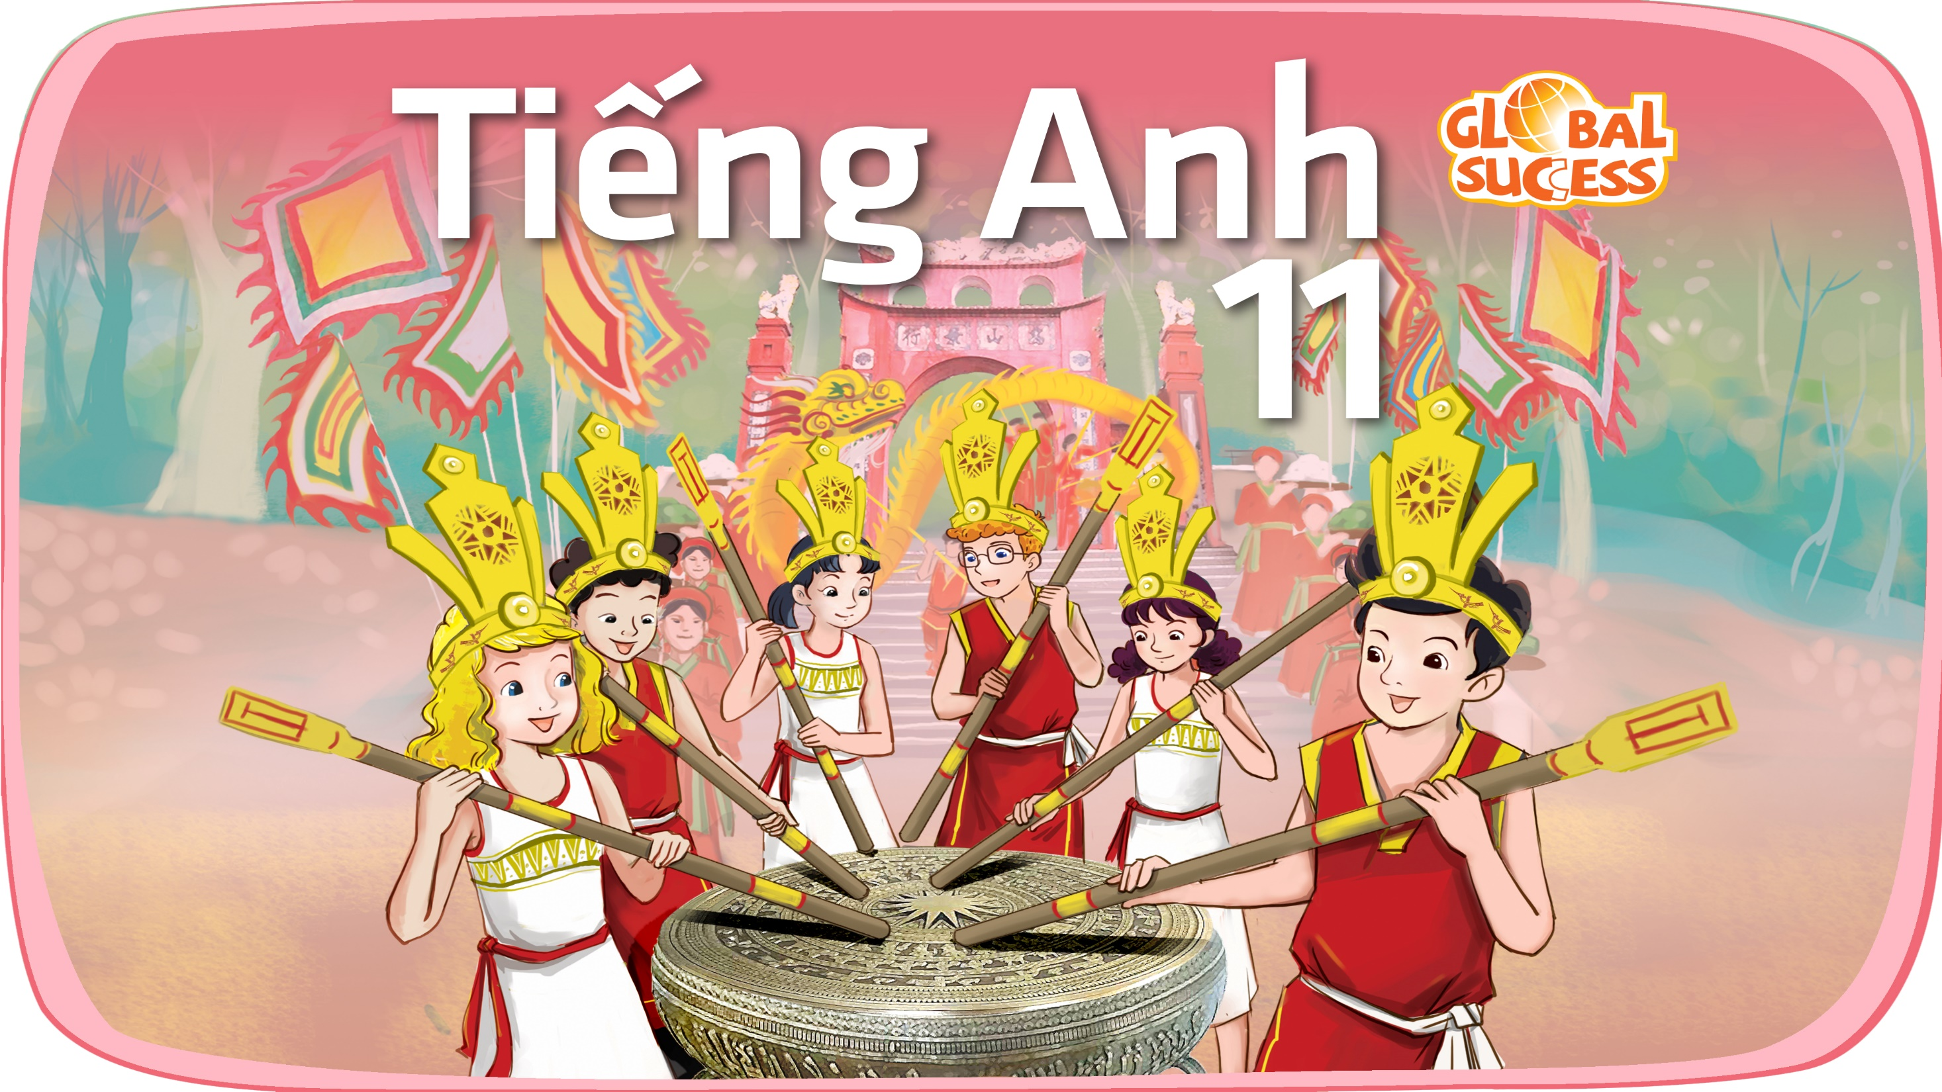

Slide 2
Unit
6
Preserving our heritage
Unit
FAMILY LIFE
LESSON 4
SPEAKING
Preserving cultural heritage

Slide 3
LESSON 4
SPEAKING
WARM-UP
Game: Jumble words
Task 1: Match the ways to preserve our heritage with the reason.
Task 2. Complete the conversation.
CONTROLLED PRACTICE
LESS CONTROLLED PRACTICE
Task 3. Make a similar conversation.
FURTHER PRACTICE
Discussion
CONSOLIDATION
Wrap-up
Homework

Slide 4
WARM-UP
GAME: JUMBLE WORDS
- Work in 2 groups.
- Rearrange the letters in the word to make a meaningful word.
- Raise your hands and say BINGO to get the chance to answer.
- One point for each correct answer.
- The team with more points will be the winner of the game.

Slide 5
WARM-UP
Question 1
U/C/O/K/F/I/M/L/S (2 words)
FOLK MUSIC

Slide 6
WARM-UP
Question 2
R/A/S/W/E/S/E/N/A
AWARENESS

Slide 7
WARM-UP
Question 3
L/I/O/M/S/E/D/A/C/I/A (2 words)
SOCIAL MEDIA

Slide 8
WARM-UP
Question 4
N/E/C/M/I/P/O/T/T/O/I
COMPETITION

Slide 9
WARM-UP
Question 5
L/A/E/F/S/I/V/T
FESTIVAL

Slide 10
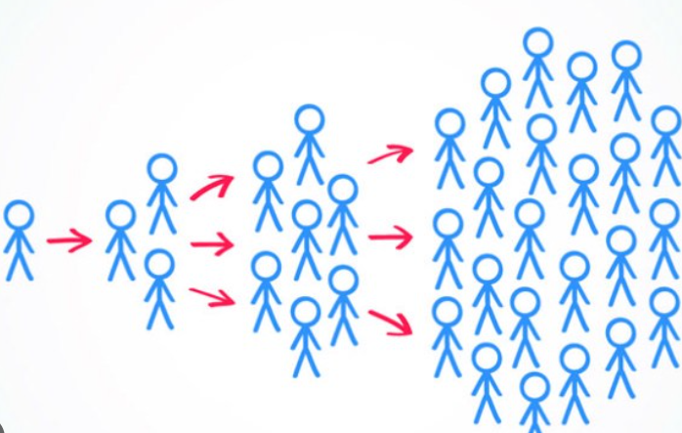

VOCABULARY
spread (v)
/spred/
to affect or make something affect, be known by, or be used by more and more people

Slide 11

VOCABULARY
involved (adj)
/ɪnˈvɒlvd/
being part of something or connected with something

Slide 12
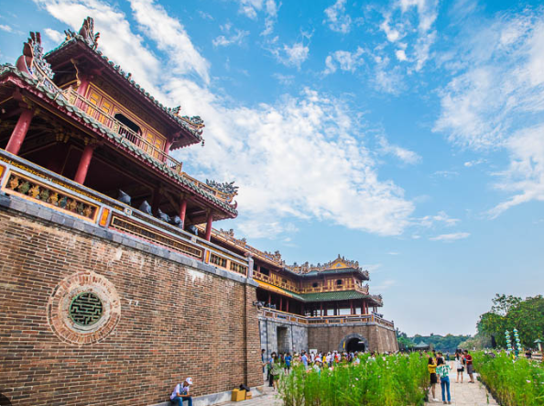
VOCABULARY
cultural heritage (n)
/ˈkʌltʃərəl ˈherɪtɪdʒ/
the heritage of tangible and intangible heritage assets of a group or society that is inherited from past generations.

Slide 13
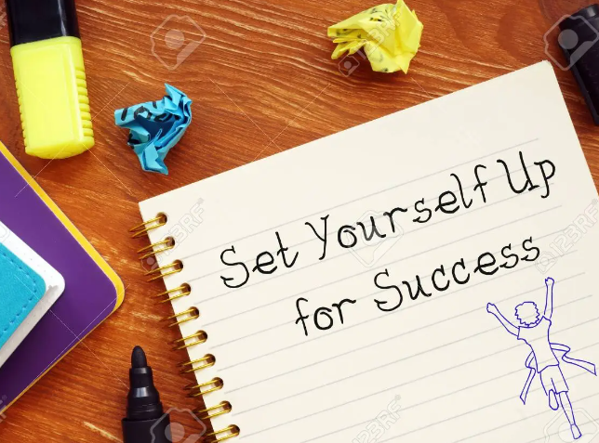
VOCABULARY
(to) set up
/set ʌp/
to create something or start it

Slide 14
Form | Pronunciation | Meaning
1. spread (v) | /spred/ | to affect or make something affect, be known by, or be used by more and more people
2. involved (adj) | /ɪnˈvɒlvd/ | being part of something or connected with something
3. cultural heritage (n) | /ˈkʌltʃərəl ˈherɪtɪdʒ/ | the heritage of tangible and intangible heritage assets of a group or society that is inherited from past generations.
4. (to) set up | /set ʌp/ | to create something or start it

Slide 15
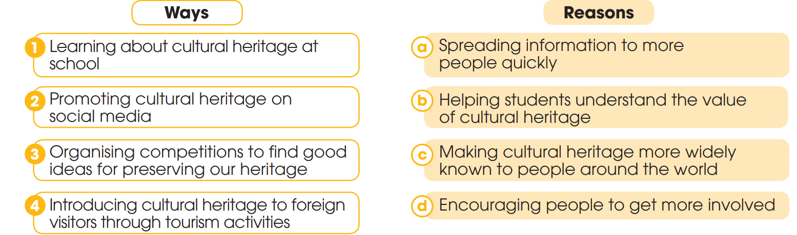
CONTROLLED PRACTICE
1
Work in pairs. Match the ways to preserve our heritage with the reason for doing so

Slide 16
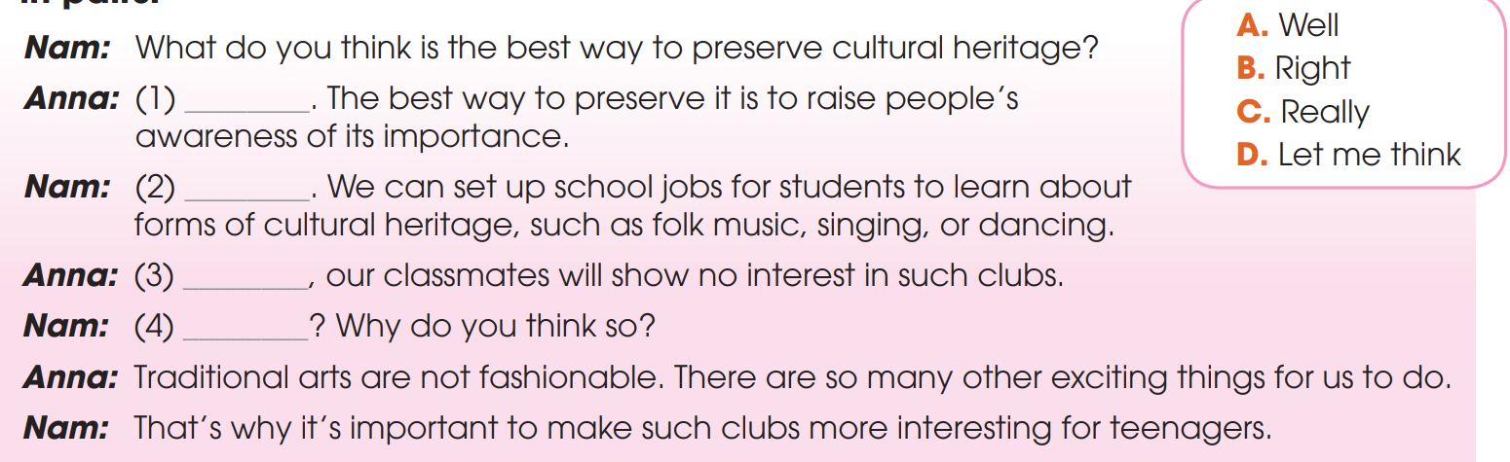
CONTROLLED PRACTICE
2
Complete the conversation with the words and phrase in the box. Then practise it in pairs.
D
B
A
C

Slide 17
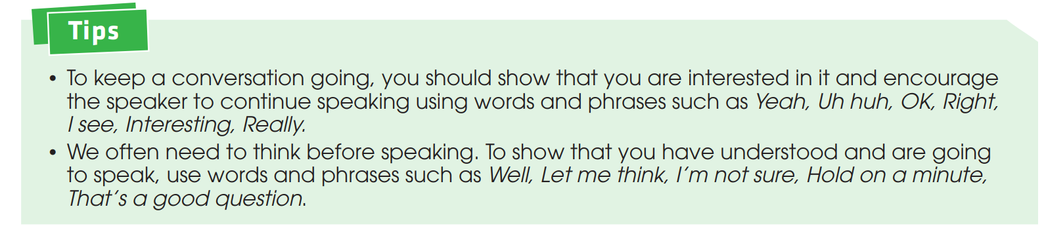
LESS CONTROLLED PRACTICE
3
Work in pairs. Make a similar conversation about ways to protect local heritage.

Slide 18
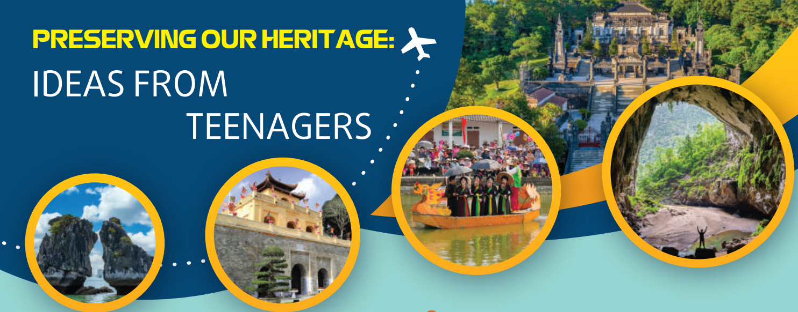
FURTHER PRACTICE
4
Work in groups. Think of a form of cultural heritage (such as a tradition, a festival, or a form of music) and discuss ways to preserve it. Report your group’s ideas to the whole class.

Slide 19
CONSOLIDATION
1
Wrap-up
What have you learnt today?
How to keep a conversation going;
Vocabulary to talk about how to preserve cultural heritage

Slide 20
CONSOLIDATION
2
Homework
Do exercises in the workbook.
Prepare for Lesson 5 - Unit 1.

Slide 21

Website: hoclieu.vn
Fanpage: facebook.com/tienganhglobalsuccess.vn/
Website: hoclieu.vn
Fanpage: facebook.com/sachmem.vn/

