Slide 1



Unit 0: Introduction
Lesson D: Grammar

Slide 2
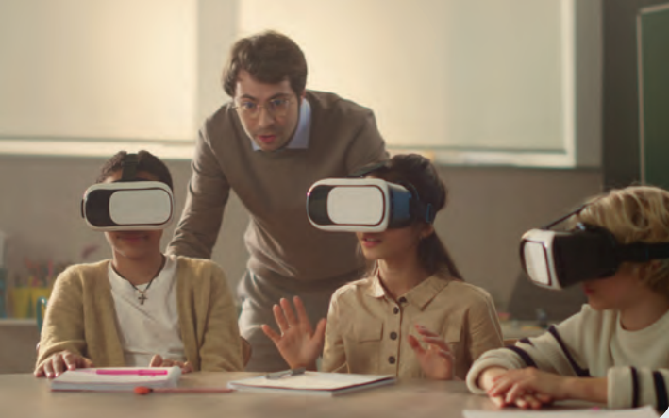
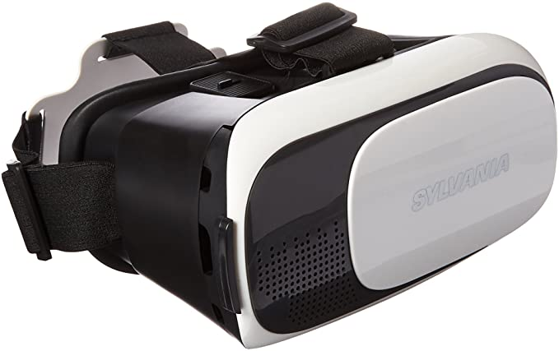

What are the students wearing on the face?
3D glasses
www.phuongnam.edu.vn

Slide 3
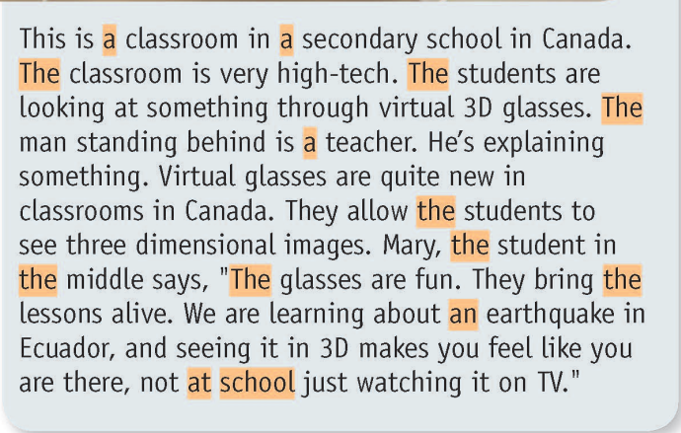
Read the text. Would you like to use 3D glasses like this at school? Why? /Why not?

Slide 4



www.phuongnam.edu.vn

Slide 5
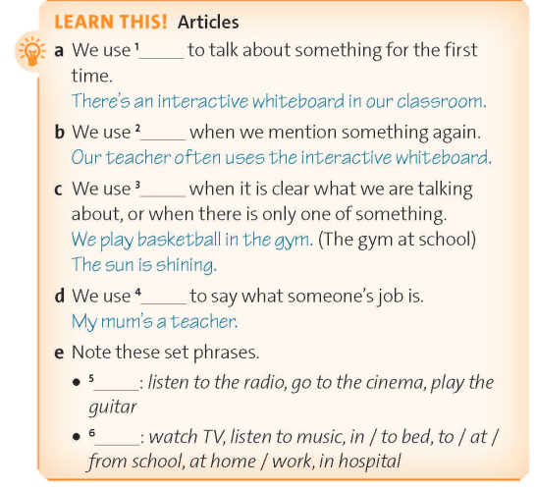
a/an
the
the
a/an
The
__
www.phuongnam.edu.vn

Slide 6

Answers:
a classroom; a secondary school
The classroom
The students; the man; the student; the students in the middle; The glasses; the lessons
a teacher
at school
a/an
the
the
a/an
The
__
www.phuongnam.edu.vn

Slide 7

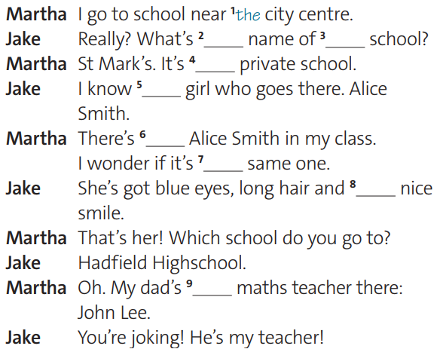
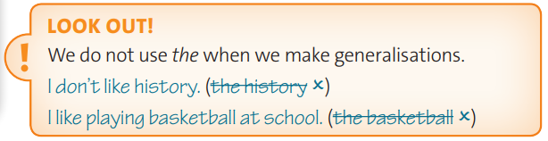
the
the
a
a
an
the
a
a
www.phuongnam.edu.vn

Slide 8

Generalisations: 1, 3, 4
Dogs / The dogs are more intelligent than cats / the cats.
Weather / The weather is nice today.
Chocolate / The chocolate is everyone’s favorite dessert
Earth / The earth is the only planet that has life on it.
www.phuongnam.edu.vn

Slide 9

Pair - Work
www.phuongnam.edu.vn

Slide 10

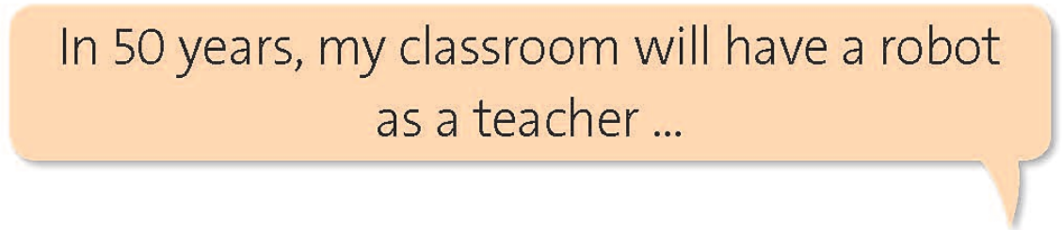
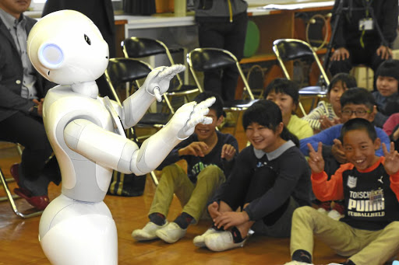
www.phuongnam.edu.vn

Slide 11
www.phuongnam.edu.vn

Slide 12

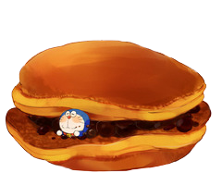
= Mystery
power-up
= points
www.phuongnam.edu.vn

Slide 13

A
B
C
D
E
F
G
H
www.phuongnam.edu.vn

Slide 14
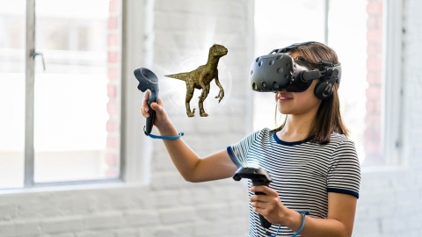
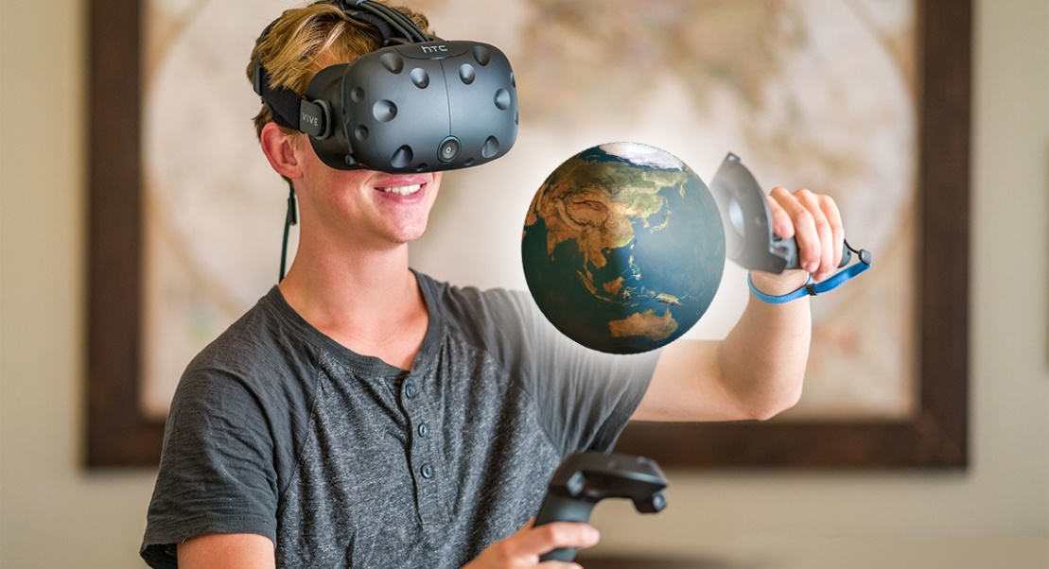


A. In 50 years, students/do/Virtual Reality Experiments.
In 50 years, students will do
Virtual Reality Experiments

Slide 16

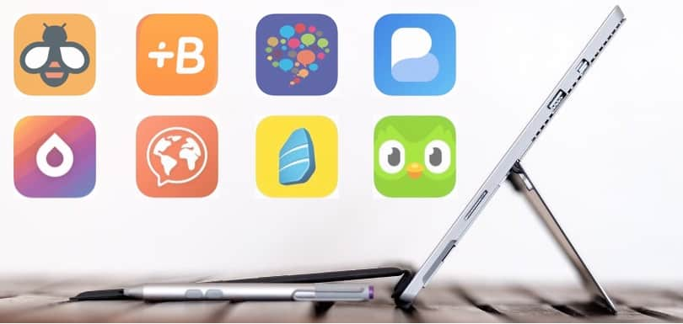
B. In 50 years, there/more/learning apps.
In 50 years, there will be
more learning apps.

Slide 18
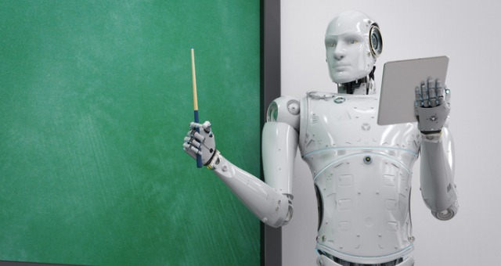
C. In 50 years, there/many/online classrooms/robot teachers.
In 50 years, there will be many online classrooms with robot teachers.

Slide 20

D. In 50 years, students/do/Face Recognition/take attendance.
In 50 years, students will do
Face Recognition to take attendance.

Slide 22
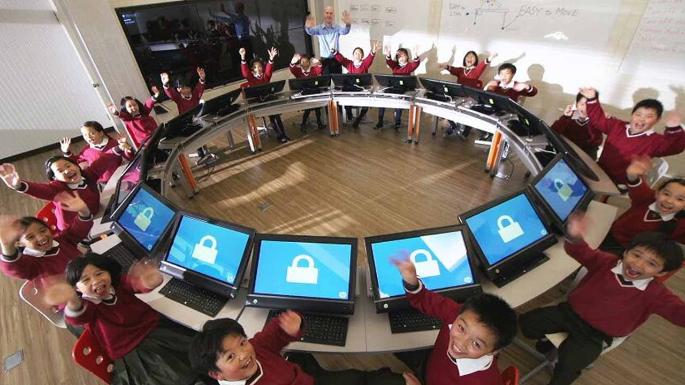
E. In 50 years, students/use/ technology devices/in stead of/papers.
In 50 years, students will use
technology devices in stead of papers.

Slide 24
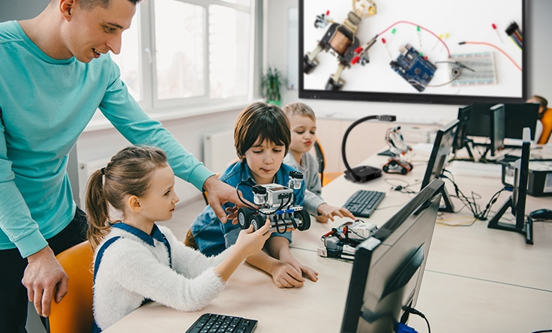
F. In 50 years, technology devices/be/ most/important/part/in/classroom.
In 50 years, technology devices will be
the most important part in the classroom.

Slide 25







Slide 26
Change points!

Slide 27
Steal 3 points!

Slide 28
7 points!

Slide 29
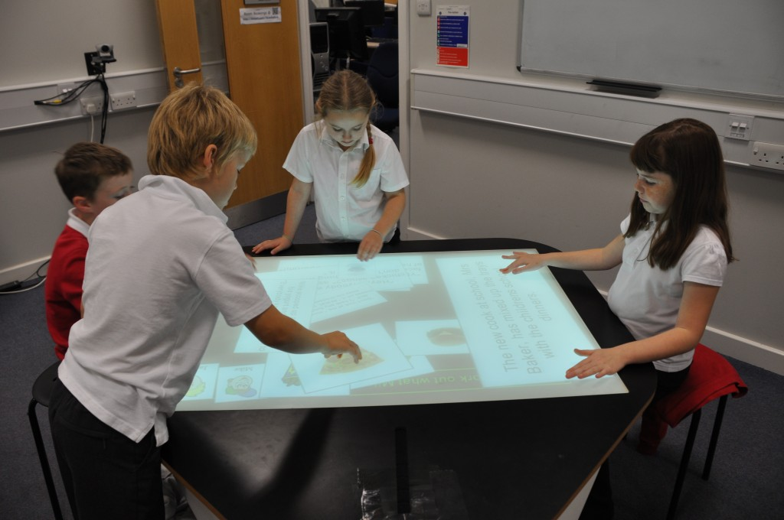
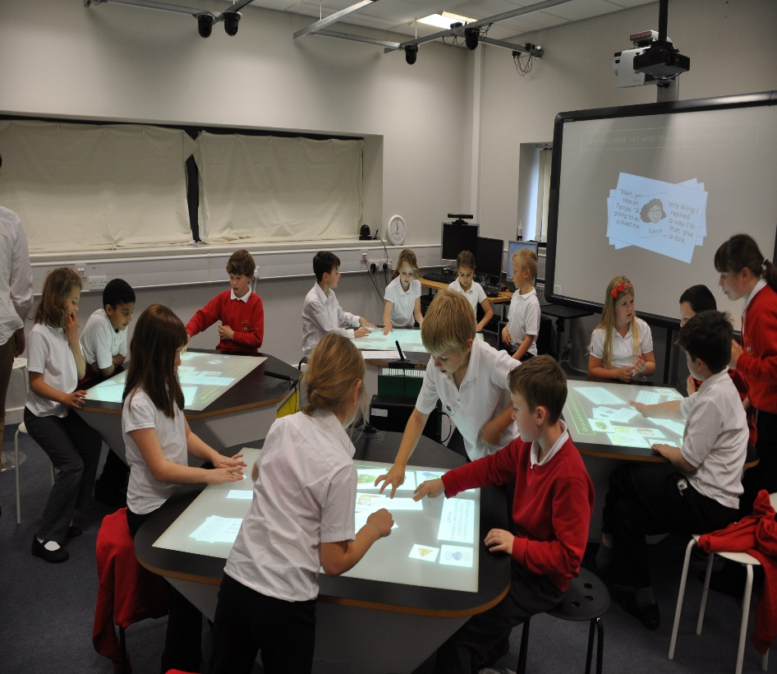
G. In 50 years, classrooms/have/multi-touch tables.
In 50 years, the classrooms
will have multi-touch tables.

Slide 31
Change points!

Slide 32




Slide 33
8 points!

Slide 34

H. In 50 years, there/more/ techniques/in teaching.
In 50 years, there will be more
techniques in teaching

Slide 35
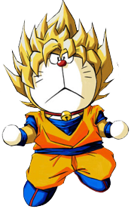



Slide 36
Steal 3 points!

Slide 38
9 points!

Slide 39
Homework
 Learn by heart all the new words.
 Prepare for next lesson – Vocabulary: How do you feel?
www.phuongnam.edu.vn

Slide 40

www.phuongnam.edu.vn

Slide 41



Thank you!
CTCP ĐẦU TƯ VÀ PHÁT TRIỂN GIÁO DỤC PHƯƠNG NAM

