Slide 2

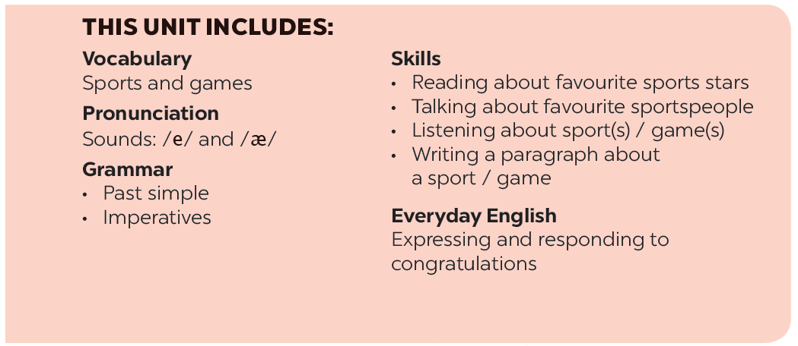

Slide 3








Vocabulary
Grammar
Find one odd word / phrase in each question.
Put the verbs in brackets in the correct form.
What do you say in these situations?
Put the correct form of the verbs play, do or go in the blanks.
Fill each blank with ONE word to complete the passage.

Slide 4
Vocabulary

Slide 5


Find one odd word / phrase in each question.
1.
A.
volleyball
B.
badminton
C.
bicycle
2.
A.
playground
B.
ball
C.
racket
3.
A.
running
B.
cycling
C.
driving
4.
A.
sports shoes
B.
winter sports
C.
goggles
5.
A.
sporty
B.
intelligent
C.
fit

Slide 6

Put the correct form of the verbs play, do or go in the blanks.
Duong can
do karate.
1.
_______ karate.
2.
Duy isn’t reading now. He
_______ table tennis with his friend.
is playing table tennis with his friend.
Michael
goes swimming nearly every day.
3.
_______ swimming nearly every day.
went fishing.
4.
Phong didn’t play football yesterday. He
_______ fishing.
_______ volleyball last Saturday.
5.
Khang
played volleyball last Saturday.
6.
The girls
are doing aerobics in the playground now.
_______ aerobics in the playground now.

Slide 7
Grammar

Slide 8

Put the verbs in brackets in the correct form.
took place in Greece in 776 BC.
1.
The first Olympic Games (take)
_______ place in Greece in 776 BC.
2.
People (start)
started to use computers about 50 years ago.
_______ to use computers about 50 years ago.
My brother (not like)
didn’t like to play games when he was small.
3.
_______ to play games when he was small.
What _______ you (do) _______ last weekend?
I (cycle) _______ round the lake with my friends. Then I (watch) _______ TV in the afternoon.
4.
What did you (do) do last weekend?
I (cycle) cycled round the lake with my friends.
Then I (watch) watched TV in the afternoon.

Slide 9

What do you say in these situations?
1.
Your friends are making a lot of noise.
Please, stop
making noise.
_______.
2.
The boy is watching TV for too long.
_______ to play with your friends.
Go out to play with your friends.
3.
Some children are feeding the animals at the zoo, but it is not allowed.
_______ the animals.
Don’t feed the animals.
4.
The teacher wants the boys to stand in line.
Stand in line, boys.
_______.
5.
Your mother tells you not to touch the dog.
Don’t touch the dog.
_______.

Slide 10

Fill each blank with ONE word to complete the passage.
Sports and games are very important in our lives. We all can (1) _______ a sport, or a game, or watch sports events on TV or at the stadium. When you listen to the radio every day, you can always (2) _______ sports news. When you open a newspaper, you will always find an article about your (3) _______kind of game. Television programmes about (4) _______ are also very popular, and you can watch something interesting every day. Stories about (5) _______ sports stars are often very interesting.

Slide 11
Fill each blank with ONE word to complete the passage.
Sports and games are very important in our lives. We all can (1) play a sport, or a game, or watch sports events on TV or at the stadium. When you listen to the radio every day, you can always (2) hear sports news. When you open a newspaper, you will always find an article about your (3) favorite kind of game. Television programmes about (4) sports are also very popular, and you can watch something interesting every day. Stories about (5) famous sports stars are often very interesting.

Slide 12

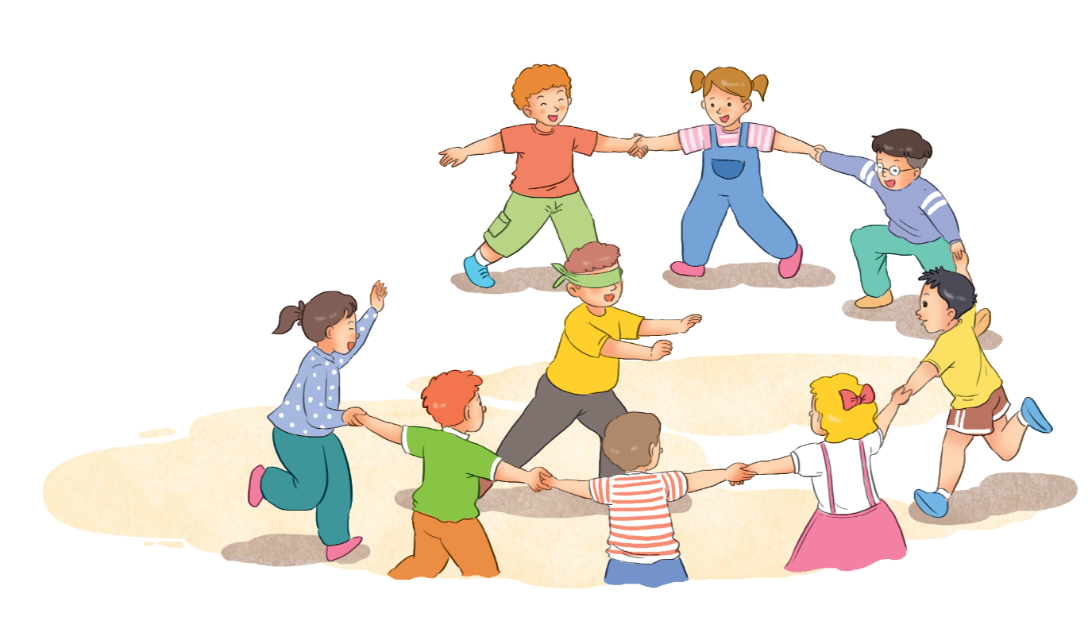
Read the information about a traditional game.
Name of the game: blind man’s buff
Number of players: five or more
Equipment: a blindfold, and open space
How to play:
1.
Players stand in a circle; one person blindfolded (the seeker) stands in the middle.
2.
The seeker tries to touch others without being caught.
3.
When the seeker catches a player, he / she tries to guess who it is by touching that player’s face and hair.
4.
When the seeker guesses that player’s name, he / she becomes the new seeker.

Slide 13
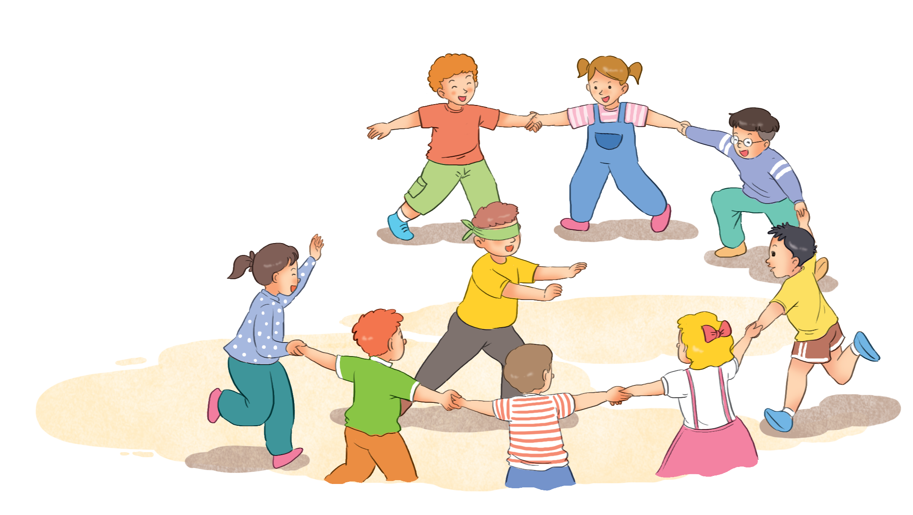
Choose one of the following games and write about it.
Tug of war (rope pulling)
Skipping
Wrestling
Cues:
Name of the game:
Number of players:
Equipment:
How to play:

Slide 14
Work in groups. Take turns to give presentation.

Slide 15
Now I can … |  |  | 
use the words related to the topic ‘Sports and Games’.
pronounce the sounds /e/ and /æ/ correctly.
use the past simple.
use imperatives to tell someone to do something.
express and respond to congratulations.
read about favourite sports stars.
talk about famous sportspeople.
listen about sport(s) / game(s).
write a paragraph about a sport / game.
✓
✓
✓
✓
✓
✓
✓
✓
✓
✓
✓
✓
✓
✓
✓
✓
✓
✓
✓
✓
✓
✓
✓
✓
✓
✓
✓

Slide 16







