Slide 2
Unit 3
GREEN LIVING
LESSON 7
COMMUNICATION AND CULTURE / CLIL

Slide 3
LESSON 7
COMMUNICATION AND CULTURE/CLIL
WARM-UP
Guessing game
Task 1: Listen and complete the conversation.
Task 2: Make similar conversations.
EVERYDAY ENGLISH
CLIL
Task 1: Read the text and put a tick.
Task 2: Suggest some green solutions.
CONSOLIDATION
Wrap-up
Homework

Slide 4
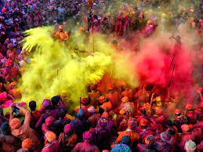
WARM-UP
What is this festival/tradition?
Holi festival
(India)

Slide 5
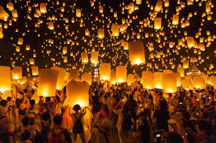
WARM-UP
What is this festival/tradition?
Lantern festival

Slide 6

WARM-UP
What is this festival/tradition?
Fireworks

Slide 7
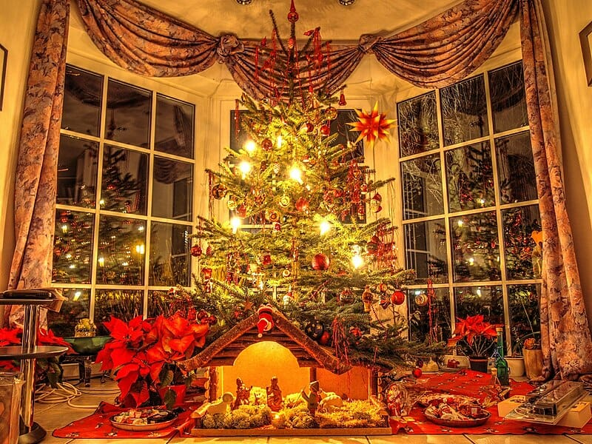
WARM-UP
What is this festival/tradition?
Christmas

Slide 8
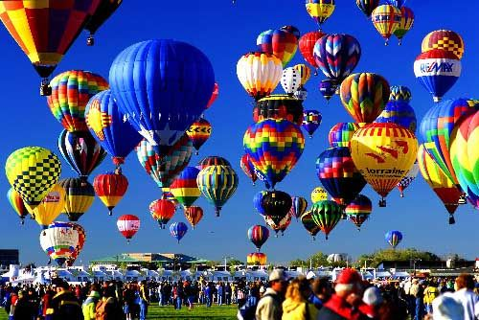
WARM-UP
What is this festival/tradition?
Balloon festival

Slide 9

EVERYDAY ENGLISH
1
Listen and complete the conversations.
A. will have a difficult decision B. is going to impress
C. in the long run D. It’s hard to predict
Mark: Tomorrow, we’ll get the results of the Green Classroom Competition. Do you think we will win?
Nam: (1) ____ who’ll win. Other classes also have very interesting projects.
Mark: I agree. The Cycling-to-school programme proposed by Class 12C (2) ____ the judges. Cycling to school will also lead to healthier lifestyles (3) ____.
Nam: True. There’re so many great ideas. The judges (4) ____ to make.
D
B
C
A

Slide 10
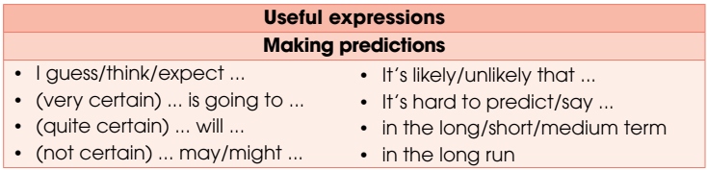
EVERYDAY ENGLISH

Slide 11
EVERYDAY ENGLISH
2
Make similar conversations.
A wonders whether the Youth Union will accept their group proposal to install automatic lights and sensor taps in the school. B, a member of the same group, makes predictions about the decision.
B asks A about the Green Day event at their school next week (e.g. the number of people attending, the activity people will like the most, the impact of the event). A makes predictions.

Slide 12
CULTURE
1
Read the following text and put a tick where relevant.
 | Polluting the air | Causing fires | Harming animals | Ending up in landfills
Balloons and sky lanterns
Fireworks
Christmas trees
✓
✓
✓
✓
✓
✓

Slide 13
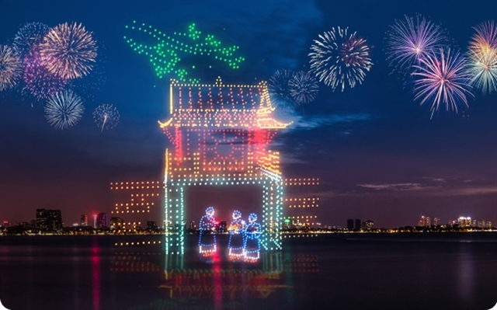
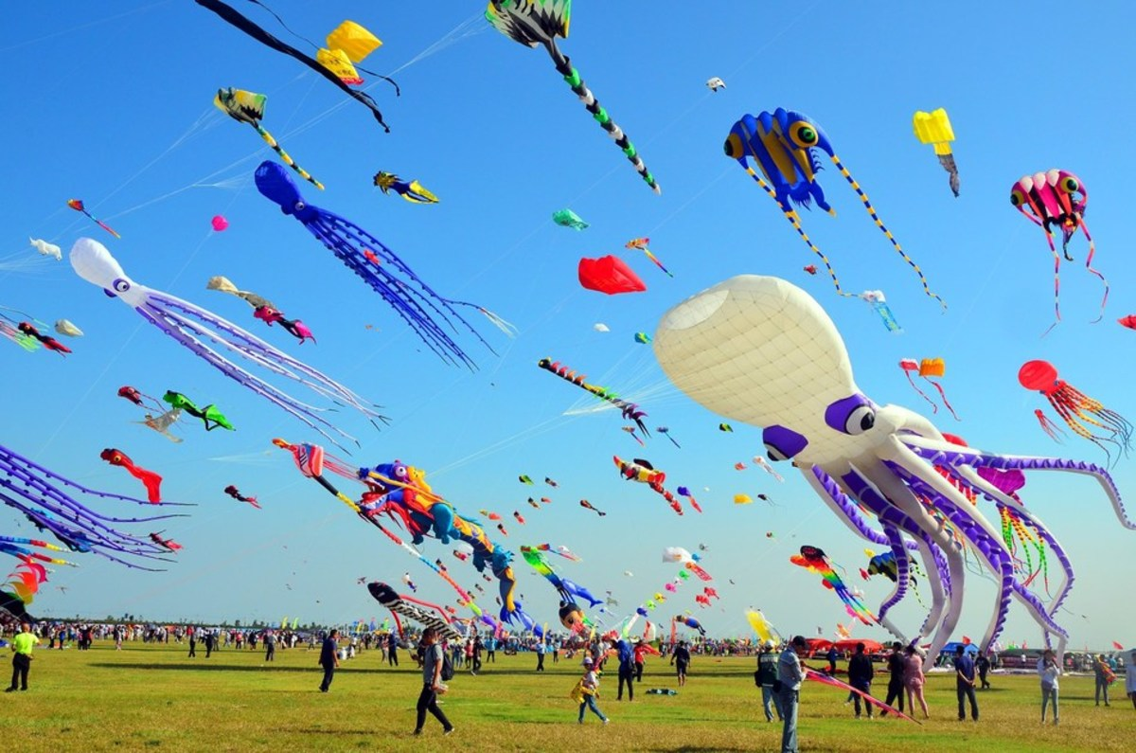
CULTURE
2
Suggest some green solutions to replace one of the traditions.

Slide 14
CONSOLIDATION
1
Wrap-up
What have you learnt today?
Review expressions for making predictions.
Identify traditions that are bad for the environment and suggest solutions.

Slide 15
CONSOLIDATION
2
Homework
Do exercises in the workbook.
Prepare for Lesson 8 – Looking back and project.

Slide 16
Website: hoclieu.vn
Fanpage: facebook.com/www.tienganhglobalsuccess.vn

