Slide 2
EXTENSION ACTIVITIES
FUN
TIME

Slide 3
TABLE OF CONTENTS
01
02
03
WARM-UP
REVIEW 1
REVIEW 2
04
05
06
ACTIVITY 1
ACTIVITY 2
ACTIVITY 3
01
02
03
Sing a song.
Review countries
Review time and Daily routines
04
05
06
Look and write.
Look and write.
Read the questions. Then tick the answers.

Slide 4
01
WARM-UP
Sing a song.

Slide 5
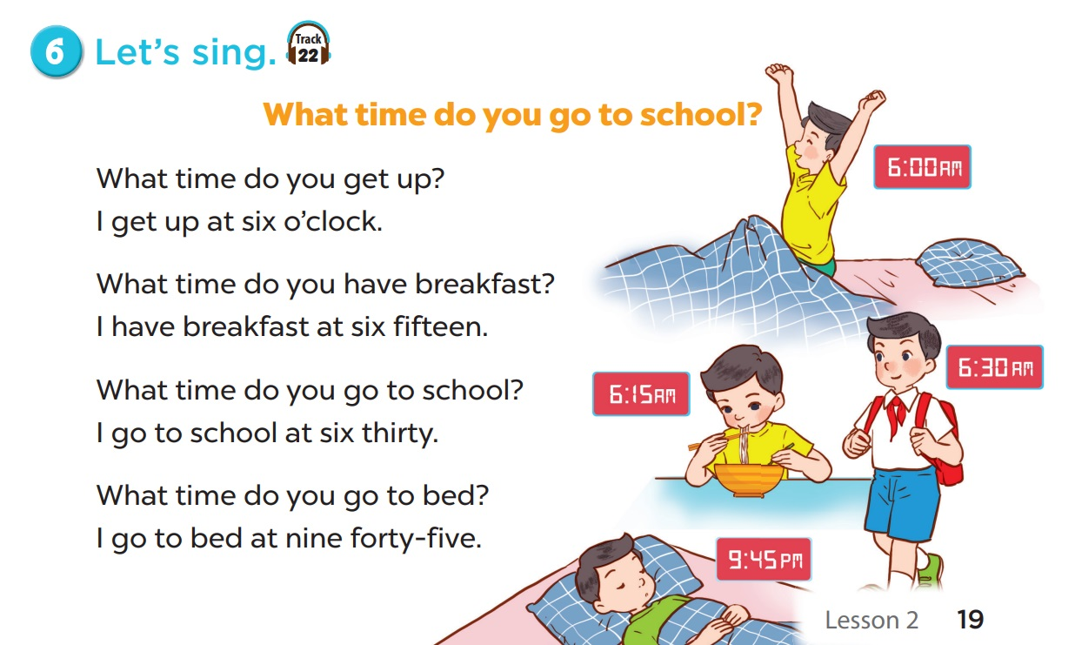

Slide 6
02
REVIEW 1
Countries

Slide 7
Singapore

Slide 8
Thailand

Slide 9
Japan

Slide 10
Malaysia

Slide 11
Canada

Slide 12
Russia

Slide 13
Laos

Slide 14
Viet Nam

Slide 15
America

Slide 16
Britain

Slide 17
Australia

Slide 18
GUESSING
GAME

Slide 19
Look and guess.
Singapore
S_ _ _ _ _ _ _ _

Slide 20
Look and guess.
Thailand
T_ _ _ _ _ _ _

Slide 21
Look and guess.
R_s_ _a
Russia

Slide 22
Look and guess.
A_s_ _ _l_ _
Australia

Slide 23
Look and guess.
C_n_d_
Canada

Slide 24
Look and guess.
Japan
J_ _ _ _

Slide 25
Look and guess.
_a_a_ _ _a
Malaysia

Slide 26
Look and guess.
L_ _s
Laos

Slide 27
04
ACTIVITY 1
Look and write.

Slide 28
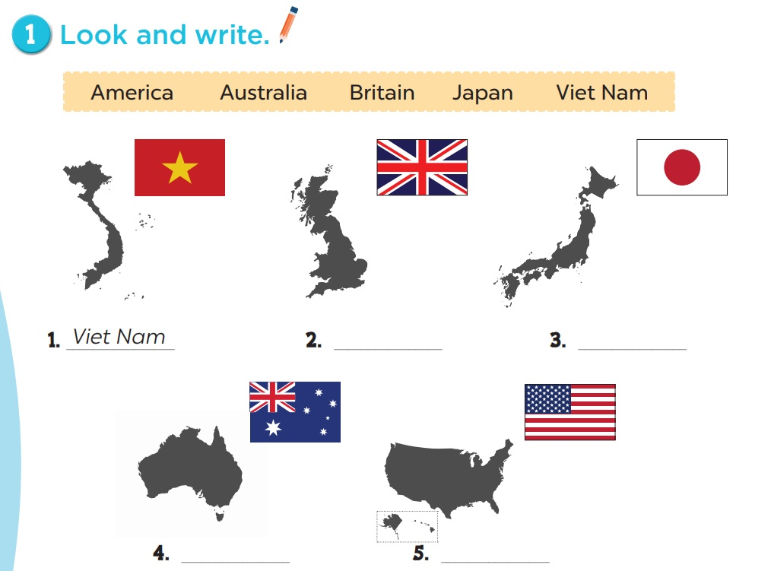
2. Britain
3. Japan
4. Australia
5. America

Slide 29
03
REVIEW 2
Time and Daily routines

Slide 30
What time is it?

Slide 31
What time is it?
It’s eight o’clock.

Slide 32
What time is it?
It’s ten fifteen.

Slide 33
Keep or Give the box?

Slide 34
A
B
C
D
E
F
G
H
Notes:
Click the letters to answer questions
Click the arrow to move to next part

Slide 35
What time is it?
It’s ten thirty.

Slide 36
Keep the box?
Give the box?

Slide 37
+5
Notes:
Click the number to come back

Slide 38
What time is it?
It’s three forty-five.

Slide 39
Keep the box?
Give the box?

Slide 40
-3
Notes:
Click the number to come back

Slide 41
What time do you get up?
I get up at six o’clock.

Slide 42
Keep the box?
Give the box?

Slide 43
+10
Notes:
Click the number to come back

Slide 44
What time do you have breakfast?
I have breakfast at seven o’clock.

Slide 45
Keep the box?
Give the box?

Slide 46
+3
Notes:
Click the number to come back

Slide 47
What time do you have lunch?
I have lunch at eleven thirty.

Slide 48
Keep the box?
Give the box?

Slide 49
+2
Notes:
Click the number to come back

Slide 50
What time is it?
It’s eleven o’clock.

Slide 51
Keep the box?
Give the box?

Slide 52
+8
Notes:
Click the number to come back

Slide 53
What time do you go to school?
I go to school at seven thirty.

Slide 54
Keep the box?
Give the box?

Slide 55
-5
Notes:
Click the number to come back

Slide 56
What time do you go to bed?
I go to bed at nine forty-five.

Slide 57
Keep the box?
Give the box?

Slide 58
+1
Notes:
Click the number to come back

Slide 59
05
ACTIVITY 2
Look and write.

Slide 60
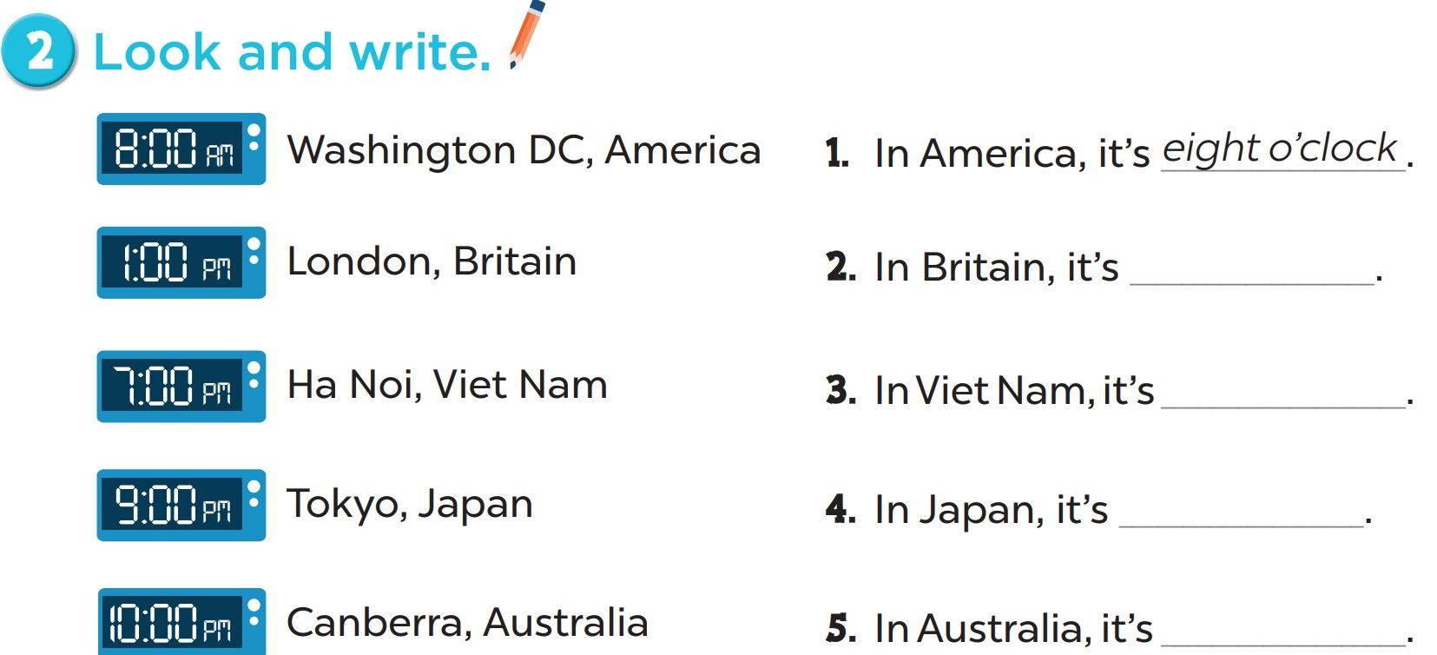
one o’clock
seven o’clock
nine o’clock
ten o’clock

Slide 61
06
ACTIVITY 3
Read the questions. Then tick the answers.

Slide 62
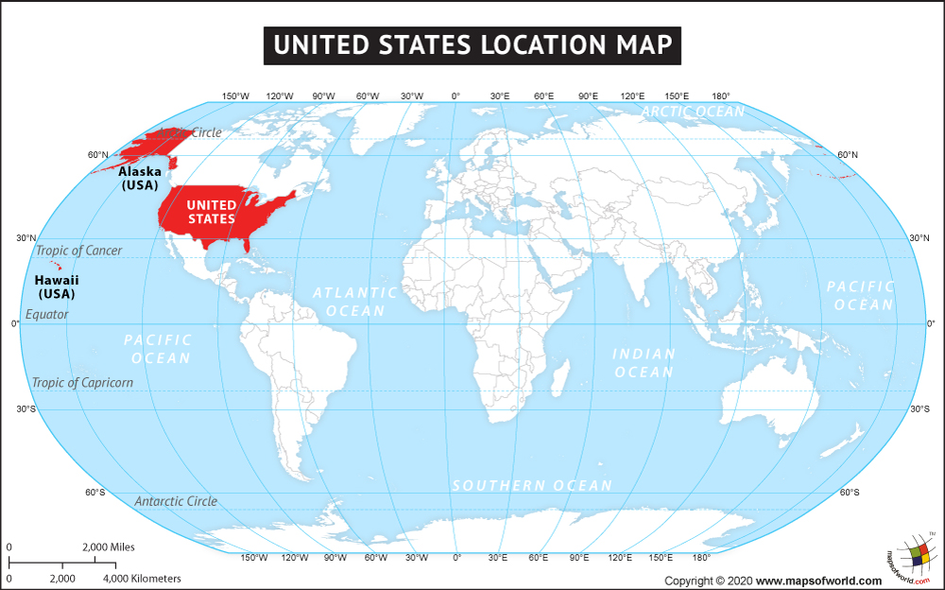
Where is Viet Nam?
Notes:
Ask pupils to look at the map and find the countries. Draw lines from countries to Viet Nam.

Slide 63
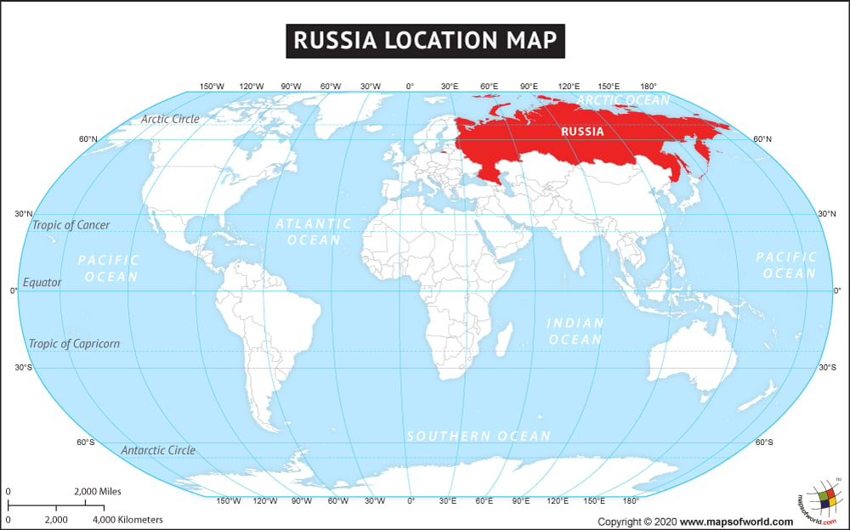
Where is Viet Nam?
Notes:
Ask pupils to look at the map and find the countries. Draw lines from countries to Viet Nam.

Slide 64
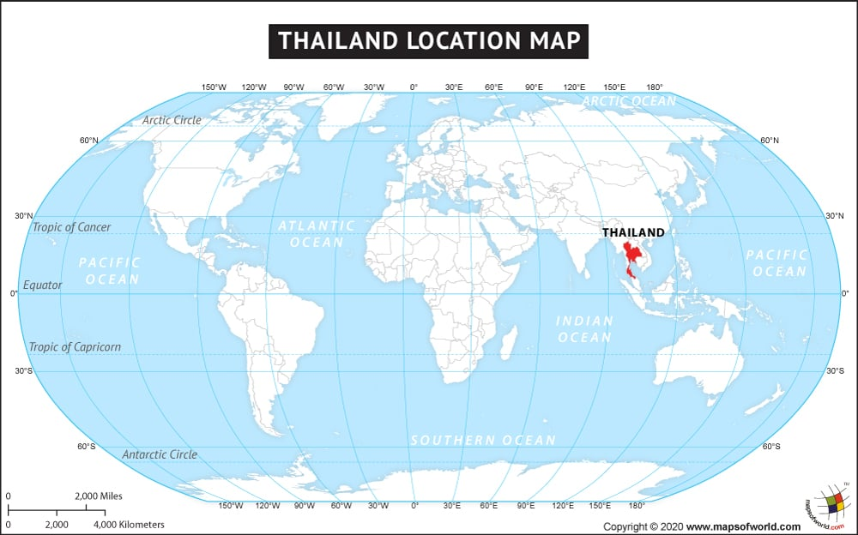
Where is Viet Nam?
Notes:
Ask pupils to look at the map and find the countries. Draw lines from countries to Viet Nam.

Slide 65
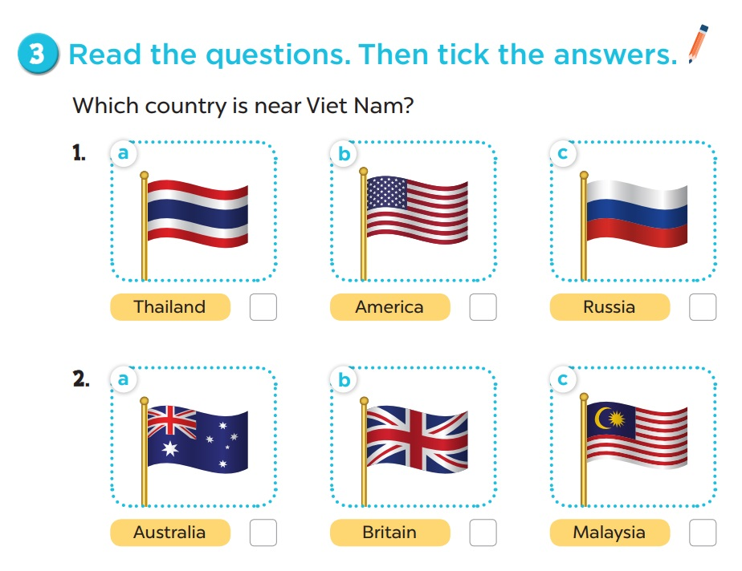

Slide 66
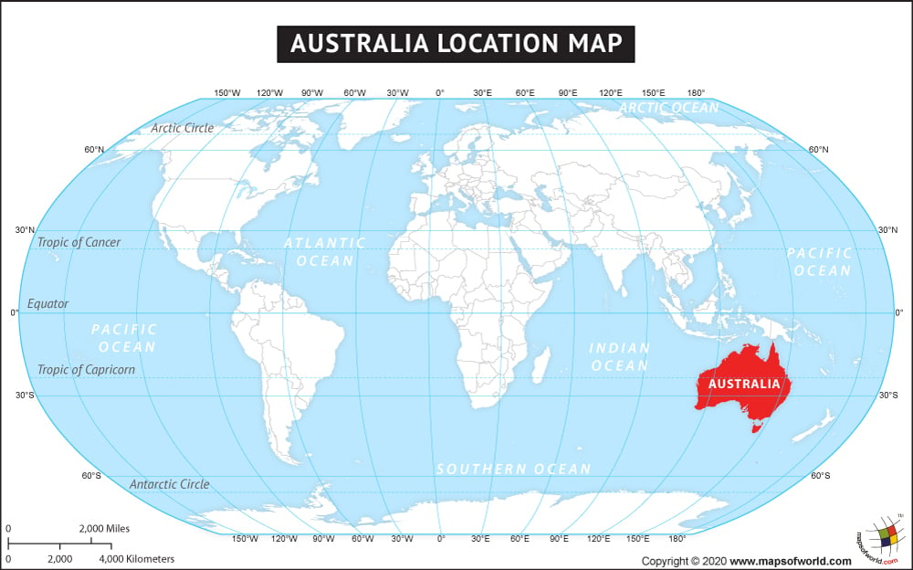
Where is Viet Nam?
Notes:
Ask pupils to look at the map and find the countries. Draw lines from countries to Viet Nam.

Slide 67
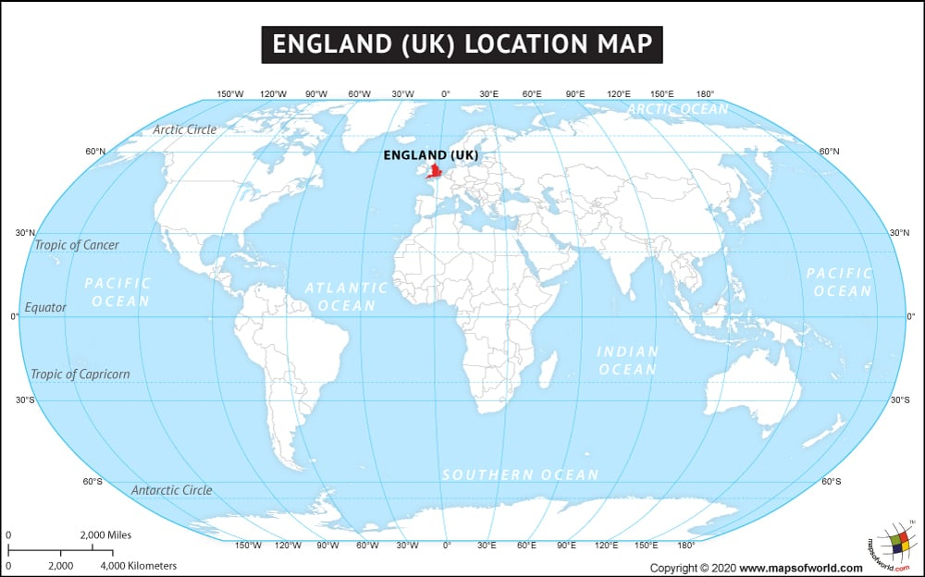
Where is Viet Nam?
Notes:
Ask pupils to look at the map and find the countries. Draw lines from countries to Viet Nam.

Slide 68
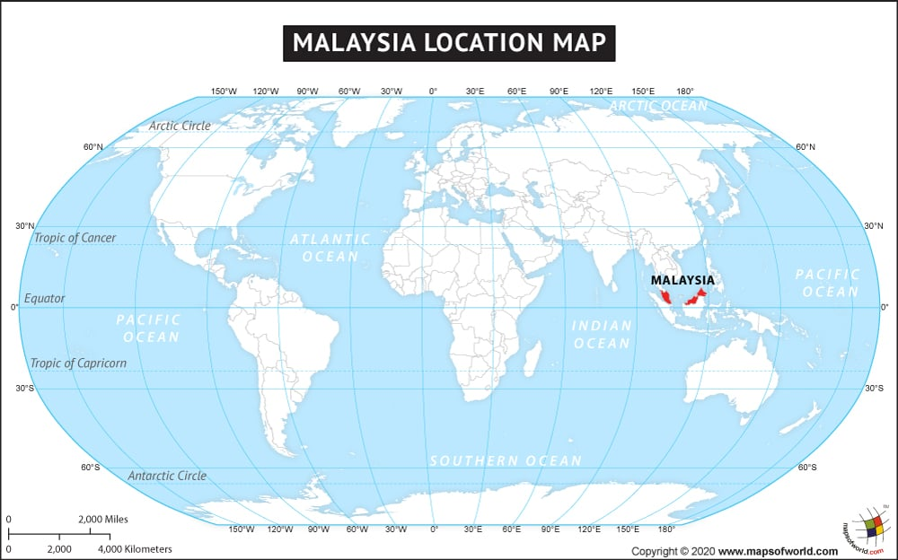
Where is Viet Nam?
Notes:
Ask pupils to look at the map and find the countries. Draw lines from countries to Viet Nam.

Slide 70
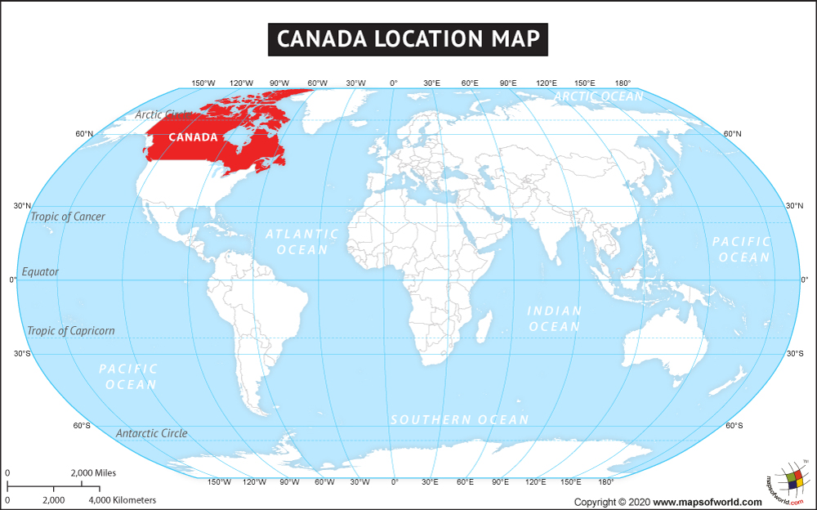
Where is Viet Nam?
Notes:
Ask pupils to look at the map and find the countries. Draw lines from countries to Viet Nam.

Slide 71
Where is Viet Nam?
Notes:
Ask pupils to look at the map and find the countries. Draw lines from countries to Viet Nam.

Slide 72
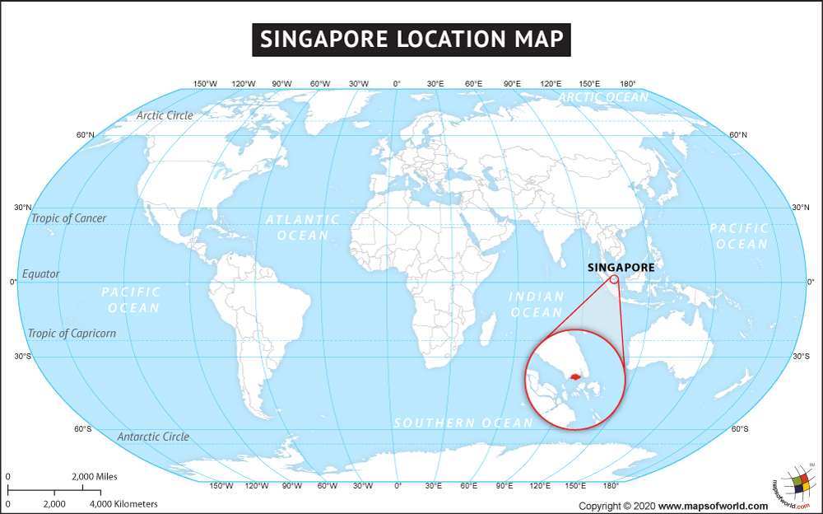
Where is Viet Nam?
Notes:
Ask pupils to look at the map and find the countries. Draw lines from countries to Viet Nam.

Slide 73
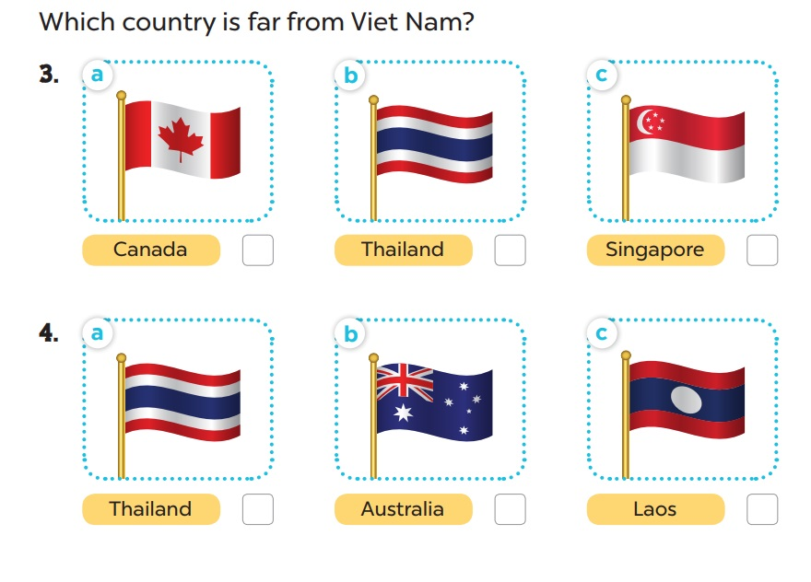

Slide 74
Where is Viet Nam?
Notes:
Ask pupils to look at the map and find the countries. Draw lines from countries to Viet Nam.

Slide 75
Where is Viet Nam?
Notes:
Ask pupils to look at the map and find the countries. Draw lines from countries to Vietnam

Slide 76
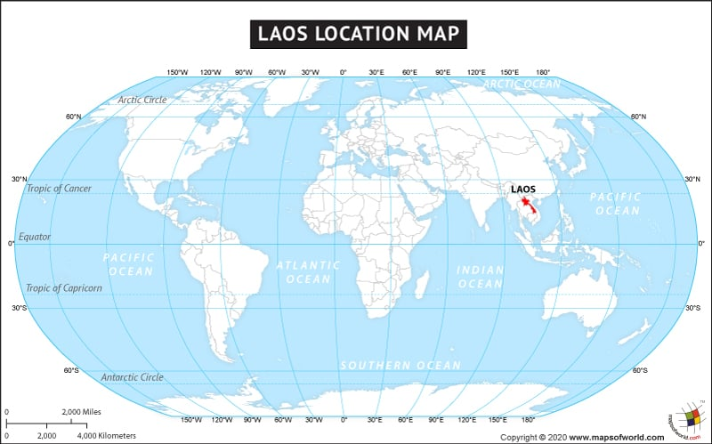
Where is Viet Nam?
Notes:
Ask pupils to look at the map and find the countries. Draw lines from countries to Viet Nam.

Slide 78
THANK YOU
Website: hoclieu.vn
Fanpage: facebook.com/www.tienganhglobalsucces.vn
Website: sachmem.vn; hoclieu.vn
Fanpage: www.facebook.com/sachmem.vn

