Slide 1

Unit 9: Houses in the Future
Review Lesson
Pages 102 & 103

Slide 2
Lesson Outline
Warm-up
Listening
Reading
Vocabulary
Grammar
Pronunciation
Consolidation
Wrap-up

Slide 3
Objectives
This lesson is to review the knowledge students have learned in Unit 9.

Slide 4

WARM-UP

Slide 5
VOCABULARY REVIEW
Work in pairs.
Test your partner the vocabulary in Unit 9.
Student A: choose a picture from A-H or 1-6.
Student B: label it with the vocabulary in Unit 9.

Slide 6
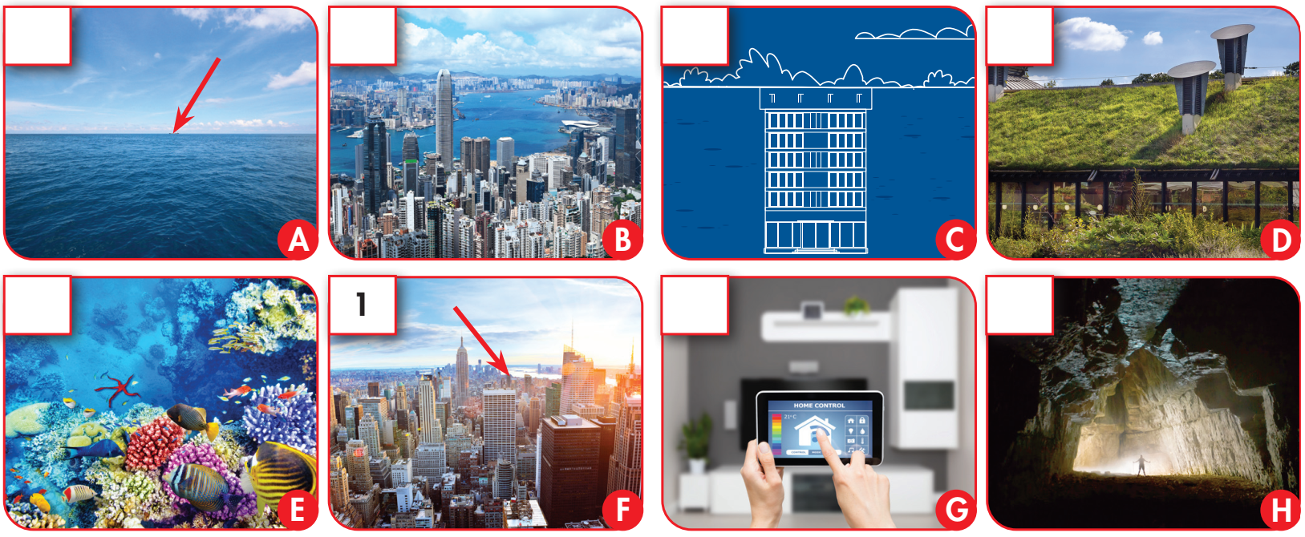
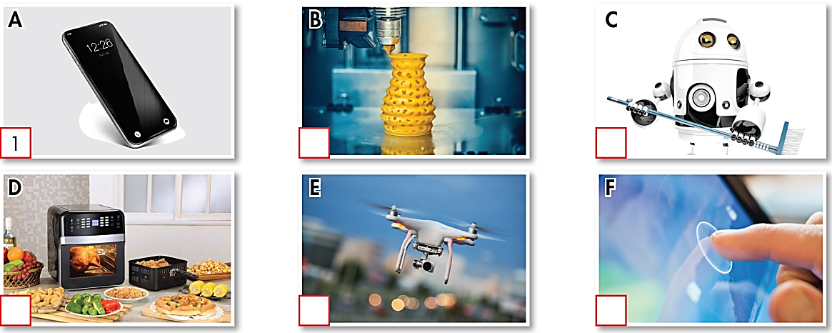
1
2
3
4
5
6

Slide 7

Listening

Slide 8

Pre-Listening
You will hear Jenny talking to her friend, Tom, about a TV show she watched.
For each question, choose the correct answer (A, B, or C).
You will hear the conversation twice.
Read the Task of the Listening exercise.
Underline the key words.
What are you going to do?
- Listen and choose the correct answers.

Slide 9
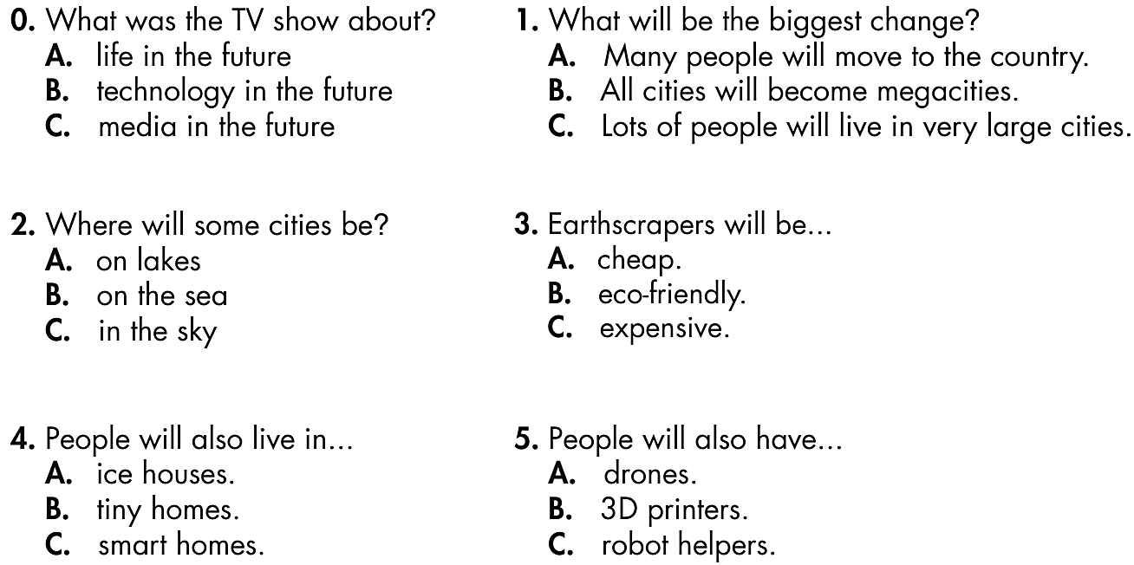
Pre-Listening
Underline the key words in each question.

Slide 10


Listen and choose the correct answer (A, B, or C).
You will hear the conversation twice.
While-Listening

Slide 11
0. What was the TV show about?
A. life in the future
B. technology in the future
C. media in the future
2. Where will some cities be?
A. on lakes
B. on the sea
C. in the sky
4. People will also live in...
A. ice houses.
B. tiny homes.
C. smart homes.
1. What will be the biggest change?
A. Many people will move to the country.
B. All cities will become megacities.
C. Lots of people will live in very large cities.
3. Earthscrapers will be...
A. cheap.
B. eco-friendly.
C. expensive.
5. People will also have...
A. drones.
B. 3D printers.
C. robot helpers.

Slide 12
Listen and look.
Post-Listening
Now practice the conversation with a partner.
G: Hey, Tom, did you watch Future Lives
on TV last night?
B: No, I didn't. What was it about, Jenny?
G: It was about where people will live in
the future. Things will change a lot.
B: Why? What's going to happen?
G: I think the biggest change will be that
many people might live in megacities.
B: I don't like big cities.
G: Not just megacities. People might live
in cities on the sea, too.
B: Wow! Where else will people live?
G: Big apartment buildings underground
called earthscrapers.
B: Urgh!
G: They'll be eco-friendly.
B: Hmm, that's good. Anything else?
G: Yeah, we'll have smart homes in the future.
B: Great.
G: They'll have things like 3D printers to make all kinds of objects like new clothes or furniture.
B: They sound awesome!

Slide 13

Reading

Slide 14
Read about the three devices of the future.
Choose the correct answer (A, B, or C).
Pre-Reading
Read the Task of the Reading exercise.
Underline the key words.
What are you going to do?
- Read and choose the correct answers.

Slide 15
Read the questions and underline the key words.
0. Which machines will help us when we are hungry?
1. Which machines will make T-shirts?
2. Which machines will do the housework?
3. Which machines will order food for us?
4. Which machines won't clean plates and dishes?
5. Which machines will make tables and chairs?

Slide 16

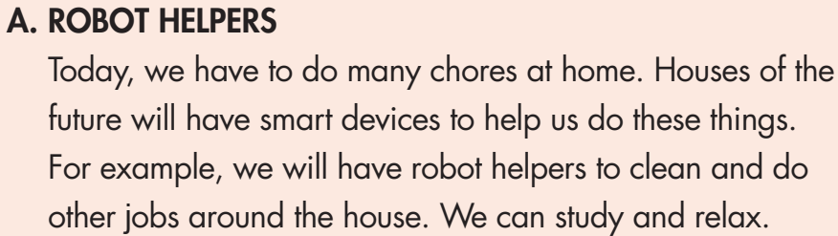
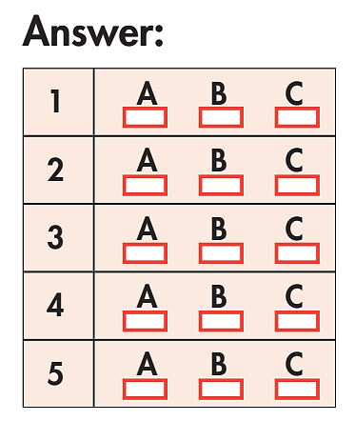
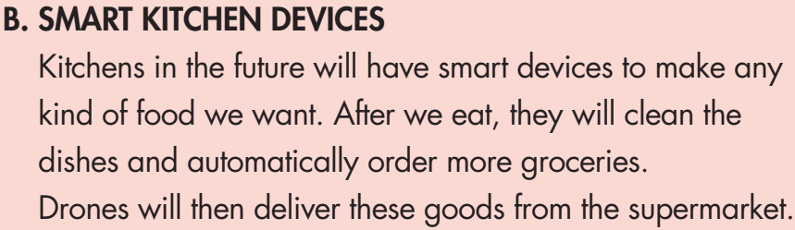
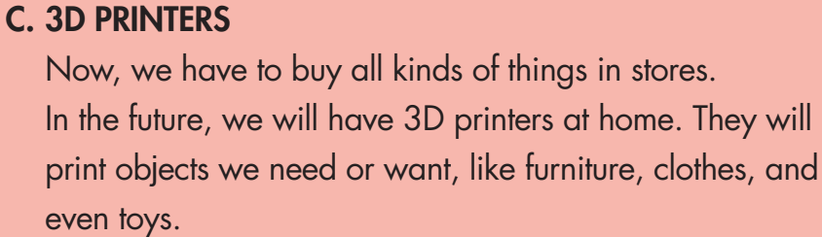
While-Reading
Read and choose the
correct answer (A, B, or C).

Slide 18
Share ideas.
Ask and answer the questions with a partner. Speak English!
1. Which machines will make T-shirts?
2. Which machines will do the housework?
3. Which machines will order food for us?
4. Which machines won't clean plates and dishes?
5. Which machines will make tables and chairs?
A B C
A B C
A B C
A B C
A B C
3D printers
Robot helpers
Smart kitchen devices
3D printers
3D printers

Slide 19

Post-Reading
Which machines do you like best:
robot helpers, smart kitchen devices, or 3D printers?
Why?

Slide 20

Vocabulary

Slide 21
Fill in the blanks with the words from the box.
smart home
1. I think living in a(n) _____________ will be really cool. You can control everything in your house through your phone!
2. I think Ho Chi Minh City will become a(n) _____________ soon. There are about nine million people living there.
3. I hope we will have _____________ soon. With them, we won’t need to do chores anymore!
4. I like to look at the _____________ at night. It's so beautiful.
5. I don't want to live _____________. It'll be so dark and sad.
6. Don't forget to _____________ the door and give the key to me.
7. You can print lots of cool things with a(n) _____________.
8. Astronauts usually stay on the _____________ for about six months.
megacity
robot helpers
Moon
underground
lock
3D printer
space station

Slide 22

Grammar

Slide 23
Write full sentences using the words below.
1. Where/you/think/people/live/future?
______________________________________________________________
2. We/might/have/automatic food machines.
______________________________________________________________
3. I/think/a few/people/live/earthscrapers.
______________________________________________________________
4. A lot of/people/live/cities/on/sea.
______________________________________________________________
5. How/astronauts/sleep/space?
______________________________________________________________
6. What/you/think/homes/be like?
______________________________________________________________
7. I/think/many people/have/robot helpers.
______________________________________________________________
8. They/have to/use/special/toilet.
______________________________________________________________
Where do you think people will live in the future?
We might have automatic food machines.
I think a few people will live in earthscrapers.
A lot of people will live in cities on the sea.
How do astronauts sleep in space?
What do you think homes will be like?
I think many people will have robot helpers.
They have to use a special toilet.

Slide 24

Pronunciation

Slide 25
Circle the word that differs from the other three in the position of primary stress in each of the following questions.
1. A. magazine B. apartment C. computer D. technology
2. A. gravity B. technology C. astronaut D. printer
3. A. future B. machine C. helper D. robot
Circle the word that has the underlined part pronounced differently from the others.
4. A. stops B. bags C. cleans D. has
5. A. units B. topics C. parks D. ways
6. A. bins B. cups C. trees D. papers

Slide 26

CONSOLIDATION

Slide 27
PAIR WORK
What do you think homes will be like in the future?

Slide 28

WRAP-UP

Slide 29
Today’s lesson
Revision of Unit 9

Slide 30
Homework
Review the vocabularies, grammar points and make sentences using them.
Prepare the next lesson (page 78, SB)
Play the consolidation games in Tiếng Anh 6 i-Learn Smart World DHA App on www.eduhome.com.vn

Slide 31

Have a nice day!

