Slide 1
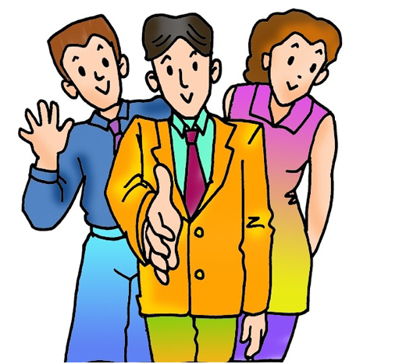
GREETINGS AND INTRODUCTIONS

Slide 2
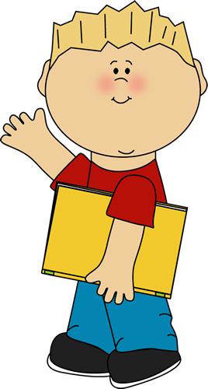
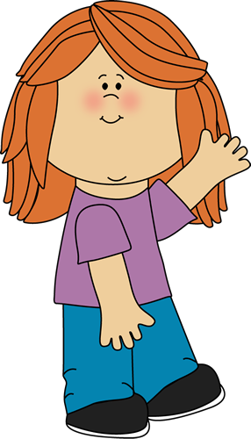
Hi!
I’m fine. Thank you!
And you?
Hello!
How are you?

Slide 3
I’m great!

Slide 4
I’m not
so good!

Slide 5
I’m OK!

Slide 6
What is your name?

Slide 7
My name is Nick.

Slide 8
What is your name?

Slide 9
My name is Mary.

Slide 10
How old are you?

Slide 11
I’m 18 years old.

Slide 12
I’m 20 years old.

Slide 13
Good afternoon!
Where do you live?

Slide 14
I live in London.

Slide 15
I live in Manchester.

Slide 16
Goodbye!
See you soon!

Slide 17
Bye!
See you!

Slide 18
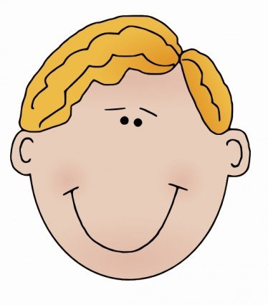
What is your name?
My name is Alexander.

Slide 19
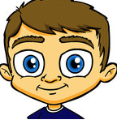
What is your name?
My name is
Benjamin.

Slide 20
What is your name?
My name is
Ian.

Slide 21
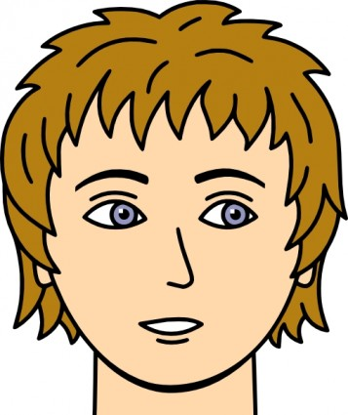
What is your name?
My name is
Kevin.

Slide 22
What is your name?
My name is
Michael.

Slide 23
What is your name?
My name is
Nigel.

Slide 24
What is your name?
My name is
Oliver.

Slide 25
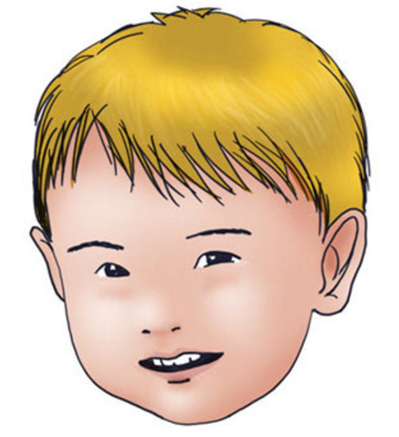
What is your name?
My name is
Paul.

Slide 26
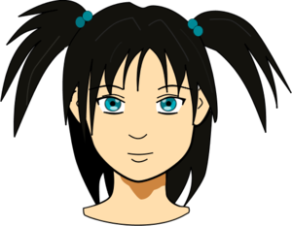
What is your name?
My name is
Lucy.

Slide 27
What is your name?
My name is
Emily.

Slide 28
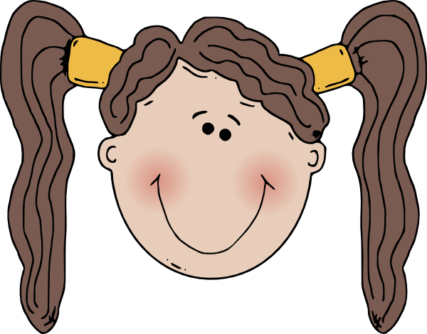
What is your name?
My name is
Scarlett.

Slide 29
What is your name?
My name is
Alice.

Slide 30
What is your name?
My name is
Jasmine.

Slide 31
What is your name?
My name is
Emma.

Slide 32
What is your name?
My name is
Olivia.

Slide 33
What is your name?
My name is
Megan.

Slide 34
What is your surname?
My surname is
Smith.

Slide 35
What is your surname?
My surname is
Taylor.

Slide 36
What is your surname?
My surname is
Williams.

Slide 37
What is your surname?
My surname is
Brown.

Slide 38
What is your surname?
My surname is
Evans.

Slide 39
What is your surname?
My surname is
Robinson.

Slide 40
What is your surname?
My surname is
White.

Slide 41
What is your surname?
My surname is
Jackson.

Slide 42
What is your surname?
My surname is
Harrison.

Slide 43
What is your surname?
My surname is
Clark.

Slide 44
What is your surname?
My surname is
Morrison.

Slide 45
What is your surname?
My surname is
Campbell.

Slide 46
What is your surname?
My surname is
Anderson.

Slide 47
What is your surname?
My surname is
Allan.

Slide 48
What is your surname?
My surname is
Parker.

Slide 49
What is your surname?
My name is
Collins.

Slide 50
How old are you?
I’m 12 years old.

Slide 51
How old are you?
I’m 11 years old.

Slide 52
How old are you?
I’m 13 years old.

Slide 53
How old are you?
I’m 15 years old.

Slide 54
How old are you?
I’m 9 years old.

Slide 55
How old are you?
I’m 8 years old.

Slide 56
How old are you?
I’m 16 years old.

Slide 57
How old are you?
I’m 5 years old.

Slide 58
How old are you?
I’m 17 years old.

Slide 59
How old are you?
I’m 10 years old.

Slide 60
How old are you?
I’m 14 years old.

Slide 61
How old are you?
I’m 18 years old.

Slide 62
How old are you?
I’m 7 years old.

Slide 63
How old are you?
I’m 6 years old.

Slide 64
How old are you?
I’m 19 years old.

Slide 65
How old are you?
I’m 10 years old.

Slide 66
Where do you live?
I live in
London.

Slide 67
Where do you live?
I live in
Cambridge.

Slide 68
Where do you live?
I live in
Oxford.

Slide 69
Where do you live?
I live in
Brighton.

Slide 70
Where do you live?
I live in
Bristol.

Slide 71
Where do you live?
I live in
Manchester.

Slide 72
Where do you live?
I live in
Liverpool.

Slide 73
Where do you live?
I live in
Portsmouth.

Slide 74
Where do you live?
I live in
Southampton.

Slide 75
Where do you live?
I live in
Chichester.

Slide 76
Where do you live?
I live in
Coventry.

Slide 77
Where do you live?
I live in
York.

Slide 78
Where do you live?
I live in
Belfast.

Slide 79
Where do you live?
I live in
Newcastle.

Slide 80
Where do you live?
I live in
Leeds.

Slide 81
Where do you live?
I live in
Sheffield.

Slide 82
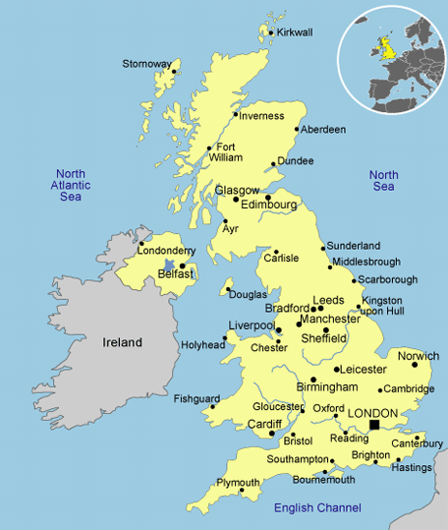

Slide 83
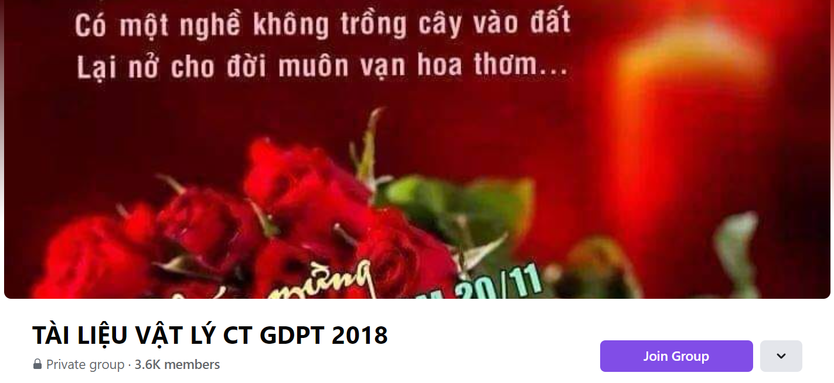
SƯU TẦM: ĐOÀN VĂN DOANH, NAM TRỰC, NAM ĐỊNH
LINK NHÓM DÀNH CHO GV BỘ MÔN VẬT LÝ TRAO ĐỔI TÀI LIỆU VÀ CHUYÊN MÔN CT 2018
https://www.facebook.com/groups/299257004355186

