Slide 1

Unit 8: Traditions of
Ethnic Groups in Vietnam
Lesson 2.3: Pronun. & Speaking
Pages 80 & 81

Slide 2
Lesson Outline
Warm-up
Pronunciation
Speaking
Consolidation
Wrap-up

Slide 3

By the end of this lesson, students will be able to…
practice the sound /oʊ/
practice reporting a conversation, using reported speech for question and functional English
showing interest to get more information

Slide 4

WARM UP

Slide 5
Choose the word whose underlined part is pronounced differently from that of the others.
A. read B. wear C. clean D. dream
/riːd/ /weər/ /kliːn/ /driːm/
2. A. bathroom B. birthday C. brother D. athlete
/bæθruːm/ /ˈbɜːrθdeɪ/ /ˈbrʌðər/ /ˈæθliːt/
3. A. chopsticks B. husband C. music D. disease
/ˈtʃɑːpstɪks/ /ˈhʌzbənd/ /ˈmjuːzɪk/ /dɪˈziːz/

Slide 6
Choose the words whose main stress is placed differently from the others.
A. dessert B. dinner C. dancing D. apron
/dɪˈzɜːrt/ /ˈdɪnər/ /ˈdænsɪŋ/ /ˈeɪprən/
2. A. musician B. tradition C. utensil D. vegetable
/mjuˈzɪʃn/ /trəˈdɪʃn/ /juːˈtensl/ /ˈvedʒtəbl/
3. A. emergency B. helicopter C. relationship D. celebrity
/ɪˈmɜːrdʒənsi/ /ˈhelɪkɑːptər/ /rɪˈleɪʃnʃɪp/ /səˈlebrəti/

Slide 7
Complete the sentences to report what these people asked.
1. “When do you have dinner in your house?”
-→ She asked him ___________________________________________.
when he had dinner in his house
2. “Do you play any traditional musical instruments?”
-→ She asked them __________________________________________.
if/whether they played any traditional musical instruments.
3. “What do you do on the weekends?”
-→ He asked her ____________________________________________.
what she did on the weekends
4. “Do you like sticky rice?”
-→ He asked us _____________________________________________.
if/whether we liked sticky rice

Slide 8

Pronunciation

Slide 9
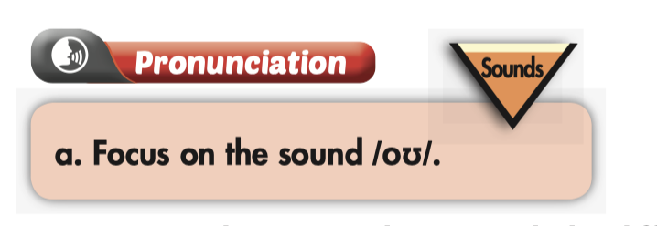

Slide 10

b. Listen to the words and focus on the underlined letters.
grow (adj)
/ɡroʊ/
sewing (adj)
/ˈsoʊɪŋ/
oh (exclamation)
/oʊ/

Slide 11
c. Listen and cross out the one with wrong stress.
Take a look at the words below
/klɑːθ/
/ɡoʊ/
/hoʊm/
/kloʊðz/
d. Read the words to your partner using the sound noted in “a”.

Slide 12
Practice

Slide 13
Take turns reporting the questions and answers. Remember to show interest to get more information as you listen. Swap roles and repeat.
1. Practice in pairs.
2. Review the rules of writing a reported speech sentence

Slide 14
Match the numbers with the letters.
A. Speaker + asked + listener + Wh-question (in a past statement form)
1. We can use reported speech to say or …
B. yes/no questions, in stead of if in formal situations.
2. We can use whether when reporting ….
3. To report a Wh-question, we use
C. Speaker + asked + listener + if/whether* + Yes/No question (in a past statement form)
4. To report a Yes/No question, we use
D. repeat questions that someone asked before the time of speaking.

Slide 15
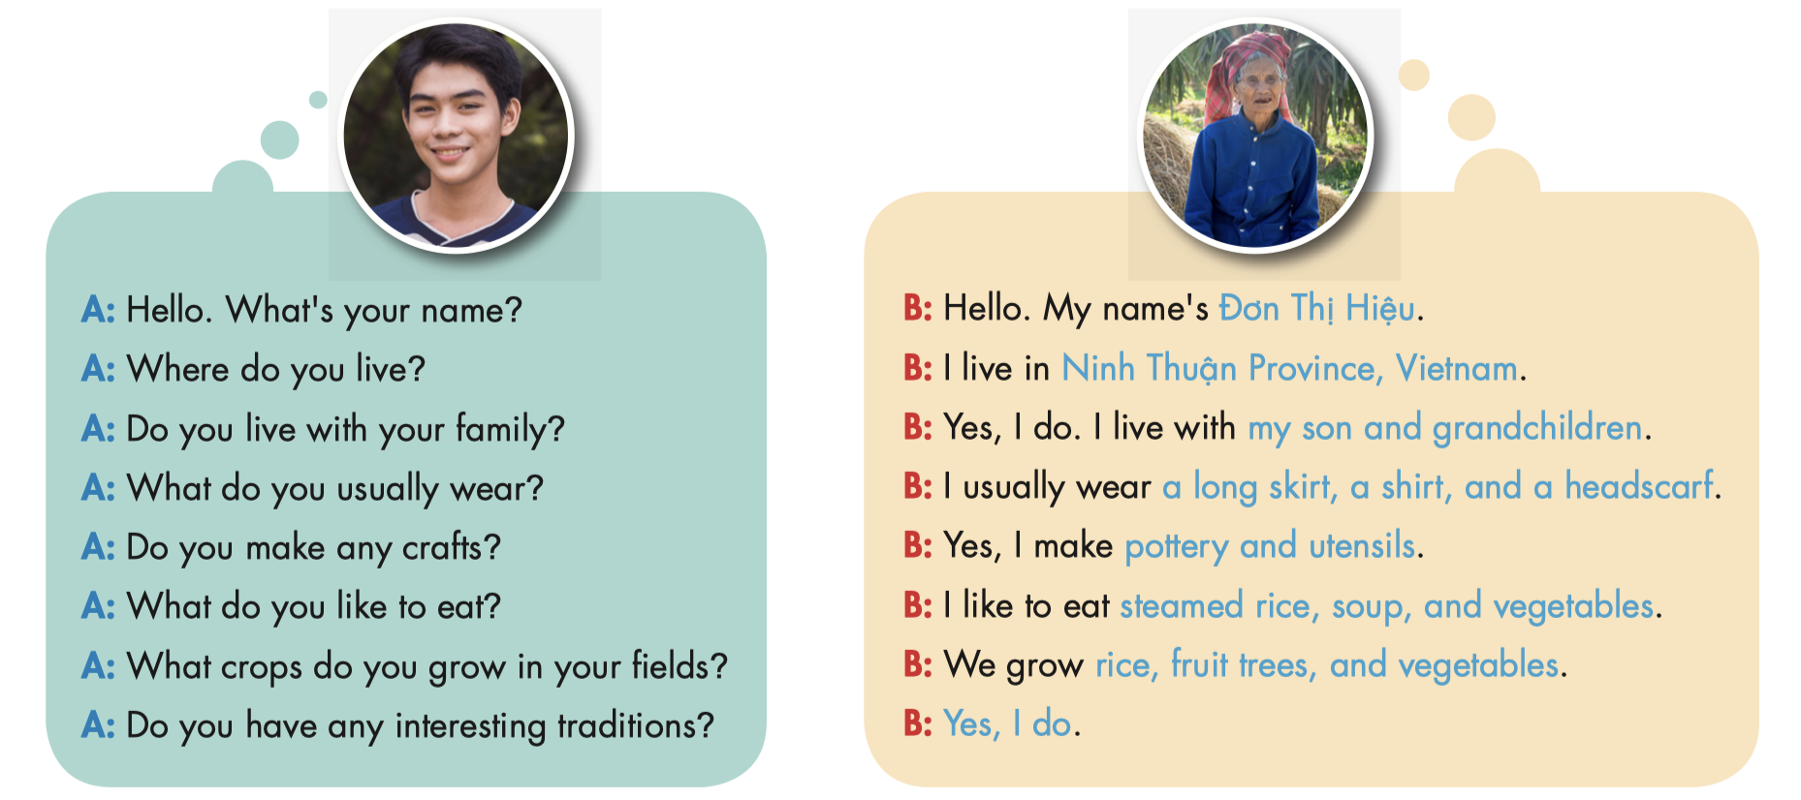

Slide 16
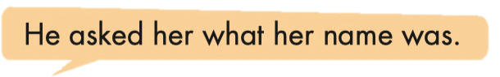
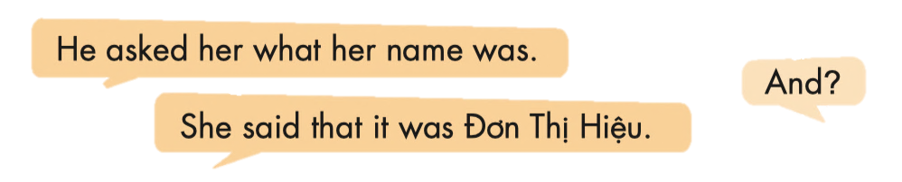

Slide 17
He asked her where she lived.
He asked her if/whether she lived with her family.
He asked her what she usually wore.
He asked her if/whether she made any crafts.
He asked her what she liked to eat.
He asked her what crops she grew in her fields.
He asked her if/whether she had any interesting traditions.

Slide 18
She said that she lived in Ninh Thuận Province, Vietnam.
She said that she lived with her son and grandchildren.
She said that she wore along skirt, a shirt, and a headscarf.
She said that she made pottery and utensils.
She said that she liked to eat steamed rice, soup, and vegetables.
She said that they grew rice, fruit trees, and vegetables.
She said she did.

Slide 19
Production

Slide 20

Task a
Meeting someone interesting
Work in pairs
You recently met an ethnic person from Vietnam on a trip and want to tell your fried about it. Tell your friend about your vacation using the notes.

Slide 21
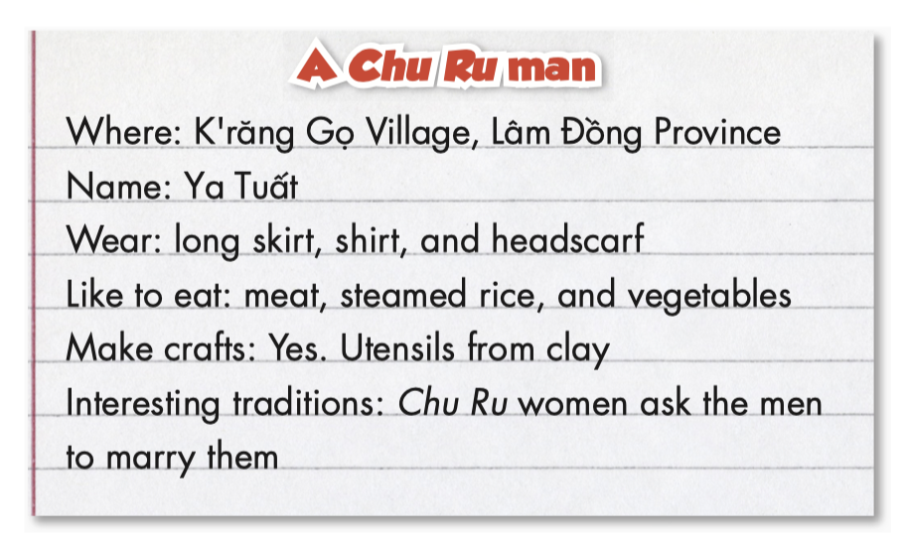
Task a
Meeting someone interesting
Student A, you spoke with a Chu Ru man

Slide 22
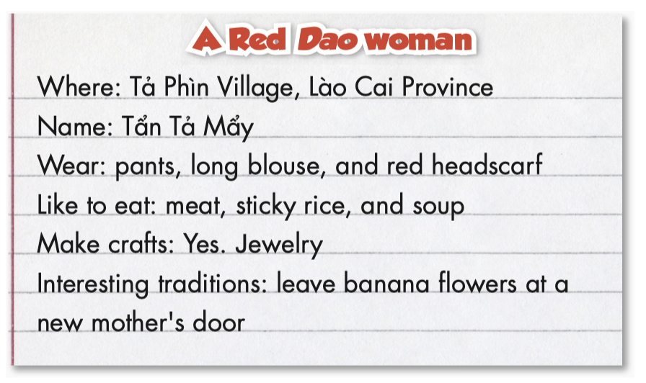
Task b
Meeting someone interesting
Student B, you spoke with a Red Dao woman

Slide 23
Task c
What information would you most like to learn about different ethnic groups? Why?
I’d like to learn about their festivals because I want to take part on one when I travel in the future.

Slide 24

CONSOLIDATION

Slide 25
Write four reported speech sentences to talk to your friend about an ethnic person you met on your vacation trip. Remember to include:
+ Where they are from
+ What they wear
+ What food the like to eat
+ What crafts they make
+ Their interesting traditions

Slide 26

WRAP-UP

Slide 27
Today’s lesson
Pronunciation
Pronouncing /oʊ/.
Speaking
Tell your friend about an ethnic person you met on your vacation trip.

Slide 28
Homework
Practice pronouncing the sound /oʊ/
Do the writing exercise on page 47 WB
Do the exercises in Tiếng Anh 8 i-Learn Smart World Notebook on page 67.
Prepare the next lesson (pages 82 & 83 SB)
Do the consolidation games on www.eduhome.com.vn

Slide 29

Lesson 3
Stay positive and have a nice day!

