Slide 1

UNIT 7: INVENTIONS
Lesson 1.3 – Pronunciation & Speaking
Page 58

Slide 2




Lesson 1.3
LESSON OUTLINE
Consolidation

Slide 3

By the end of this lesson,
students will be able to …
practice word stress for compound nouns.
talk about invention and their works.

Slide 4



Slide 5

Choose the word whose main stress is placed
differently from the others.
Work in pairs.
A. invention B. telescope C. dishwasher D. pianist
2. A. invent B. study C. create D. forget
3. A. Mercury B. microscope C. production D. snorkeling
/ɪnˈvenʃən/
/ˈteləskoʊp/
/ˈdɪʃˌwɒ:ʃə/
/ˈpi:ənɪst/
/ɪnˈvent/
/ˈstʌdi/
/kriˈeɪt/
/fəˈɡet/
/ˈmɜ:kjəri/
/ˈmaɪkrəskoʊp/
/prəˈdʌkʃən/
/ˈsnɔ:kəlɪŋ/

Slide 6
Work in pairs.
Choose the word whose underlined part is
pronounced differently from that of the other words.
A. bulb B. stuff C. use D. sun
2. A. engineer B. scientist C. inventor D. finalist
3. A. learning B. speaker C. reader D. teacher
/bʌlb/
/stʌf/
/ju:s/
/sʌn/
/ˌendʒɪˈnɪr/
/ˈsaɪəntɪst/
/ɪnˈventə/
/ˈfaɪnəlɪst/
/ˈlɜ:nɪŋ/
/ˈspi:kə/
/ˈri:də/
/ˈti:tʃə/

Slide 7
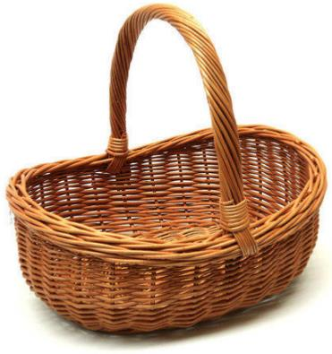
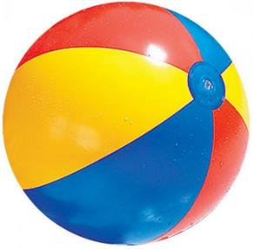
Game: Guessing words
BASKETBALL

Slide 8
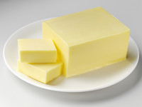
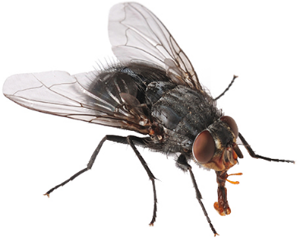
Game: Guessing words
BUTTERFLY

Slide 9


Game: Guessing words
HOTDOG

Slide 10



Slide 11
Lead-in
Compound nouns
basketball
basket
ball
Noun + Noun
hotdog
hot
dog
Adjective + Noun
Stress on the
first syllable

Slide 12

b. Listen to the words and focus on the underlined letters.
c. Listen and cross out the word with the wrong word stress.
d. Read the words with the correct stress to a partner.

Slide 13

Practice

Slide 14

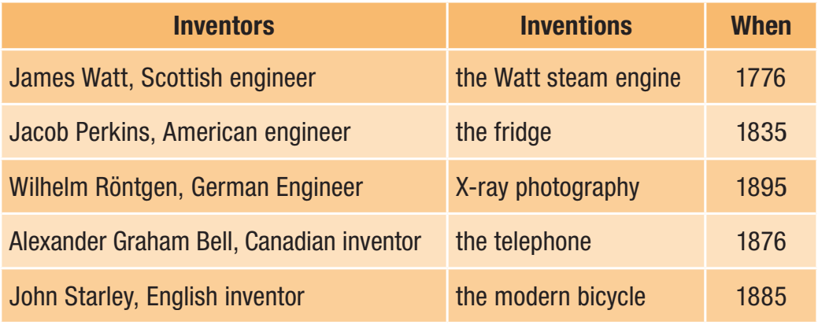
Practice making sentences about the inventors and their inventions.

Slide 15
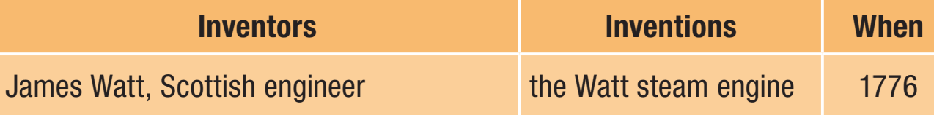

Example
Remember to use Non-defining relative clause

Slide 16
Jacob Perkins, who was an American engineer, invented the fridge in 1835.

Slide 17
Wilhelm Röntgen, who was a German engineer, invented X-ray photography in 1895.

Slide 18
Alexander Graham Bell, who was a Canadian inventor, invented the telephone in 1876.

Slide 19
John Starley, who was a an English inventor, invented the modern bicycle in 1876.

Slide 20

Production

Slide 21
You're in a quiz show.
Work in pairs: Make four questions about famous inventors and inventions. Use ideas from the lesson or your own ideas, then close your books and quiz another pair.

Slide 22
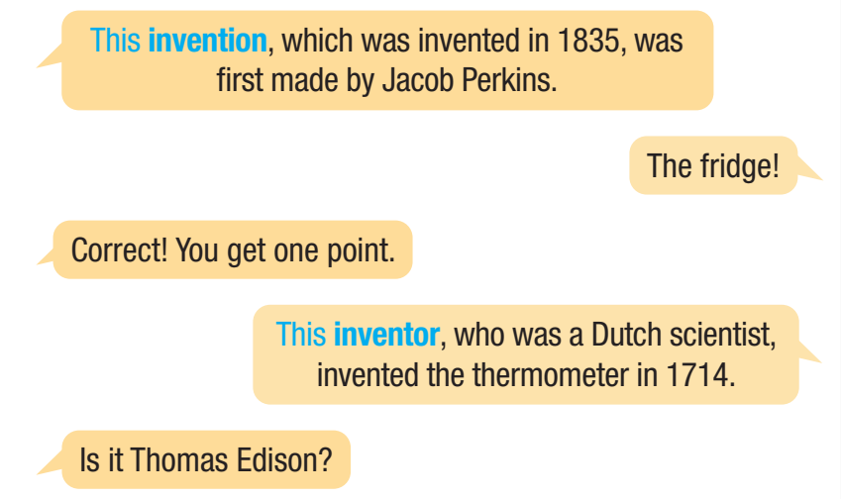

Slide 23

Consolidation

Slide 24

Work in pairs.
b. Which invention do you think had the biggest impact on the world? Why?
I think smartphone has the biggest impact on the world.
Why?
Because it helps people be closer and work more effectively.

Slide 25

WRAP-UP

Slide 26
Today’s lesson
Pronunciation: practice stress for compound nouns
Speaking: ask and answer about inventions and their works

Slide 27

Review all the vocabularies and grammar point in the lesson.
Practice talking about inventors and their inventions with Non-defining relative clause.
Find out more compound nouns and practice saying them.
Prepare the next lesson – Lesson 2 on page 59 in SB.
Play the consolidation games in Tiếng Anh i-Learn Smart World DHA App on www.eduhome.com.vn

