Slide 1


Slide 2


Unit
6
LIFESTYLES
LESSON 7: LOOKING BACK & PROJECT
1

Slide 3
LESSON 1: GETTING STARTED
WARM-UP
Warm-up
Task 1: Match each word or phrase with its meaning.
Task 2: ﻿Complete each sentence with a word or phrase from the box.
VOCABULARY
﻿Task 3: Complete the sentences, using the correct tense of the verbs in brackets.
Task 4: Rewrite the following sentences, so that their meaning stays the same.
GRAMMAR
PROJECT
Interesting lifestyles around the world
CONSOLIDATION
Wrap-up
Homework

Slide 4
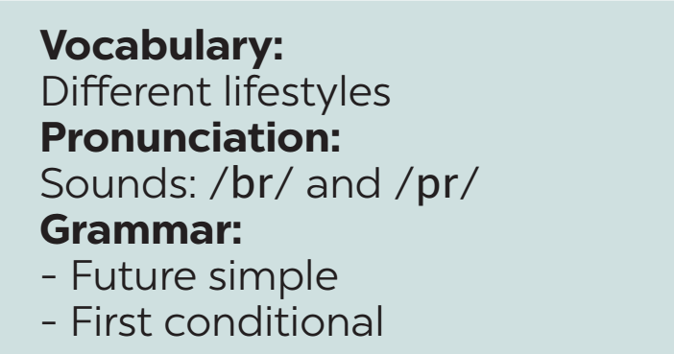

WARM-UP
REVISION

Slide 5
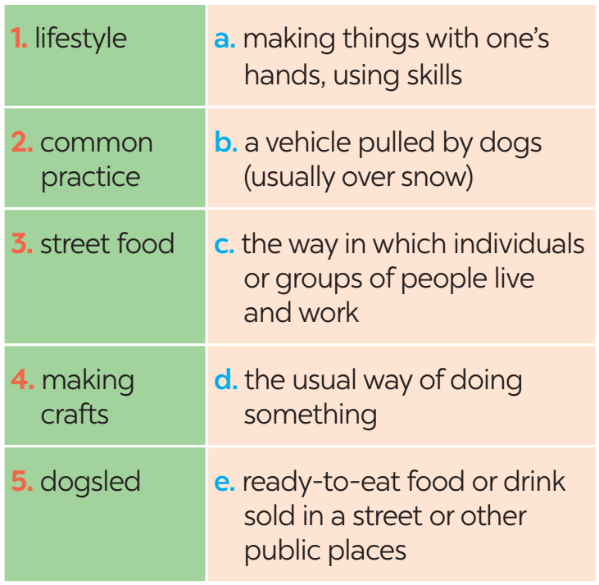
VOCABULARY
1
﻿Match each word or phrase with its meaning.

Slide 6
VOCABULARY
2
﻿Complete each sentence with a word or phrase from the box.
maintain | in the habit of | greeted | lifestyle | online lesson
1. My younger sister is _____________ listening to music while studying.
2. The native people there ________ us warmly when we arrived.
3. Many people are trying to adopt a healthy ________ these days.
﻿in the habit of
greeted
lifestyle

Slide 7
VOCABULARY
2
﻿Complete each sentence with a word or phrase from the box.
maintain | in the habit of | greeted | lifestyle | online lesson
4. I believe that ____________ are not as interesting as offline lessons.
5. The native people there __________ us warmly when we arrived.
online lessons
maintain

Slide 8
GRAMMAR
3
﻿Complete the sentences, using the correct tense of the verbs in brackets.
1. No worries. The organisers (send) _________ us an invitation soon.
2. Unless they behave, those children (not be) ________ welcome here.
3. Do you think online learning (become) ___________ the new mode of education?
4. If I (win) ______ the competition, I will donate half of the prize money to charity.
5. ______ we (have to) _______ keep to the left when we drive in Singapore next week?
will send
won’t be
will become
win
Will
have to

Slide 9
GRAMMAR
4
﻿Rewrite the following sentences, so that their meaning stays the same.
﻿1. Don’t play computer games for too long. You will harm your eyes.
﻿→ If you play ___________________________________________.
2. Be careful with what you eat, or you will get overweight.
→ ﻿You will _____________________________________________.
3. We’ll go to the beach unless it rains
→ ﻿If _____________________________.
→ ﻿If _____________________________.
computer games for too long, you will harm your eyes
get overweight unless you are careful with what you eat
it doesn’t rain, we’ll go to the beach
it rains, we won’t go to the beach

Slide 10
GRAMMAR
4
﻿Rewrite the following sentences, so that their meaning stays the same.
﻿4. If you don’t hurry up, you will be late.
﻿→ Unless ________________________.
5. Unless the teacher explains the lesson again, we won’t understand it very well.
→ ﻿If ____________________________________
__________________________.
you hurry up, you will be late
the teacher doesn’t explain the lesson again,
we won’t understand it very well

Slide 11


PROJECT

Slide 12
CONSOLIDATION
1
Wrap-up
Vocabulary review
Grammar review
Project: Interesting lifestyle around the world

Slide 13

CONSOLIDATION
2
Homework
Students’ workbook.
Prepare for the next lesson.

Slide 14

Website: hoclieu.vn
Fanpage: facebook.com/www.tienganhglobalsuccess.vn/

