Slide 1
Unit 3:
Protecting the Environment
Lesson 3.2 – Speaking & Writing
Page 33

Slide 2
Lesson Outline
Warm-up
Speaking
Writing
Consolidation
Wrap-up

Slide 3
By the end of this lesson, students will be able to…
- talk about ways to protect the environment.
- write a guide to make their school greener.

Slide 4
WARM UP

Slide 5
Match
If they keep polluting the river,
If they keep burning trash,
If they continue cutting down trees,
there will have no trees.
all the fish will die.
the air will be polluted.
Make more sentences using First Conditional.

Slide 6
Pre-writing

Slide 7
Work in pairs
Discuss some ways for your school to be greener.

Slide 8
Work in pairs
So, what do you think our school should do?
We should start a recycling program.
How can we do it?
We should put recycling bins in our school yard.

Slide 9
Share in front of classroom.
So, what do you think our school should do?
We should start a recycling program.
How can we do it?
We should put recycling bins in our school yard.

Slide 10
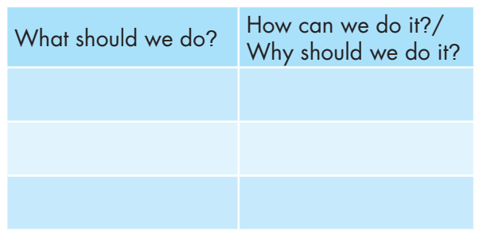
Now, choose the best three to four solution.
In pairs: Discuss the points on the table below and write your own idea.

Slide 11
While-Writing

Slide 12
Now, write a guide to make your school greener using the idea you discussed in Speaking. Use the Writing Skill box and your speaking notes to help you. Write 80 to 100 words.

Slide 13
Writing guides: To write a good, simple guide, you should:
Create a title. Tell everyone what this guide is for.
Write an introduction. Tell everyone what topic is and that you are going to tell them how to do it.
Create clear, short headings. Begin each point with a clear heading. Remember to use imperatives.
Explain each step. Under your headings, give more information about how to do it or why it’s important. Your sentences should be clear and easy to understand.

Slide 14
Can you remember?
What is a structure of a guide?
How many sections are there in a guide?
Which part do we have to use imperatives?
What do you write in a title and introduction?

Slide 15
Write a guide.
Check your answers with a partner, using the feedback form.

Slide 16
Post-writing

Slide 17
You will have your passages assessed thanks to these criteria:
• a guide structure
• interesting ideas
• sentence fluency
• word choice
• spelling and punctuation
• easy to understand

Slide 18
How to Make Our School Greener Our school has many environmental problems. Here are some simple things we can do to help our school's environment. Recycle everything. We should get more recycling bins and start a recycling program. This will help improve land pollution. Plant more trees. We should plant more trees around the playground. This will help reduce air pollution. Use less plastic. We should sell less plastic in our school cafeteria to reduce trash. This will help reduce plastic pollution on land and in the sea.
Suggested writing

Slide 19
CONSOLIDATION

Slide 20
How to write a guide?
A guide
Title
What is a guide for.
Introduction
Should be clear and easy to understand.
Headings
Explain
What the topic is.
What to tell about.
Should be clear, short.
Use the imperatives.

Slide 21
WRAP-UP

Slide 22
Today’s lesson
Speaking: discuss some ways for your school to be greener.
Writing: How to write a guide.

Slide 23
Homework
- Review how to write a guide.
- Finish the writing part.
- Do the exercises in WB: Writing (page 19).
- Play consolidation games in Tiếng Anh 8 i-Learn Smart World DHA App on www.eduhome.com.vn
- Prepare: Unit 3 – Review – page 90.

Slide 24
Lesson 3
Stay positive and have a nice day!

