Slide 1


Slide 2




Unit
4
MUSIC AND ARTS
LESSON 1: GETTING STARTED
A talk at the school gate
Unit
HOBBIES

Slide 3

OBJECTIVES
By the end of the lesson, students will be able to:
get an overview about the topic Music and arts
use the vocabulary to talk about Music and arts

Slide 4
LESSON 1: GETTING STARTED
WARM-UP
Chatting
PRESENTATION
Vocabulary
Listen and read.
Task 1: Circle the correct answer.
Task 2: Complete each of the sentences with a suitable word or phrase from the box.
Task 3: Write the correct word or phrase under each picture.
Task 4: Quiz “How artistic are you?”.
PRACTICE
CONSOLIDATION
Wrap-up
Homework

Slide 5

LESSON 1: GETTING STARTED
WARM-UP
Chatting
Aims of the stage:
to create an active atmosphere in the class before the lesson
to introduce the topic

Slide 6


WARM-UP: CHATTING

Slide 7
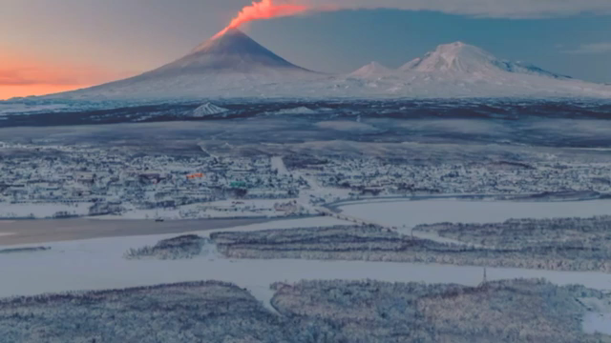
WARM-UP: CHATTING

Slide 8
WARM-UP: CHATTING
- Do you like the piece of music you have listened?
- Do you know what kind of music it is?
- When do you listen to music?
- How do you feel when you listen to music?
- Is music important to our life?

Slide 9

LESSON 1: GETTING STARTED
WARM-UP
Chatting
PRESENTATION
Vocabulary
Listen and read.
Aims of the stage:
to provide students with vocabulary
to help students well-prepared for the listening and reading tasks

Slide 10
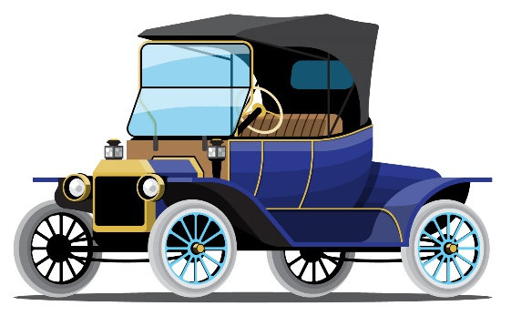
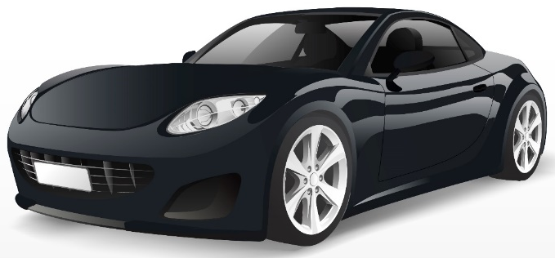
PRESENTATION
classical (adj)
modern
/ˈklæsɪkəl/
cổ điển

Slide 11




PRESENTATION
spare time (n)
/speər taɪm/
thời gian rảnh rỗi

Slide 12
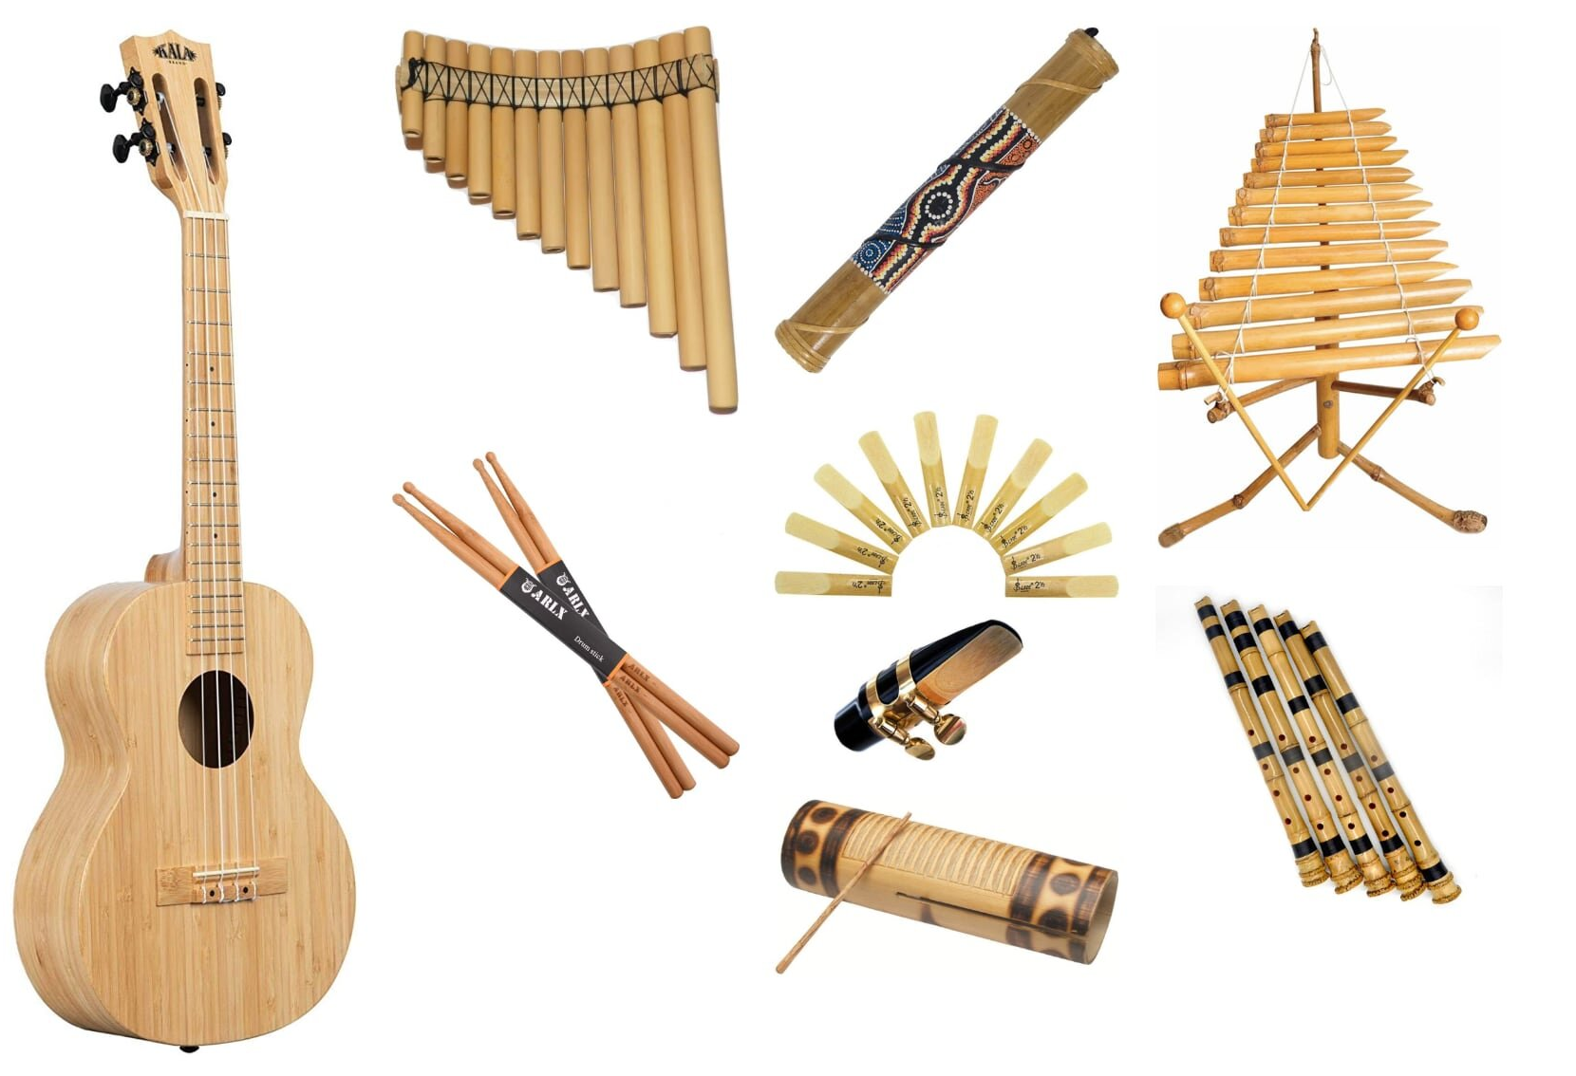
PRESENTATION
musical instruments (n)
/ˈmjuːzɪkəl ˈɪnstrəmənts/
nhạc cụ

Slide 13

PRESENTATION
landscape (n)
/ˈlændskeɪp/
cảnh quan

Slide 14
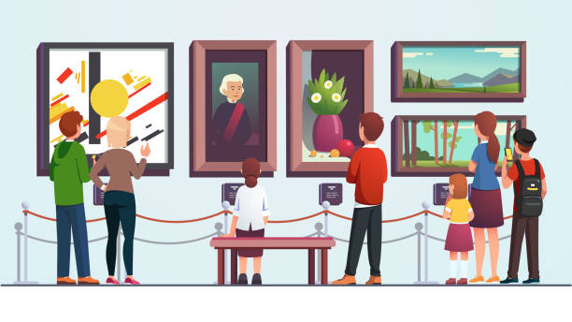
PRESENTATION
art gallery (n)
/ˈɑːt ˌɡæləri/
phòng trưng bày
nghệ thuật

Slide 15
PRESENTATION
New words | Pronunciation | Meaning
classical (adj) | /ˈklæsɪkəl/ | cổ điển
spare time (n) | /speər taɪm/ | thời gian rảnh rỗi
musical instruments (n) | /ˈmjuːzɪkəl ˈɪnstrəmənts/ | nhạc cụ
landscape (n) | /ˈlændskeɪp/ | cảnh quan
art gallery (n) | /ˈɑːt ˌɡæləri/ | phòng trưng bày nghệ thuật

Slide 16
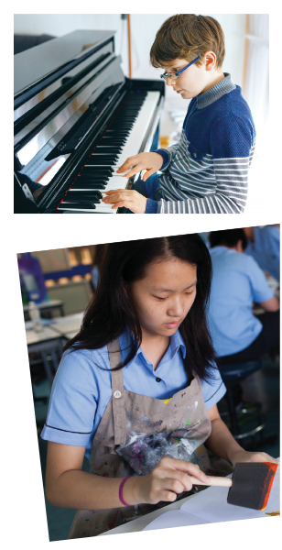
PRESENTATION: LISTEN AND READ
Aim of the task:
to have students get to know the topic

Slide 17

PRESENTATION: LISTEN AND READ.
Trang: Hi Nick. What are you listening to?
Nick: I’m listening to music. I like classical music, and I often play the piano in my spare time.
Trang: Wow. I can’t play any instruments.
Nick: And what about you? What’s your hobby?
Trang: I like painting and taking photos.
Nick: Taking photo? I’ve never tried it. Is it fun?
Trang: Yeah, it is, but not as fun as painting.
Nick: Right. They seem quite different from each other. What do you normally paint?
Trang: Landscapes and animals, just for pleasure, you know. I sometimes share them with my friends.
Nick: Really? Um, maybe we should go to an art gallery next weekend?
Trang: Sounds good, but I’d prefer to go to the music festival at my school.
Nick: Well … OK. That’s fine.

Slide 18
LESSON 1: GETTING STARTED
WARM-UP
Chatting
PRESENTATION
Vocabulary
Listen and read.
Task 1: Tick the correct answer.
Task 2: Complete each of the sentences with a suitable word or phrase from the box.
Task 3: Write the correct word or phrase under each picture.
Task 4: Quiz “How artistic are you?”.
PRACTICE

Slide 19
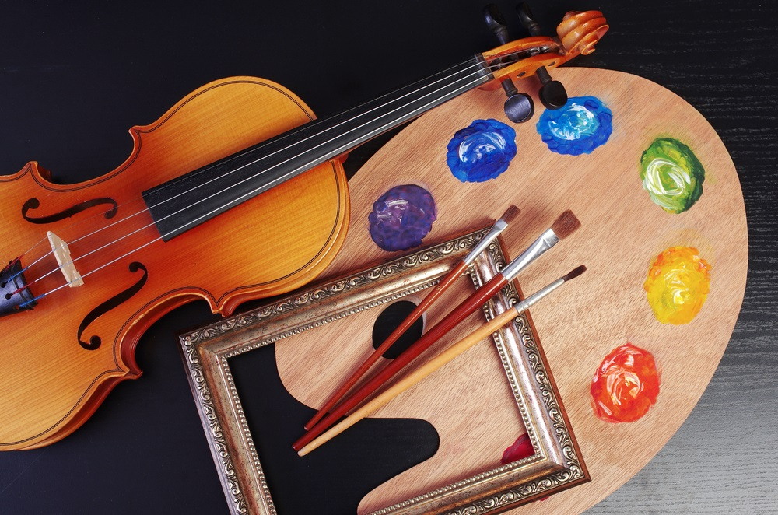
PRACTICE
1
Tick the correct answer.
1. What are Trang and Nick talking about?
A. Playing the piano.
B. Drawing and painting.
C. Music and arts.
Trang: Hi Nick. What are you listening to?
Nick: I’m listening to music. I like classical music, and I often play the piano in my spare time.

Slide 20
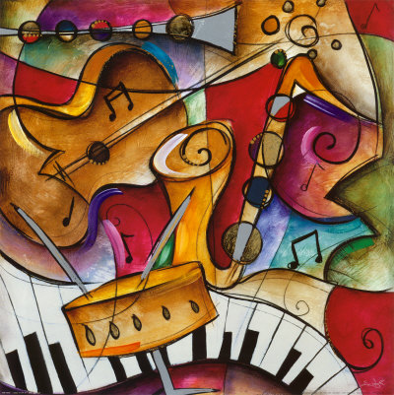
PRACTICE
2
Complete each of the sentences with a suitable word or phrase from the box.
photos like different from art gallery musical instruments
Nick wants to go to a(n) _____________ next week.
You can use your smartphone to take ________.
This photo is very bright. It is _____________ that dark one.
Nick and Trang agree that taking photos is not _____________ painting.
My friend David is very talented. He plays three _______________________.
art gallery
photos
different from
like
musical instruments

Slide 21
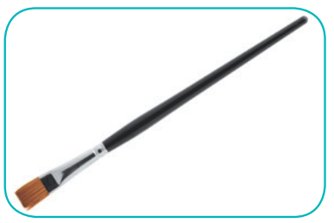

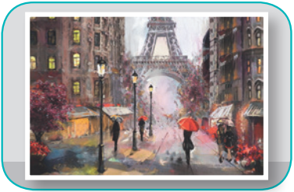
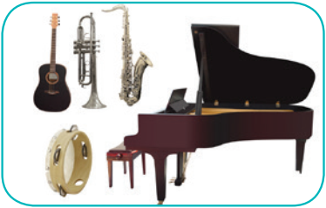
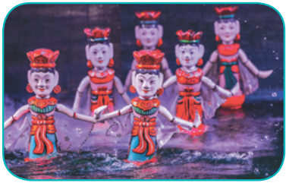
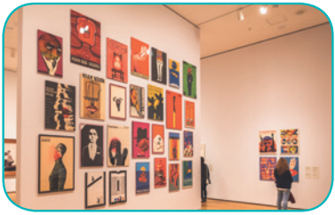
PRACTICE
3
Write the correct word or phrase under each picture. Then listen and repeat.
camera water puppet show art gallery
painting paintbrush musical instruments
paintbrush
camera
painting
1. ______________
2. ____________
3. ____________
musical instruments
water puppet show
4. __________________________
5. _________________________
art gallery
6. ____________

Slide 22


PRACTICE
4
Quiz “How artistic are you?”.

Slide 23
LESSON 1: GETTING STARTED
WARM-UP
Chatting
PRESENTATION
Vocabulary
Listen and read.
Task 1: Circle the correct answer.
Task 2: Complete each of the sentences with a suitable word or phrase from the box.
Task 3: Write the correct word or phrase under each picture.
Task 4: Quiz “How artistic are you?”.
PRACTICE
CONSOLIDATION
Wrap-up
Homework

Slide 24
CONSOLIDATION
1
WRAP-UP
MUSIC AND ARTS
ABOUT MUSIC
ABOUT ARTS
Topic of the unit
Vocabulary

Slide 25

CONSOLIDATION
2
HOMEWORK
Prepare the vocabulary for the next lesson: A closer look 1.
Prepare for the Project lesson.

Slide 26

Website: hoclieu.vn
Fanpage: facebook.com/www.tienganhglobalsuccess.vn/

