Slide 1






UNIT 2.
HEALTHY LIVING

Slide 2



PART 1. THEORY
I. VOCABULARY

Slide 3

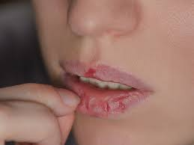
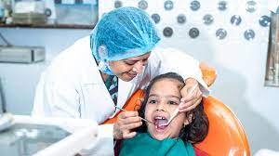

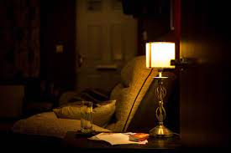

1. chapped lips (n):
/tʃæpt lɪps/
môi bị nứt nẻ
/'dentɪst/
nha sỹ
2. dentist (n):
4. doctor (n):
3. dim light (n):
/dɪm laɪt/
ánh sáng yếu,
mờ
/'dɒktə(r)/
bác sỹ

Slide 4
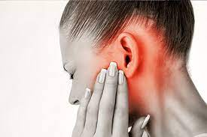
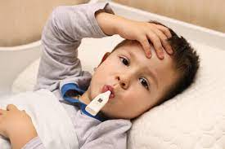
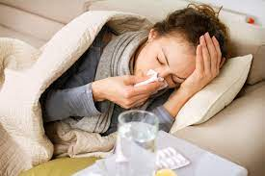
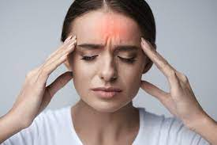
5. earache (n):
/’ɪəreɪk/
đau tai
6. fever (n):
/'fi:və(r)/
sốt
7. flu (n):
8. headache (n):
/'hedeɪk/
đau đầu
/flu:/
cúm

Slide 5
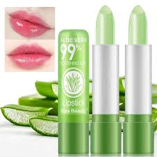
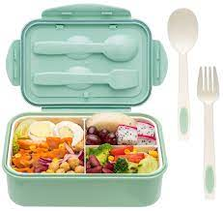
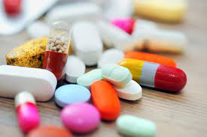
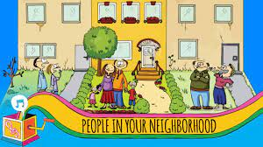
10. lunch box (n):
9. lip balm (n):
/lɪp bɑːm/
son dưỡng môi
/lʌntʃ bɒks/
hộp cơm trưa
12. neighbourhood (n):
11. medicine (n):
/'medsn/
thuốc
/'neɪbərhʊd/
hàng xóm, láng giềng

Slide 6
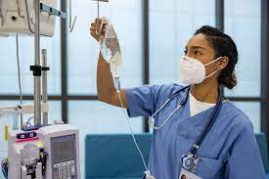
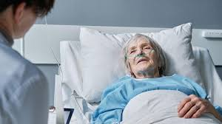
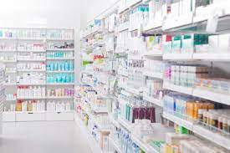
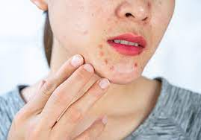
/nɜ:s/
y tá
/'peɪʃnt/
bệnh nhân
13. nurse (n):
14. patient (n):
15. pharmacy (n):
/'fɑːməsɪ/
hiệu thuốc
16. red spot (n):
/red spɒt/
đốm đỏ

Slide 7
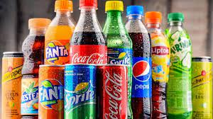
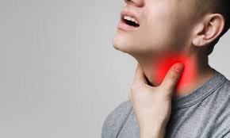
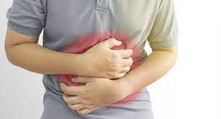
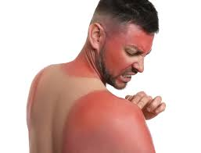
17. soft drink (n):
18. sore throat (n):
/sɑː'θrəʊt/
đau họng
/sɒft drɪηk/
nước ngọt
19. stomach ache (n):
20. sunburn (n):
/'stʌmək eɪk/
đau bụng
/'sʌnbɜ:n/
cháy nắng,
sạm da

Slide 8
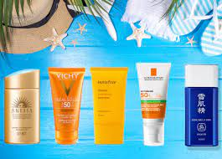
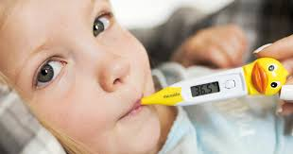
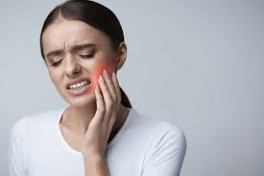
21. sun cream (n):
/'sʌn krɪrm/
kem chống nắng
22. temperature (n):
/'temprətʃə(r)/
sốt
23. toothache (n):
/'tu:θeɪk/
đau răng

Slide 9
chapped lips
dentist
dim light
doctor
earache
fever
flu
headache
lip balm
lunch box
medicine
neighbourhood
nurse
patient
pharmacy
red spot
soft drink
sore throat
stomach ache
sunburn
sun cream
temperature
toothache

Slide 10

VOCABULARY CHECKING
https://wordwall.net/resource/1015343
https://wordwall.net/resource/58458109
https://wordwall.net/resource/57995170

Slide 11
PART 1. THEORY
II. GRAMMAR

Slide 12


Simple sentences
- Câu đơn là cầu diễn tả 1 ý. Nó thường có 1 chủ ngữ và 1 động từ.
Ex. Tom sleeps. (Tom ngủ.)
James is reading. (James đang đọc.)
- Một số cầu đơn có thêm tân ngữ
Ex. I go to school. (Tôi đi học.)
He plays football. (Anh ấy chơi đá bóng.)
- Một số câu đơn có thêm cả trạng ngữ.
Ex. Tom drives carefully. (Tom lái xe cẩn thận.)
They often play football on Sunday. (Họ thường chơi đá bóng vào Chủ nhật.)

Slide 13
GRAMMAR CHECKING
https://wordwall.net/resource/27990819
https://wordwall.net/resource/35689830

Slide 14
PART 1. THEORY
iii. PHONETICS

Slide 15
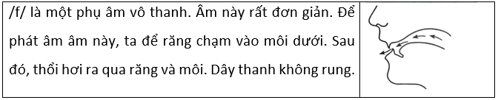
 Sound /f/ and /v/
1. Cách phát âm âm /f/ và âm /v/
a. Cách phát âm âm /f/

Slide 16
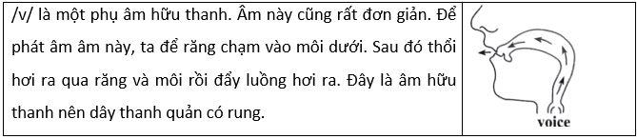
b. Cách phát âm âm /v/

Slide 17
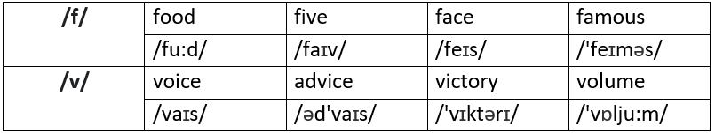
2. Listen and repeat these words.  Track 04

Slide 18
PART 2. LANGUAGE
I. VOCABULARY

Slide 19


Exercise 1. Find the odd one out among A, B, C or D.
1. A. cough B. weak C. headache D. sore throat
2. A. sunburn B. toothache C. earache D. unhealthy
3. A. sick B. temperature C. tired D. weak
4. A. flu B. stomachache C. allergy D. fat
5. A. sleep B. happy C. live D. smile
6. A. sick B. tired C. sore D. fit
7. A. cough B. flu C. sunshine D. sunburn
8. A. sleep B. rest C. relax D. work
9. A. and B. but C. so D. although
10. A. healthy B. fit C. well D. sick

Slide 20
Exercise 2. Fill in each blank with the correct health problem from the box according to the description.
toothache
headache
stomachache
sore throat
backache
earache
cough
flu
1. ______________: a pain caused by something being wrong with one of your teeth.
2. ______________: a pain in your back.
3. ______________: a very severe pain that you feel in your head.
4. ______________: pain in your stomach.
5. ______________: a pain in the inside part of your ear.
6. ______________: a problem which is like a very bad cold, but which causes a temperature.
7. ______________: a pain in your throat.
8. ______________: a health problem that you make a lot of loud sounds.

Slide 21
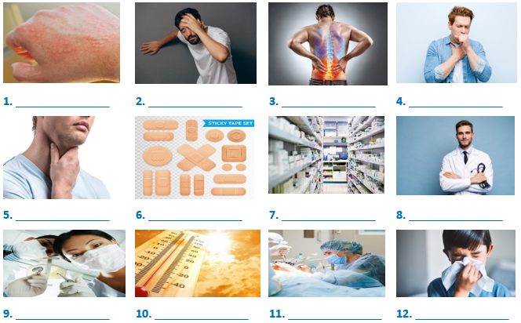
Exercise 3. Look at the pictures and complete with suitable words.
sore throat
pharmacy
allergy
plaster
cough
hot
flu
dizzy
dentist
doctor
surgeon
backache

Slide 22
Exercise 4. Fill in the blank with a word in the box.
obesity
rest
sun hat
allergic
clean
exercise
bright eyes
put on
tooth decay
spending
1. If you brush your teeth regularly, you will not have _____________.
2. You look tired. You should more _____________.
3. Today the weather is cold, so you should _____________ your warm clothes.
4. Some people are _____________ to crabs.
5. If you want to be healthy, you should eat less fast food and do more _____________.
6. Today it is very hot. Please wear a _____________ when you go out.
7. Eating too many sweets and fast foods causes health problems such as tooth decay, _____________.
8. Eating carrots regularly will help you have _____________.
9. You can avoid some diseases by keeping your hands _____________.
10. _____________more time on computer games may lead to sore eyes.

Slide 23
Exercise 5. Fill in each blank with a word in the box.
dry
provide
health
swimming
stay
physical
flu
weight
getting
exercise
1. In order to have good _____________, you should eat lightly and laugh cheerfully.
2. My father does morning _____________ every day.
3. Do you want to know how you can _____________ healthy?
4. You should eat a lot of fruits and vegetables because they _____________ vitamin A, which is good for the eyes.
5. If you want to be fit, stay outdoors more and do more _____________ activities.
6. Eat less junk high-fat food to keep you from _____________ fat.
7. He plays computer games and watches TV a lot so his eyes are often _____________.
8. He eats a lot of burgers and chips so he's putting on _____________.
9. They sometimes go _____________ even when it's cold.
10. To prevent _____________, you should eat a lot of garlic and keep your body warm.

Slide 24
PART 2. LANGUAGE
II. GRAMMAR

Slide 25
Exercise 1. Write T for the simple sentences. Write F for not simple sentences.
1. I like fish but I don’t like pork. _______
2. James drinks two bottles of water every day. _______
3. My mother often drinks orange juice. _______
4. Linda is tall and beautiful. _______
5. You should eat more vegetables. _______
6. My sister always wears sunglasses when she goes out in summer. _______
F
T
T
T
T
F
F

Slide 26
Exercise 2. Reorder the words to have correct sentences.
1. food./ mother/ My/ healthy/ often/ eats/
→ My mother often eats healthy food.
2. likes/ pizzas,/ fast food/ Tom/ sandwiches./ and Linda/ such as/
→ Tom and Linda likes fast food such as pizzas, sandwiches.
3. sometimes/ We/ beef noodles./ eat/
→ We sometimes eat beef noodles.
4. usually/ and fruit./ eats/ Mr. Long/ vegetables/
→ Mr. Long usually eats vegetables and fruit.

Slide 27
Exercise 2. Reorder the words to have correct sentences.
5. often/ What/ breakfast?/ do/ you/ have/ for/
→ What do you often have for breakfast?
6. hot/ today./ go out/ Don’t/ very/ because/ it’s/
→ Don't go out because it's very hot today.
7. you/ How often/ morning/ exercise?/ do/ do/
→ How often do you do morning exercise?
8. avoids/ Tuan/ and/ soft drinks./ often/ sweetened food/
→ Tuan often avoids sweetened food and soft drinks.

Slide 28
Exercise 3. Write complete sentences basing on the given words.
1. It/ cold/ outside./ Not go out.
→ It's cold outside. Don't go out.
2. Apples/ very good/ health.
→ Apples are very good for health.
3. Lots/ children/ have/ chapped lips/ this season.
→ Lots of children have chapped lips this season.
4. Long and Tuan/ not do/ morning exercise/ every day.
→ Long and Tuan don't do morning exercise every day.

Slide 29
Exercise 3. Write complete sentences basing on the given words.
5. You/ shouldn’t/ eat/ too much/ fast food./ You/ should/ eat/ more vegetables/ and fruit.
→ You shouldn't eat too much fast food. You should eat more vegetables and fruit.
6. We/ often/ play football/ school.
→ We often play football after school.
7. My friends/ love/ outdoor/ and/ indoor/ activities.
→ My friends love both outdoor and indoor activities.
8. We/ should/ wear/ hat/ and sunscreen/ avoid damage from/ sun.
→ We should wear a hat and sunscreen to avoid damage from the sun.

Slide 30
Exercise 4. Write complete sentences basing on the given words.
1. How/ you/ go to school/ ?
→ How do you go to school?
2. what/ your/ job/ ?
→ What's your job?
3. where/ John/ come from/ ?
→ Where does John come from?
4. how long/ it/ take/ from London/ Paris/ ?
→ How long does it take from London to Paris?
5. how often/ she/ go to the cinema/ ?
→ How often does she go to the cinema?

Slide 31
Exercise 4. Write complete sentences basing on the given words.
6. when/ you/ get up/ ?
→ When do you get up?
7. how often/ you/ study English/ ?
→ How often do you study English?
8. what time/ film/ start/ ?
→ What time does the film start?
9. where/ you/ play tennis/ ?
→ Where do you play tennis?
10. what sports/ Linda/ like/ ?
→ What sports does Linda like?

Slide 32
Exercise 5. Put the verbs in brackets in the correct form.
1. I (be) __________ at school at the weekend.
2. She (not study) ________________ on Friday.
3. My students (be) __________ hard-working.
4. He (have) __________ a new haircut today.
5. I usually (have) __________ breakfast at 7.00.
6. (She/ live) ____________________ in a house?
7. Where (be) __________ your children?
am
doesn't study
are
has
have
Does she live
are

Slide 33
Exercise 5. Put the verbs in brackets in the correct form.
8. My sister (work) __________ in a bank.
9. Dogs (like) __________ meat.
10. She (live) __________ in Florida.
11. It (rain) __________ almost every day in Manchester.
12. We (fly) __________ to Spain every summer.
13. My mother (fry) __________ eggs for breakfast every morning.
14. The bank (close) __________ at four o'clock.
works
like
lives
rains
fly
fries
closes

Slide 34
Exercise 6. Put the verbs in brackets in the correct form.
1. Nam looks brown. He was on holiday last week. He (get) __________ sunburn.
2. Relaxing is very good. It (help) __________ you to avoid depression.
3. The Japanese (eat) __________ a lot of fish so they are very intelligent.
4. If you wash your hands more, you (have) __________ less chance of catching flu.
5. Eating carrots regularly (help) __________ you see better.
6. It is very hot outside. Please (wear) __________ a sun hat when you go out.
7. Do more exercise and you (feel) __________ healthier.
8. I don’t want (be) __________ tired tomorrow, so I go to bed early.
9. Nowadays, I don’t feel well. I often (feel) __________ sick and weak.
10. People who (smile) __________ more are happier and live longer.
got
helps
eat
will have
will help
wear
will feel
to be
feel
smile

Slide 35
PART 2. LANGUAGE
III. PHONETICS

Slide 36
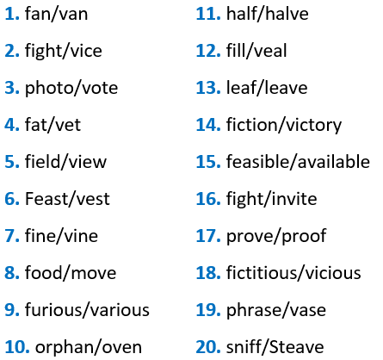
Listen and circle the words you hear.  TRACK 5

Slide 37
PART 3. COMMUNICATION SKILLS
I. LISTENING

Slide 38
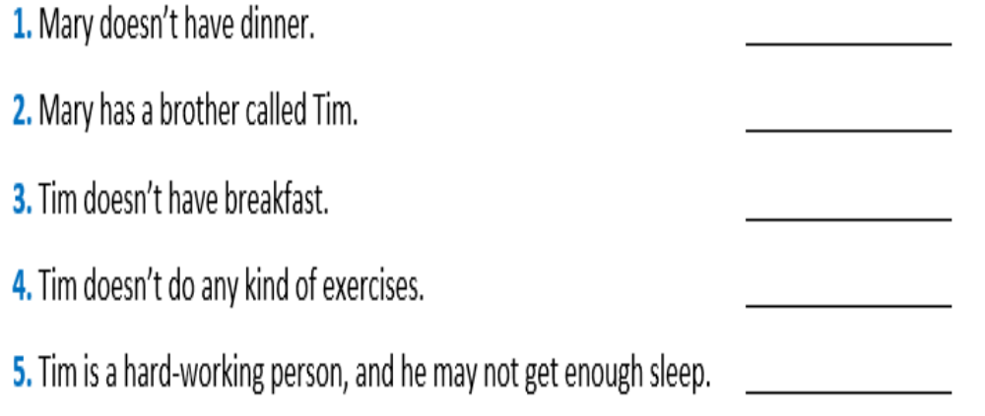
☞ Listen and do the tasks followed.  Track 06
Exercise 1. Listen and decide if each statement is True (T) or False (F).
F
T
T
F
T

Slide 39
Exercise 2. Listen again and answer the questions.
1. Where does Mary study?
→ She studies at a high school.
2. What does Mary usually have for breakfast?
→ She usually has cereal and a glass of milk
3. Does Mary like milk?
→ No, she doesn't.
4. What does Mary have for lunch?
→ She has a sandwich and fruits.
5. Does Mary do any kind of exercises?
→ Yes, she does.

Slide 40
PART 3. COMMUNICATION SKILLS
II. SPEAKING

Slide 41
Exercise 1. Read the conservation and answer the questions.
Phong: What time do you usually come home from school?
Nick: I usually come home at 11.30.
Phong: When do you often have lunch?
Nick: I often have lunch at 12 o’clock.
Phong: What do you usually have for lunch?
Nick: I often have fish and eggs.
Phong: What do you do after dinner?
Nick: I sometimes go to the cinema, but I usually stay at home, watch TV and do my homework.
Phong: Do you often watch TV?
Nick: Yes, I do. I like watching sports very much.
Phong: When do you go to bed?
Nick: I always go to bed at 9.30.1 never stay up late.

Slide 42
Exercise 1. Read the conservation and answer the questions.
1. What time does Nick usually come home from school?
→ He usually comes home at 11.30.
2. When does he often have lunch?
→ He often has lunch at 12 o'clock.
3. What does he usually have for lunch?
→ He usually has fish and eggs for lunch.
4. What does he often do after dinner?
→ He sometimes goes to the cinema, but he usually stays at home, watches TV and does his homework.
5. What TV programme does he like watching?
→ He likes watching sports very much.

Slide 43

Exercise 2. Rearrange the conversation in the correct order then write your answers in each blank.
d
a. Mary: You shouldn't eat so much in the evening.
b. Mary: Oh, dear. How long have you had that?
c. Daisy: I know. What should I do now?
d. Mary: You don’t look very well. Are you OK?
e. Daisy: No. I have a stomachache.
f. Mary: So take some medicine and go to bed.
g. Daisy: I don’t like going to the doctor.
h. Daisy: Good idea.
i. Daisy: It started last night. I ate a big Chinese meal.
j. Mary: You should go to the doctor.
e
b
i
a
c
j
g
f
h

Slide 44
PART 3. COMMUNICATION SKILLS
III. READING

Slide 45
Exercise 1. Choose the word which best fits each gap.
Breakfast is the (1) ___ important meal of the day. It provides the nutrients your body needs for good health, the calories it needs for (2) ____ and helps to maintain your blood sugar level. Studies have shown that people who don’t have breakfast have a low blood sugar level and are often slow, tired, hungry and (3) ___ to concentrate. Surprisingly, breakfast actually plays a part in weight control. It's easier to (4) ___ weight if you eat in the morning rather than later in the day. Dividing the day’s calories (5) ____ three meals helps take off weight more efficiently than (6) ______ breakfast and having two larger meals a day does.
1. A. healthy B. tasty C. main D. most
2. A. strength B. power C. energy D. effort
3. A. able B. enable C. unable D. capable
4. A. lose B. put C. gain D. drop
5. A. in B. into C. up D. for
6. A. skipping B. making C. buying D. serving

Slide 46
Exercise 2. Read the text and choose the best option.
It’s important to (1) _____________ well, especially when you are studying. If you are at primary (2), _____________ you may not go home for lunch and have a cooked meal of meat or (3) _____________ and vegetables. A chicken and lettuce sandwich, with some (4) _____________ fruit would be a light but (5) _____________ lunch. Many people around the world eat plain, boiled (6) _____________ two or three times a day. Pupils and students often don’t eat (7) _________ when they’re revising for an exam - they eat chocolate and (8) _________ lots of black coffee! And by the way, doctors say everybody should start the day with healthy (9) _________. It’s also good for you to drink a lot of (10) _________ through the day.

Slide 47
Exercise 2. Read the text and choose the best option.
1. A. launching B. emitting C. eat D. peaking
2. A. school B. weapons C. spaceships D. rockets
3. A. to B. towards C. with D. fish
4. A. as soon as B. fresh C. as well as D. such as
5. A. burnt B. explored C. went off D. healthy
6. A. rice B. audience C. observatories D. watcher
7. A. sent back B. returned to C. well D. except for
8. A. weightlessness B. drink C. wavelengths D. length
9. A. space B. atmosphere C. vacant D. breakfast
10. A. scientists B. drivers C. water D. astronauts

Slide 48
Exercise 3. Choose the correct word A, B, or C for each gap to complete the following passage.
We need calories or (1) _______ to do the things every day. For example, when we walk to school or (2) _______ a bike to school we spend a certain amount of (3) _______ and even when we sleep, we also use them. But how many calories should we (4) _______ a day to stay in shape? It’s difficult (5) _______ us to calculate. If people want to keep (6) _______, they should remember that everyone should have between 1600 and 2500 calories a day.
We get calories (7) _______the food we eat. If we get too many food and don’t take part (8) _______any activities, we can get fat quickly. So besides studying, we should do some (9) _______, play sports or do the housework, such as cleaning the floor, cooking etc. Otherwise, we don’t eat enough, we will be (10) _______ and weak.

Slide 49
Exercise 3. Choose the correct word A, B, or C for each gap to complete the following passage.
1. A. food B. energy C. drink
2. A. ride B. come C. drive
3. A. things B. food C. calories
4. A. do B. spend C. have
5. A. for B. with C. in
6. A. health B. fit C. Active
7. A. in B. of C. from
8. A. with B. in C. on
9. A. exercise B. activity C. healthy
10. A. good B. tired C. thirsty

Slide 50
PART 3. COMMUNICATION SKILLS
IV. WRITING

Slide 51
Exercise l. Make sentences using the words and phrases given.
Example: Dr. Minh / diet / expert/. → Dr. Minh is a diet expert.
1. Relaxing/ really/ important.
→ Relaxing is really important.
2. It/ easy/ get/ flu/./ we/ should/ try/ avoid/ go out/ cold weather./
→ It is easy to get the flu. We should try to avoid going out in cold weather.
3. I/ have/ toothache/ yesterday/ because/1 eat/ many/ sweets/.
→ I had a toothache yesterday because Late many sweets.
4. He/ has/ flu/./ he/ keep/ sneezing/ coughing/.
→ He has a flu. He keeps sneezing and coughing.
5. Which/ activity/ use/ more/ calories:/ walking/ or/ riding/ bicycle/ ?
→ Which activity uses more calories: walking or riding a bicycle?

Slide 52
Exercise l. Make sentences using the words and phrases given.
Example: Dr. Minh / diet / expert/. → Dr. Minh is a diet expert.
6. You/ not/ play/ computer games/ in/ free time.
→ You shouldn't play computer games so much in your free time.
7. Doctor/ asking/ Mai/ questions/ about/ health problems.
→ The doctor is asking Mal some questions about health problems.
8. Vitamins/ play/ important/ role/ our diet.
→ Vitamins play an important role in our diet.
9. We/ keep/ our bodies/ warm/ avoid/ cold.
We should keep our bodies warm to avoid cold.
10. Getting/ enough/ rest/ help/ you/ concentrate/ school.
→ Getting enough rest will help you to concentrate at school.

Slide 53
Exercise 2. Find a mistake in the four underlined parts of each sentence.
1. Laughing (A) is good (B) with (C) health (D).
2. Some (A) people have a (B) very bad (C) habit in (D) littering in public.
3. People who live (A) in a dusty area (B) often suffer (C) on (D) diseases.
4. In (A) prevent flu, we should keep (B) our hands clean (C), and our feet warm (D).
5. She (A) has (B) a (C) sore throat yesterday (D).

Slide 54
Exercise 3. Make sentences using the words and phrases given.
Choose the correct answer for each sentence.
1. Do / exercise I regularly / help I you I stay I healthy.
A. Doing exercise regularly helps you stay healthy.
B. Doing exercise regularly help you stay healthy.
C. Do exercise regularly helps you stay healthy.
D. Doing exercise regularly helps you are stay healthy.
2. We I need I calories I or I energy I do / things / every day.
A. We need calories or energy do things every day.
B. We need calories or energy doing things every day.
C. We needs calories or energy do things every day.
D. We need calories or energy to do things every day.

Slide 55
Exercise 3. Make sentences using the words and phrases given.
Choose the correct answer for each sentence.
3. We I should I balance / calories I we I get/from/food / with / calories / we / use/physical activity.
A. We should balance calories we get from food with calories we use physical activity.
B. We should balance calories we get from food with calories we use for physical activity.
C. We should be balance calories we get from food with calories we use physical activity.
D. We should balances calories we get from food with calories we use to physical activity.
4. Eat / healthy/ be / important /part / maintain / good / health.
A. Eat healthily is important part to maintain good health.
B. Eat healthily is an part important to maintain good health.
C. Eating healthily is an important part to maintain good health.
D. Eating healthily is a important part to maintain good health.

Slide 56
Exercise 3. Make sentences using the words and phrases given.
Choose the correct answer for each sentence.
5. Eat / less / sweet/food / and / eat / more/fruit / vegetables.
A. Eating less sweet food and eat more fruits and vegetables.
B. Eating less sweet food and eating more fruits and vegetables.
C. Eating less sweet food and to eat more fruits and vegetables.
D. Eat less sweet food and eat more fruits and vegetables.
6. Drink I lots I water I be /good / our health.
A. Drinking lots of water is good for our health.
B. Drink lots of water is good for our health.
C. Drinking a lots of water is good for our health.
D. Drink a lots of water is good for our health.

Slide 57
Exercise 3. Make sentences using the words and phrases given.
Choose the correct answer for each sentence.
7. I / have / toothache / so /I / have to /see / dentist.
A. I have a toothache so I have to see dentist.
B. I have toothache so I have to see dentist.
C. I have a toothache so I have to see the dentist.
D. I have toothaches so I have to see the dentists.
8. Watch / much / TV / not/good/your eyes.
A. Watch much TV is not good for your eyes.
B. Watching much TV are not good for your eyes.
C. Watch too much TV is not good for your eyes.
D. Watching too much TV is not good for your eyes.

Slide 58
Exercise 3. Make sentences using the words and phrases given.
Choose the correct answer for each sentence.
9. When/I/ ten/ begin/play football.
A. When I was ten, I began to play football.
B. When I was ten, I begin to play football.
C. When I am ten, I began to play football.
D. When I was ten, I began play football.
10. Calories/important/human /health.
A. Calories are important for human health.
B. Calories is important for human health.
C. Calories are important with human health.
D. Calories is important with human health.

Slide 59
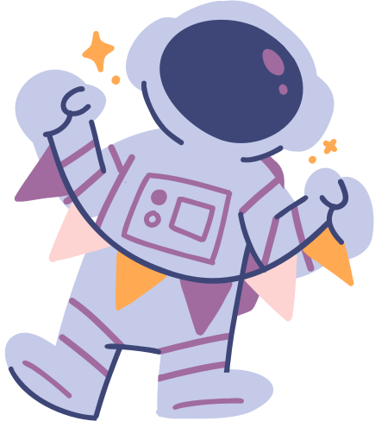
Thank You
and goodbye

