Slide 1

UNIT 7: TEENS
Lesson 2.3 – Pronun & Speaking
Pages 70 & 71

Slide 2
Lesson Outline
Warm-up
Pronunciation
Practice
Speaking
Consolidation
Wrap-up

Slide 3

By the end of this lesson, students will be able to…
Practice the sound /d/
Practice reporting how teen celebrities live, using reported speech for statements

Slide 4

WARM UP

Slide 5
Choose the word whose underlined part is pronounced differently from that of the others.
A. filling B. sliding C. smiling D. filing
A. explain B. excuse C. except D. expert
3. A. promise B. product C. project D. program
/ ˈfɪlɪŋ/ /'slaɪdɪŋ/ /ˈsmaɪlɪŋ/ /ˈfaɪlɪŋ/
/ɪkˈspleɪn/ /ɪkˈskjuːz/ /ɪkˈsept/ /ˈekspəːrt/
/ˈprɑːmɪs/ /ˈprɑː dʌkt/ /ˈprɑː dʒekt / /ˈprougræm/

Slide 6

Pronunciation

Slide 7


Listen and repeat.
______________
director
dentist
dream
drought
damage
disappear
disease

Slide 8



b. Listen to the words and focus on the underlined letters.
reported
told
said

Slide 9

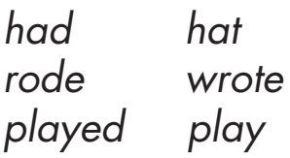

c. Listen and circle the words you hear.

Slide 10
d. Read the words to your partner using the sound noted in "a."
reported had hat
told rode wrote
said played play

Slide 11
Practice

Slide 12
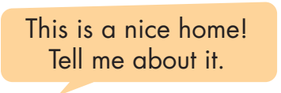
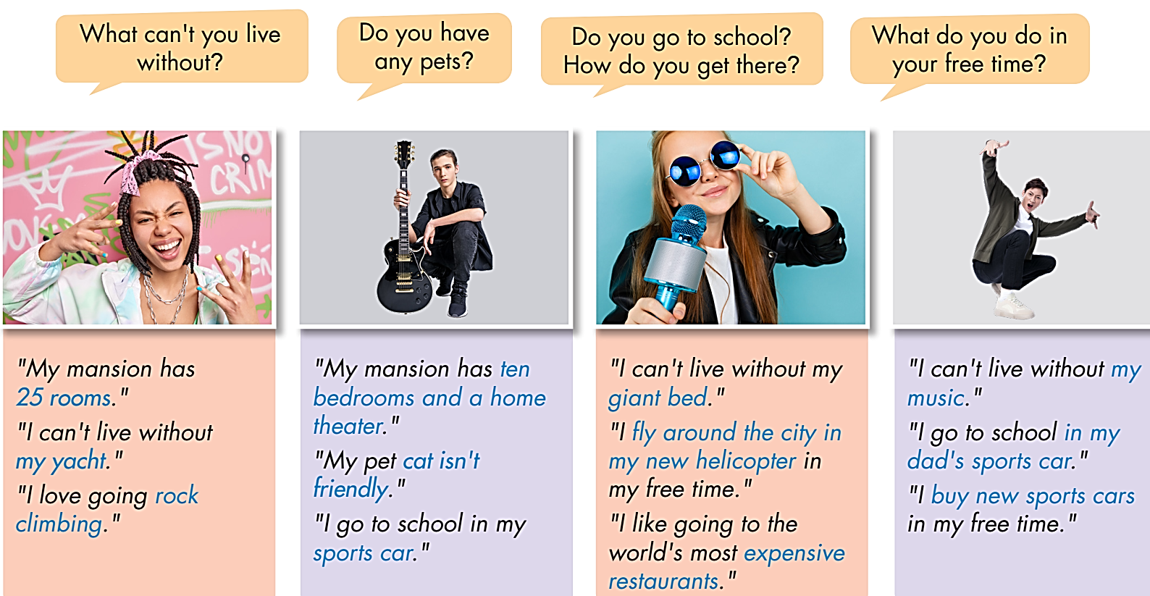
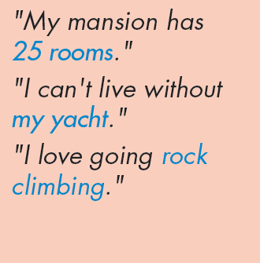
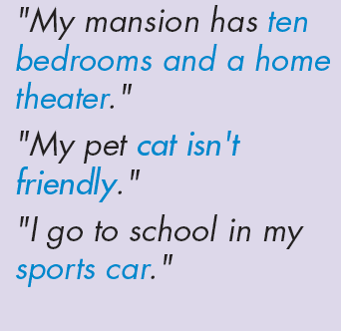
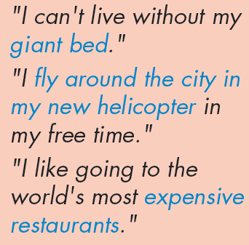
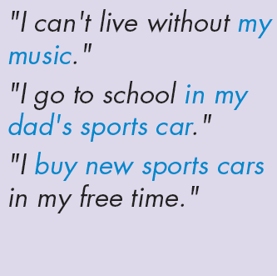
a. Point, ask, and answer about what the people said using reported speech.

Slide 13

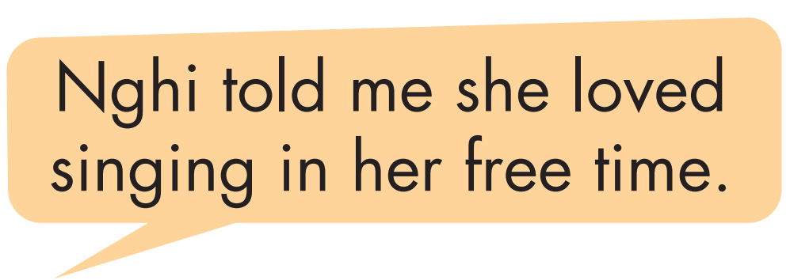
b. Use your own ideas to make similar sentences about yourself and tell your partner. Then, report your partner's statements to another student.

Slide 14
Further
Practice

Slide 15
Choose the words whose main stress is placed differently from the others.
Extra Practice
A. engineer B. museum C. computer D. example
A. director B. designer C. attendant D. architect
A. typhoon B. blizzard C. landslide D. earthquake
/ˌendʒɪˈnɪr/ /mjuːˈziəm/ /kəmˈpjuːtər/ /ɪgˈ zæmpəl/
/dɪˈrektər/ /dɪˈzaɪnər/ /əˈtendənt/ /ˈɑːrkɪtekt/
/ˌtaɪˈfuːn/ /ˈblɪzərd/ /ˈlændslaɪd/ / ˈəːrθ kweɪk/

Slide 16
Speaking

Slide 17


You're a famous young celebrity with a very interesting and different life. A journalist is interviewing you at your home.
In pairs:

Slide 18
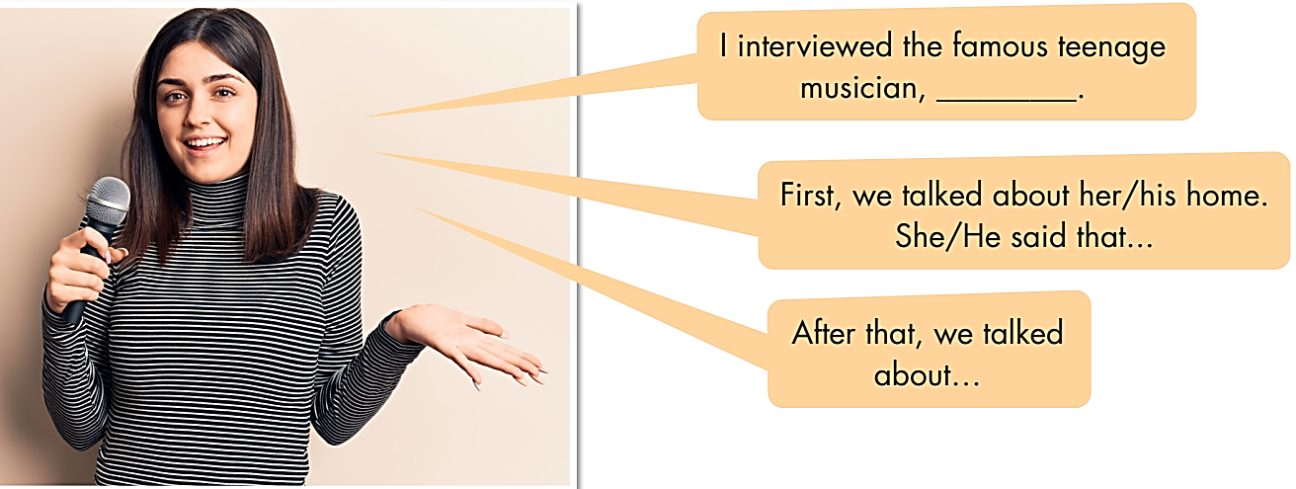
b. You're talking about the interview on TV. Join a new partner. Tell them what the famous teenage musician told you in your interview.

Slide 19
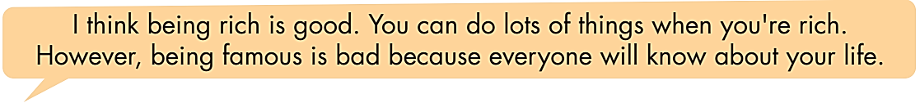
c. In pairs: Do you think being rich and famous is good for teenagers? Why (not)?

Slide 20

CONSOLIDATION

Slide 21
Choose the word whose underlined part is pronounced differently from that of the others.
Extra Practice
1. A. arrived | B. believed | C. received | D. hoped
2. A. opened | B. knocked | C. played | D. enjoyed
3. A. grabbed | B. learned | C. stopped | D. filled
/ əˈraɪvd / / bɪˈliːvd / / rɪˈsiːvd / / houpt /
/ ˈoupənd / / nɑːkt / / pleɪd / / ɪnˈdʒɔɪd /
/græbd/ /ləːrnd/ /stɑːpt / /fɪld/

Slide 22

WRAP-UP

Slide 23
Today’s lesson
Pronunciation:
Practice the sound /d/
Speaking:
Practice reporting how teen celebrities live, using reported speech for statements

Slide 24
Homework
Practice the sound /d/
Do the exercises on page 41, WB.
Prepare the next lesson (pages 72 & 73, SB)
Play the consolidation games on www.eduhome.com.vn

Slide 25

Lesson 3
Stay positive and have a nice day!

