Slide 1


Slide 2
Unit
4
Asean and Viet Nam
Unit
FAMILY LIFE
LESSON 6
WRITING
A PROPOSAL FOR A WELCOME EVENT

Slide 3
LESSON 6
WRITING
WARM-UP
Quiz: left or right?
Task 1: Match the headings.
Task 2. Discuss and add more ideas.
PRE-WRITING
WHILE-WRITING
Task 3. Write a proposal (120–150 words) about a welcome event.
POST-WRITING
Peer review
Wrap-up
Homework
CONSOLIDATION

Slide 4

WARM-UP
left or right?

Slide 5
WARM-UP
Are the requests below formal or in formal?
Raise your left/ right hand to choose ONE answer for each sentence.

Slide 6
WARM-UP
Will you get me a cup of coffee?
FORMAL
INFORMAL

Slide 7
WARM-UP
Would you mind bringing me some files?
INFORMAL
FORMAL

Slide 8
WARM-UP
I’m hungry. Can you come over?
INFORMAL
FORMAL

Slide 9
WARM-UP
Could you possibly give me a lift to work ?
INFORMAL
FORMAL

Slide 10

PRE-WRITING
1
Read the following proposal and match the headings (1–4) with the paragraphs (A–D).
3
1
4
2

Slide 11

PRE-WRITING
2
Discuss and add more ideas to the following notes.

Slide 12
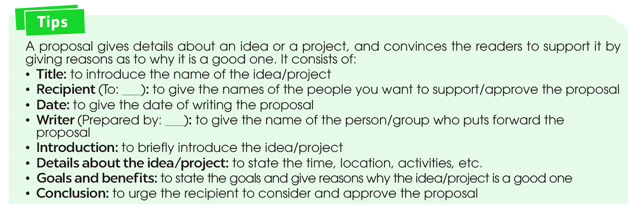
PRE-WRITING

Slide 13
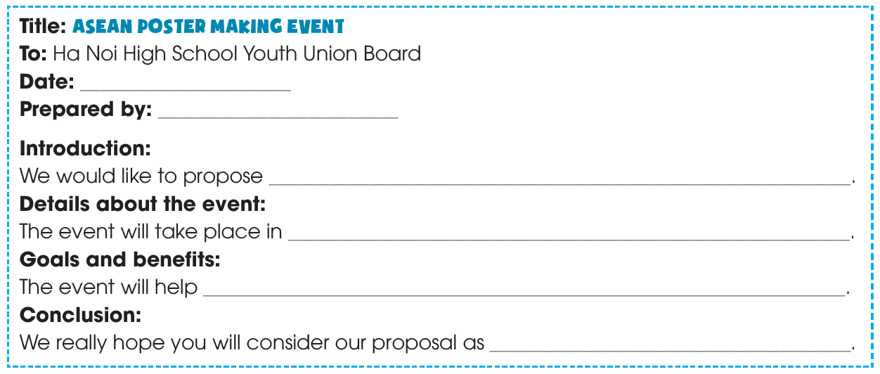
WHILE-WRITING
3
Write a proposal (120–150 words) about a welcome event.

Slide 14

WHILE-WRITING
SUGGESTED ANSWER
Title: ASEAN POSTER MAKING EVENT
To: The Hanoi High School Youth Union Board
Date: 10 January 20__
Prepared by: Grade 11 students
Introduction
We would like to propose an ASEAN poster making event to welcome a group of students from ASEAN countries who are coming to visit our school on 3rd of March.
Details about the event
The event will take place in the School Hall from 9 a.m. until 5 p.m. We will organise all the activities and invite all ASEAN students and representatives of other classes. In the morning, students will take part in training workshops on poster design, presentations and discussions on current issues in ASEAN, and group brainstorming activities. We’ll also arrange for packed lunch boxes to be delivered at 1 p.m. so participants can eat in the school hall. In the afternoon, the teams will make their posters.
Goals and benefits
The event will help young people from ASEAN countries meet and build a community. Participants will also have a chance to learn about each other’s culture. We believe that the event will help develop students’ ability to work with people from other countries and create shared values.
Conclusion
We really hope you will consider our proposal as we think that it will be beneficial to both local students and the visiting ASEAN students.

Slide 15
POST-WRITING
4
*Exchange your writing with your friend for peer review.
WRITING RUBRIC
Organization: …/10
Legibility: …/10
Ideas: …/10
Word choice: …/10
Grammar usage and mechanics: …/10
TOTAL: …/50

Slide 16
CONSOLIDATION
1
Wrap-up
What have you learnt today?
How to write a proposal for a welcome event.
Be able to give details ideas about a proposal or a project, or event.

Slide 17

CONSOLIDATION
2
Homework
Do exercises in the workbook.
Prepare for Lesson 7 - Unit 4.

Slide 18

Website: hoclieu.vn
Fanpage: facebook.com/www.tienganhglobalsuccess.vn

