Slide 1


Slide 2

1
Unit
7
VIET NAM AND INTERNATIONAL ORGANIZATIONS
Unit
FAMILY LIFE
LESSON 4
SPEAKING
Programmes for communities

Slide 3

Unit
1
1
FAMILY LIFE
Family Life
Unit
OBJECTIVES
- Understand how to express opinions
- Discuss and express opinions about a project or a programme that can benefit your local area

Slide 4
LESSON 4
SPEAKING
WARM-UP
Quiz: Intro to child rights
CONTROLLED PRACTICE
Task 1: Complete the conversation.
Task 2: Work in pairs to complete your table.
LESS CONTROLLED
PRACTICE
Task 3: Discussion
CONSOLIDATION
Wrap-up
Home work

Slide 5
LESSON 4
SPEAKING
WARM-UP
Quiz: Intro to child rights

Slide 6

WARM-UP
UNICEF quiz: Intro to child rights
https://create.kahoot.it/pages/32c22a99-b815-4a16-8bf1-ec2915c82986?_=1571351723

Slide 7
LESSON 4
SPEAKING
WARM-UP
Quiz: Intro to child rights
CONTROLLED PRACTICE
Task 1: Complete the conversation.
Task 2: Work in pairs to complete your table.

Slide 8
CONTROLLED PRACTICE
1
Complete the conversation about a UNICEF programme with the sentences in the box. Then practise it in pairs.
1
A: What is the name of the programme? B: (1) __________ A: What does this programme focus on? B: (2) __________ A: What are the activities of this programme? B: (3) __________ | It offers young people job training and career advice. It also teaches them essential skills for the job market. It is Education for Disadvantaged Young People. It focuses on helping disadvantaged teenagers continue their education.
b
c
a

Slide 9

CONTROLLED PRACTICE
2
Work in pairs. Student A looks at the table below. Student B looks at the table on page 85. Ask each other the questions in 1 to complete your table.
Suggested answer:
Conversation 1:
Student A: What is the name of the UNDP project?
Student B: It’s called Poverty Reduction.
Student A: What does it focus on?
Student B: It focuses on reducing poverty and developing economy in disadvantaged areas.
Student A: What are the activities of this project?
Student B: It aims to provide technical support and help develop solutions to local issues.
Suggested answer:
Conversation 2:
Student B: What is the name of the UNICEF programme?
Student A: It’s called Vaccines for Children.
Student B: What does it focus on?
Student A: It focuses on protecting children with life-saving vaccines.
Student B: What are the activities of this programme?
Student A: Its activities include educating people about the benefits of vaccines and vaccinating as many children as possible.

Slide 10
LESSON 4
SPEAKING
WARM-UP
Quiz: Intro to child rights
CONTROLLED PRACTICE
Task 1: Complete the conversation.
Task 2: Work in pairs to complete your table.
LESS CONTROLLED
PRACTICE
Task 3: Discussion

Slide 11
LESS CONTROLLED PRACTICE
3
Discussion
1
Useful expressions:
I think / believe that the project / programme … is more important / necessary for my local area because …
This project / programme helps local people … / brings local people more opportunities to …
In our group, most of us agree that … But one member thinks that …
Example:
A: Now, let’s decide which programme or project will bring more benefits to people in our village. B, what do you think?
B: Well, I think Education for Disadvantaged Young People will be a very useful programme for our village. You see, many teenagers here drop out of school and start working to earn a living. They really need help.
A: You’re right, B.
...

Slide 12
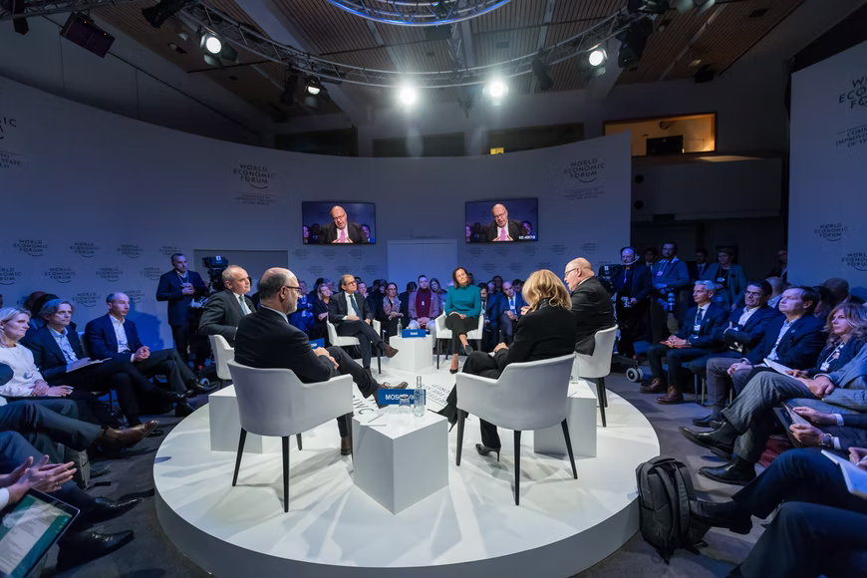
LESS CONTROLLED PRACTICE
3
Discussion.
Debate: UNICEF or UNDP programme?
Two teams debate which one is better for our local area.
The whole class: Vote for the most convincing team!
Be polite and respectful to the opponent team!
Preparation: 5 minutes
Speaking time:
+ 2 minutes/speaker
+ Closing/Summary: 1 minute/team

Slide 13
LESSON 4
SPEAKING
WARM-UP
Quiz: Intro to child rights
CONTROLLED PRACTICE
Task 1: Complete the conversation.
Task 2: Work in pairs to complete your table.
LESS CONTROLLED
PRACTICE
Task 3: Discussion
CONSOLIDATION
Wrap-up
Home work

Slide 14
CONSOLIDATION
1
Wrap-up
Check if you learned to:
- understand how to express opinions;
- discuss and express opinions about a project or a programme that can benefit your local area.

Slide 15
CONSOLIDATION
2
Homework
- Workbook exercises
- Prepare the presentation for Project lesson

Slide 16

Website: hoclieu.vn
Fanpage: facebook.com/tienganhglobalsuccess.vn/

