Slide 1
Unit 5: INVENTIONS Lesson 6: Writing
Writing about the benefits of an invention

Slide 2
Unit
1
1
FAMILY LIFE
Family Life
Unit
OBJECTIVES
Write about the benefits of an invention.

Slide 3
Table of contents
01
02
03
Warm-up
Pre-writing
While-writing
04
Post-writing
05
Consolidation

Slide 4
Warm-up
01
Game: Hot seat

Slide 5
GAME: HOT SEAT
Work in groups.
A representative of each group sits on a chair, facing the class.
Others from each group look at the picture shown on the slide and give hints about it.
The representative of each group says out loud the word.

Slide 6
Electric light

Slide 7
Airplane

Slide 8
Automobile

Slide 9
Pre-writing
02

Slide 10
PRE-WRITING
1
Draw a diagram.
Choose an invention from the unit,
keep it secret.
Draw a diagram in a notebook or on a piece of paper, listing some benefits or uses of the invention.
Work in groups, swap the diagrams with others.
Take turns reading the diagrams and guessing the inventions.

Slide 11
PRE-WRITING

Slide 13
Rewrite the sentence:
AI helps drivers to find the best routes in transport.
-> Helping ….
→ Helping drivers to find the best routes is one of the benefits of AI in transport.

Slide 14
Rewrite the sentence:
Vacuum cleaners allow us to clean the house quickly.
-> Vacuum cleaners ….
→ Vacuum cleaners are useful for cleaning / in cleaning the house quickly.

Slide 15
Rewrite the sentence:
Smartphones are used for learning languages.
-> Smartphones ….
→ Smartphones help us to learn languages.

Slide 16
Rewrite the sentence:
Telephones are useful in communicating over long distances.
-> Telephones ….
→ Telephones are used to communicate / for communication / for communicating over long distances.

Slide 17
While-writing
03

Slide 18
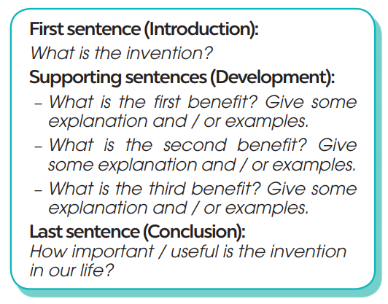
WHILE-WRITING
3
Write a paragraph (120 - 150 words) to describe benefits of the invention.

Slide 19
WHILE-WRITING
3
Write a paragraph (120 - 150 words) to describe benefits of the invention.
Sample:
Electricity is one of the great inventions of the past, because it has brought many benefits for people. First, electricity can be used to light our houses and streets. Without it, the world will be dark and dangerous. Second, electricity is also useful in heating. For example, in cold areas, electric heaters can keep us warm and healthy in long winters. Finally, the most important use of electricity is to run machines. Without electricity, factories, schools and hospitals cannot run normally. Everyone and everything will stop working. Other inventions, such as TVs, computers and robots will become useless without electricity. In conclusion, electricity plays a very important part in our life today and we cannot live without it.

Slide 20
Post-writing
04

Slide 21
POST-WRITING
Peer review
Teacher’s feedback

Slide 22
Consolidation
05

Slide 23
CONSOLIDATION
1
Wrap-up
Write about the benefits of an invention.

Slide 24
CONSOLIDATION
2
Homework
Prepare for the next lesson: Unit 5 – Communication and culture/ CLIL.
2. Do exercises in the workbook

Slide 25
SEE YOU NEXT TIME !!

