Slide 1


Slide 2


REVIEW
3
UNITS 7 – 8 - 9
LESSON 1: LANGUAGE
1

Slide 3
LESSON 1: Language
WARM-UP
Keywords game
Task 1a: Listen and repeat, paying attention to the underlined words.
Task 1b: Choose A, B, C, or D to show the word in each group with a different stress pattern.
PRONUNCIATION
VOCABULARY
Task 2: Complete the sentences with the words and phrase from the box.
Task 3: Use the correct forms of the words in brackets to complete the sentences.
Task 4: Use the correct tense of the verbs in brackets to complete the sentences.
Task 5: Complete the sentences so that they are true for you.
GRAMMAR
CONSOLIDATION
Wrap-up
Homework

Slide 4



WARM-UP
SET 1
UNIT 7: ENVIRONMENTAL PROTECTION

Slide 5
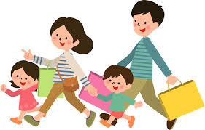
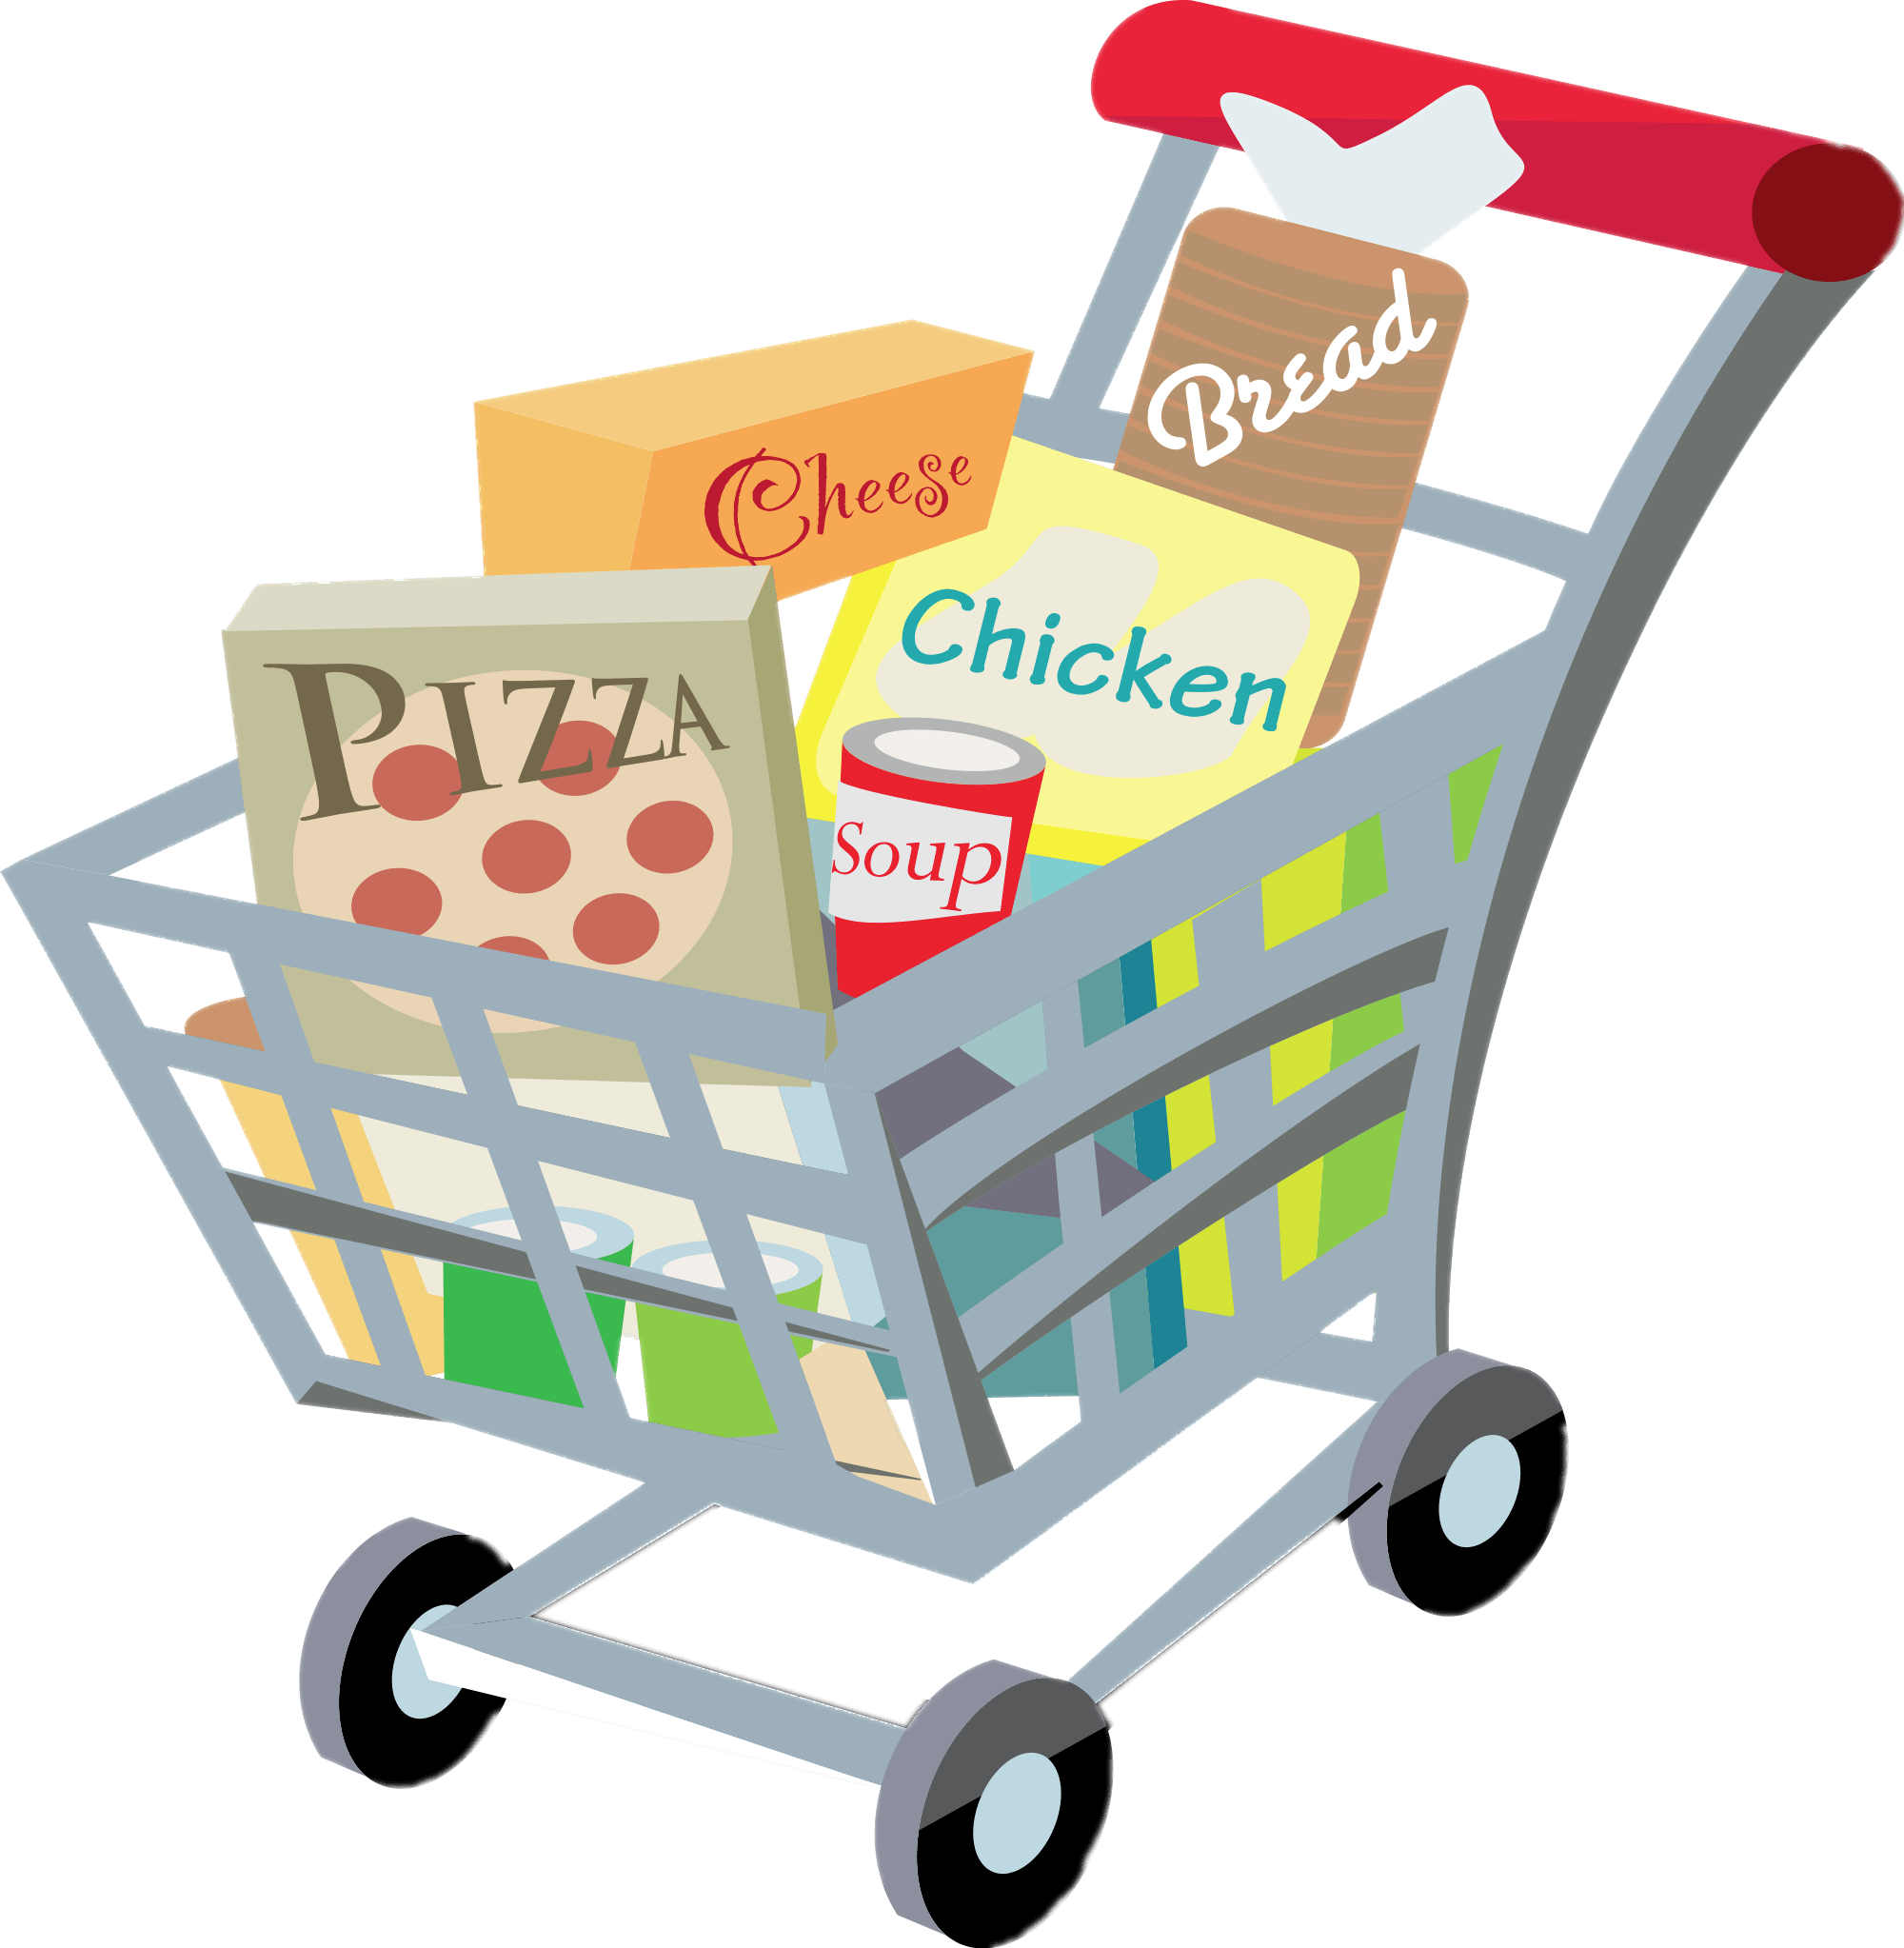

WARM-UP
SET 2
UNIT 8: SHOPPING

Slide 6
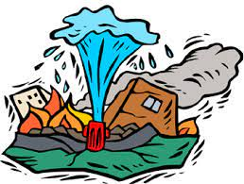
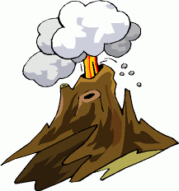
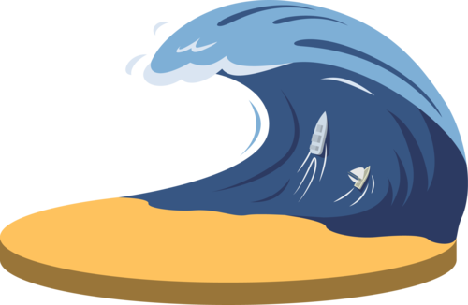
WARM-UP
SET 3
UNIT 9: NATURAL DISASTERS

Slide 7

PRONUNCIATION
1a
Listen and repeat, paying attention to the underlined words
1. The sky today is clear and blue.
2. The speaker talked a lot about honesty.
3. The store on that corner sells local specialities.

Slide 8
PRONUNCIATION
1b
Choose A, B, C, or D to show the word in each group with a different stress pattern.
1. A. humorous B. tremendous C. numerous D. generous
2. A. national B. animal C. arrival D. typical
3. A. festival B. cultural C. poisonous D. ambitious

Slide 9
VOCABULARY
2
Complete each of the sentences with a word or phrase from the box.
customers bargain single-use
habitats natural disasters
single-use
1. We should recycle various _________ products instead of throwing them away.
2. Shopping centres attract a lot of _________ during the sales season.
3. Population growth is causing destruction of wildlife ________ throughout the world.
customers
habitats

Slide 10
VOCABULARY
2
Complete each of the sentences with a word or phrase from the box.
customers bargain single-use
habitats natural disasters
natural disasters
4. Luckily, my home town rarely suffers from _______________, such as floods or storms.
5. Generally you can’t _______ over prices of goods in supermarkets.
bargain

Slide 11
VOCABULARY
3
Use the correct forms of the words in brackets to complete the sentences.
destructive
1. The tsunami in Tonga was very (destroy) __________; hundreds of houses were swept away.
2. One (advantage) _____________ of shopping online is that you do not know exactly what you will get.
3. Endangered species are animals in the wild that face a high risk of (extinct) _________.
disadvantage
extinction

Slide 12
VOCABULARY
3
Use the correct forms of the words in brackets to complete the sentences.
Addictive
4. (Addict) ___________ shopping is a form of behaviour that makes shoppers buy many items they don’t need.
5. When a natural disaster happens, we must listen to (instruct) _____________ from local authorities.
instructions

Slide 13
VOCABULARY
4
Use the correct forms of the words in brackets to complete the sentences.
was cleaning
1. While I (clean) ____________ out my cupboards, I found these photos.
2. Sam is studying hard. He (have) _____ his exam this Friday.
3. This brochure says that the big sale (start) ________ next Friday.
4. ______ the flood victims still (wait) _______ when the rescuers came?
5. I (fall) ______________ asleep last night when I (hear) ______ a knock at the door.
has
starts
Were
waiting
was just falling
heard

Slide 14
GRAMMAR
5
Complete the sentences, so that they are true for you.
my friends were waiting for me
1. When I finished my lessons yesterday, __________________________.
2. Before I go to bed at night, ___________________________.
3. I will wait until the teacher ______________________.
4. As soon as we have our summer holiday, _________________________.
5. I usually listen to music while _______________________.
my mother read a story for me
finds out my exam paper
we will go to our uncle’s farm
I am doing my housework

Slide 15

CONSOLIDATION
1
Wrap-up
What have we learnt in this lesson?
review the vocabulary and grammar of Unit 7, 8, 9

Slide 16

CONSOLIDATION
2
Homework
Do the exercises in the workbook.

Slide 17

Website: hoclieu.vn
Fanpage: facebook.com/tienganhglobalsuccess.vn/

