Slide 1


Slide 2

Unit
10
1
Unit
FAMILY LIFE
ECOTOURISM
LESSON 4
SPEAKING
How to become an ecotourist

Slide 3

Unit
1
1
FAMILY LIFE
Family Life
Unit
OBJECTIVES
Talk about how to become an ecotourist

Slide 4
LESSON 4
SPEAKING
Unit
GETTING STARTED
WARM-UP
Matching game
Task 1: Match each verb on the left with a phrase on the right. use the pictures to help you. (p. 114)
PRE-SPEAKING
Task 2: Work in pairs. discuss which of the things in Task 1 we should or should not do to become ecotourists. Use the expressions below to help you. (p. 115)
WHILE-SPEAKING
Task 3: Work in groups. Talk about what tourists should or should not do if they are on an ecotour to a tourist attraction in your local area. use the discussion questions below to help you. (p. 115)
POST-SPEAKING
Task 4: Share your ideas with the whole class. Vote for the best ideas. (p. 115)
Wrap-up
Homework
CONSOLIDATION

Slide 5
LESSON 4
SPEAKING
Unit
GETTING STARTED
WARM-UP
Matching game
Task 1: Match each verb on the left with a phrase on the right. use the pictures to help you. (p. 114)

Slide 6
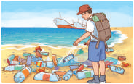
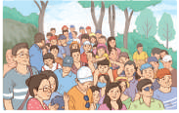
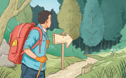
WARM-UP
1
Match each verb on the left with a phrase on the right. Use the pictures to help you.
1. litter
2. avoid
3. follow
c. on the beach or the street
d. crowded places
a. walking paths and trails

Slide 7
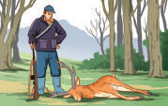
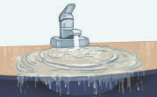

WARM-UP
1
Match each verb on the left with a phrase on the right. Use the pictures to help you.
4. hunt
5. waste
6. buy
b. wild animals
f. water and electricity
e. locally made souvenirs

Slide 8
LESSON 4
SPEAKING
Unit
GETTING STARTED
WARM-UP
Matching game
Task 1: Match each verb on the left with a phrase on the right. use the pictures to help you. (p. 114)
PRE-SPEAKING
Task 2: Work in pairs. discuss which of the things in Task 1 we should or should not do to become ecotourists. Use the expressions below to help you. (p. 115)

Slide 9
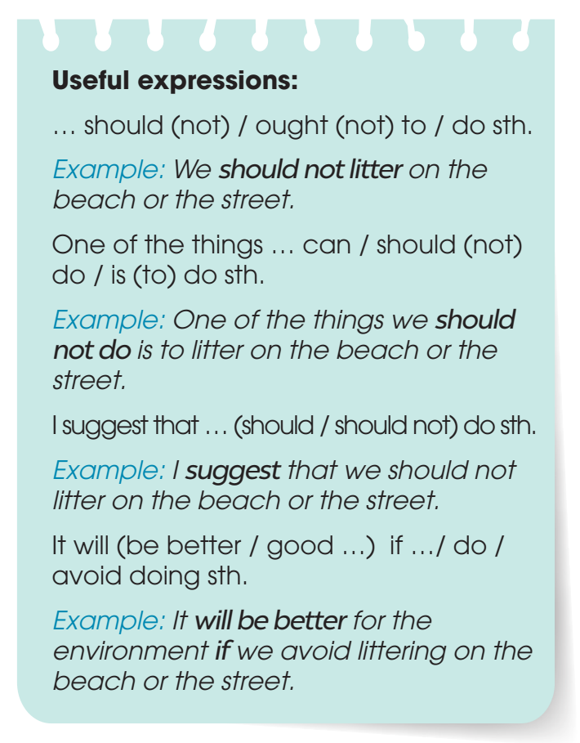

PRE-SPEAKING
2
Work in pairs. discuss which of the things in Task 1 we should or should not do to become ecotourists. use the expressions below to help you.

Slide 10
LESSON 4
SPEAKING
Unit
GETTING STARTED
WARM-UP
Matching game
Task 1: Match each verb on the left with a phrase on the right. use the pictures to help you. (p. 114)
PRE-SPEAKING
Task 2: Work in pairs. discuss which of the things in Task 1 we should or should not do to become ecotourists. Use the expressions below to help you. (p. 115)
WHILE-SPEAKING
Task 3: Work in groups. Talk about what tourists should or should not do if they are on an ecotour to a tourist attraction in your local area. use the discussion questions below to help you. (p. 115)

Slide 11
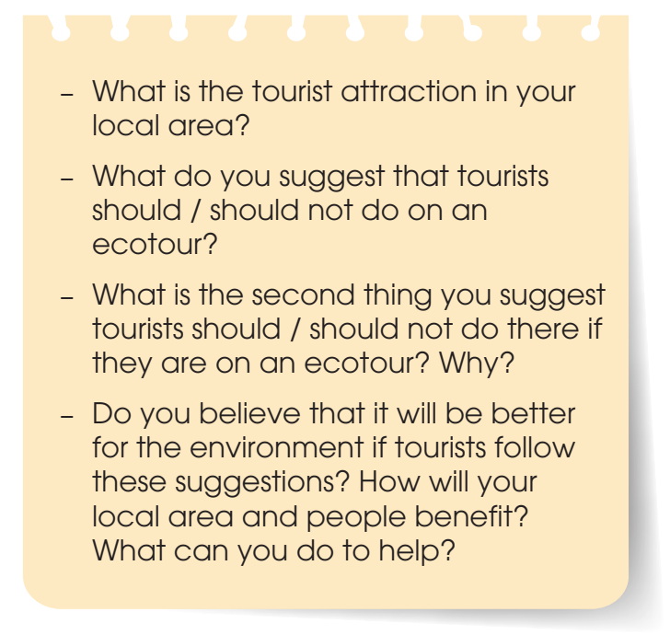

WHILE-SPEAKING
3
Work in groups. Talk about what tourists should or should not do if they are on an ecotour to a tourist attraction in your local area. use the discussion questions below to help you.

Slide 12
LESSON 4
SPEAKING
Unit
GETTING STARTED
WARM-UP
Matching game
Task 1: Match each verb on the left with a phrase on the right. use the pictures to help you. (p. 114)
PRE-SPEAKING
Task 2: Work in pairs. discuss which of the things in Task 1 we should or should not do to become ecotourists. Use the expressions below to help you. (p. 115)
WHILE-SPEAKING
Task 3: Work in groups. Talk about what tourists should or should not do if they are on an ecotour to a tourist attraction in your local area. use the discussion questions below to help you. (p. 115)
POST-SPEAKING
Task 4: Share your ideas with the whole class. Vote for the best ideas. (p. 115)

Slide 13
LESSON 4
SPEAKING
Unit
GETTING STARTED
WARM-UP
Jumbled words
PRE-SPEAKING
Task 1: Choose the THREE most important benefits of volunteering activities.
Task 2: Complete the diagram with examples and details that explain the benefits of volunteering activities.
WHILE-SPEAKING
POST-SPEAKING
Task 3: Give a presentation about the benefits of volunteering activities

Slide 14

POST-SPEAKING
4
Share your ideas with the whole class. Vote for the best ideas.

Slide 15
LESSON 4
SPEAKING
Unit
GETTING STARTED
WARM-UP
Matching game
Task 1: Match each verb on the left with a phrase on the right. use the pictures to help you. (p. 114)
PRE-SPEAKING
Task 2: Work in pairs. discuss which of the things in Task 1 we should or should not do to become ecotourists. Use the expressions below to help you. (p. 115)
WHILE-SPEAKING
Task 3: Work in groups. Talk about what tourists should or should not do if they are on an ecotour to a tourist attraction in your local area. use the discussion questions below to help you. (p. 115)
POST-SPEAKING
Task 4: Share your ideas with the whole class. Vote for the best ideas. (p. 115)
Wrap-up
Homework
CONSOLIDATION

Slide 16
CONSOLIDATION
1
Wrap-up
Talk about how to become an ecotourist

Slide 17
CONSOLIDATION
2
Homework
Prepare for the next lesson: Unit 10: Listening
2. Do exercises in the workbook

Slide 18


