Slide 2




Unit
12
ROBOTS
LESSON 5: SKILLS 1

Slide 3


LESSON 5: SKILLS 1
LESSON 1: GETTING STARTED
Task 1: Choose the best answer.
WARM-UP
Vocabulary
Task 2: Read the text and choose the best answer to each of the questions (p. 64).
Task 3: Read the text again and fill the table. (p. 64)
READING
Task 4: Work in groups. Discuss what you think robots can do in the five places. (p. 64)
Task 5: Present your discussion. (p. 64)
SPEAKING
CONSOLIDATION
Wrap-up
Homework

Slide 4

WARM-UP
QUIZ TIME

Slide 5
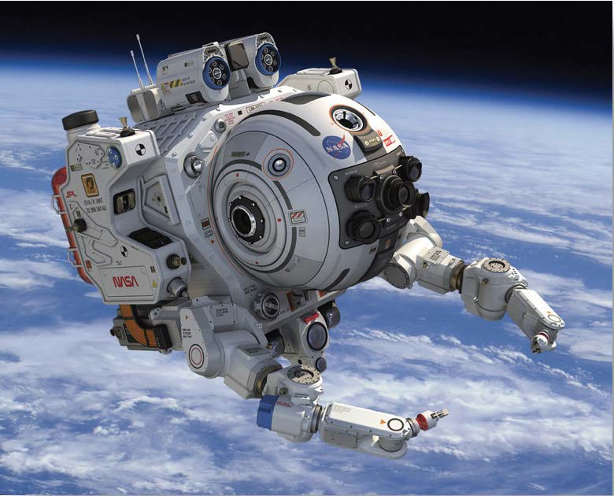
1. What type of robot is that?
WARM-UP
Home robot
Space robot
Teacher robot
Doctor robot

Slide 6
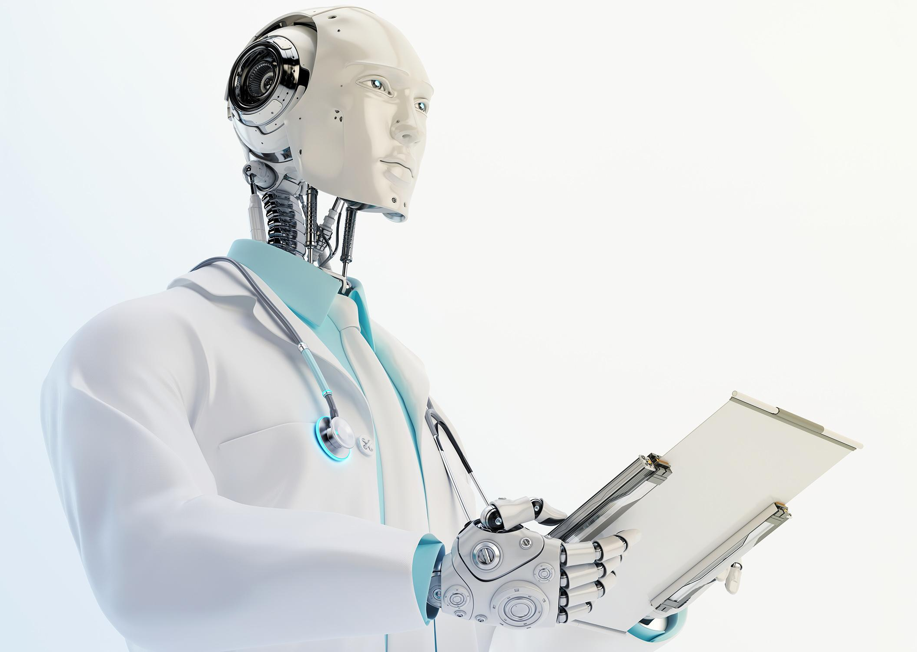
2. What type of robot is that?
WARM-UP
Worker robot
Space robot
Teacher robot
Doctor robot

Slide 7
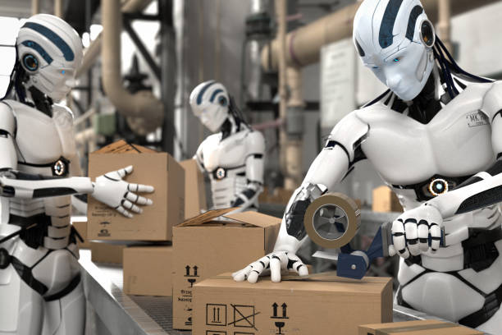
3. What type of robot is that?
WARM-UP
Home robot
Worker robot
Teacher robot
Doctor robot

Slide 8
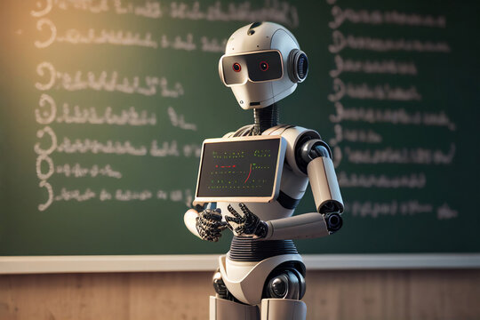
4. What type of robot is that?
WARM-UP
Home robot
Space robot
Teacher robot
Doctor robot

Slide 9
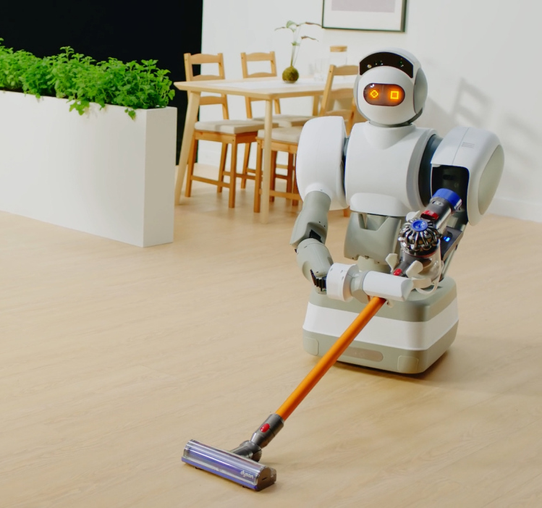
5. What type of robot is that?
WARM-UP
Home robot
Space robot
Teacher robot
Doctor robot

Slide 10
What robots are you interested in? Why?
WARM-UP
Example:
I am interested in home robots because they can help my mom do the housework.

Slide 11
LESSON 5: SKILLS 1
LESSON 1: GETTING STARTED
Task 1: Choose the best answer.
WARM-UP
Vocabulary
Task 2: Read the text and choose the best answer to each of the questions (p. 64).
Task 3: Read the text again and fill the table. (p. 64)
READING

Slide 12



VOCABULARY
LITERATURE (n)
pieces of writing that are valued as works of art, especially novels, plays and poems
/ˈlɪtrətʃər/
văn học

Slide 13

VOCABULARY
SUBJECT (n)
an area of knowledge studied in a school, college, etc.
/ˈsʌbdʒekt/
môn học

Slide 14
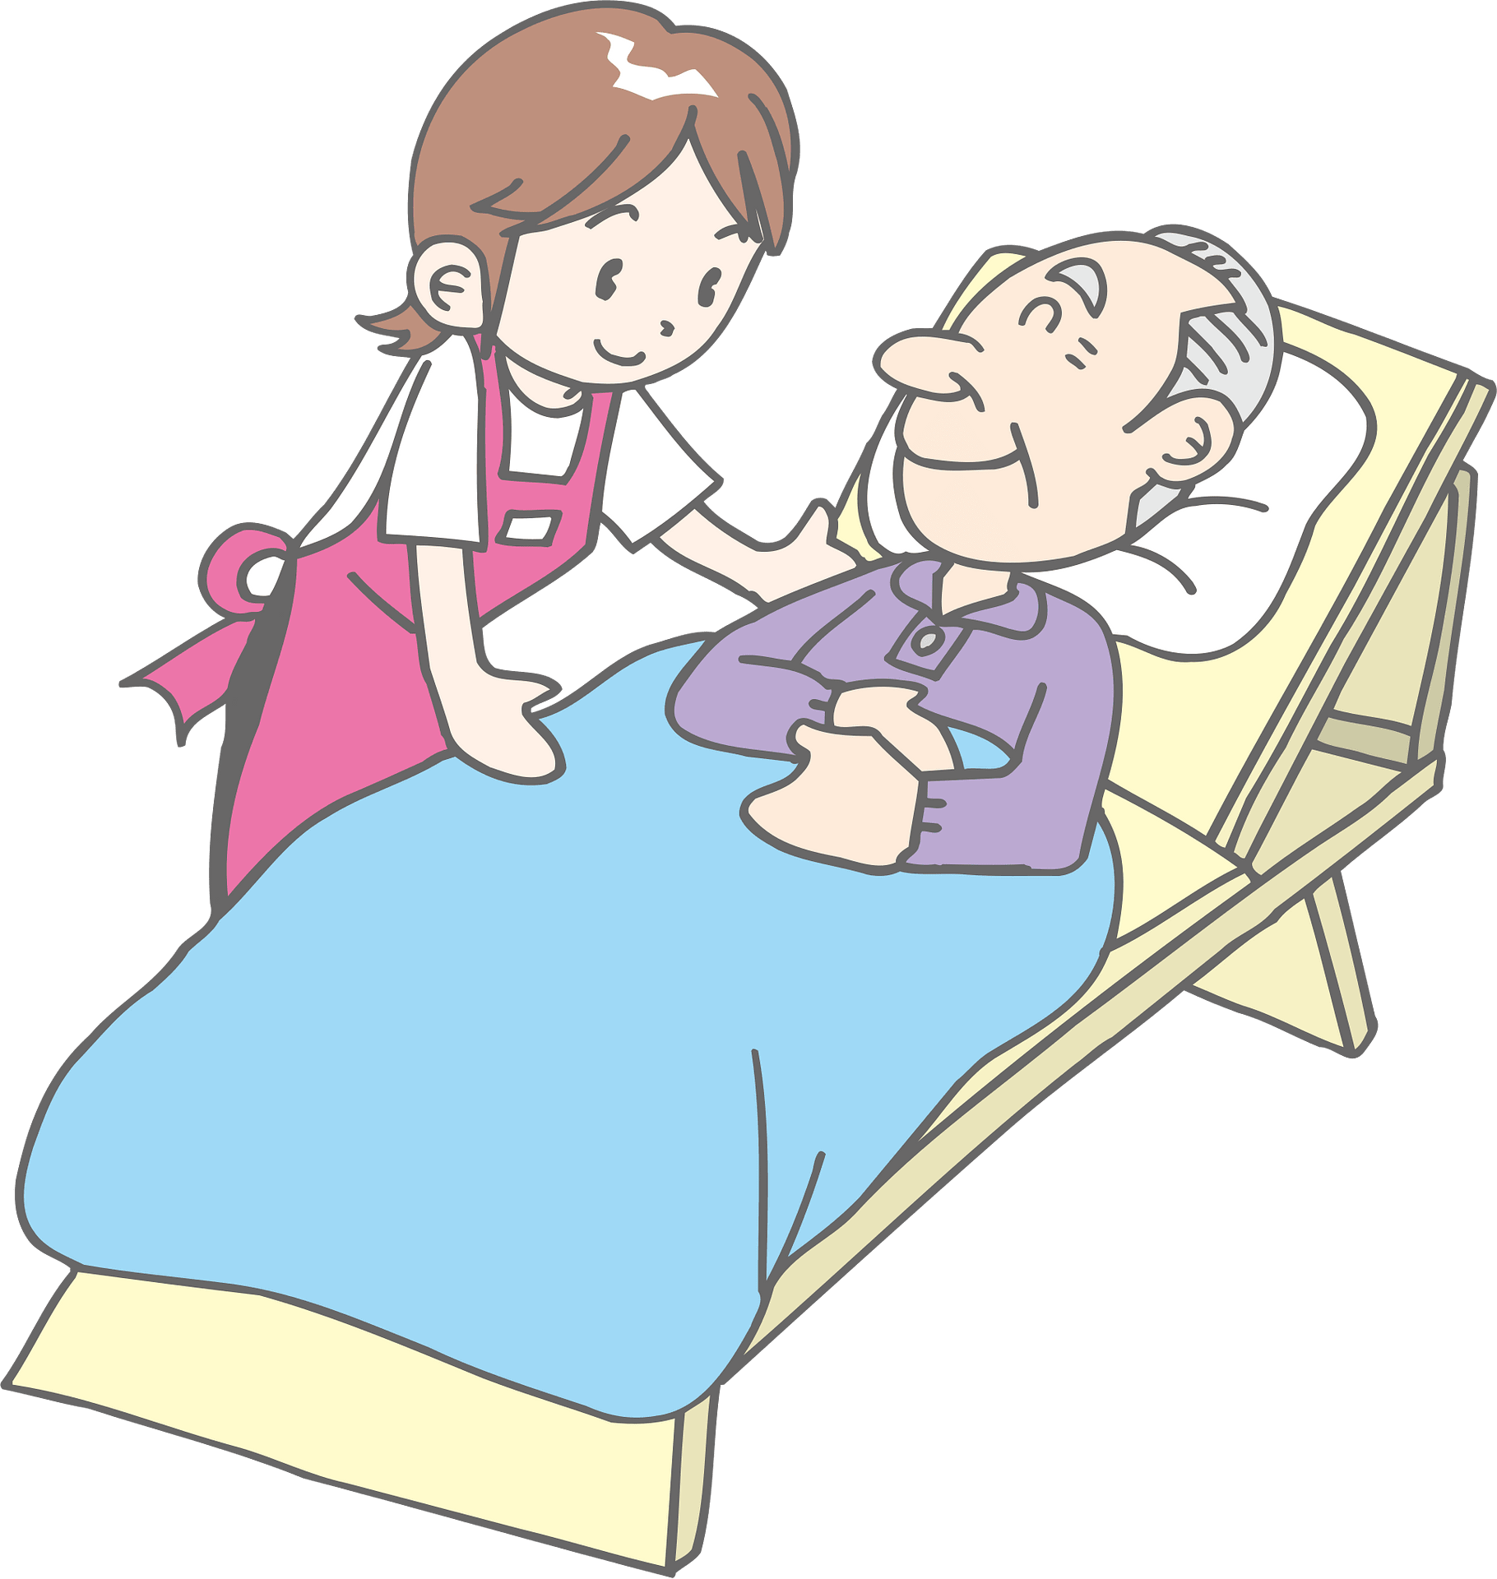
VOCABULARY
IMPROVE (v)
to become better than before
/ɪmˈpruːv/
cải thiện, tiến bộ

Slide 15
`
VOCABULARY
LOOK AFTER
take care of
/ˈlʊk æftər/
trông nom, chăm sóc

Slide 16
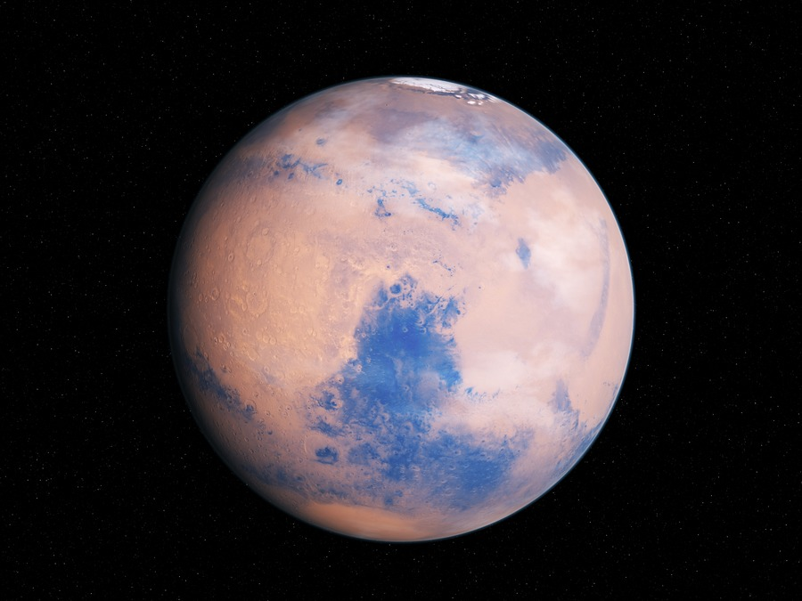
`
VOCABULARY
a large structure that is sent into space and remains above the earth as a base for people working and travelling in space
SPACE STATION
/ˈspeɪs steɪʃn/
trạm vũ trụ

Slide 17
`
VOCABULARY
a large round object in space that moves around a star (such as the sun) and receives light from it
PLANET (N)
/ˈplænɪt/
hành tinh

Slide 18
`
VOCABULARY
New words | Pronunciation | Meaning
1. literature (n) | /ˈlɪtrətʃər/ | văn học
2. subject (n) | /ˈsʌbdʒekt/ | văn học
3. improve (v) | /ɪmˈpruːv/ | cải thiện, tiến bộ
4. look after | /ˈlʊk æftər/ | trông nom, chăm sóc

Slide 19
`
VOCABULARY
New words | Pronunciation | Meaning
5. space station | /ˈspeɪs steɪʃn/ | trạm vũ trụ
6. planet (n) | /ˈplænɪt/ | hành tinh

Slide 20

READING
Work in pairs. Discuss the following questions.
1. What types of robots are there?
2. What robots are children interested in?

Slide 21
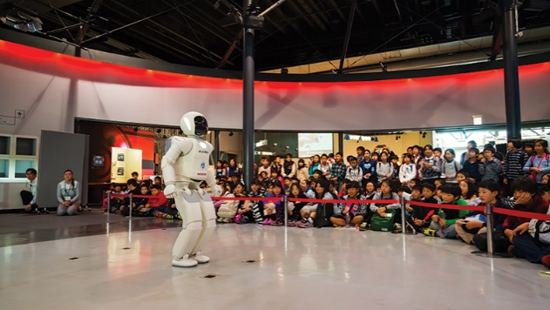

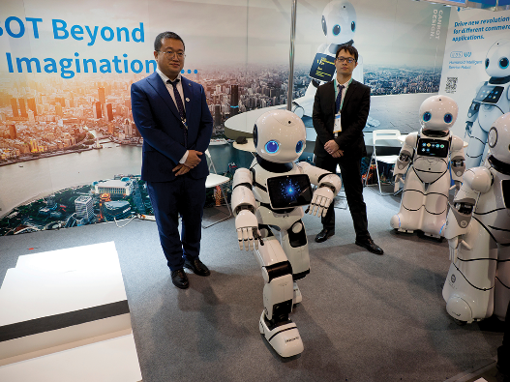
READING
Today there is an international robot show in Ha Noi. People can see many types of robots there.
Home robots are useful for housework. They can do most of the housework: cook meals, clean the house, do the washing, and iron clothes.
Teacher robots are the best choice for children. They can help them to study. They can teach them English, literature, maths and other subjects. They can also help children to improve their English pronunciation.
People are also interested in other types of robots at the show. Worker robots can build houses and move heavy things; doctor robots can look after sick people and space robots can build space stations on the Moon and on planets.
Read the text and choose the best answer to each of the questions.

Slide 22
READING
Read the text and choose the best answer to each of the questions.
1.
What show is on in Ha Noi now?
A.
B.
A robot show
A fashion show
C.
A pet show
2.
Which type of robots can help children in their study?
A.
Home robots
B.
Worker robots
C.
Teacher robots

Slide 23
READING
Read the text and choose the best answer to each of the questions.
3.
Doctor robots can _______.
A.
help children to study
B.
build houses
C.
take care of sick people
4.
Which of the following sentences is NOT true according to the passage?
A.
Worker robots can build houses and move heavy things.
B.
Space robots can build space stations on the Moon.
C.
Home robots can’t do much of the housework.

Slide 24

READING
Today there is an international robot show in Ha Noi. People can see many types of robots there.
Home robots are useful for housework. They can do most of the housework: cook meals, clean the house, do the washing, and iron clothes.
Teacher robots are the best choice for children. They can help them to study. They can teach them English, literature, maths and other subjects. They can also help children to improve their English pronunciation.
People are also interested in other types of robots at the show. Worker robots can build houses and move heavy things; doctor robots can look after sick people and space robots can build space stations on the Moon and on planets.
Read the text again and fill the table below.

Slide 25
READING
Read the text again and fill the table below.
Types of robots | What they can do
Home robots
Teacher robots
Worker robots
Doctor robots
Space robots
cook meals, clean the house, do the washing and iron clothes
help children study, teach English, literature, maths and other subjects, help children improve English pronunciation
build houses, move heavy things
look after sick people
build space stations on the Moon and on planets

Slide 26
LESSON 5: SKILLS 1
LESSON 1: GETTING STARTED
Task 1: Choose the best answer.
WARM-UP
Vocabulary
Task 2: Read the text and choose the best answer to each of the questions (p. 64).
Task 3: Read the text again and fill the table. (p. 64)
READING
Task 4: Work in groups. Discuss what you think robots can do in the five places. (p. 64)
Task 5: Present your discussion. (p. 64)
SPEAKING

Slide 27

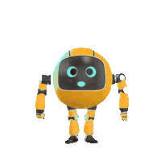
Work in pairs. Discuss what you think robots can do in the following places.
Places | What robots can do
Home
Schools
Factory
Hospital
Garden
Example:
A: What can robots do at home?
B: They can take care of children.

Slide 28

SPEAKING
Work in groups. Take turns to talk about robots and what you think they can do. Can you think of other types of robots?
- Share your disscussion
- Think about any types of robots you want
- Tell me what they can do, and where they work.

Slide 29
LESSON 5: SKILLS 1
LESSON 1: GETTING STARTED
Task 1: Choose the best answer.
WARM-UP
Vocabulary
Task 2: Read the text and choose the best answer to each of the questions (p. 64).
Task 3: Read the text again and fill the table. (p. 64)
READING
Task 4: Work in groups. Discuss what you think robots can do in the five places. (p. 64)
Task 5: Present your discussion. (p. 64)
SPEAKING
CONSOLIDATION
Wrap-up
Homework

Slide 30

CONSOLIDATION
1
Wrap-up
What have we learnt in this lesson?
Develop reading skill for general and specific information
Identify different features of different types of robots
Use what they have learnt to practice describing what a robot can do

Slide 31

CONSOLIDATION
2
Homework
Choose a type of robot in reading text and write about what they can do.

Slide 32






Website: hoclieu.vn
Fanpage: facebook.com/www.tienganhglobalsuccess.vn/

