Slide 1
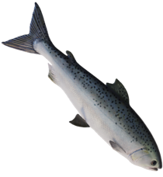
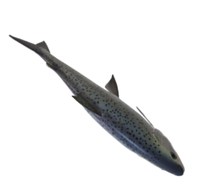
HOW TO
PLAY
9
8
7
6
5
4
3
2
1
9
0
8
7
6
5
4
3
2
1
0
9
8
7
6
5
4
3
2
1
0
9
8
7
6
5
4
3
2
1
0
9
8
7
6
5
4
3
2
1
9
0
8
7
6
5
4
3
2
1
0
9
8
7
6
5
4
3
2
1
9
0
8
7
6
5
4
3
2
1
0
PLAY
GONE FISHING!
A GAME FOR UP TO 4 PLAYERS

Slide 2
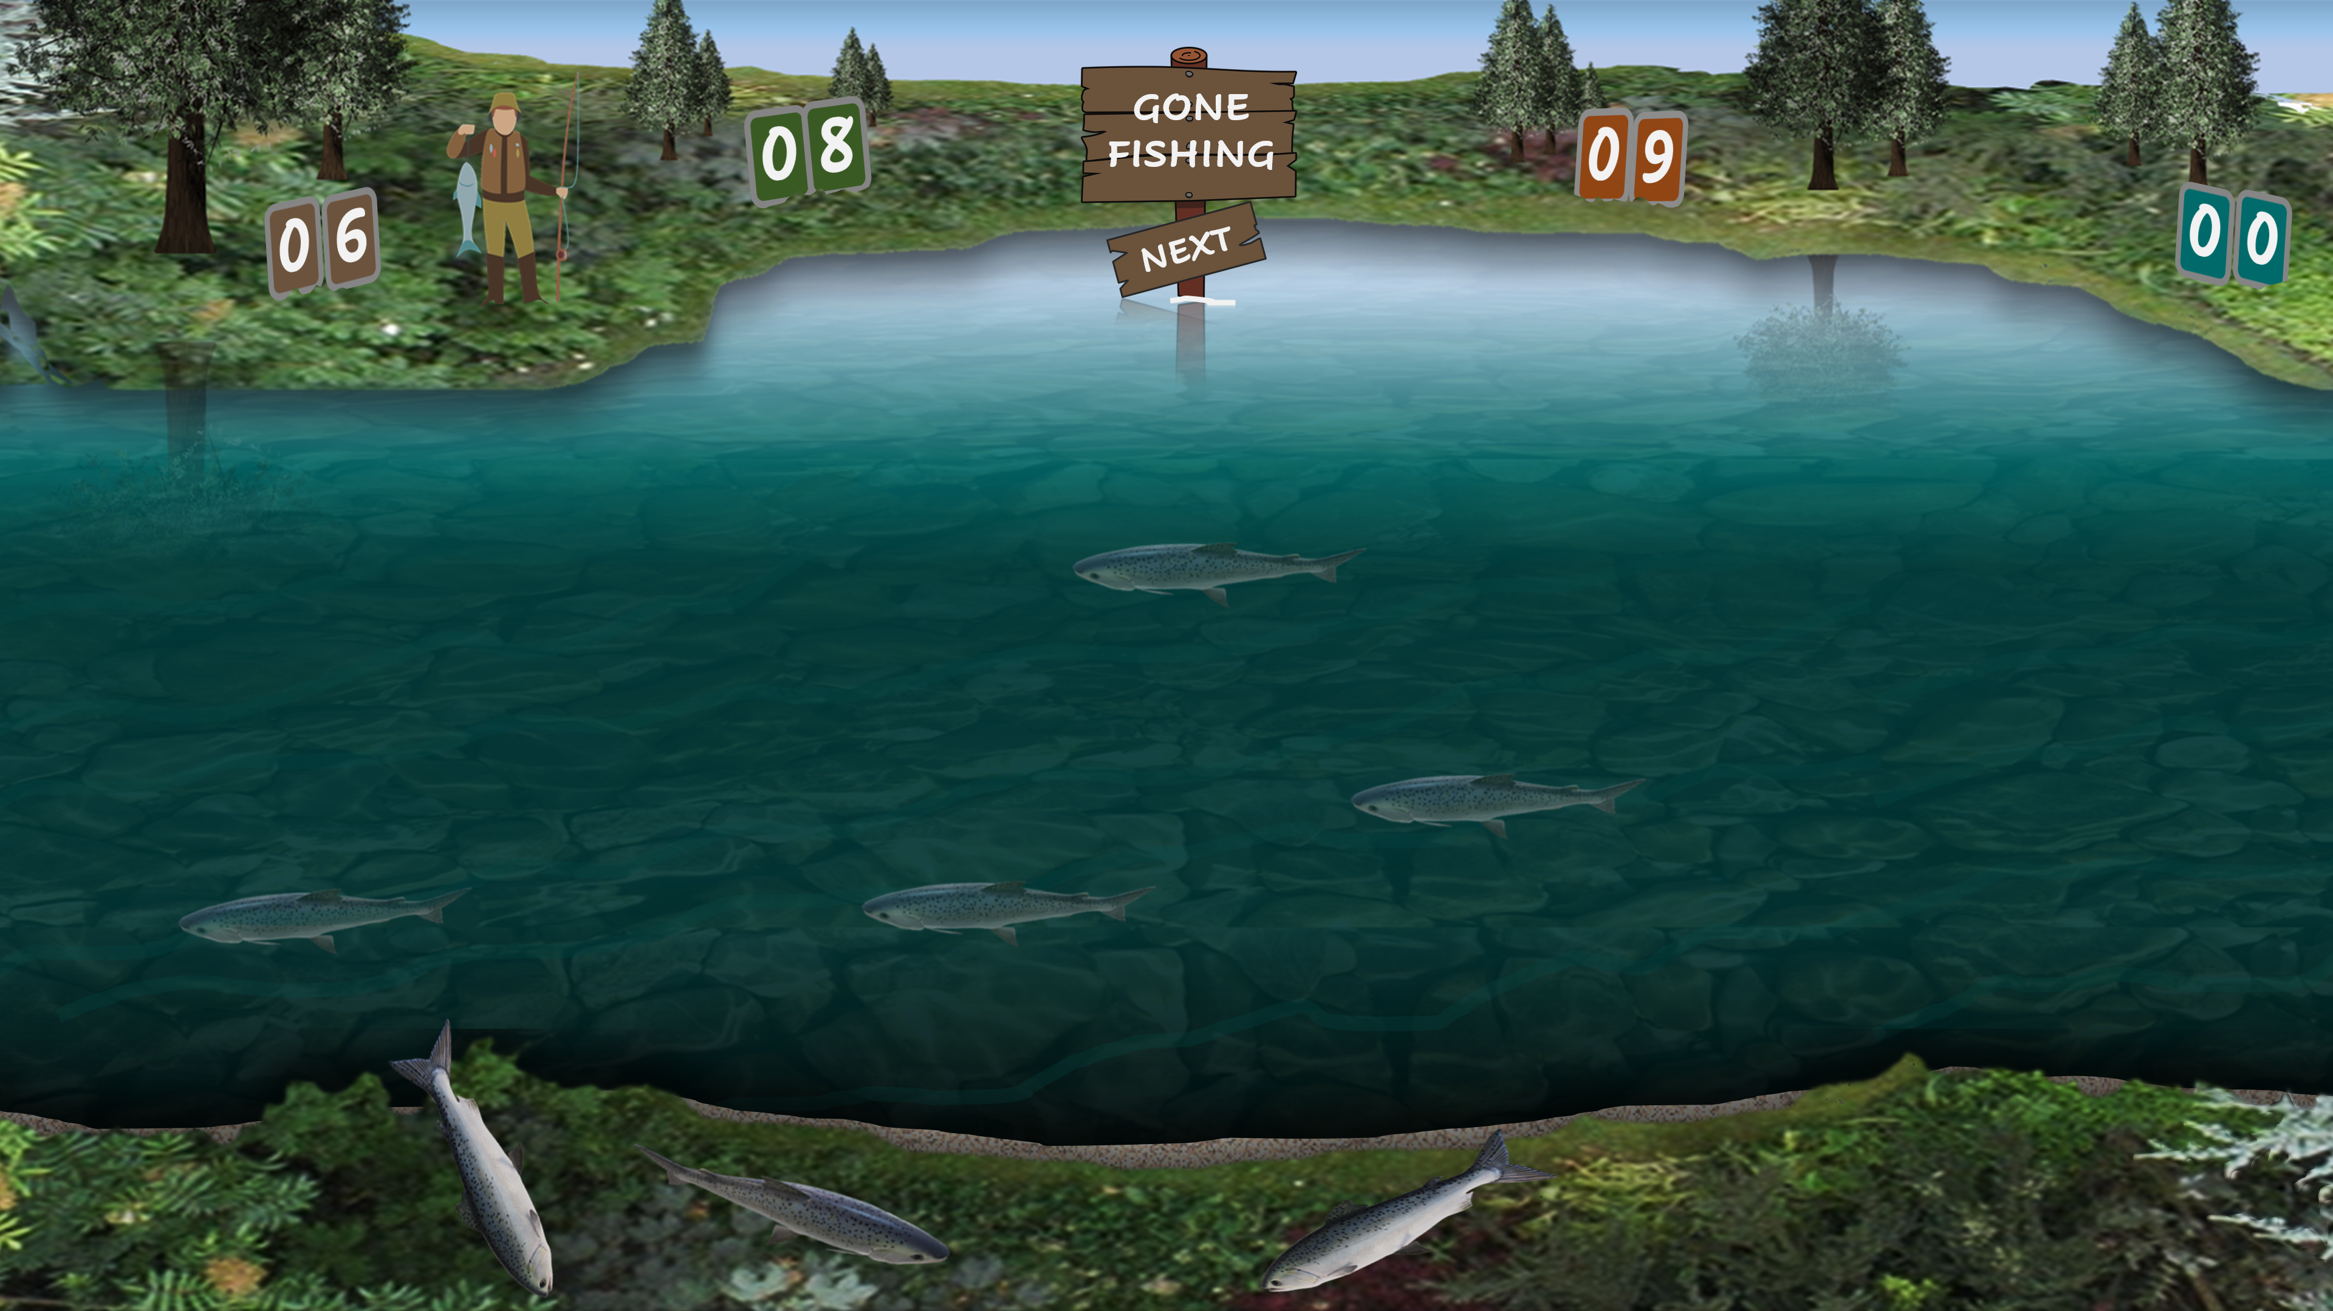
GONE FISHING!
1. TO START, CLICK ON THE ‘GO FISHING’ SIGN.
(IT WILL THEN SAY ‘GONE FISHING’)
HOW TO PLAY
4. CLICK ON THE ‘NEXT’ SIGN FOR THE NEXT PLAYER TO CLICK ON THE ‘GO FISHING’ SIGN AND PLAY
2. CLICK ON EACH FISH IN ANY ORDER.
IF YOU CATCH IT YOU WILL LAND IT ON THE BANK.
IF NOT, IT WILL SWIM AWAY
5. THE PLAYER WITH THE HIGHEST SCORE AT THE END OF THE AGREED TIME OR NUMBER OF ROUNDS WILL BE THE WINNER
3. WHEN YOU HAVE CLICKED ON EVERY FISH, COUNT-UP THE NUMBER OF FISH ON THE BANK AND ADD THE SCORE TO YOUR SCOREBOARD
6. CLICK ON THE FISHERMAN TO RESET THE SCOREBOARDS TO ZERO TO START A NEW GAME
PLAY

Slide 3
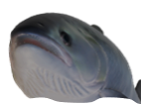
GONE FISHING
9
GO FISHING
8
7
6
5
4
3
2
1
9
0
8
7
6
5
4
3
2
1
0
9
8
7
6
5
4
3
2
1
0
9
8
7
6
5
4
3
2
1
0
9
8
7
6
5
4
3
2
1
9
0
8
7
6
5
4
3
2
1
0
9
8
7
6
5
4
3
2
1
9
0
8
7
6
5
4
3
2
1
0
NEXT

