Slide 1

Unit 3: School
Lesson 1.3
Page 40

Slide 2
Lesson Outline
Warm-up
Practice
Speaking
Consolidation
Wrap-up

Slide 3
Objectives
By the end of this lesson, students will be able to ask and answer who owns different school supplies.
Vocabulary: eraser, ruler, pencil, notebook, pencil case
Structure: Is this your eraser?
- Yes, it is./No, it isn't.
Are these your notebooks?
- Yes, they are./No, they aren't.

Slide 4

WARM UP

Slide 5



SPACE RACE
Choose One:
Rocket Ship or Alien Ship?

Slide 6
How to Play:
SPACE RACE
-Make 2 teams: one team is the ’Rocket’ and one team is the ‘Alien Ship’
- The teams take turns to choose a number and then answer the question.
- After answering the question correctly, click on the Rocket / Alien Ship and it will move.
-The first team to arrive at Mars is the winner.

Slide 7














SPACE RACE
GO!
3
2
1
ROCKET SHIP WINS!
ALIEN SHIP
WINS!

Slide 8





SPACE RACE
1
2
3
4
5
6
7
8
9
10
11
12
13
14
15

Slide 9
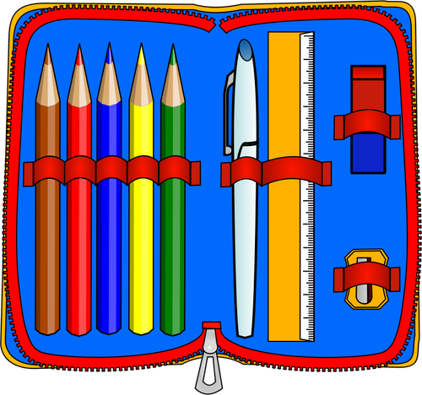

What’s this?
It’s a pencil case.

Slide 10

What’s this?
It’s a book.

Slide 11

What’s this?
It’s an eraser.

Slide 12

What’s this?
It’s a pencil.

Slide 13
Is this a pencil?
Yes, it is.

Slide 14

What are these?
They are pens.

Slide 15

Is this a notebook?
No, it isn’t.

Slide 16
Are these rulers?
No, they aren’t.

Slide 17
What are these?
They are erasers.

Slide 18
Are these erasers?
Yes, they are.

Slide 19

What’s this?
It’s a notebook.

Slide 20
What’s this?
It’s a notebook.

Slide 21
What’s this?
It’s a pencil case.

Slide 22
What are these?
They are pencil cases.

Slide 23

It’s time to learn …

Slide 24
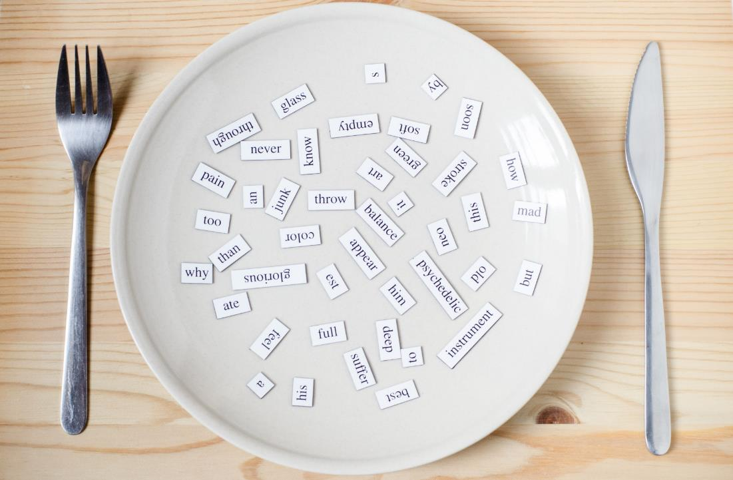
Structures
Is this your eraser?
Yes, it is./No, it isn’t.
Are these your notebooks?
Yes, they are./No, they aren't.

Slide 25

Presentation

Slide 26

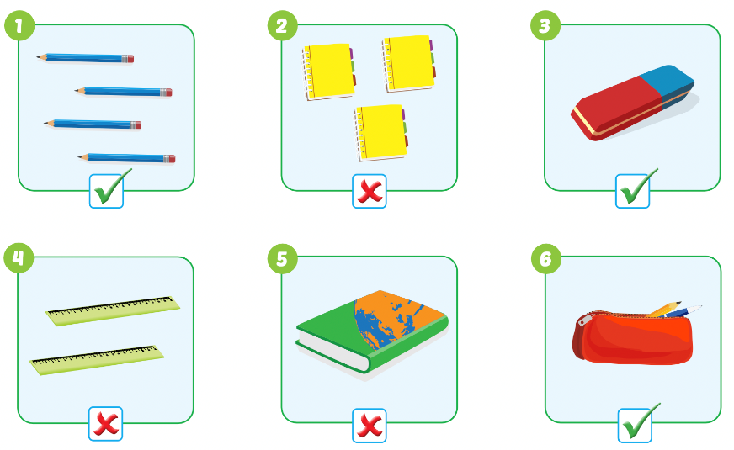

Slide 27



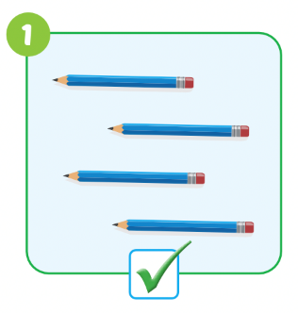
Teacher models first!

Slide 28

Practice

Slide 29
Divide the class into two teams.
Have Team A ask the question and Team B answer it.
Swap roles and repeat.

Slide 30
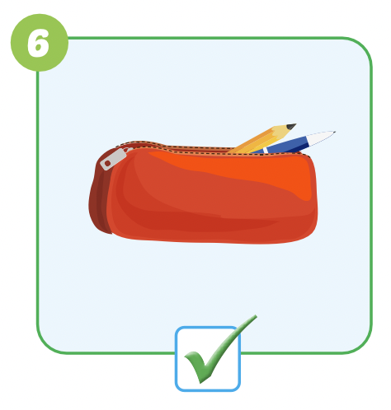

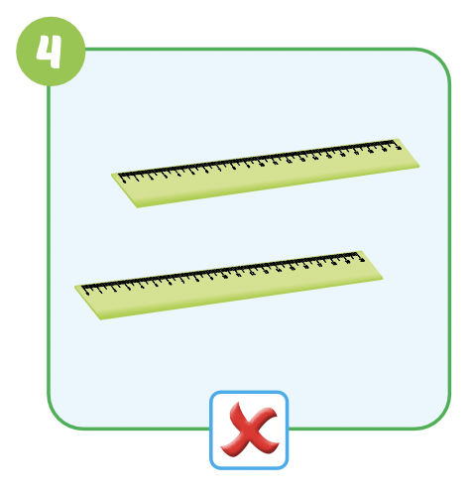
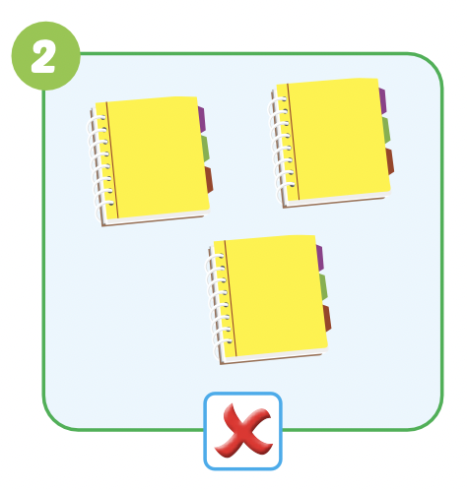

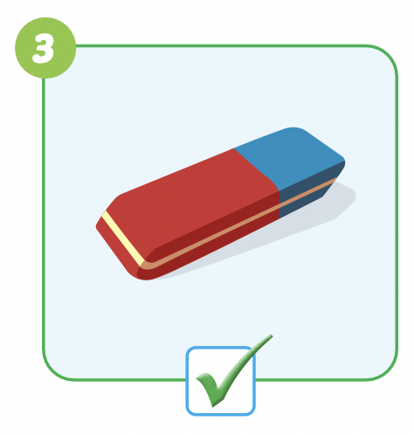
Are these your………………..?

Slide 31

Speaking

Slide 32
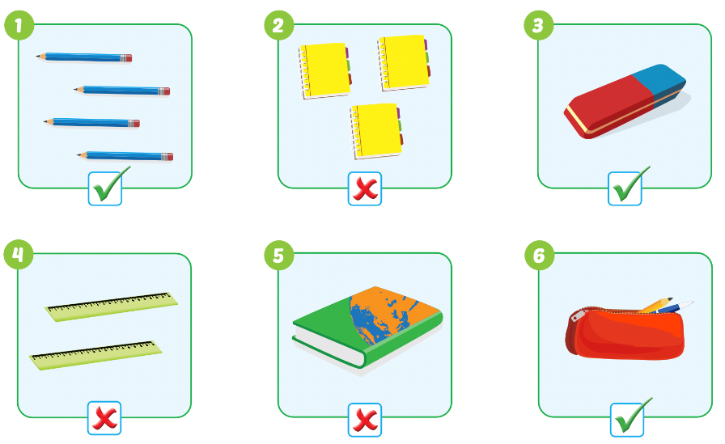
Pairwork

Slide 33

DEMONSTRATION
Have some pairs demonstrate the activity in front of the class

Slide 34

Production

Slide 35

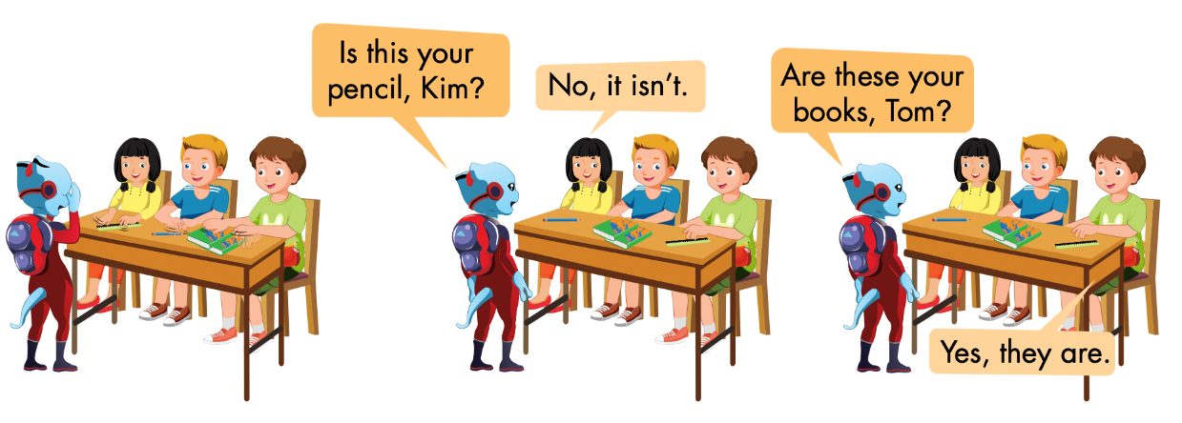
Notes:
Divide the class into groups of four.
Have Student A cover their eyes.
Have the other students put one of their own items on the
desk in a random order.
Have Student A open their eyes and try to guess.
Have other students respond.
Have students swap roles and repeat.

Slide 36

CONSOLIDATION

Slide 37
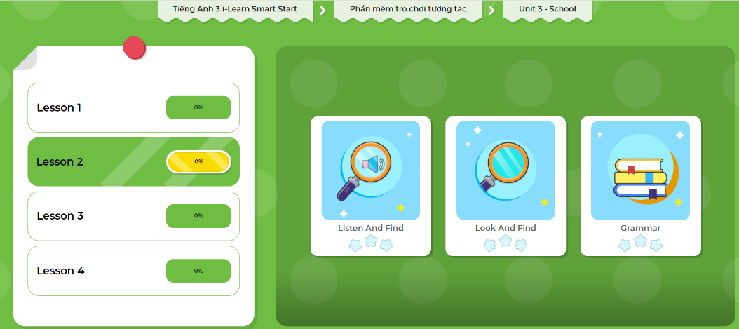
Extra Practice
DHA App
Let’s play!
Click on the picture below

Slide 38
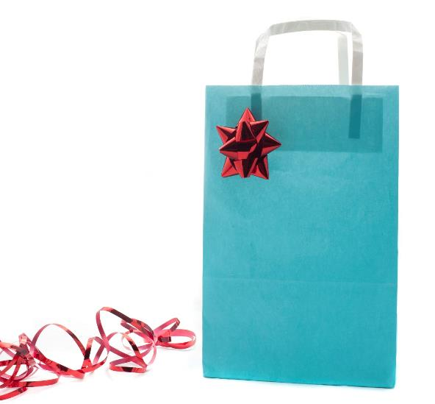
Guessing game
Work in groups of 4
Choose your favorite school thing and put it in a bag
Take turns to take out 1 school thing
Make a guess by asking:
Is this your…?
Are these your…?
Notes:
134722862

Slide 39

WRAP-UP

Slide 40
Lesson 3
Today’s lesson
Structures/ Sentence patterns
Is this your (eraser)?
- Yes, it is./No, it isn't.
Are these your (notebooks)?
- Yes, they are./No, they aren't.

Slide 41
Lesson 3
Homework
Review the vocabularies, structure and make sentences using them.
Do the exercises on page 29 WB.
Do the exercises in Tiếng Anh 3 i-Learn Smart Start Notebook on page 22.
Prepare the next lesson (page 41 SB).
Play the consolidation games in Tiếng Anh 3 i-Learn Smart Start DHA App on www.eduhome.com.vn

Slide 42

Enjoy your day!

