Slide 1

Unit 10: Cities around the World
Lesson 1.2: Grammar
Page 79

Slide 2
Lesson Outline
Warm-up
Grammar
Consolidation
Wrap-up

Slide 3
Objectives
By the end of this lesson, students will be able to…
- use the first Conditional sentences correctly

Slide 4

WARM-UP

Slide 5
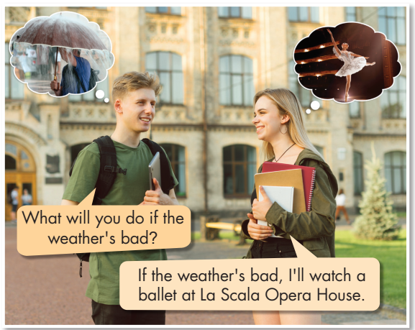
Look at the boy’s question and the picture.
Guess the girl’s answer.

Slide 6

Listen and repeat

Slide 7

Presentation

Slide 8
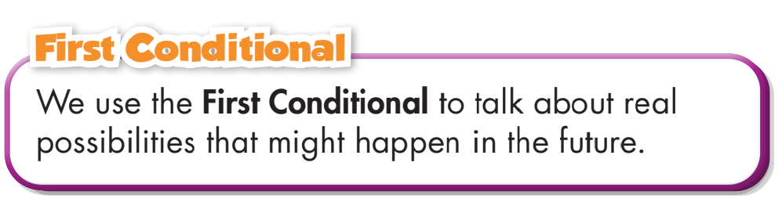
Presentation
Ex: If the weather's bad, I will watch the ballet.
Meaning and Use

Slide 9
Presentation
Example:
If the weather is bad, I will watch the ballet.
Form:
If clause
Main clause
Present Simple tense
Future Simple tense
V_{1(s/es)}
_{Be → am/is/are}
Will + V₀

Slide 10
Presentation
Example:
If it is snowy, I will not go to the cathedral.
Form:
If clause
Main clause
Present Simple tense
Future Simple tense
(Negative)
V_{1(s/es)}
_{Be → am/is/are}
Will not + V₀

Slide 11
Presentation
Example:
What will you do if the weather is not sunny?
Form:
Main clause
If clause
Future Simple tense
(question)
Present Simple tense (Negative)
do/does + not + V₀
_{(Be → am/is/are + not)}
Will + S +V₀

Slide 12

Practice

Slide 13
Practice
b. Fill in the blanks with the correct forms of the verbs.
1. If I ______ (have) time, I ______ (go) to the opera house.
2. If the weather ___ (be) cold, I _________ (watch) Kabuki at the Kabukiza Theater.
3. I _________ (not go) to Ueno Park if it ____ (be) freezing.
4. If I ______ (have) time, I _________ (visit) the Imperial Palace.
5. If the museum ____ (be) closed, I ________ (visit) Sensoji Temple.
6. If I ___________ (not have) any money, I _________ (not go) to Tokyo Tower.
have
will go
is
will watch
won’t go
is
have
will visit
is
will visit
don’t have
won’t go

Slide 14
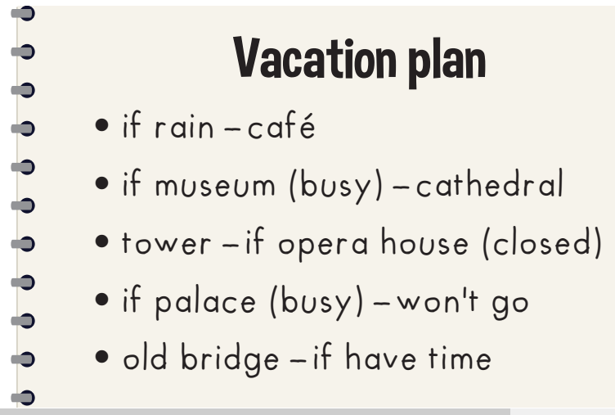
Practice
c. Look at Mary's plan and write sentences.
1. If it rains, Mary will go to the café.
2._______________________________________________________________________.
3._______________________________________________________________________.
4. __________________________________.
5._______________________________________________________________________.
If the museum is busy, Mary will go to the cathedral
Mary will go to the tower if the opera house is closed
If the palace is busy, Mary won't go there
Mary will go to the old bridge if she has time

Slide 15
Extra Practice
WB page 57
a. Fill in the blanks with the correct form of the verbs.
1. He ________ (visit) the Golden Gate Bridge if he has time.
2. If we can buy cheap tickets, we _________ (travel) by plane.
3. My best friend will watch a movie tonight if she _________ (finish) her homework early.
4. If the weather _____ (be) bad, Lisa will visit the Sensoji Temple.
5. We will visit Hyde Park this weekend if it ___________ (not rain).
6. I will climb the mountain if it ______ (not be) cold.
will visit
will travel
finishes
is
doesn’t rain
is not

Slide 16
Extra Practice
WB page 57
b. Underline the mistakes in the sentences.
Write the correct words on the lines.
1. They visit Milan Cathedral if it rains.
2. She travels to China if she can find cheap plane tickets.
3. I will swim in the sea if the weather will be good.
4. If I have money, I buy you souvenirs when I get back from my holiday.
5. If it rains, we spend the morning in a nice café.
will visit
will travel
is
will buy
will spend

Slide 17
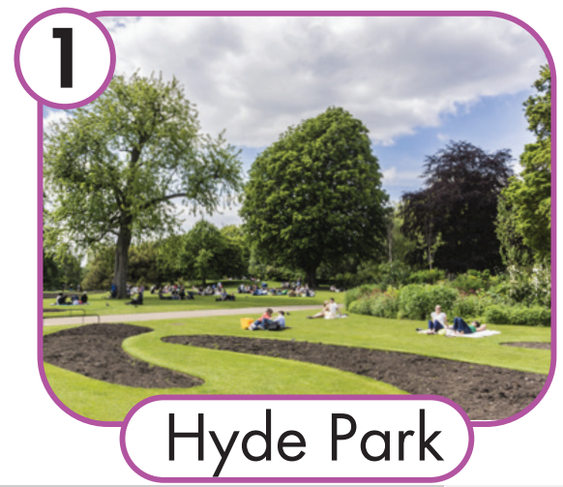
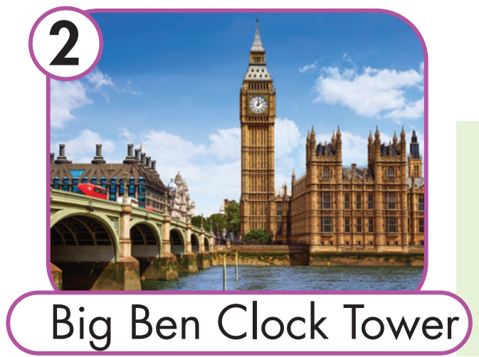
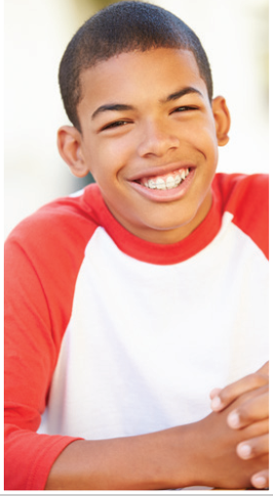
Extra Practice
WB page 57
c. Look at the pictures and write the answers.
nice weather
What will Jay do if the weather is nice?
1. He will go to Hyde Park if the weather is nice.
2. _________________________________________
He will visit the Big Ben Clock Tower if the weather is nice.

Slide 18
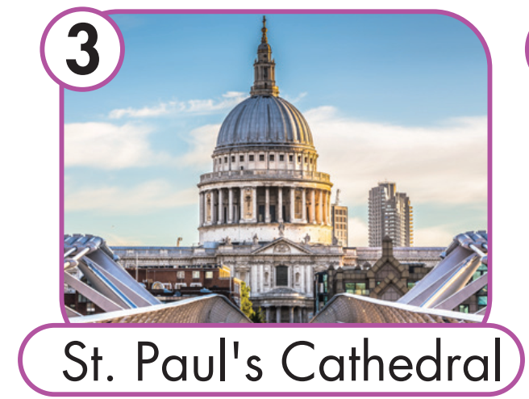

Extra Practice
WB page 57
c. Look at the pictures and write the answers.
bad weather
What will Jay do if the weather is bad?
1. _________________________________________
2. _________________________________________
He will visit St. Paul's Cathedral if the weather is bad.
He will go to the British Museum if the weather is bad.

Slide 19

Production

Slide 20
Play game:
Consequences Chains
The teacher gives the condition: If you are free next week, what will you do?
Students will complete the results, using the previous result into the condition.
Example:
The 1st student says: “If I am free next week, I will travel to Da Lat.”
The 2nd say: “If I travel to Da Lat, I will climb to LANGBIANG.”,
The 3rd says: “If I climb to LANGBIANG, I will be tired.”,
The 4th says: “If I am tired, I will stay at home.”, etc.
The consequences of the action and the consequences of the consequences. Students continue until they reach a certain number of steps (usually 8 to 10 is a good number) or come to a natural or funny conclusion.

Slide 21

CONSOLIDATION

Slide 22
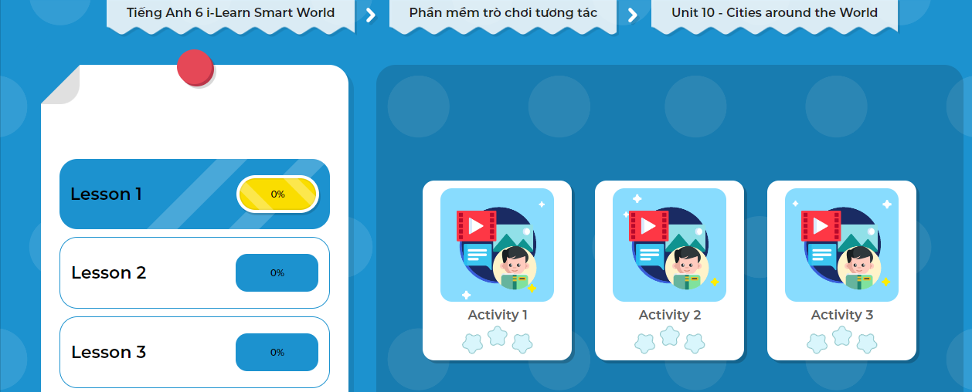
LET’S PLAY!
Click here to play the game!
Notes:
Mở Ứng dụng DHA trên Eduhome. Sách lớp 6, Unit 10, Lesson 1, Activity 2

Slide 23

WRAP-UP

Slide 24

Today’s lesson
Meaning and Use:
We use the First Conditional to talk about real possibilities that might happen in the future.
Form:
We use if + Present Simple to express the condition and will + bare infinitive to say the result.

Slide 25
Homework
Do the exercises Writing on page 57 Workbook
Do the exercises in Tiếng Anh 6 i-Learn Smart World Notebook on page 59
Prepare the next lesson (page 80 SB)

Slide 26
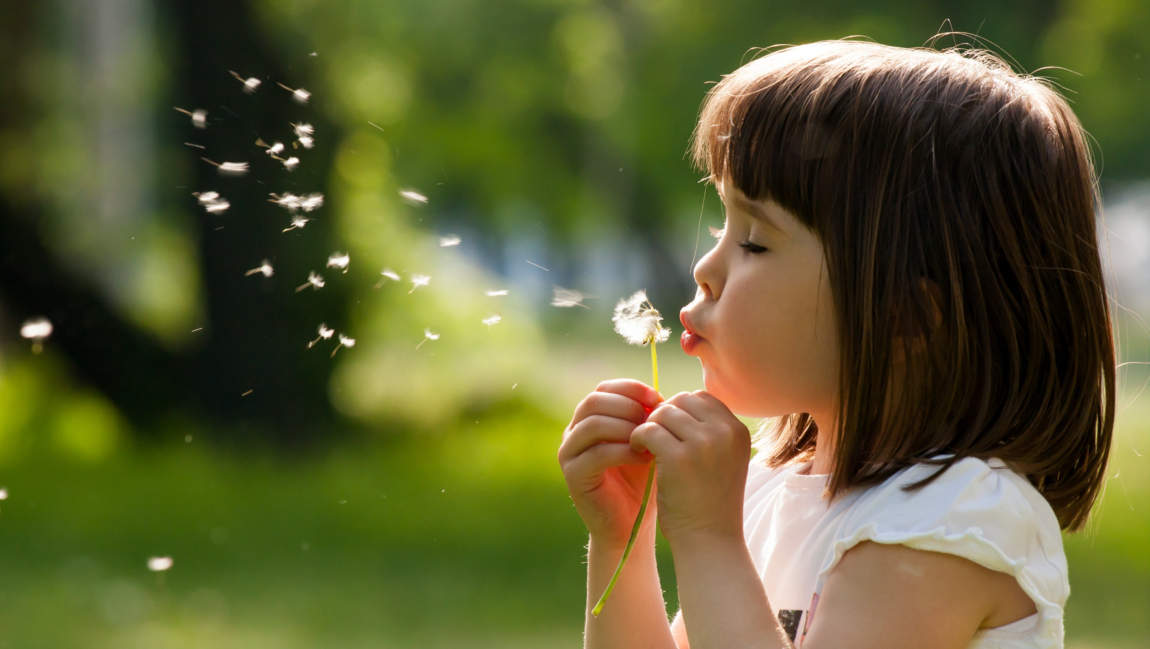
Enjoy your day!

