Slide 1

UNIT 3: SHOPPING
Lesson 3.1 – Listening & Reading
Page 26

Slide 2



Unit 3 Lesson 3.1
Lesson 3.1
LESSSON OUTLINE
Consolidation

Slide 3

Unit 3 Lesson 3.1
By the end of this lesson,
students will be able to:
- practice listening and reading for main ideas and specific information.
- talk about problems when shopping.

Slide 4



Slide 5

Unit 3 Lesson 3.1
Work in pairs.
What things do you like to buy?
What can you do if there's a problem with an item?
I like to buy ….
I will take it to the ….

Slide 6



Slide 7
Unit 3 Lesson 3.1
Pre - Listening
a. Listen to an expert talking about shopping online. What's the main idea?
What are you going to listen to?
Listen to an expert talking about shopping online
Do you think what he/she is talking about?
→ What to do when shopping online

Slide 8


Unit 3 Lesson 3.1
While - Listening
a. Listen to an expert talking about shopping online. What's the main idea?
It's better to buy clothes in-store than online.
You should be careful when buying online.
✓

Slide 9
Unit 3 Lesson 3.1
Pre - Listening
b. Now, listen and complete the notes. Write one word only for each answer.
What are you going to do?
→ Listen and complete the notes
How many words should be filled in each blank?
→ One word

Slide 10
Unit 3 Lesson 3.1
b. Now, listen and complete the notes. Write one word only for each answer.
While - Listening
Positives:
• Convenient – can buy from (1) home
• Fast
• Many products are (2) _________ online than in-store.
Negatives:
• Can't try before buying: clothes might be: - too (3) _________
- too small
- low-quality
• Deliveries: - late
- shipper may damage or (4) _________ your items
- wrong item
• Fraud: company takes your (5) _________ and keeps it
cheaper
big
lose
money

Slide 11
Unit 3 Lesson 3.1
Audio Scripts
Matt: Welcome back to Teen Weekly. Here's our shopping expert, Keeley, to tell us about online shopping.
Keeley: Thanks, Matt. Online shopping, or e-commerce, is growing fast. From 2019 to 2020, online sales increased by over thirty percent in the USA. Why? Well, first, it's so convenient. You can buy anything you want while sitting on your sofa at home. It's really fast, and you don't need to go outside! Lots of products are actually cheaper online than in-store. Sounds great, right? Well, it's not perfect. There are some issues with buying online. First, you can't always try before you buy. If you buy clothes online, they may not fit you. They could be too big, too small, or low-quality.

Slide 12
Unit 3 Lesson 3.1
Audio Scripts
The second problem is with deliveries. The shipper may deliver your items late, damage them, or lose them. Sometimes you can even receive the wrong item!
The final problem is fraud. This is when you pay for something but it never arrives. The company takes your money and keeps it. hoppers around the world lose billions of dollars because of fraud. So, what do you do if you have a problem? Well, you should write a complaint email to the company...

Slide 13
Unit 3 Lesson 3.1
Extra Practice
WB, page 18
a. Listen to a man calling customer service. Why does he call?
What are you going to listen?
→ A conversation
Who are they?
→ A man is calling customer service
What are you going to do?
→ Choose the best answer
Notes:
Taken from TA 10 i-Learn Smart World WB, page 2

Slide 14
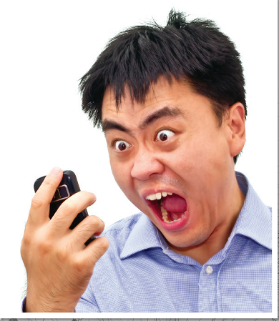
Unit 3 Lesson 3.1
Extra Practice
WB, page 18
a. Listen to a man calling customer service. Why does he call?
1. He wants to check his order.
2. He wants to complain about a package.
✓
Notes:
Taken from TA 10 i-Learn Smart World WB, page 2

Slide 15
Unit 3 Lesson 3.1
Extra Practice
WB, page 18
b. Now, listen and circle A or B.
What are you going to do?
→ Listen and circle the correct answer
What are some key words?
→ order number, How long, size,…
Notes:
Taken from TA 10 i-Learn Smart World WB, page 2

Slide 16
Unit 3 Lesson 3.1
Extra Practice
WB, page 18
b. Now, listen and circle A or B.
1. What's the order number?
A. 147258 B. 147298
2. How long did James have to wait for his order?
A. 5 days B. 10 days
3. What is the size of the sneakers?
A. 42 B. 45
4. What was in the package?
A. a jacket and a pair of sneakers B. a jacket and a T-shirt
5. What does the customer service agent offer James?
A. an exchange B. a refund
Notes:
Taken from TA 10 i-Learn Smart World WB, page 2

Slide 17

Unit 3 Lesson 3.1
Post - Listening
c. In pairs:
What will you do if your items you have bought don’t work? How do you feel?
I will take it to the ….
I feel disappointed because ……

Slide 18



Slide 19

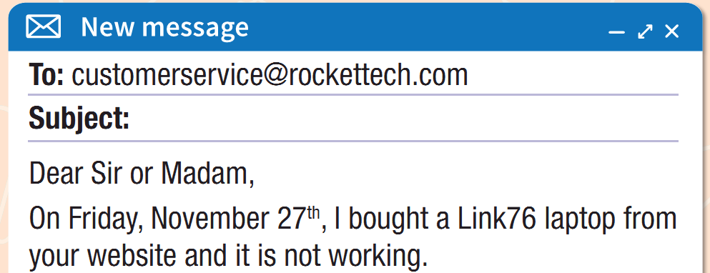
Unit 3 Lesson 3.1
a. Read June's email and choose the best subject heading.
✓
1. Link76 Problems
2. Link76 Review

Slide 20
Unit 3 Lesson 3.1
b. Now, read and circle the answers.
1. June bought her laptop from...
a. the internet. b. a store. c. a friend
2. The laptop gets too hot when she...
a. does her homework. b. plays games. c. watches movies.
3. June contacted RocketTech...
a. by online chat. b. by email. c. by phone.
4. She had to wait to speak to customer service...
a. for 3 hours. b. for 30 minutes. c. for 10 minutes.

Slide 21
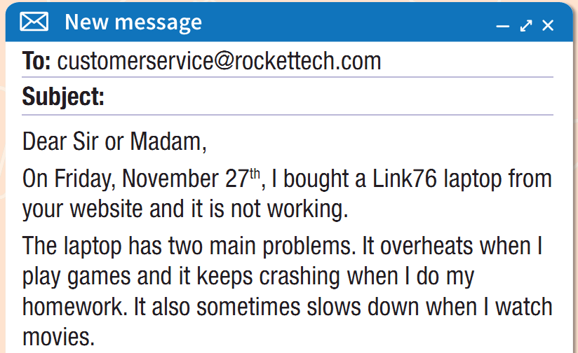
Unit 3 Lesson 3.1
b. Now, read and circle the answers.
1. June bought her laptop from...
a. the internet.
b. a store.
c. a friend

Slide 22
Unit 3 Lesson 3.1
b. Now, read and circle the answers.
2. The laptop gets too hot when she...
a. does her homework.
b. plays games. c. watches movies.

Slide 23
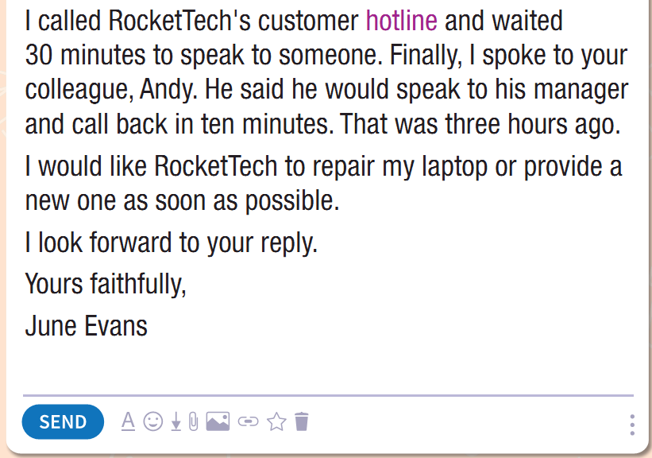
Unit 3 Lesson 3.1
b. Now, read and circle the answers.
3. June contacted RocketTech...
a. by online chat.
b. by email.
c. by phone.

Slide 24
Unit 3 Lesson 3.1
b. Now, read and circle the answers.
4. She had to wait to speak to customer service...
a. for 3 hours.
b. for 30 minutes.
c. for 10 minutes.

Slide 25
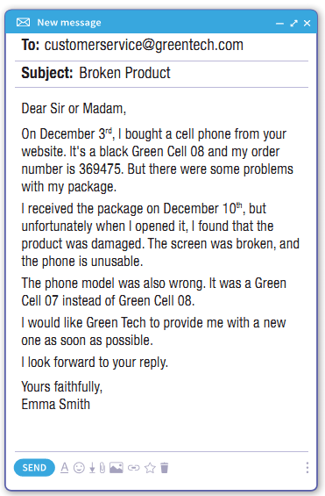
Unit 3 Lesson 3.1
Extra Practice
WB, page 18
a. Read the email and answer the questions.
1. How many problems does the package have?
2. Does Emma want a refund?
Notes:
Taken from TA 10 i-Learn Smart World WB, page 2

Slide 26
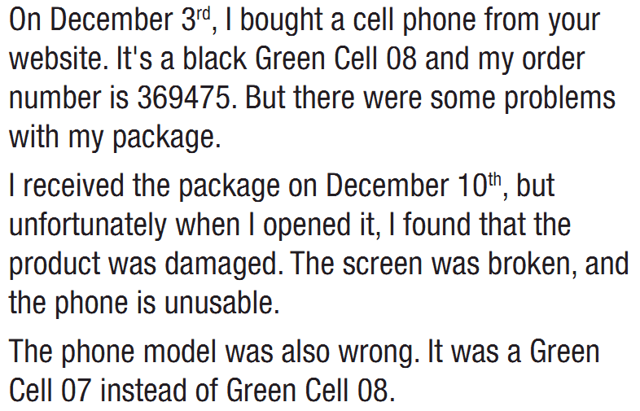
Unit 3 Lesson 3.1
Extra Practice
WB, page 18
a. Read the email and answer the questions.
1. How many problems does the package have?
2 problems
The product was damaged.
The phone model was also wrong.
Notes:
Taken from TA 10 i-Learn Smart World WB, page 2

Slide 27
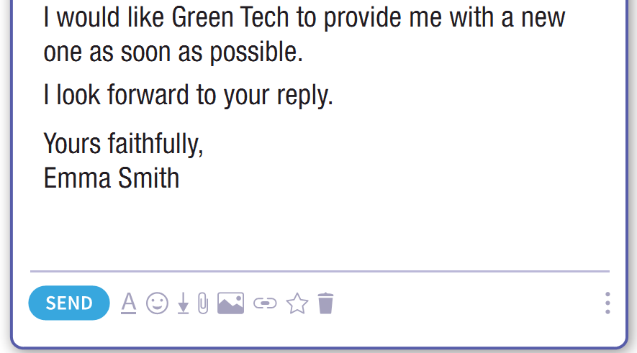
Unit 3 Lesson 3.1
Extra Practice
WB, page 18
a. Read the email and answer the questions.
2. Does Emma want a refund?
No, she isn’t. She want Green Tech to provide her with a new one.
Notes:
Taken from TA 10 i-Learn Smart World WB, page 2

Slide 28
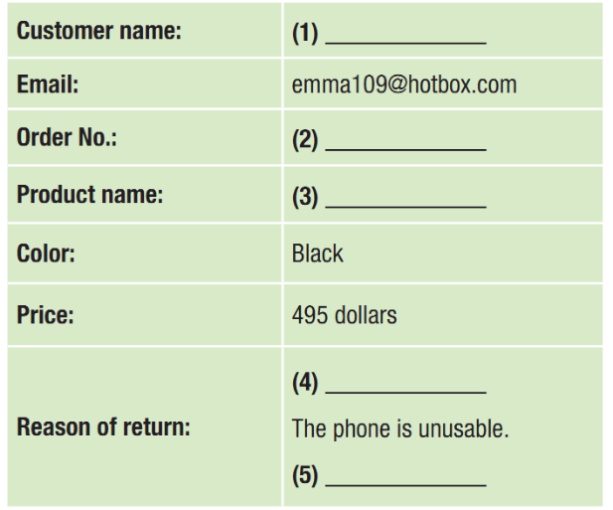
Unit 3 Lesson 3.1
Extra Practice
WB, page 18
b. Read and complete the table.
Notes:
Taken from TA 10 i-Learn Smart World WB, page 2

Slide 29

Unit 3 Lesson 3.1
Extra Practice
WB, page 18
b. Read and complete the table.
Emma Smith
Notes:
Taken from TA 10 i-Learn Smart World WB, page 2

Slide 30
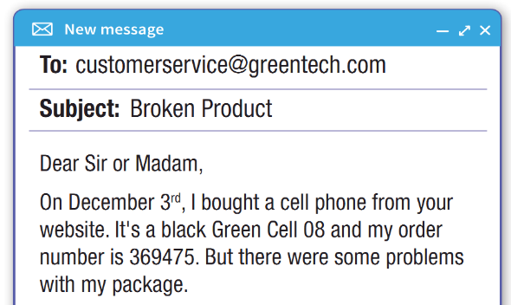
Unit 3 Lesson 3.1
Extra Practice
WB, page 18
b. Read and complete the table.
Emma Smith
369475
Notes:
Taken from TA 10 i-Learn Smart World WB, page 2

Slide 31
Unit 3 Lesson 3.1
Extra Practice
WB, page 18
b. Read and complete the table.
Emma Smith
369475
Green Cell 08
Notes:
Taken from TA 10 i-Learn Smart World WB, page 2

Slide 32
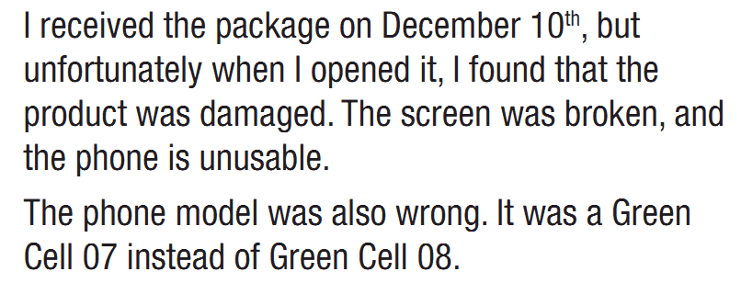
Unit 3 Lesson 3.1
Extra Practice
WB, page 18
b. Read and complete the table.
Emma Smith
369475
Green Cell 08
The screen was broken, and the phone is unusable.
Notes:
Taken from TA 10 i-Learn Smart World WB, page 2

Slide 33
Unit 3 Lesson 3.1
Extra Practice
WB, page 18
b. Read and complete the table.
Emma Smith
369475
Green Cell 08
The screen was broken, and the phone is unusable.
The phone model was also wrong
Notes:
Taken from TA 10 i-Learn Smart World WB, page 2

Slide 34


Unit 3 Lesson 3.1
c. In pairs:
Have you ever contacted customer service about something you bought?
Did they fix your problem?

Slide 35

Consolidation

Slide 36

Unit 3 Lesson 3.1
Work in pairs.
Student A is a customer and complain about the quality of the new laptop he/she has just bought from the store.
Student B is the manager of the store and answer student A’s questions.

Slide 37

WRAP-UP

Slide 38
Unit 3 Lesson 3.1
Today’s lesson
Consolidation
Listening: for main ideas and specific information
Reading: for main ideas and specific information
Speaking: starting a formal conversation asking and answering about the problems of the items

Slide 39
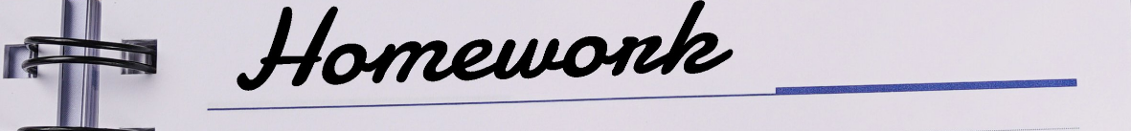
Unit 3 Lesson 3.1
Make 10 sentences about complaints.
Do the exercises in WB on page 18.
Do the exercises in Tiếng Anh 10 i-Learn Smart World Notebook on page 18.
Prepare the next lesson – Writing on page 27 in SB.
Play the consolidation games in Tiếng Anh 10 i-Learn Smart World DHA App on www.eduhome.com.vn

Slide 40

Have a nice day!

