Slide 1


Slide 2
Intonation in statements, commands, and lists
Unit
6
Preserving our heritage
Unit
FAMILY LIFE
LESSON 2
LANGUAGE

Slide 3
LESSON 2
LANGUAGE
WARM-UP
Watch a video
Task 1: Listen and repeat.
Task 2: Listen and mark the intonation.
PRONUNCIATION
Task 1: Match the words with their meanings.
Task 2: Complete the sentences.
VOCABULARY
Task 1: Combine the sentences.
Task 2. Ask and answer questions about heritage sites or traditions.
GRAMMAR
Wrap-up
Homework
CONSOLIDATION

Slide 4
WARM-UP
WATCH A VIDEO
Work in 4 groups.
Watch the video and list out name the destinations and cultural heritage of Vietnam that they see in the video.
Stick the paper on the boards.
The group with the most correct answers is the winner.

Slide 5
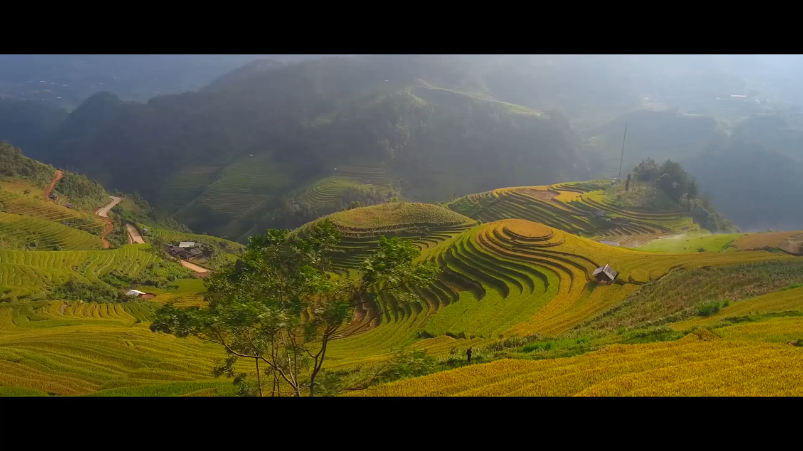
WARM-UP
WATCH A VIDEO
Notes:
https://www.youtube.com/watch?v=zDsjiWWwG80

Slide 6
WARM-UP
Destinations and cultural heritage of Vietnam
Complex of Hue Monuments | Hoi An Ancient Town
Space of gong Culture (Không gian văn hoá Cồng chiêng Tây Nguyên) | Vietnamese Court Music (Nhã Nhạc Cung Đình Huế )
My Son Sanctuary | Quan họ Bac Ninh
Hạ Long Bay | Ca tru Singing
Phong Nha – Ke Bang National Park | Imperial Citadel of Thang Long
Art of Don ca tai tu music and song in southern Viet Nam | Practices related to Viet beliefs in the Mother Goddesses of Three Realms (Tín ngưỡng thờ Mẫu Tam Phủ)
Trang An Scenic Landscape Complex

Slide 7

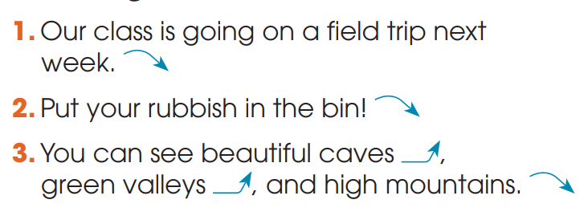
PRONUNCIATION
1
Listen and repeat. Pay attention to the falling intonation and level-rising intonation in the following sentences.

Slide 8


PRONUNCIATION
2
Listen and mark the intonation in these sentences, using falling intonation or level-rising intonation.
1. Hoi An Ancient Town became a world heritage site in 1999.
2. Please turn on the light. It’s dark in here.
3. Cultural heritage may include temples, pagodas and monuments.
4. Tourists can visit the pedestrian streets in Ha Noi.

Slide 9
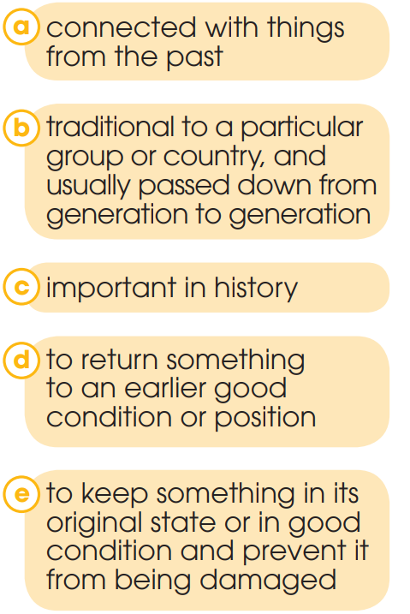
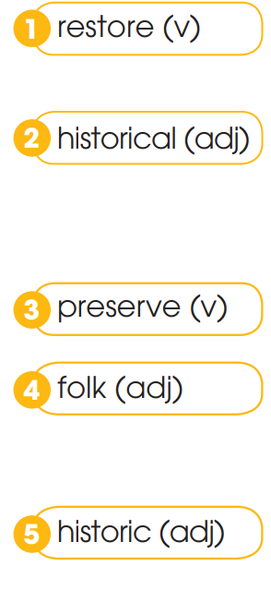
VOCABULARY
1
Match the words with their meanings

Slide 10
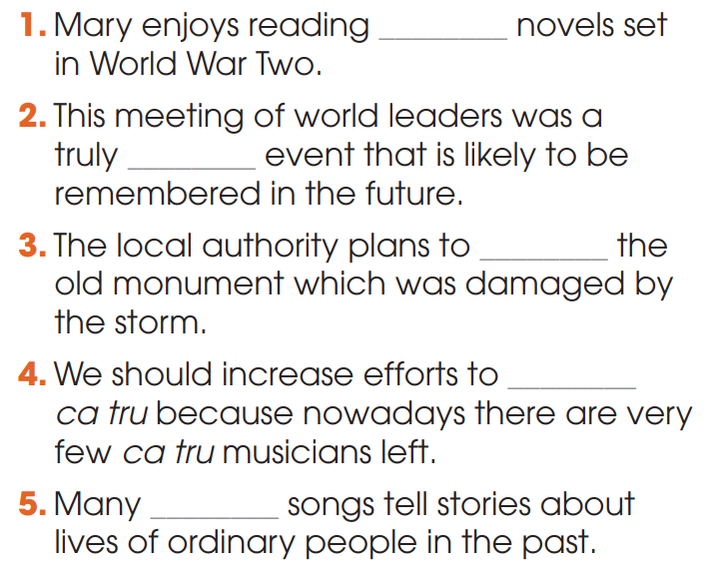
VOCABULARY
2
Complete the sentences using the words in Task 1
KEY:
1. historical
2. historic
3. restore
4. preserve
5. folk

Slide 11
GRAMMAR
A to-infinitive clause can be used:
1. to express purpose | E.g: He studied hard to pass the exam. I bought some souvenirs to give to my parents.
2. to modify a noun or noun phrase that contain ordinal numbers (the first, the second, etc.), superlatives (the best, the most beautiful, etc.) and next, last, and only. | E.g: Ethan is usually the last person to understand the joke.

Slide 12
GRAMMAR
1
Combine the sentences using to-infinitive clauses
1. Lan went to Hue. She wanted to see the monuments there.
→ Lan _____________________________________.
2. Minh created a website. He wanted to give more information about local historical sites to visitors.
→ Minh ___________________________________.
went to Hue to see the monuments there
created a website to give more information about local historical sites to visitors.

Slide 13
GRAMMAR
1
Combine the sentences using to-infinitive clauses
3. Peter took a boat trip around the floating market. He wanted to listen to don ca tai tu there.
→ Peter ________________________________.
4. My sister has opened a small shop behind the museum. She wanted to sell postcards and souvenirs to tourists.
→ My sister _____________________________.
took a boat trip around the floating market to listen to don ca tai tu
has opened a small shop behind the museum to sell postcards and souvenirs to tourists

Slide 14
GRAMMAR
2
Work in pairs. Ask and answer questions about heritage sites of traditions, using to-infinitive clauses.
Suggested answer:
1. The only thing to see at the Citadel of the Ho Dynasty is the stone walls.
2. The Complex of Hue Monuments was the first site in Viet Nam to be recognised as a World Heritage Site by UNESCO.
3. Bao Dai was the last king of the Nguyen Dynasty to rule Viet Nam.
4. My brother is the youngest person to win a folk song competition.

Slide 15
CONSOLIDATION
1
Wrap-up
What have you learnt today?
Some lexical items about heritage;
Intonation in statements, commands and lists;
To-infinitive clauses.

Slide 16
CONSOLIDATION
2
Homework
Do exercises in the workbook.
Prepare for Lesson 3 - Unit 6.

Slide 17

Website: hoclieu.vn
Fanpage: facebook.com/tienganhglobalsuccess.vn/
Website: hoclieu.vn
Fanpage: facebook.com/sachmem.vn/

