Slide 1

UNIT 9: TRAVEL AND TOURISM
Lesson 1.3 – Pronunciation & Speaking
Page 76

Slide 2



Lesson 1.3
LESSSON OUTLINE
Consolidation

Slide 3

By the end of this lesson,
students will be able to:
- practice sound change of a, the.
- talk about things to do on vacations.
- improve speaking skill.

Slide 4



Slide 5

Choose the word whose main stress is placed
differently from the others.
Work in pairs.
A. sightseeing B. heritage C. snorkeling D. solution
2. A. castle B. tower C. release D. product
3. A. professor B. museum C. inventor D. volunteer
/ˈsaɪtˌsi:ɪŋ/
/ˈherɪtɪdʒ/
/ˈsnɔ:kəlɪŋ/
/səˈlu:ʃən/
/ˈkæsəl/
/ˈtaʊə/
/rɪˈli:s/
/ˈprɑ:dʌkt/
/prəˈfesə/
/mju:ˈzi:əm/
/ɪnˈventə/
/ˌvɑ:lənˈtɪr/

Slide 6
Work in pairs.
Choose the word whose underlined part is
pronounced differently from that of the other words.
A. mentioned B. traveled C. buried D. needed
2. A. picture B. ticket C. river D. driver
3. A. think B. write C. list D. miss
/ˈmenʃənd/
/ˈtrævəld/
/ˈberid/
/ˈni:dɪd/
/ˈpɪktʃə/
/ˈtɪkɪt/
/ˈrɪvə/
/ˈdraɪvə/
/θɪŋk/
/raɪt/
/lɪst/
/mɪs/

Slide 7
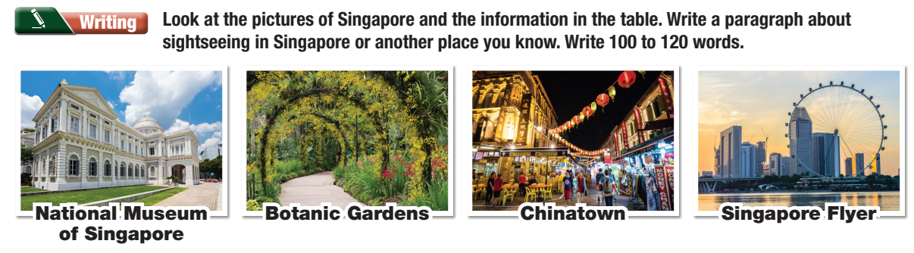
Checking homework
Notes:
Choose some student’s products to stick on the board, ask the others to move around to read and give comments (check the grammar mistakes related to the articles)

Slide 8
Suggested answers/ product.
Singapore is one of Asia's favorite vacation spots. These are some of its best sightseeing spots which attract many tourists. The National Museum of Singapore is the country's oldest museum. It shows Singapore's history and culture. If you love the nature, you should go to the Singapore Botanic Gardens. It is a UNESCO World Heritage Site. It has 314 species of plants, including rare plants. Then, you should go to Chinatown. The markets and food stands here sell a lot of traditional Singaporean food. Shopping in Chinatown is also cheap and fun! To people who love the city's skyline, Singapore Flyer is a place they cannot miss. This giant wheel is 165 meters high. There are many restaurants and stores under it, so you don't have to worry about where to have dinner after enjoying your time on the wheel. We loved visiting Singapore, and we hope you will love it, too!
Notes:
Choose some student’s products to stick on the board, ask the others to move around to read and give comments (check the grammar mistakes related to the articles)

Slide 9


Notice the sound changes of the underlined words.
The Leaning Tower of Pisa is a famous tower in Italy.
The tower is fifty-six meters tall.

Slide 10
Listen and cross out the sentence with the wrong sound changes.
The Loire is France's longest river.
We went to a museum
It's the largest island in Vietnam.
Read the sentences with the correct sound changes to a partner.

Slide 11

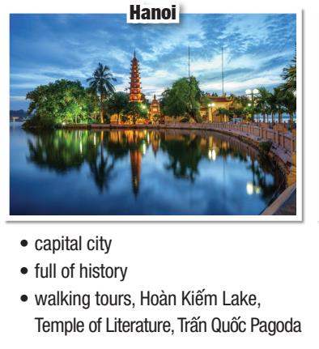
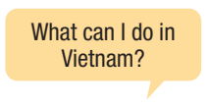
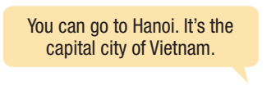
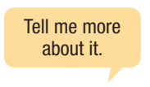
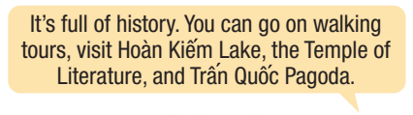
Ask and answer about Vietnam using the pictures and prompts.
Example:

Slide 12

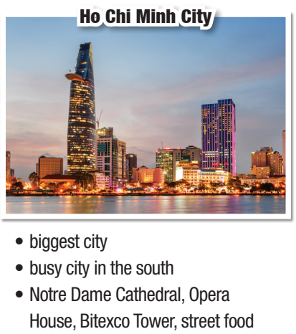
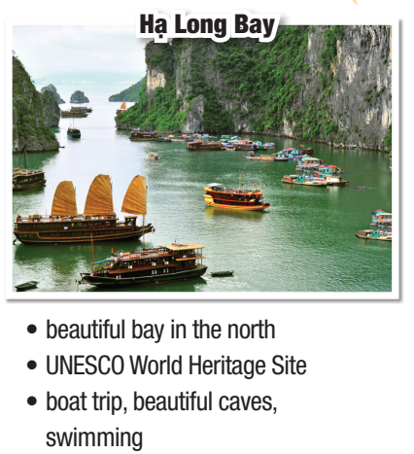
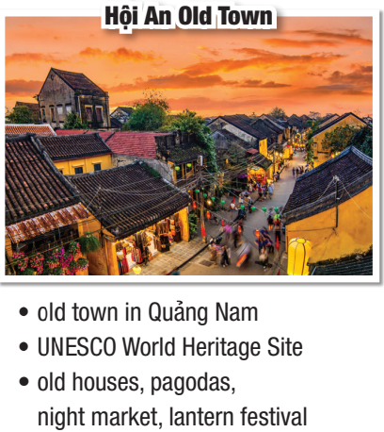

Slide 13
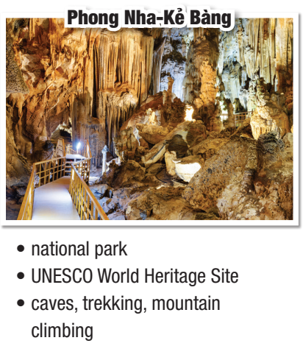
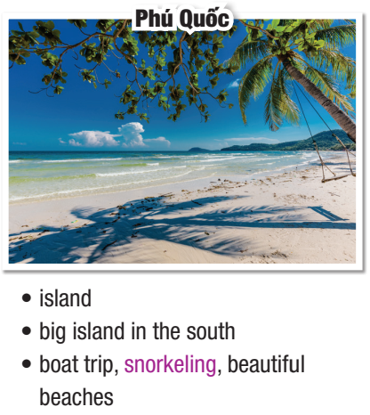

Slide 14


You're visiting a new city and have time to visit three famous places. In pairs: Student A, open your book Page 94 – file 5 Student B, open your book Page 92 – file 2
→ Use example in Practice
Notes:
Teacher can print out these pages of the book as the handouts and give students to avoid confusing

Slide 15
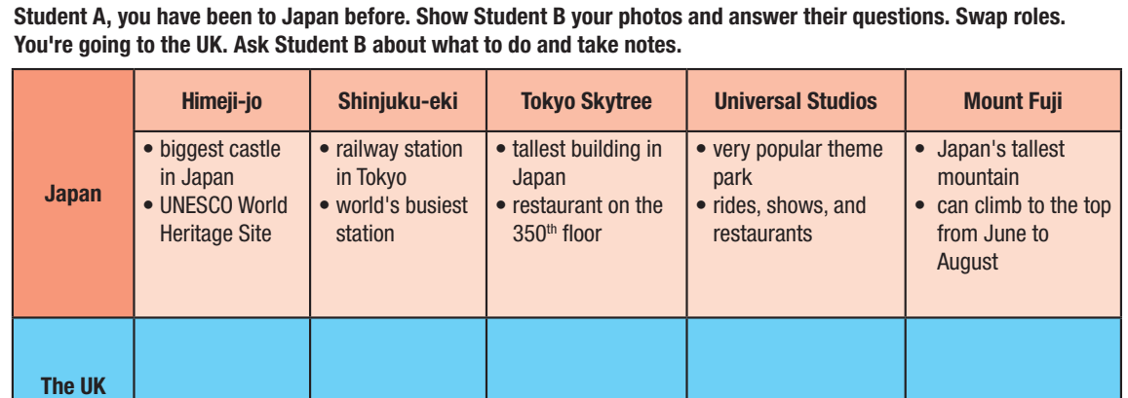

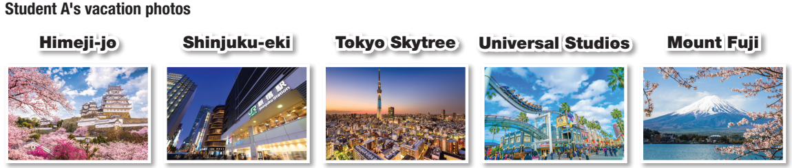
Page 94
file 5
Notes:
Teacher can print out these pages of the book as the handouts and give students to avoid confusing

Slide 16
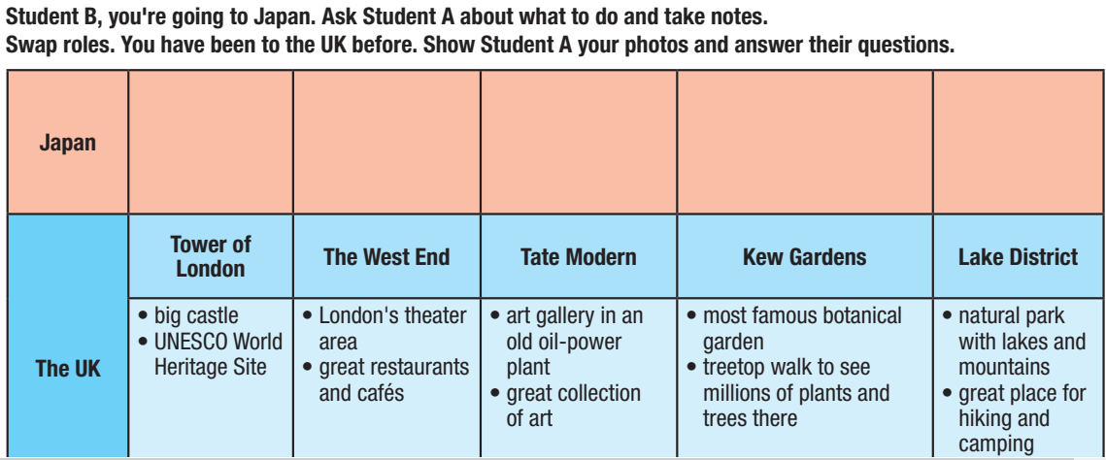

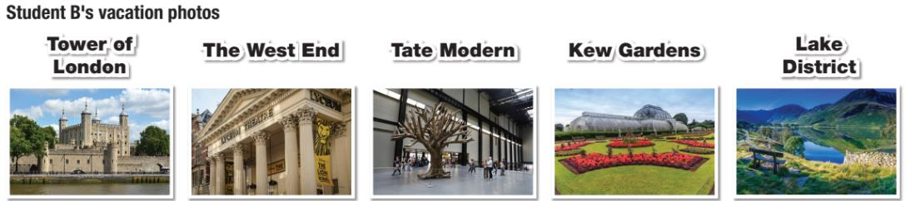
Page 92
file 2
Notes:
Teacher can print out these pages of the book as the handouts and give students to avoid confusing

Slide 17

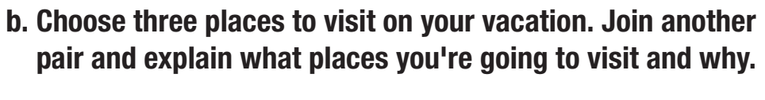
Post Speaking
Suggested answer:
I am going to visit Himeji-jo, Tokyo Skytree and Mount Fuji.
Firstly, I choose Himeji-jo to visit because it is the biggest castle
in Japan and it is also a UNESCO World Heritage Site. Next, I’d like to travel to the tallest building in Japan and enjoy meal in the restaurant on the 350th floor in Tokyo Skytree. Finally, I will go hiking in Japan's tallest mountain and climb to the top of Mount Fuji (from June to August)

Slide 18

Consolidation

Slide 19
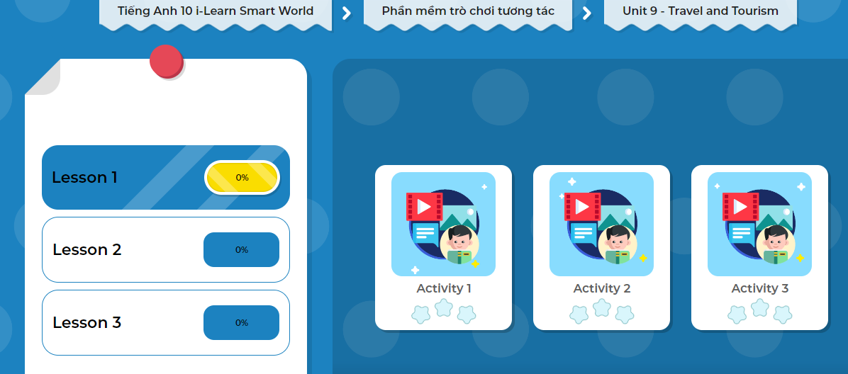
Click here to play the games
Let’s Play!

Slide 20
Wrap-up
Today’s lesson
Pronunciation: Sound change of “ a” , “the”
Speaking: Talk about things to do on vacations

Slide 21

- Make a short clip about the places you want to visit and why.
Prepare the next lesson: Lesson 2.1 Reading, (page 77).
Play the consolidation games in Tiếng Anh 10 i-Learn Smart World DHA App on www.eduhome.com.vn

