Slide 1

Unit 6: Education
Lesson 1.1: Vocabulary & Listening
Page 44

Slide 2



LESSON OUTLINE
Consolidation

Slide 3
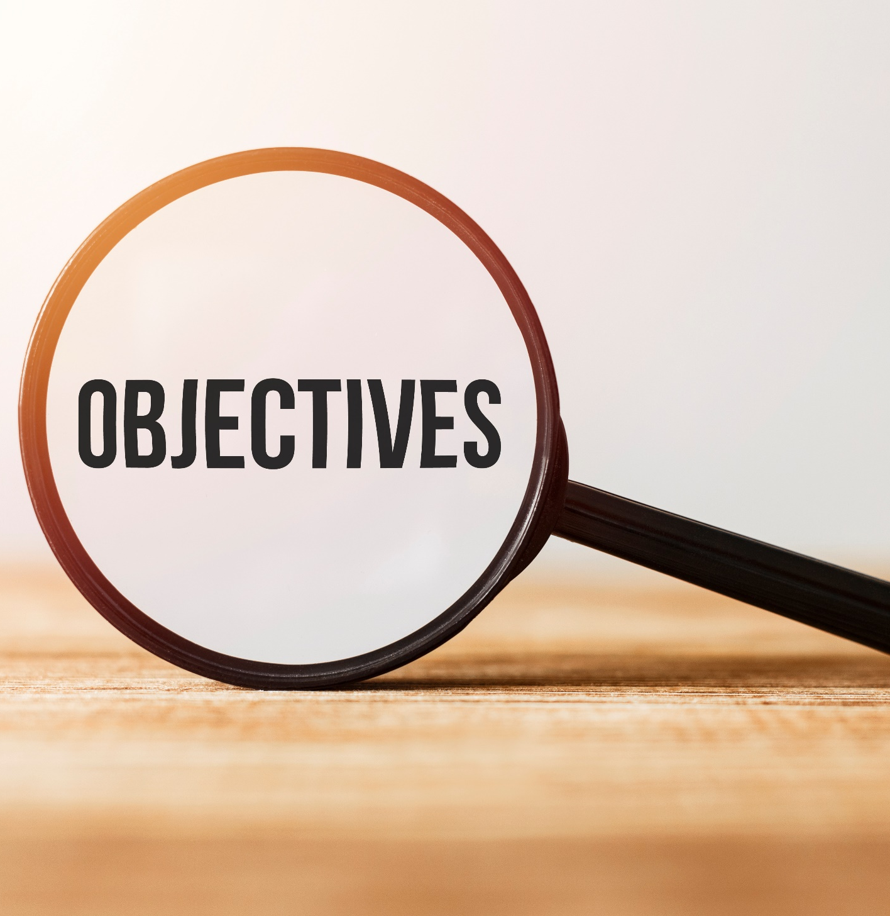
By the end of this lesson, students will be able to…
decline an invitation.
practice listening for main ideas and specific information.

Slide 4
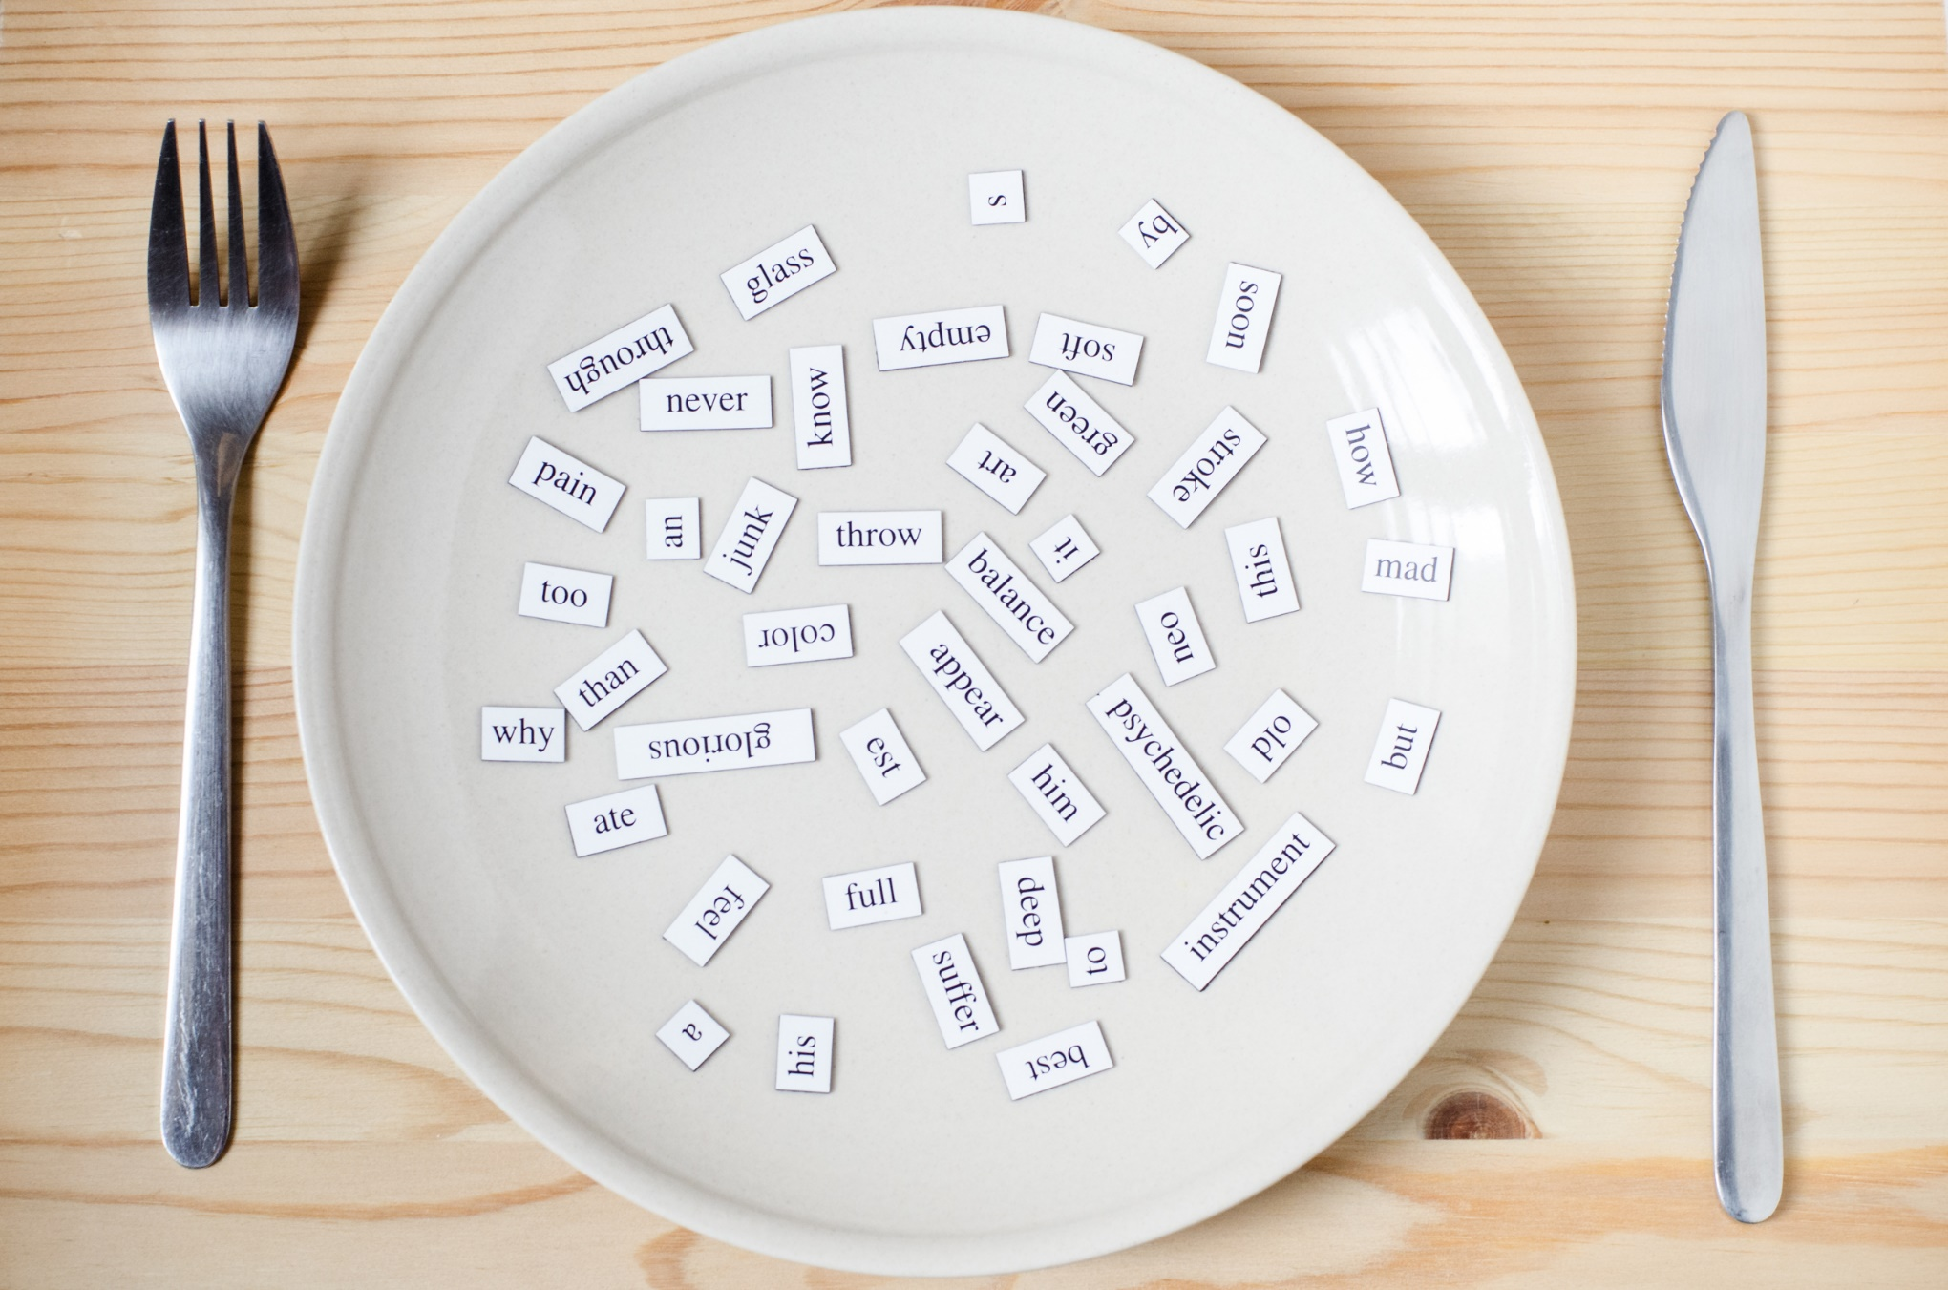
New words
Essay
Project
Homework
Book report
Test
Presentation

Slide 5

WARM-UP

Slide 6

Work in pairs.
Which days of the week are you free? What do you often do?
Which days of the week are you busy? What are you busy with?

Slide 7
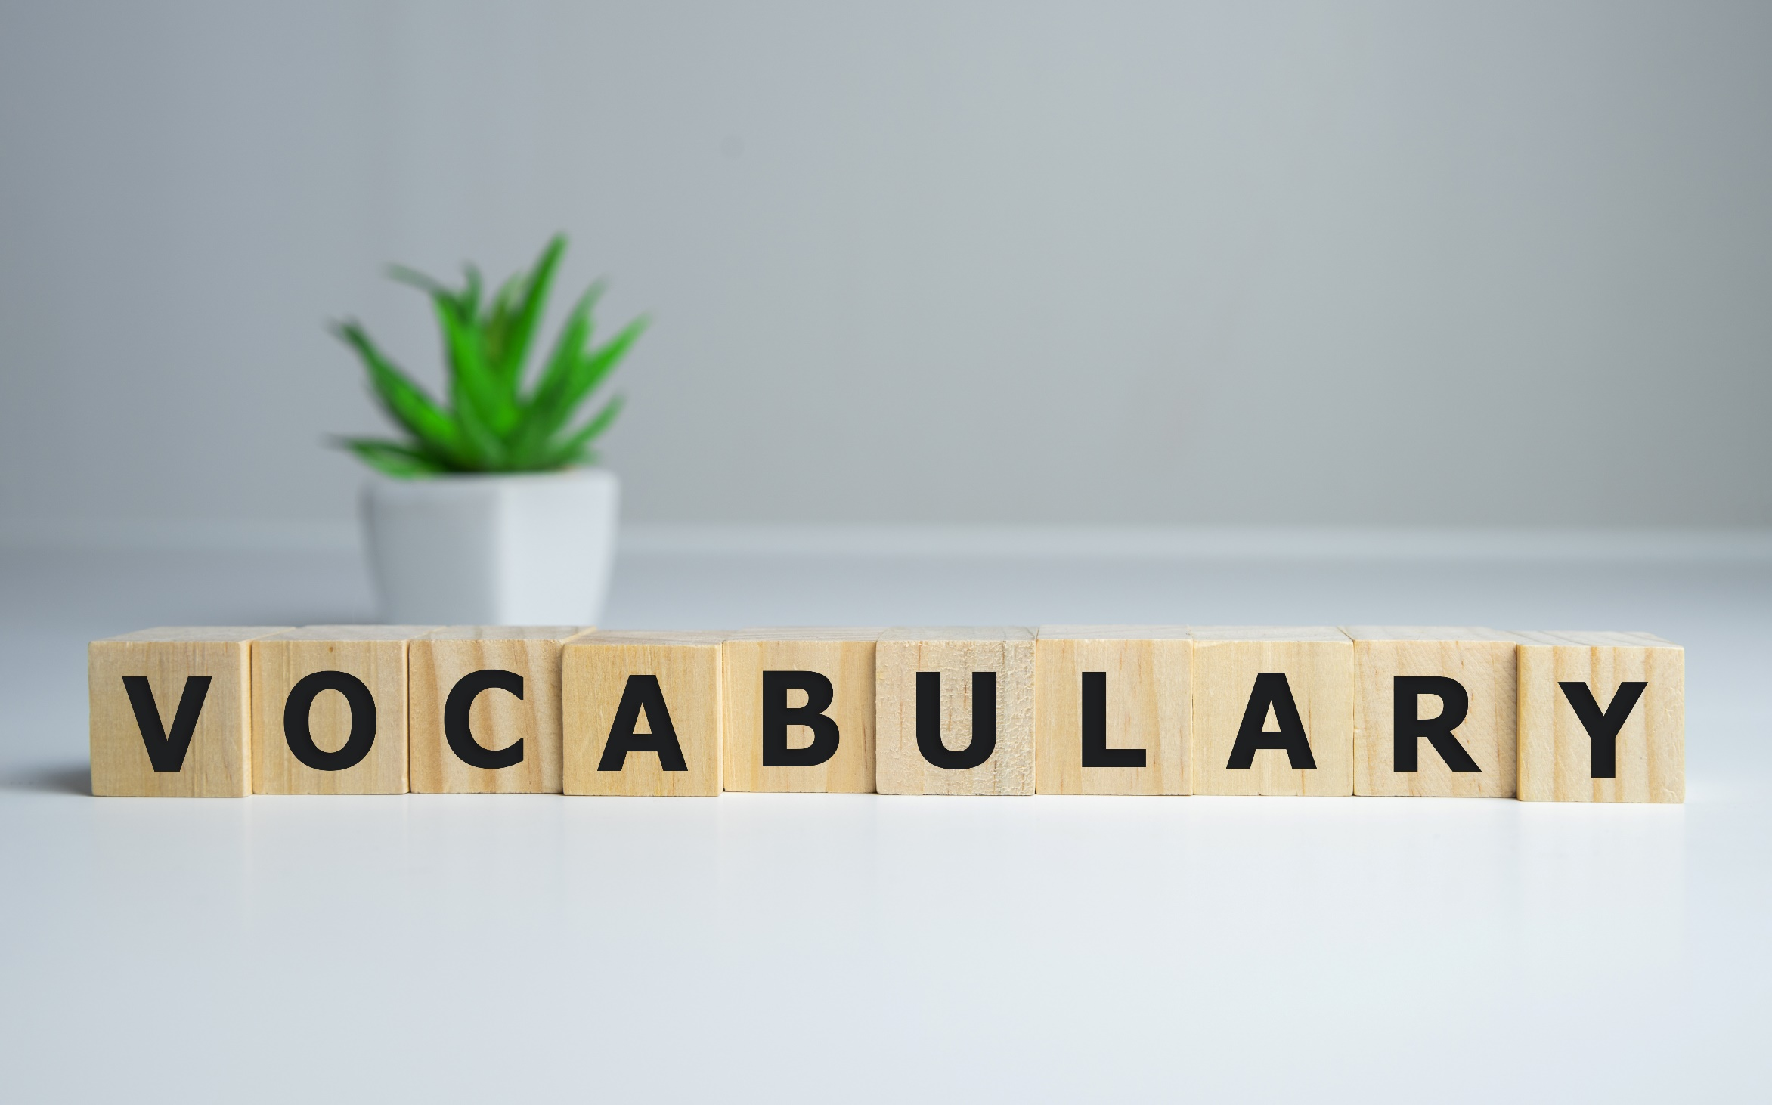


Slide 8
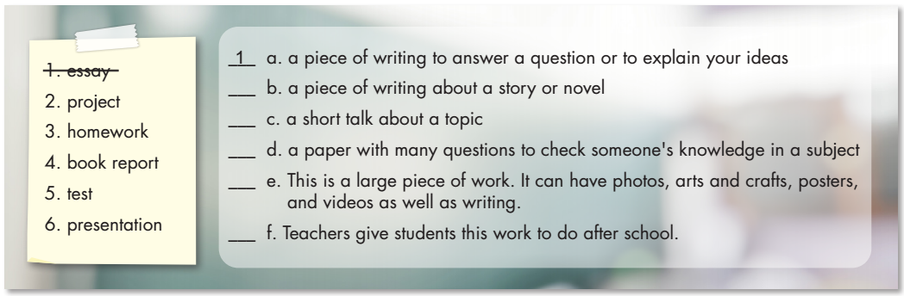
Work in pairs. Match the words with the definitions.
4
6
5
2
3

Slide 9


Listen and repeat. Click each word to hear the sound
essay (n) /ˈeseɪ/ bài tiểu luận
project (n) /ˈprɑːdʒekt/ dự án, đồ án
homework (n) /ˈhoʊmwɜːrk/ bài tập về nhà
book report (n. phr) /bʊk rɪˈpɔːrt/ báo cáo về sách, bài thu hoạch sau khi đọc sách
test (n) /test/ bài kiểm tra
presentation (n) /ˌpreːznˈteɪʃn/ bài/buổi thuyết trình

Slide 10
Choose the correct verb to fill in each blank.
finish write (x2) study do give
1. I go to the library to read books. The teacher tells us to ___________ a book report.
2. I have to ___________ a presentation in my science class next Friday.
3. We work in group to ___________ our science project.
4. I have to ___________ for a math test.
5. I have to ___________ an essay on food this weekend.
6. When do you ___________ your homework?
write
give
finish
study
write
do

Slide 11
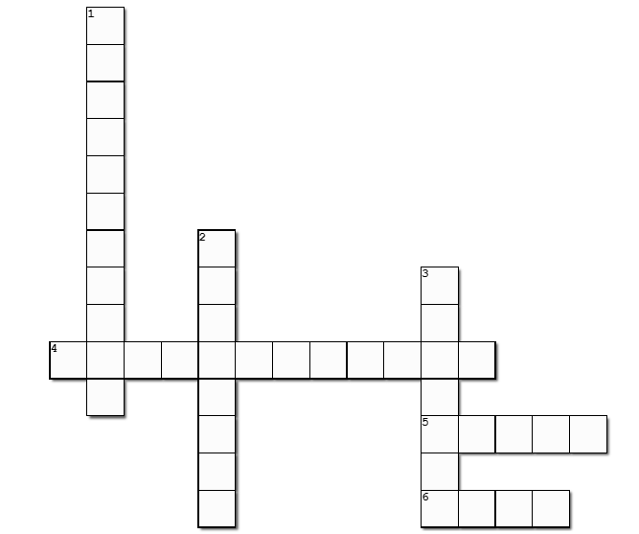
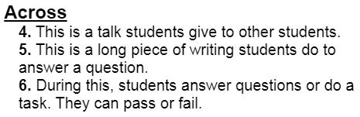
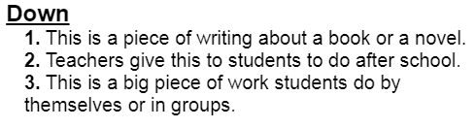
1
B
O
O
K
R
2
E
H
3
P
O
P
O
M
R
4
P
R
E
S
E
N
T
A
T
I
O
N
Complete the puzzle
T
W
J
O
5
E
S
S
A
Y
Click on each number to see the answer
R
C
K
6
T
E
S
T

Slide 12
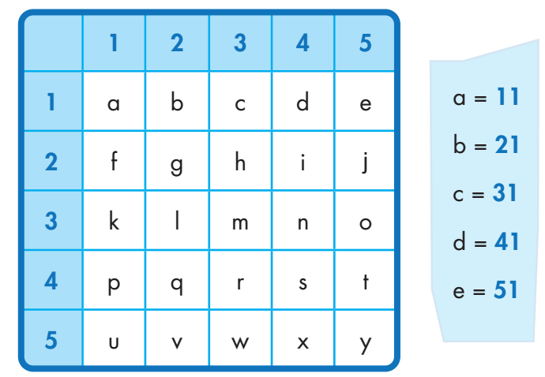
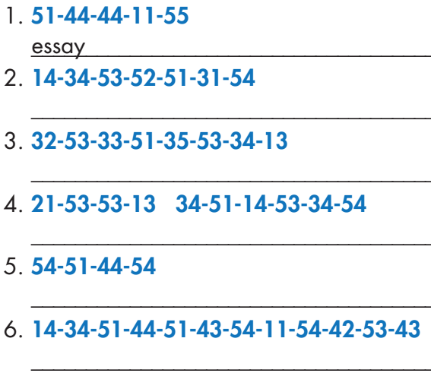
Extra Practice
WB, page 32
project
homework
book report
test
presentation

Slide 13
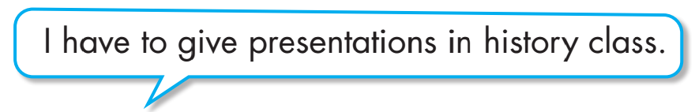

Work in pairs.
Say which things you have to do at school.

Slide 14
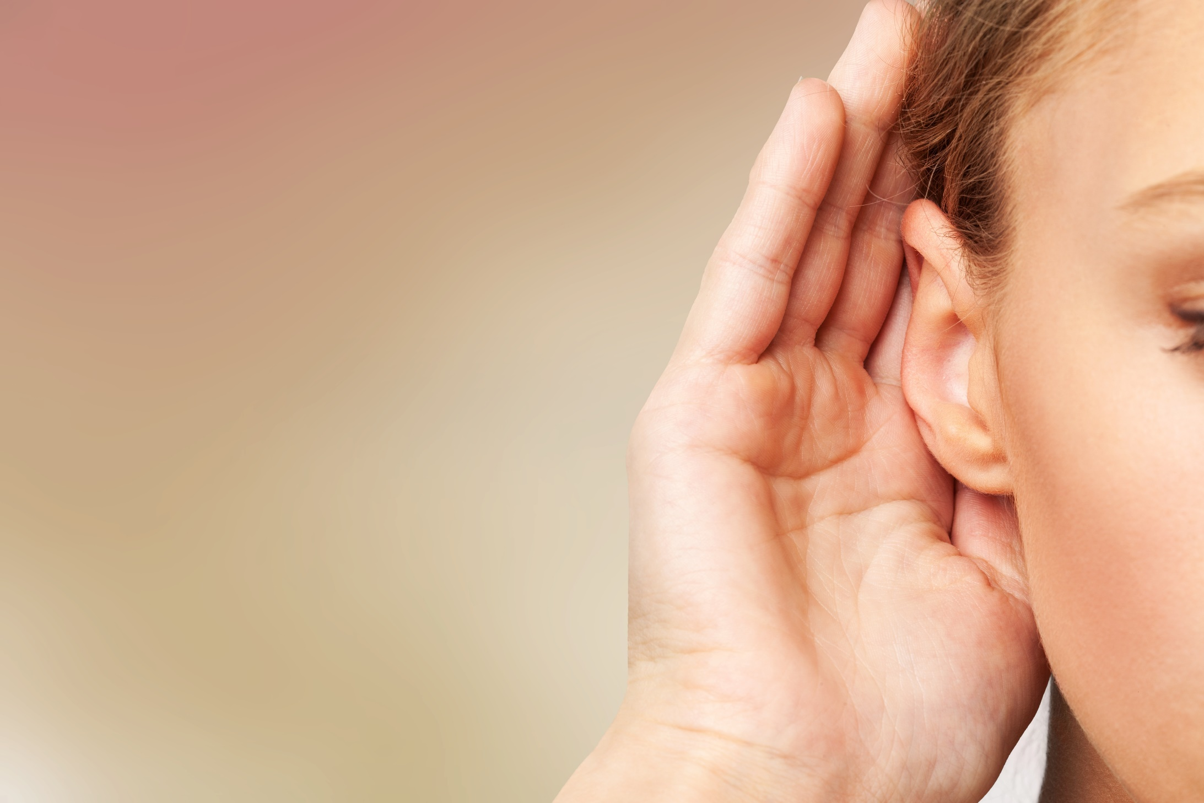

It’s listening time….

Slide 15

Pre - listening
Read the instruction quickly. Underline the key words. What are we going to do?
Listen and choose the correct answer.

Slide 16

While - listening
Click on the icon to hear the sound
Now listen and choose the correct answer.  FIRST TIME
☞ YOUR ANSWER?
☞ WHY?

Slide 17
Click on the icon to hear the sound
While - listening
Now listen again and check.  SECOND TIME
While you are listening, focus on what Alan and Lucy asked and answered about their plan.
Alan: Oh, I'm sorry, I can't. I have to finish my science project.
Alan: Oh, I'm sorry I can't go. I have to study for a math test.
Alan: Oh no! I have to work on my book report.
Lucy: Oh no! I'm sorry, I can't. I have to give a presentation on Saturday.
☞ YOUR ANSWER?
1. Alan
2. Lucy
☞ THE ANSWER IS …

Slide 18
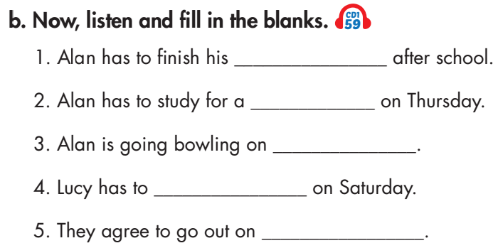
Pre - listening
Read the instruction and questions quickly. Underline the key words. What are we going to do?

Slide 19
While - listening
Now listen and fill in the blanks.  FIRST TIME
☞ WHAT ARE YOUR ANSWERS?

Slide 20
While - listening
Now listen again and check.  SECOND TIME
Click on the icon to hear the sound
☞ WHY ARE THESE ANSWERS?
science project
math test
Saturday
give a presentation
Sunday

Slide 21
While - listening
Now listen again and check.  THIRD TIME
Lucy: Hey Alan. Do you want to see a movie after school?
Alan: Oh, I'm sorry, I can't. I have to finish my science project.
Click on the icon to hear the sound
1. Alan has to finish his _____ after school.
science project
Lucy: Oh, no problem. What about Thursday? Are you free?
Alan: Why?
Lucy: Sue's having a party.
Alan: Oh, I'm sorry I can't go.
Lucy: Why?
Alan: I have to study for a math test.
2. Alan has to study for a ______ on Thursday.
math test

Slide 22
While - listening
Now listen again and check.  THIRD TIME
Click on the icon to hear the sound
Alan: Well, this Saturday, I'm going bowling with my brother. Do you want to come with us?
3. Alan is going bowling on ____.
Saturday
Lucy: Oh no! I'm sorry, I can't. I have to give a presentation on Saturday.
4. Lucy has to ______ on Saturday.
give a presentation
Alan: I know! Let's go on Sunday.
Lucy: Yeah.
5. They agree to go out on ____.
Sunday

Slide 23
Practice the conversation with a partner.
Audio - Scripts
Lucy: Hey Alan. Do you want to see a movie after school?
Alan: Oh, I'm sorry, I can't. I have to finish my science project.
Lucy: Oh, no problem. What about Thursday? Are you free?
Alan: Why?
Lucy: Sue's having a party.
Alan: Oh, I'm sorry I can't go.
Lucy: Why?
Alan: I have to study for a math test.
Lucy: Hmm. Are you busy on Friday? A few of us are going to the library.
Alan: Oh no! I have to work on my book report.
Lucy: So when are you free?
Alan: Well, this Saturday, I'm going bowling with my brother. Do you want to come with us?
Lucy: Oh no! I'm sorry, I can't. I have to give a presentation on Saturday.
Alan: I know! Let's go on Sunday.
Lucy: Yeah!

Slide 24

Work in pairs.
Post - listening
Does your life sound more like Alan's or Lucy's? Why?
I think my life sounds more like Alan’s. I’m quite busy. I have to do my homework, study for tests, and play sports with my brother.

Slide 25
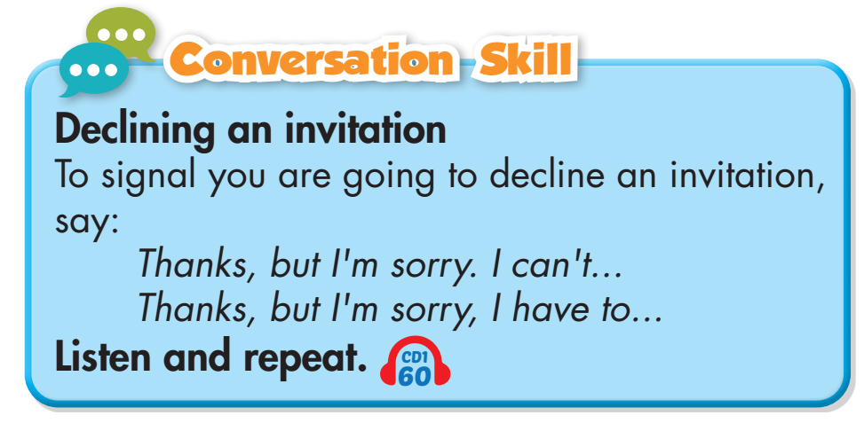
Click on the icon to hear the sound

Slide 26
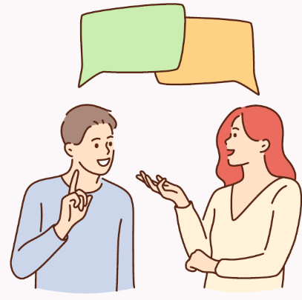
Work in pairs
Take turns to practice inviting and declining an invitation. Do as example:
Student A: Hey B. Do you want to see a movie after school?
Student B: Thanks, but I'm sorry. I have to finish my science project.

Slide 27
Work in pairs.
Student A
Student B
decline the invitation. And say why you can’t go.
1. Invite your friend to do something fun on ____.

Slide 28

CONSOLIDATION

Slide 29
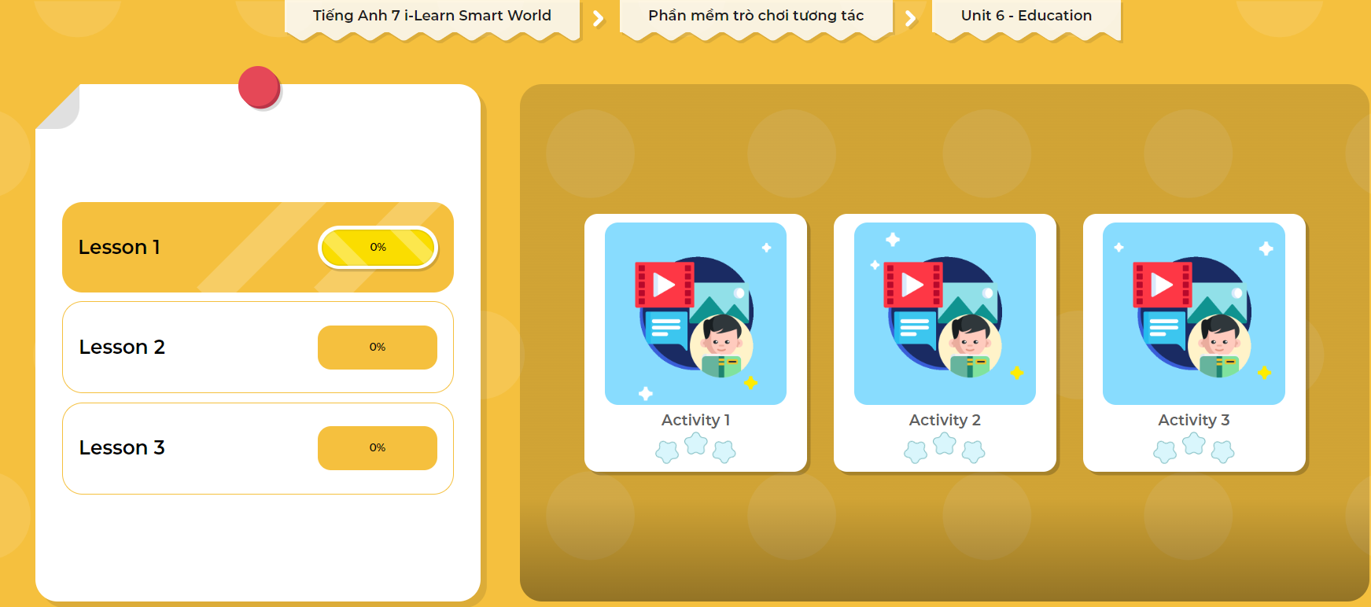
LET’S PLAY!
Click here to play the games

Slide 30
Write 5 sentences about what you do in class and after class. You can use the information from the Listening Section.
Use the Present Simple:
I have to do my homework.
I have to finish my science project.

Slide 31
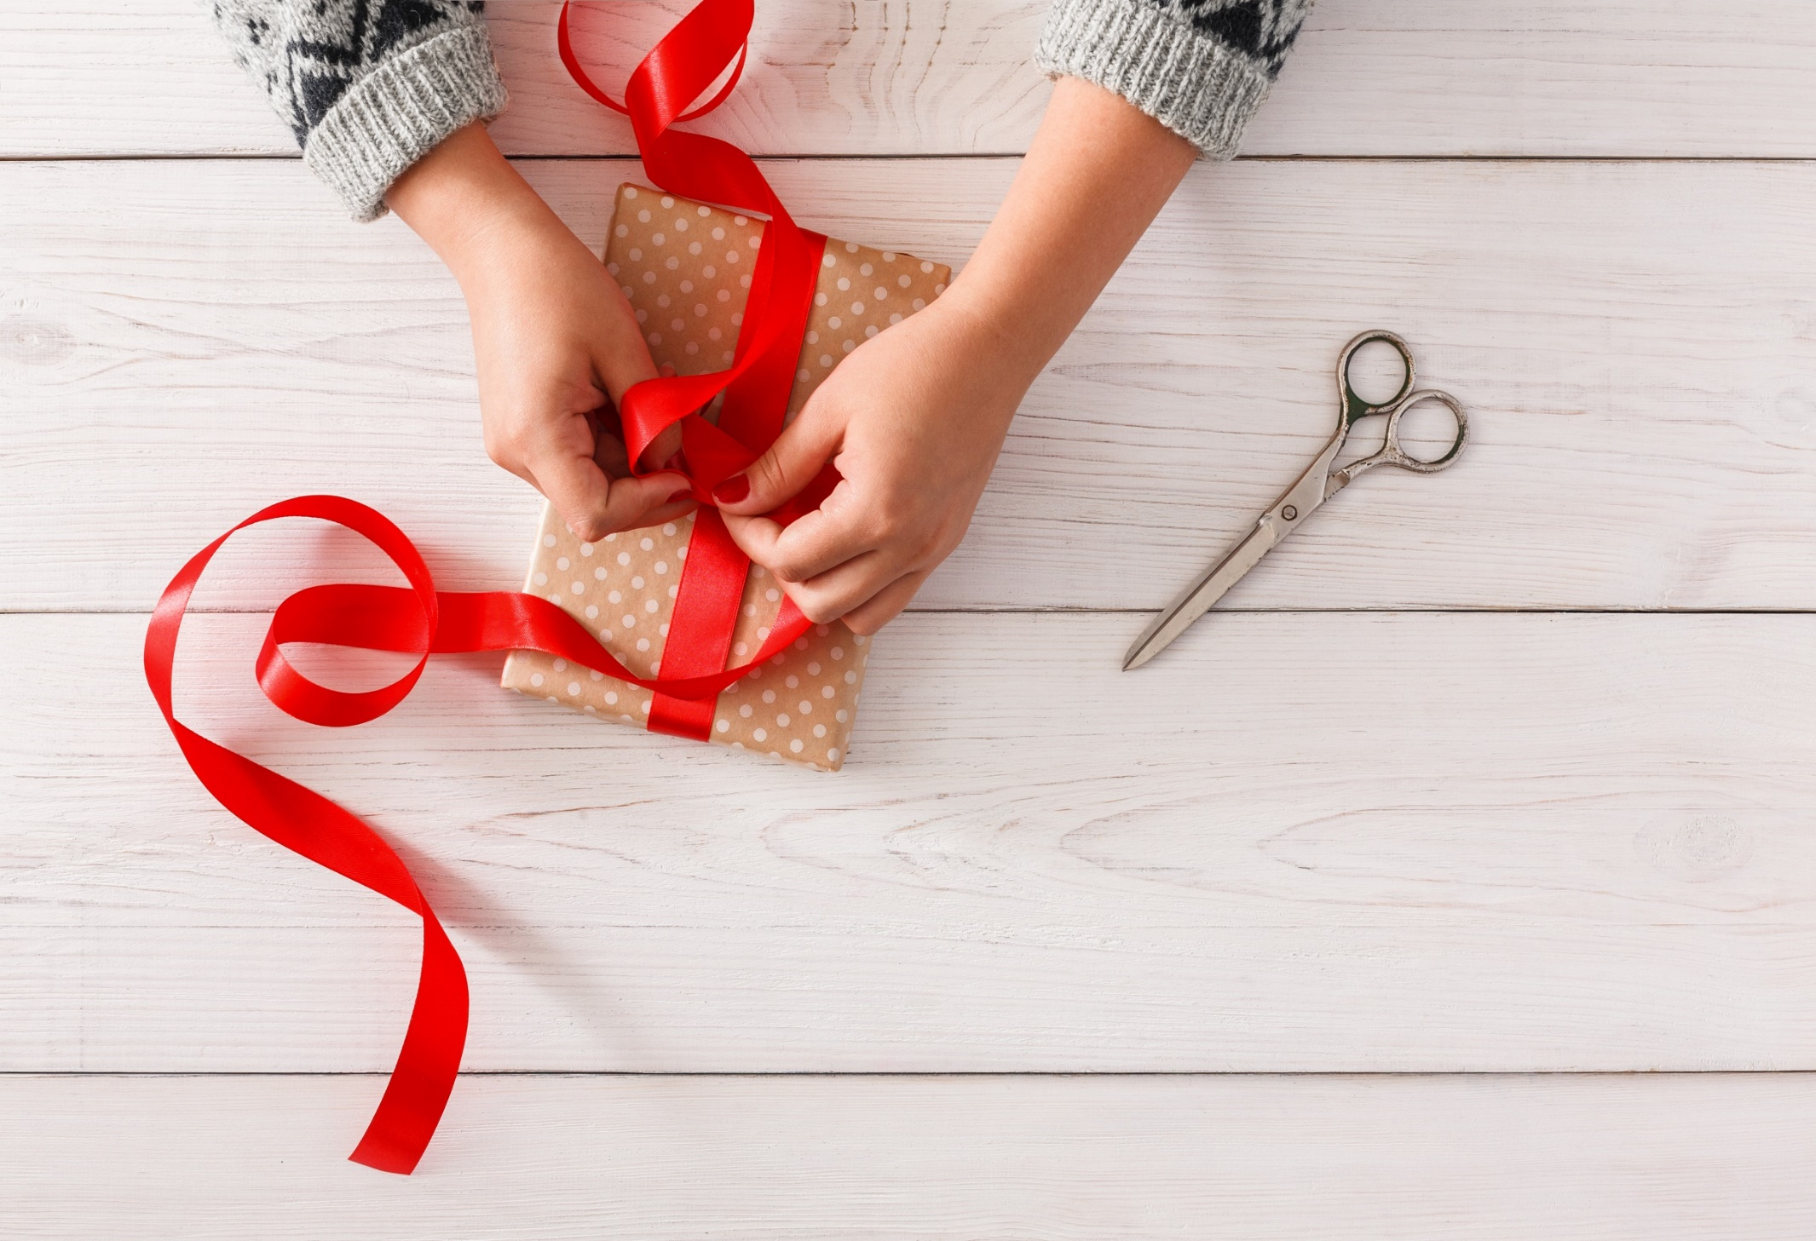
WRAP-UP

Slide 32
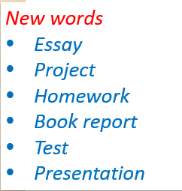
Today’s lesson

Slide 33
Today’s lesson
Listening:
Listening for main ideas and specific information.
Speaking:
Talking about what you do in class and after class.
Declining and invitation.

Slide 34
Homework
Practice the vocabularies and make sentences using them.
Do the Listening exercise in Tiếng Anh 7 i-Learn Smart World Workbook (page 33).
Do the exercises in Tiếng Anh 7 i-Learn Smart World Notebook (page 36).
Prepare the next lesson (page 45 SB).
Play the consolidation games in Tiếng Anh 7 i-Learn Smart World DHA App on www.eduhome.com.vn

Slide 35
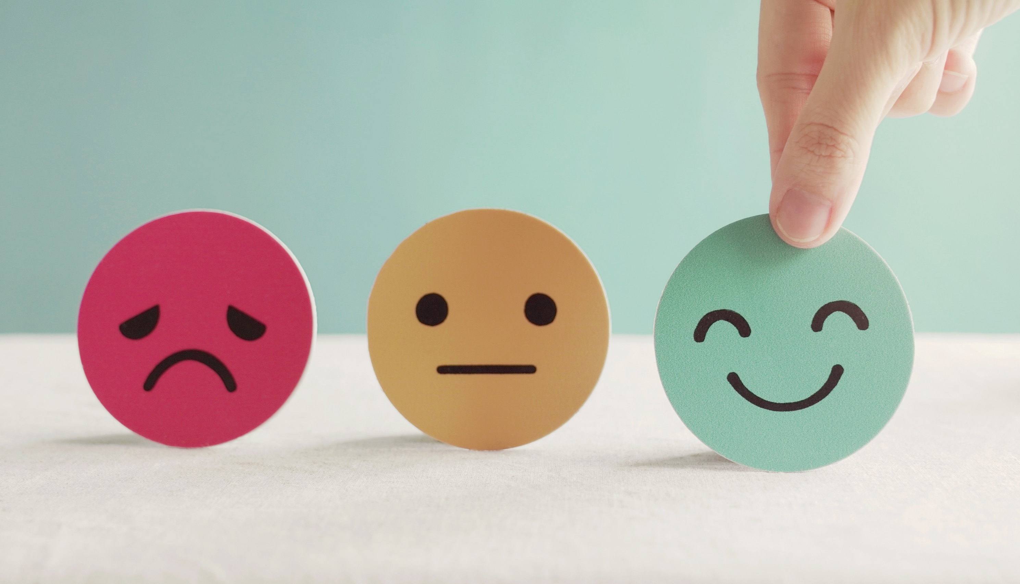
Lesson 3
Stay positive and have a nice day!

