Slide 1


Slide 2

1
Unit
FAMILY LIFE
REVIEW 1
LESSON 2
SKILL 1_LISTENING AND SPEAKING

Slide 3

Unit
1
1
FAMILY LIFE
Family Life
Unit
OBJECTIVES
Practice listening for general and specific information about music;
Practice talking about favorite singer or musician.

Slide 4
LESSON 2
SKILL 1_ LISTENING AND SPEAKING
Unit
GETTING STARTED
Name the pictures: Traditional music
WARM-UP
LISTENING
Task 1: Listen and choose the best title for the talk. (p. 40)
Task 2: Listen again and fill in each gap in the Quick facts with a number. (p. 40)
SPEAKING
Task 1: Work in pairs. Talk about your favourite singer or musician. Use the expressions below to help you. (p. 40)
CONSOLIDATION
Wrap up
Homework

Slide 5

LESSON 2
SKILL 1_ LISTENING AND SPEAKING
Unit
GETTING STARTED
WARM-UP
Name the pictures: Traditional music

Slide 6
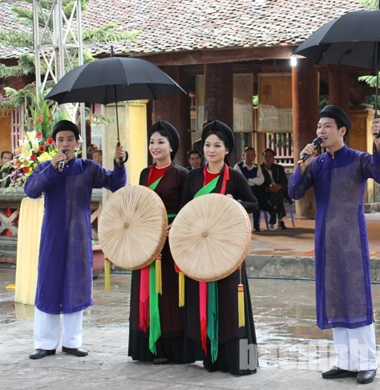

WARM-UP
Game: Name the pictures
Xoan singing
Chau van singing
Quan ho singing

Slide 7

LESSON 2
SKILL 1_ LISTENING AND SPEAKING
Unit
GETTING STARTED
Name the pictures: Traditional music
WARM-UP
LISTENING
Task 1: Listen and choose the best title for the talk. (p. 40)
Task 2: Listen again and fill in each gap in the Quick facts with a number. (p. 40)

Slide 8

LISTENING
1
Listen and choose the best title for the talk. (p. 40)
A. Presley’s death
B. Presley’s singles
C. Presley’s life and career

Slide 9
LISTENING
1
Listen and choose the best title for the talk. (p. 40)
C. Presley’s life and career

Slide 10
LISTENING
2
Listen again and fill in each gap in the Quick facts with a number. (p. 40)
Quick facts
1. He was born in ______.
2. He had his number 1 hit when he was _____.
3. He won _____ Grammy awards.
4. He died at the age of _______.
1935
21
3
42

Slide 11
LISTENING
2
Audio script – Track 26 + 27:
Elvis Presley was an American singer, musician and actor born in 1935. His single Heartbreak Hotel, released when he was 21, became a number-one hit in the United States. Starting with the film Love Me Tender, Presley also made 31 films. His single of the same name sold more than a million 67 copies even before the film was released. During his life, he received many awards, including three Grammys. Presley died of a heart attack at the age of 42. Many years after his death, Presley is still one of the best-selling singers of all time.

Slide 12
LESSON 2
SKILL 1_ LISTENING AND SPEAKING
Unit
GETTING STARTED
Name the pictures: Traditional music
WARM-UP
LISTENING
Task 1: Listen and choose the best title for the talk. (p. 40)
Task 2: Listen again and fill in each gap in the Quick facts with a number. (p. 40)
SPEAKING
Task 1: Work in pairs. Talk about your favourite singer or musician. Use the expressions below to help you. (p. 40)

Slide 13
SPEAKING
1
Work in pairs. Talk about your favourite singer or musician. Use the expressions below to help you. (p. 40)
Useful expressions:
- My favourite singer / musician is ...
- His / Her (most famous) single / song / album / work is ...
- His / Her single became a (number 1) hit in ...
- (During his / her life), he / she has received (many / some …) awards, including ...

Slide 14
LESSON 2
SKILL 1_ LISTENING AND SPEAKING
Unit
GETTING STARTED
Name the pictures: Traditional music
WARM-UP
LISTENING
Task 1: Listen and choose the best title for the talk. (p. 40)
Task 2: Listen again and fill in each gap in the Quick facts with a number. (p. 40)
SPEAKING
Task 1: Work in pairs. Talk about your favourite singer or musician. Use the expressions below to help you. (p. 40)
CONSOLIDATION
Wrap up
Homework

Slide 15
CONSOLIDATION
1
Wrap-up
Practice listening for general and specific information about music;
Practice talking about favorite singer or musician.

Slide 16
CONSOLIDATION
2
Homework
Prepare for Review 1 – Skills 2_ Reading and writing.

Slide 17


