Slide 1

Unit 10: Energy Sources
Lesson 3.1: Listening & Reading
Page 82

Slide 2



LESSSON OUTLINE
Consolidation

Slide 3

By the end of this lesson, students will be able to…
- review sources of energy.
practice listening and reading for main ideas and specific information.
be well-prepared for the writing activity in the next lesson.

Slide 4

WARM-UP

Slide 5

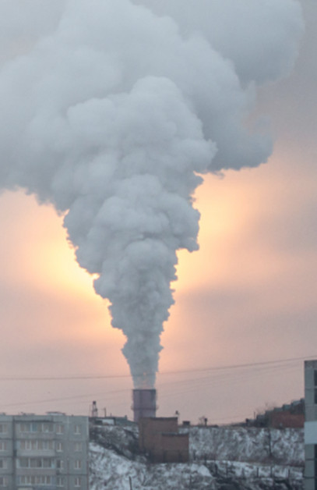
Work in pairs
Look at the picture and discuss:
1. What problem can you see?
2. What causes it?
3. What can we do to improve it?
Suggested answers:
1. I can see lots of smoke. → air pollution
2. Perhaps the factory uses coal to run/burn.
3. It should change into another energy source.

Slide 6


It’s listening time….

Slide 7
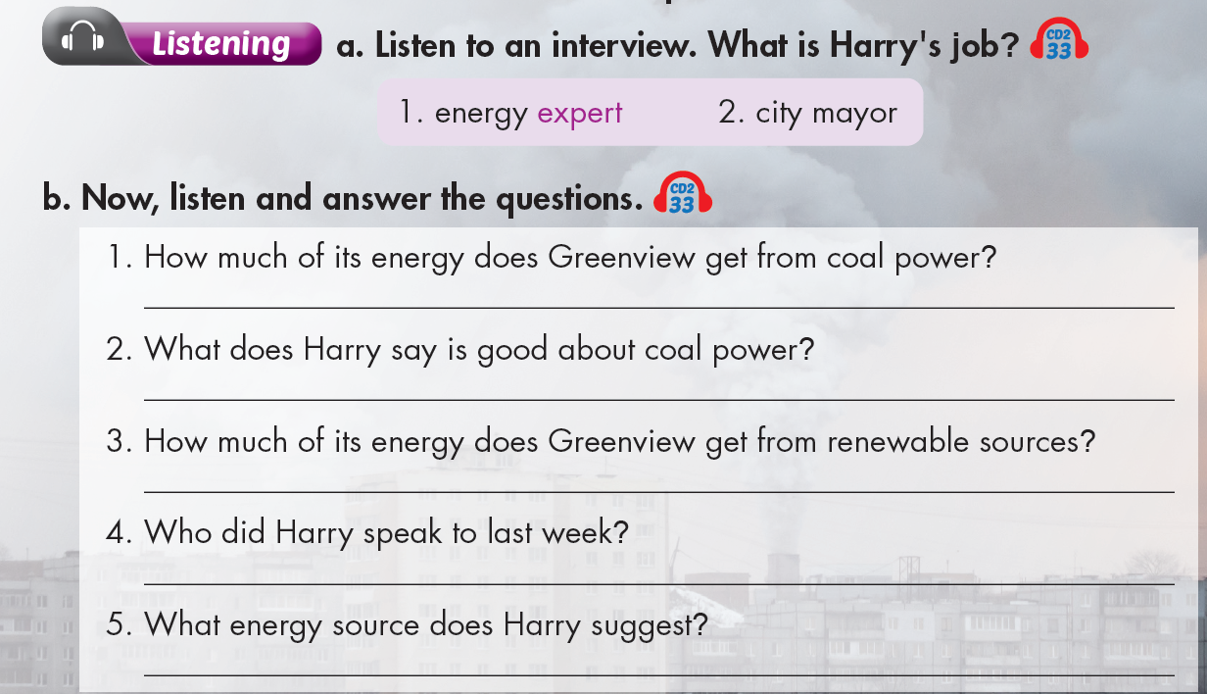

Slide 8

Pre – listening
Before listening
a. Underline the key words and guess what Harry’s job is.
a person with special knowledge, skill, or training in something
the head of the government of a town or city, etc., elected by the public

Slide 9
b. Underline the key words in each question and predict the answer.
Percentage.
1. How much of its energy does Greenview get from coal power?
2. What does Harry say is good about coal power?
Advantages.

Slide 10
b. Underline the key words in each question and predict the answer.
Percentage.
3. How much of its energy does Greenview get from renewable sources?
4. Who did Harry speak to last week?
5. What energy source does Harry suggest?
The person Harry spoke to.
Harry gave advice another energy source.

Slide 11

While - listening
Click on the icon to hear the sound
Listen the first time to recognize what Harry’s job is.
“I spoke to the city mayor last week and told
him that things need to change. I think the city
needs to use more solar power.”
→ Harry is an energy expert.

Slide 12
While - listening
Listen twice to answer the questions.
Click on the icon to hear the sound
1. How much of its energy does Greenview get from coal power?
2. What does Harry say is good about coal power?
The city gets over sixty percent of its energy from coal.
Coal is cheap to run.

Slide 13
While - listening
Listen twice to answer the questions.
Click on the icon to hear the sound
3. How much of its energy does Greenview get from renewable sources?
4. Who did Harry speak to last week?
5. What energy source does Harry suggest?
It only gets ten percent from renewable sources.
He spoke to the city mayor last week.
He suggests the city needs to use more solar power.

Slide 14

Post - listening
Work in pairs.
Do you think the city mayor agrees with Harry? Why (not)?

Slide 15
Audio Scripts
Practice the conversation with a partner.
W: Hello. I’m here today with Harry Devine. He has been looking very closely at how Greenview gets its energy.
M: Hello. It's great to be here.
W: What can you tell us about the energy used in Greenview?
M: The city gets over sixty percent of its energy from coal. Coal is cheap to run, but it causes pollution.
W: That's terrible.
M: And, the city gets thirty percent of its energy from nuclear power. This can be very dangerous.
W: I see.
M: It only gets ten percent from renewable sources. This just isn't enough.
W: So what needs to change?
M: Well, I spoke to the city mayor last week and told him that things need to change. I think the city needs to use more solar power. It's a very sunny place and solar energy is cheap and eco-friendly.
W: Thank you for talking with me, Harry.

Slide 16

Extra Practice
WB, page 60
Pre – listening
Before listening
a. Underline the key words and guess the main idea of the talk between two students.

Slide 17
While - listening
Click on the icon to hear the sound
To suggest the city should use more renewable energy.
Linda: I think we should use more renewable energy.
John: Yes. Our city gets five percent of its energy from wind power. We only have one small wind power plant. I hope we could make more energy from wind in the future.
Extra Practice
WB, page 60

Slide 18
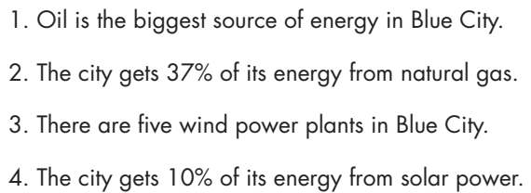
Pre – listening
b. Underline the key words.
Extra Practice
WB, page 60

Slide 19
While - listening
Listen again to check True/False.
Click on the icon to hear the sound
True
32%
False
We only have one small wind power plant.
False
True
Extra Practice
WB, page 60

Slide 20
Audio Scripts
Linda: Hi, welcome to Teens' Talk. Kate and John are here to talk about energy sources in Blue City.
Kate: Hello, everyone. Let's start with oil. We get thirty-seven percent of our energy from oil. It's the biggest source of energy used in our city.
Linda: Wow! That's a lot.
Kate: Yeah. Oil causes lots of pollution. We also use lots of natural gas. The city gets thirty-two percent of its energy from natural gas.
Linda: I think we should use more renewable energy.
John: Yes. Our city gets five percent of its energy from wind power. We only have one small wind power plant. I hope we could make more energy from wind in the future.
Linda: How about solar power?
John: Now, we only get ten percent of our energy from solar power. I think the city needs to use more solar power.

Slide 21
Post - listening
Work in pairs
Do you think solar power is the best energy source?

Slide 22
Pre - reading
Underline the key words and guess the biggest problem in Windrush City.
too many wind turbines
too much air pollution
spending too much money on energy

Slide 23
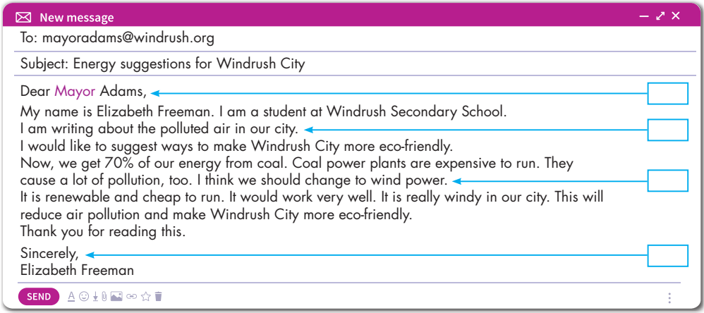
While - reading
Skim the email and underline the key words.
The biggest problem is
2. Too much air pollution

Slide 24
While - reading
Scan the email again and fill in the blanks.
1. Elizabeth goes to _____________ Secondary School.
2. She is writing about the _____________ air in the city.
3. The city gets most of its energy from _____________.
4. Wind power is _____________ to run.
5. Windrush City will become more _____________ if Mayor Adams follows Elizabeth's suggestion.
Windrush
polluted
coal
cheap
eco-friendly

Slide 25

Post - reading
Work in pairs
1. Is your town/ area polluted?
2. What are the causes?
3. What should your town/ area do to improve it?

Slide 26

CONSOLIDATION

Slide 27
Write a paragraph about what your town/ area should do to improve the pollution. (60-80 words)

Slide 28

WRAP-UP

Slide 29
Today’s lesson
Review sources of energy
Listening:
- Listen for gist and recognize the correct/ incorrect information
Reading:
- Skim and scan for general and specific information

Slide 30
Homework
Practice the vocabularies and make sentences using them.
Do the exercises in Tiếng Anh 7 i-Learn Smart World Workbook on page 60.
Do exercises in Tiếng Anh 7 i-Learn Smart World Notebook on page 64.
Prepare the next lesson (page 83 SB).
Play consolidation games in Tiếng Anh 7 i-Learn Smart World DHA App on www.eduhome.com.vn

Slide 31

Lesson 3
Stay positive and have a nice day!

