Slide 1


Slide 2
Unit
3
Cities of the future
Unit
FAMILY LIFE
LESSON I
GETTING STARTED
An exhibition of future cities

Slide 3
LESSON I
GETTING STARTED
WARM-UP
GAME: Hot potato
PRESENTATION
Vocabulary
Task 1: Listen and read.
Task 2: Complete the notes.
Task 3: Match the words to make phrases .
Task 4: Compete the sentences.
PRACTICE
PRODUCTION
Interview
CONSOLIDATION
Wrap-up
Homework

Slide 4
WARM-UP
HOT POTATO GAME
Ss stand in a circle or two rows facing each other and set a time limit for the game.
T throws the ball to one student and has him/her call out one target word or phrase from Unit 2. Then he/she throws the ball to another student, who has to say another target word.
The game continues until the time is up or all ss have had a chance to say a word or phrase.

Slide 5

PRESENTATION
impact (n)
E.g: The report assesses the impact of the disease on mortality and population growth.
/ˈɪmpækt/
the powerful effect that something has on somebody/something

Slide 6
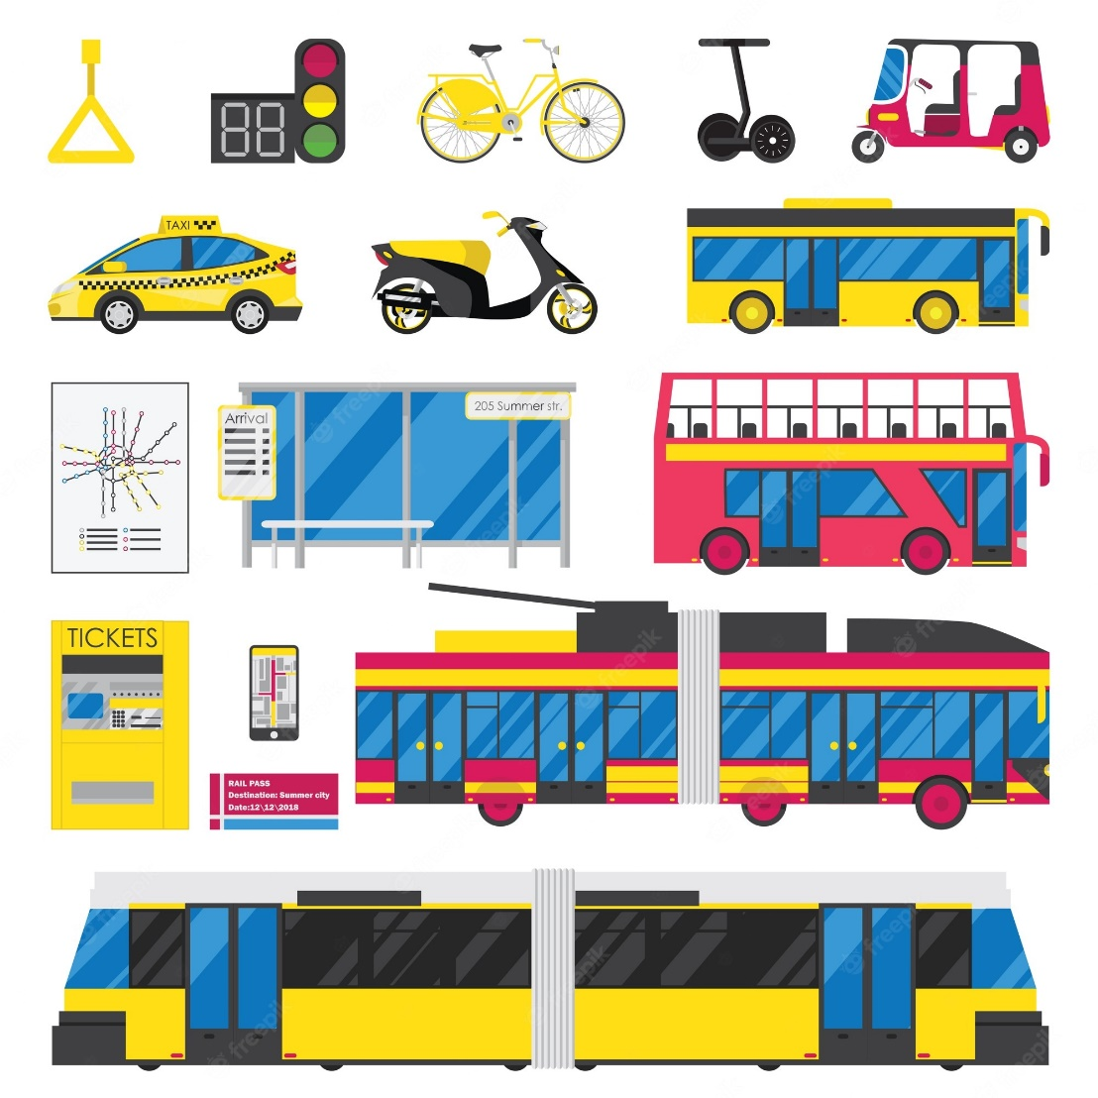
PRESENTATION
public transport (n)
/ˌpʌblɪk ˈtrænspɔːt/
The system of buses, trains, etc. provided by the government or by companies, which people use to travel from one place to another
E.g: Most of us use public transport to get to work.

Slide 7
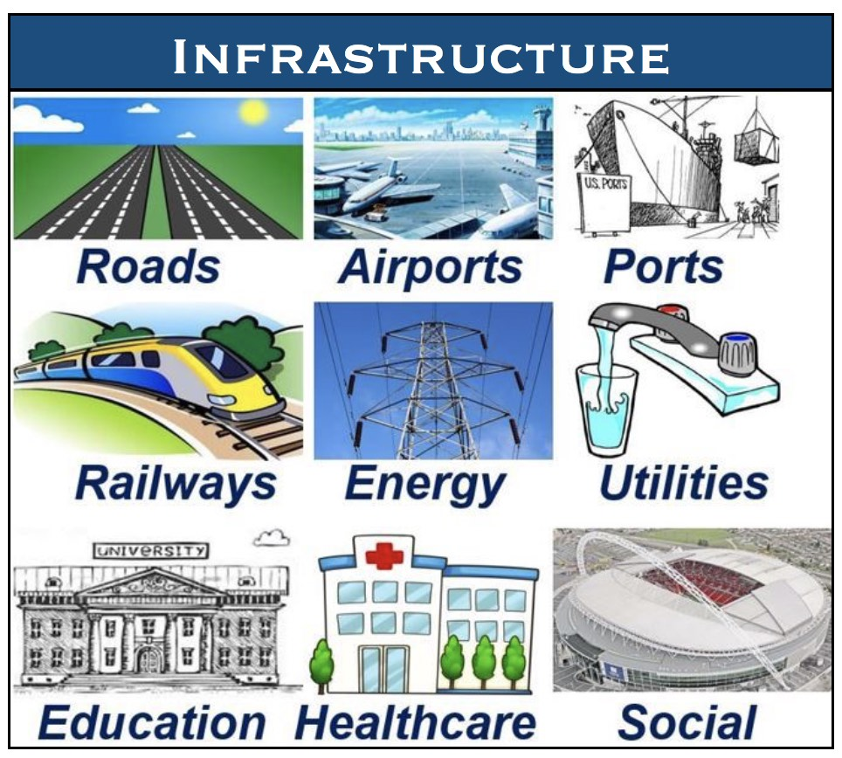
PRESENTATION
infrastructure (n)
/ˈɪnfrəˌstrʌktʃə/
the basic systems and structures that a country or organization needs in order to work properly

Slide 8
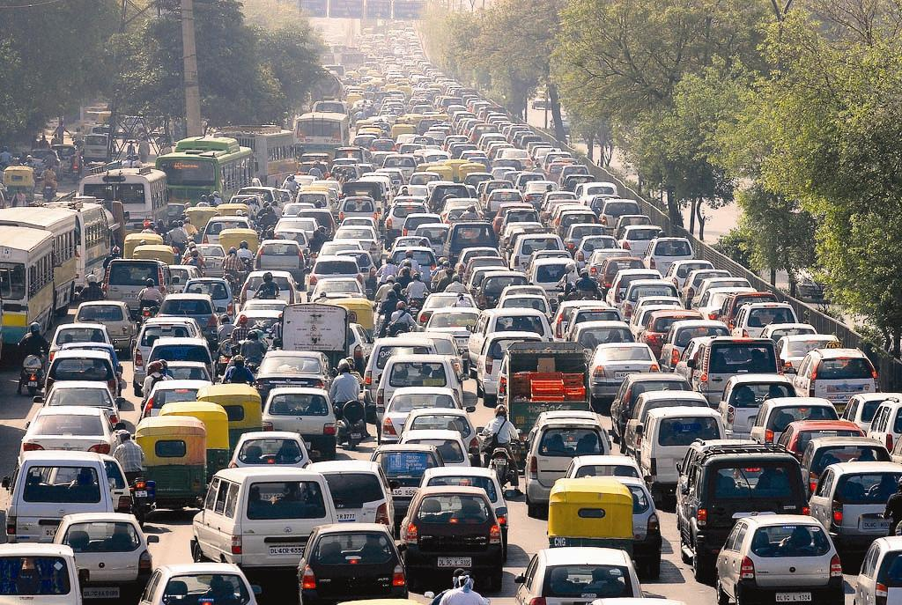
PRESENTATION
traffic jam (n)
/ˈtræfɪk dʒæm/
a long line of vehicles on a road that cannot move or can only move very slowly

Slide 9
PRESENTATION
carbon footprint (n)
/ˈkɑːbən ˈfʊtˌprɪnt/
Eg: There are lots of ways you can reduce your carbon footprint.
the amount of carbon dioxide that a person or organization produces by the things they do

Slide 10
Form | Pronunciation | Meaning | Vietnamese equivalent
1. impact (n) | /ˈɪmpækt/ | the effect or influence that an event, situation etc has on someone or something | ảnh hưởng
2. public transport (n) | /ˈpʌblɪk ˈtrænspɔːt/ | buses, trains etc that are available for everyone to use | phương tiện công cộng
3. infrastructure (n) | /ˈɪnfrəˌstrʌktʃə/ | the basic systems and structures that a country or organization needs in order to work properly | cơ sở hạ tầng
4. traffic jam (n) | /ˈtræfɪk dʒæm/ | a long line of vehicles on a road that cannot move or can only move very slowly | tắc nghẽn giao thông
5. carbon footprint (n) | /ˈkɑːbən ˈfʊtˌprɪnt/ | the amount of carbon dioxide that a person or organization produces by the things they do | dấu chân cacbon

Slide 11
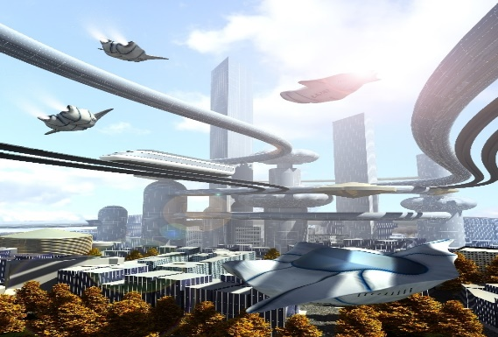
PRACTICE
1
Listen and read.

Slide 12
PRACTICE
2
Read the conversation again and complete the notes.
Future cities | T
Green city | Smart city
- More than 50% of it is made up of (1) _________. - Using public transport will help reduce (2) __________ and pollution. | - AI (3) ___________ will help the city operate more efficiently. - High-rise buildings will help solve the (4) _________ problems.
technology
green areas
traffic jams
housing

Slide 13
PRACTICE
3
Match the words to make phrases mentioned in 1.
public | 1 - | city
2. private | 2 - | b. infrastructure
3. modern | 3 - | c. transport
4. high-rise | 4 - | d. vehicles
5. smart | 5 - | e. buildings
c
d
b
e
a

Slide 14
PRACTICE
4
Complete the sentences with phrases from 1.
1. It ___________________ to many environmental problems.
2. The modern infrastructure of the city _________________.
3. I ___________________ living in a smarty city in the future.
seems a good solution
looks beautiful
am thinking of

Slide 15
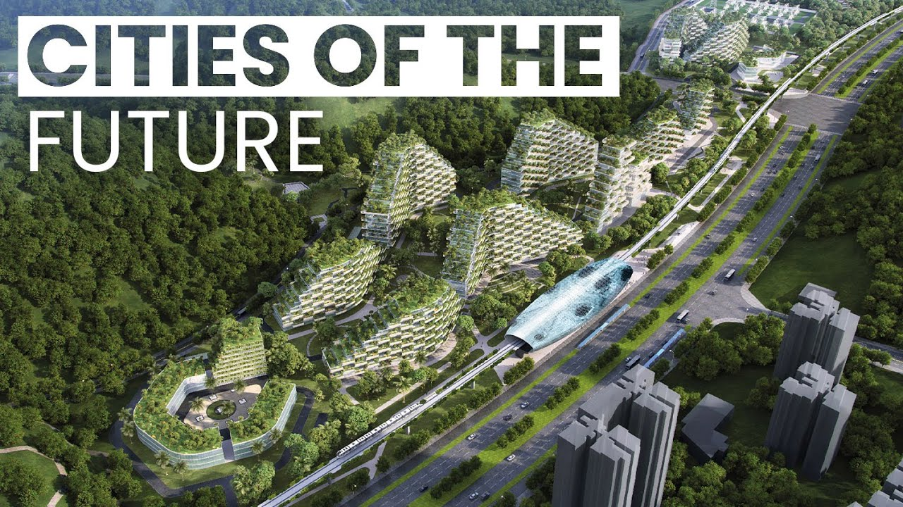
PRODUCTION
Interview
- Ss work in pairs.
- Each student draws their own dream city of the future.
- Look at the picture and ask each other about the city of the future.
- 7 minutes to prepare for the interview.
- 3 minutes for the performance.

Slide 16
CONSOLIDATION
1
Wrap-up
What have you learnt today?
Some lexical items about cities of the future
Reading for specific information about future cities
Stative verbs and linking verbs

Slide 17
CONSOLIDATION
2
Homework
Do exercises in the workbook.
Prepare for Lesson 2 - Unit 3.
Prepare materials for the project in lesson 8.

Slide 18

Website: hoclieu.vn
Fanpage: facebook.com/www.tienganhglobalsuccess.vn

