Slide 1
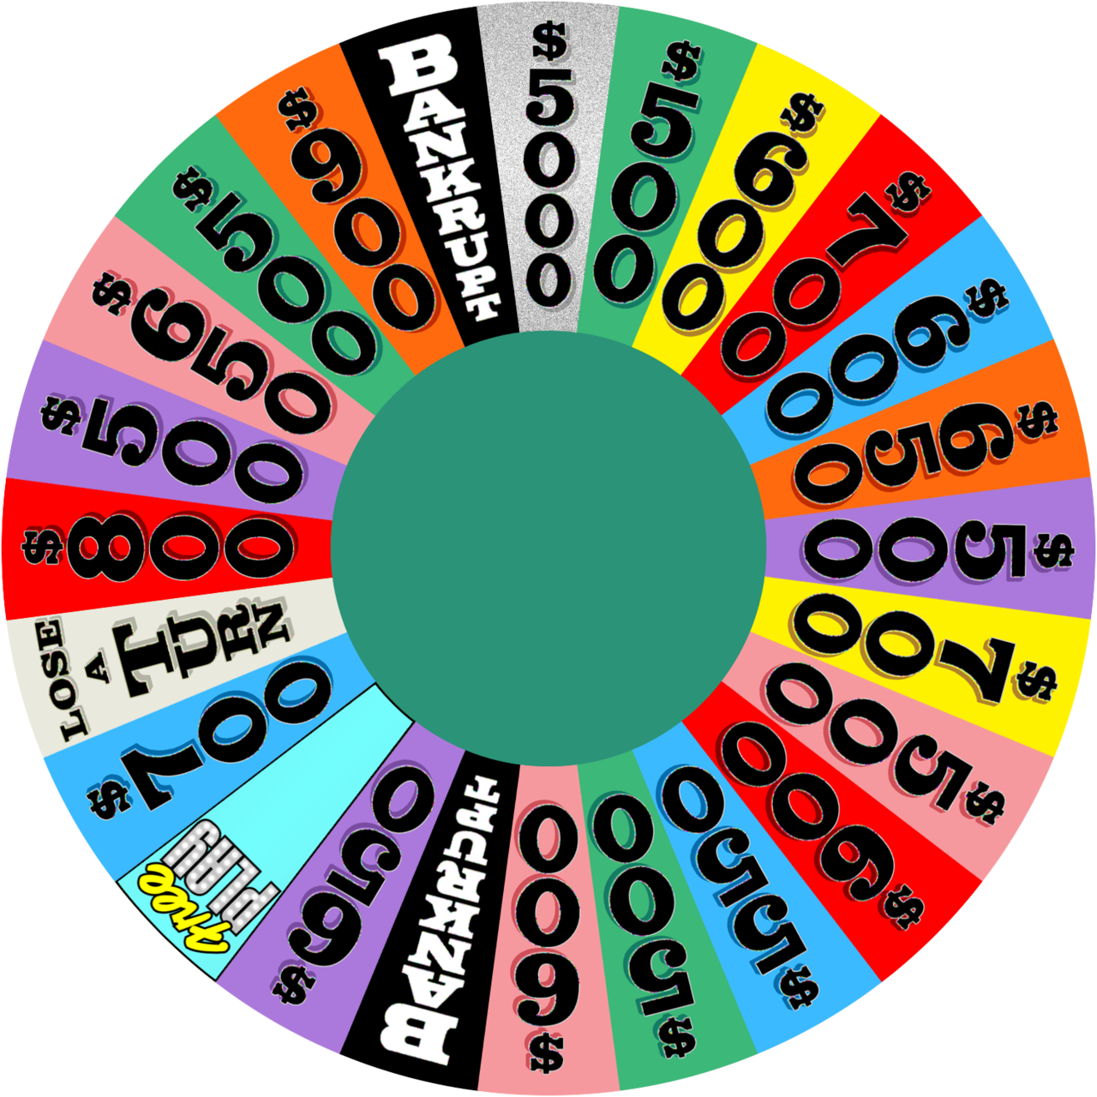


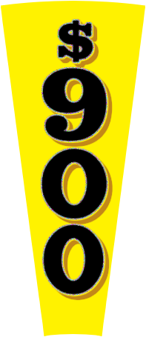


Macros/active content are disabled.
Please enable them to use this template. Learn more
PowerPoint Edition
How to Use
Set Up Puzzles
Puzzle Board
Version 5.2 Check for Updates
About/Credits

Slide 2

Wheel
Wheel
Wheel
RSTLNE
Wheel
?
B
C
D
F
G
H
J
K
L
M
N
gamesbytim.com
Set Up Puzzles
Clear Board
End Game
Ñ
P
Q
R
S
T
V
W
X
Y
Z
WHEEL OF FORTUNE
A
E
I
O
U
1
0
5
9
12
13
15
16
21
23
22
24
27
26
25
14
11
10
8
7
6
4
3
2
1
29
28
20
19
18
17
10
9
8
7
6
5
4
3
2
1
FINAL SPIN
Load Puzzle
Bonus Round
(+$1000 to wheel value)
Fourth Round
Express Round
Mystery Round
Normal Round
3 Players
+
Player 1
Player 2
Player 3
Player 4
Round
$
0
$
0
$
0
$
0
x
x
x
x
Totals
$
0
$
0
$
0
$
0

Slide 3





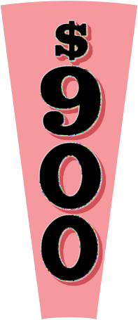

Normal Round
Click the wheel to spin!
?
Remove Wild Card
You landed on
Remove $10,000 Wedge
Add Gift Tag
Back

Slide 4
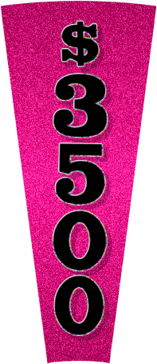

Mystery Round
Click the wheel to spin!
?
Remove Wild Card
You landed on
Remove $10,000 Wedge
Add Gift Tag
?
x
Back

Slide 5

Express Round
Click the wheel to spin!
?
Remove Wild Card
You landed on
Remove $10,000 Wedge
Add Gift Tag
Back

Slide 6
Fourth Round
Click the wheel to spin!
?
You landed on
Back

Slide 7
0
Set Up Puzzles
1
2
3
4
5
6
7
8
9
10
11
12
FOR HOST’S EYES ONLY!
Select a number above to set up your puzzle. You’ll use that number to load it to the puzzle board.
How to Use
Puzzle Board

Slide 8
Set Up Puzzles
1
2
3
4
5
6
7
8
9
10
11
12
Category:
How to Use
Puzzle Board

Slide 9
Settings
1
2
3
4
5
6
7
8
9
10
11
12
?
Vowel Price:
$250
?
Wheel Values:
current ($500 min)
?
House Minimum:
$1000
?
Wheel Items:
claimable once
?
Shot Clock:
none
?
Backdrop:
studio
?
Blue Tiles:
on
Configure Sound Effects
?
Confirm Solve:
off
Show All Puzzles
?
Spanish Ñ:
off
Delete All Puzzles
How to Use
Puzzle Board
GD

Slide 10
Configure Sound Effects
Click a sound effect box to preview its sound.
To customize sound effects, switch to Editing view and follow the steps on this slide’s notes.
Guess Letter Correct
Load Puzzle Chime
Guess Letter Wrong
Solve Puzzle Chime
Spin Wheel
Go Back
Notes:
HOW TO CUSTOMIZE SOUND EFFECTS
Each sound effect is an action button with a sound file set to play on click. During the game, Wheel of Fortune for PowerPoint uses macros to dynamically “click” the action button, playing its sound effect.
To change a sound effect:
Select the sound effect box.
On the PowerPoint ribbon, go to the Insert tab -> Action. An Action Settings pop-up should appear.
On the Mouse click tab, change the Play sound file (scroll down to Other Sound… in the dropdown menu). All sound effects must be in WAV format.
To disable the sound effect, select [No Sound].

Slide 11
1
2
3
1
2
3
4
5
6
4
5
6
7
8
9
7
8
9
10
11
12
10
11
12
Go Back

Slide 12
Normal Round
A typical Wheel of Fortune game has multiple rounds with different wheels. This is the normal wheel.
To claim landed-on wheel items (Wild Card, $10,o00 Wedge, Gift Tag), the player must call a correct letter.
The Wild Card, when used by the player, lets them call another consonant worth the value of their prior spin.
The $10,000 Wedge rewards $10,000, regardless of the amount of correct letters.
The Gift Tag gives the player a prize of your choice.
Close

Slide 13
Mystery Round
If a player lands on the Mystery Wedge and calls a correct letter, they can:
  1) Receive $1,000 for each letter in the puzzle or
  2) Chance receiving $10,000 or a Bankrupt.
If the player chooses option 2, click the giant question mark on the bottom left to determine their fate.
That Mystery Wedge disappears. The other Mystery Wedge becomes a standard $1,000 space.
Close

Slide 14
Express Round
If a player lands on the Express Wedge and calls a correct letter (worth $1,000), they have the option to “hop aboard” the Express.
When aboard, the player gets to call letters continuously at $1,000. But be careful: an incorrect letter leads to a Bankrupt.
The Express is a high risk, high reward challenge. Hop aboard if you dare!
Close

Slide 15
Fourth Round
This is the last of the wheels. The game continues with this wheel until the host calls the Final Spin (click the Final Spin button on the puzzle board to activate).
During the Final Spin Round:
  Vowels are free, consonants are worth whatever the host spins, plus $1,000. Players no longer spin the wheel.
  If a player on their turn calls a correct letter, they have 3 seconds to solve the puzzle before turn passes to the next player.
Close

Slide 16
Bonus Round
The winning player tries to solve a puzzle with a limited amount of letters.
Reveal all the R, S, T, L, N, and E’s in the puzzle.
RSTLNE
?
The player chooses three more consonants and a vowel. (Add another consonant if they have a Wild Card.)
Use the letter selector to input these letters. Then click these letters to reveal them in the puzzle.
RSTLNE
GJMA
?
The player has ten seconds to guess the puzzle.
10
Close

Slide 17
Thanks for using
Wheel of Fortune for PowerPoint.
End show
Wipe all puzzles/scores and end show
Wait! Go back
Remember to save before closing PowerPoint, and check out more projects at Games by Tim.

Slide 18
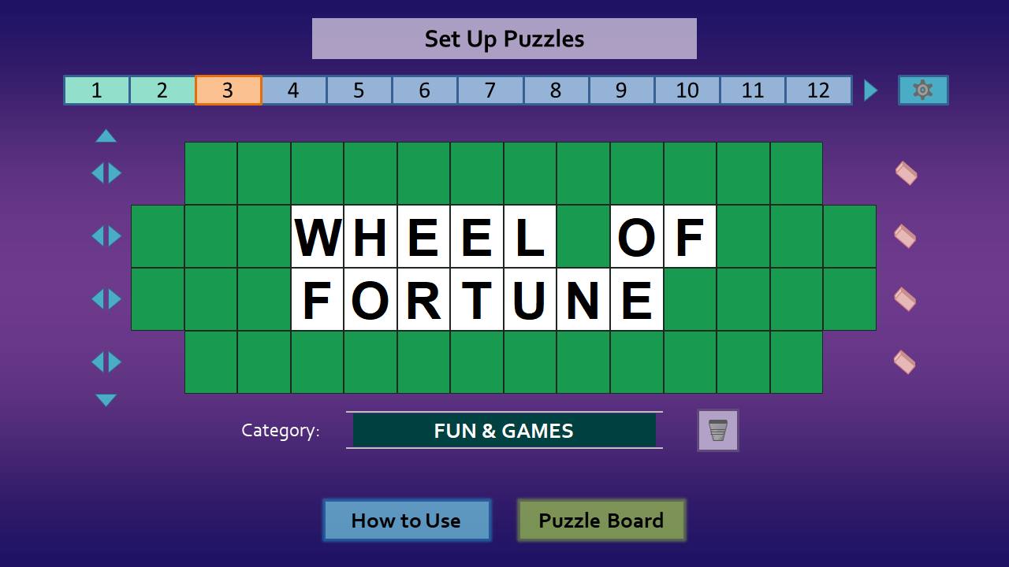
How to Use – Setup
Before you start your game, you’ll need to set up puzzles.
Remember the puzzle number you’re currently on.
Fine-tune your game in Settings.
Type the puzzle solution here.
Type the puzzle category.
Set Up Puzzles
Puzzle Board
Next

Slide 19
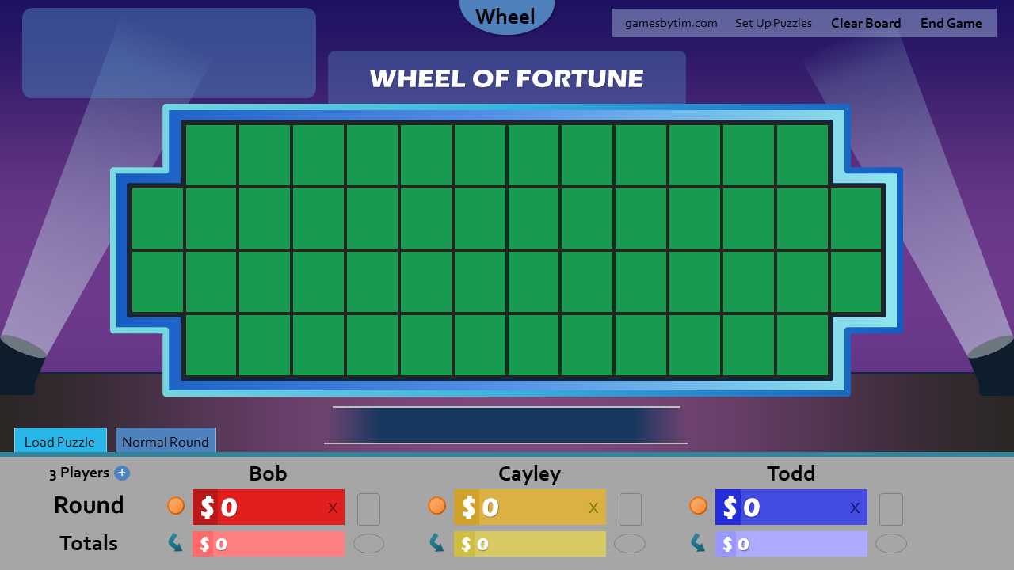
How to Use – Setup
Once you have enough puzzles, you’re ready for the puzzle board.
Load puzzles using your puzzle numbers.
Edit the player names.
Optionally add a fourth player.
Prev.
Set Up Puzzles
Puzzle Board
Next

Slide 20
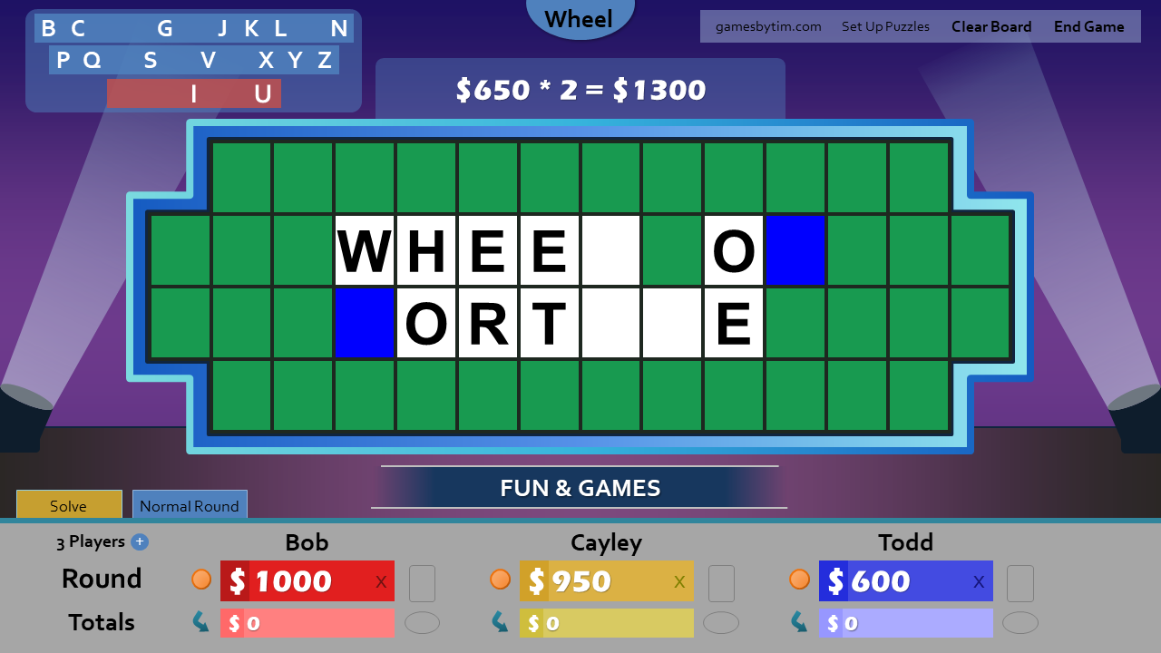
How to Use – Gameplay
The Value Panel holds the scored amount based on letters found and the spun wheel value.
Click letters to see if they’re in the puzzle.
Click the blue tiles that appear to reveal the letter.
Click the player’s round score to add the amount shown on the Value Panel.
Manually adjust score if needed with the player’s dollar sign.
Toggle who has the Wild Card/Gift Tag.
Click here if the player buys a vowel.
Prev.
Set Up Puzzles
Puzzle Board
Next

Slide 21
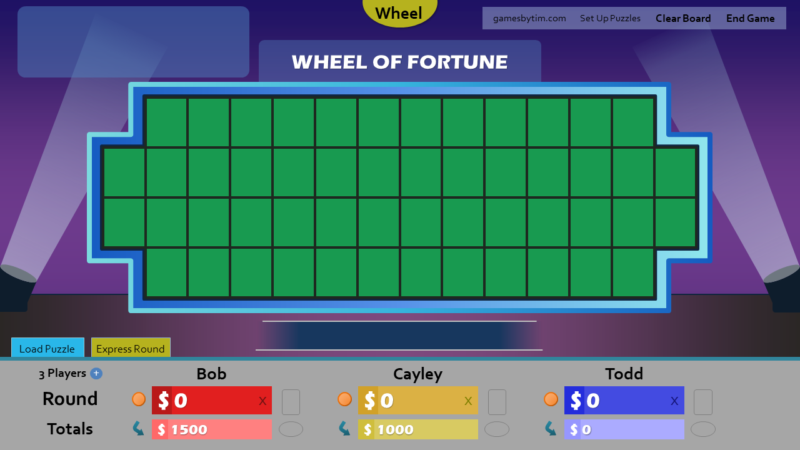
How to Use – The Next Round
Clear the board for a new round.
Click on the lights for stage effects.
Change the type of wheel used for the next round.
Transfer the winning player’s round score to their totals.
Prev.
Set Up Puzzles
Puzzle Board
Next

Slide 22
How to Use – Tips & Tricks
Using a real-life wheel? Click the Value Panel to manually set the spun wheel value.
Want a toss-up round? Input the money at stake to the Value Panel. Click white puzzle board tiles at random until someone calls the solution.
Prefer the Wild Card to work differently? Make your own rules! For instance, you can treat the Wild Card like a free spin, a free vowel, whatever you like.
Hosting through video call? It may help to run the slide show as a window. In editing view, go to the Slide Show tab -> Set Up Slide Show. Select “Browsed by an individual (window)”.
Prev.
Set Up Puzzles
Puzzle Board
Next

Slide 23
How to Use – Troubleshooting
PowerPoint 2010 (Windows)/2011 for Mac or newer is required.
You can find the last version to support PowerPoint 2007 here.
Enable macros, active content (Windows), and editing in order for Wheel of Fortune for PowerPoint to work.
If you run the slide show as a window, do not change slides with the scroll wheel/keyboard.
Remember to save when closing the file to retain your puzzles.
Report bugs to the project’s comments page. Here’s some tips to help me debug.
Prev.
Set Up Puzzles
Puzzle Board

Slide 24
Wheel of Fortune for PowerPoint
Developer: Timothy Hsu Revision Date: December 1, 2020
Wheel Graphics
wheelgenius from Deviantart
MarioGS from Buy a Vowel Boards
Sound Effects
Made with Logic Pro
Special Thanks
Merv Griffin (Wheel of Fortune founder)
Pat Sajak/Vanna White (Wheel of Fortune hosts)
SuperNikestar (YouTube user who inspired me to create this project)
Rusnakcreative (Inspiration from his Wheel of Fortune template)
The family/friends who participated in my test playthroughs
Legal
“Wheel of Fortune” is a registered trademark of Califon Productions, Inc, which was not involved in the production of, and does not endorse, this product. For more information about the game show, visit www.wheeloffortune.com.
For more projects from the developer, visit www.gamesbytim.com.
Back to Title
Wheel of Fortune for PowerPoint is licensed under a Creative Commons Attribution-NonCommercial-ShareAlike 4.0 International License.

