Slide 1


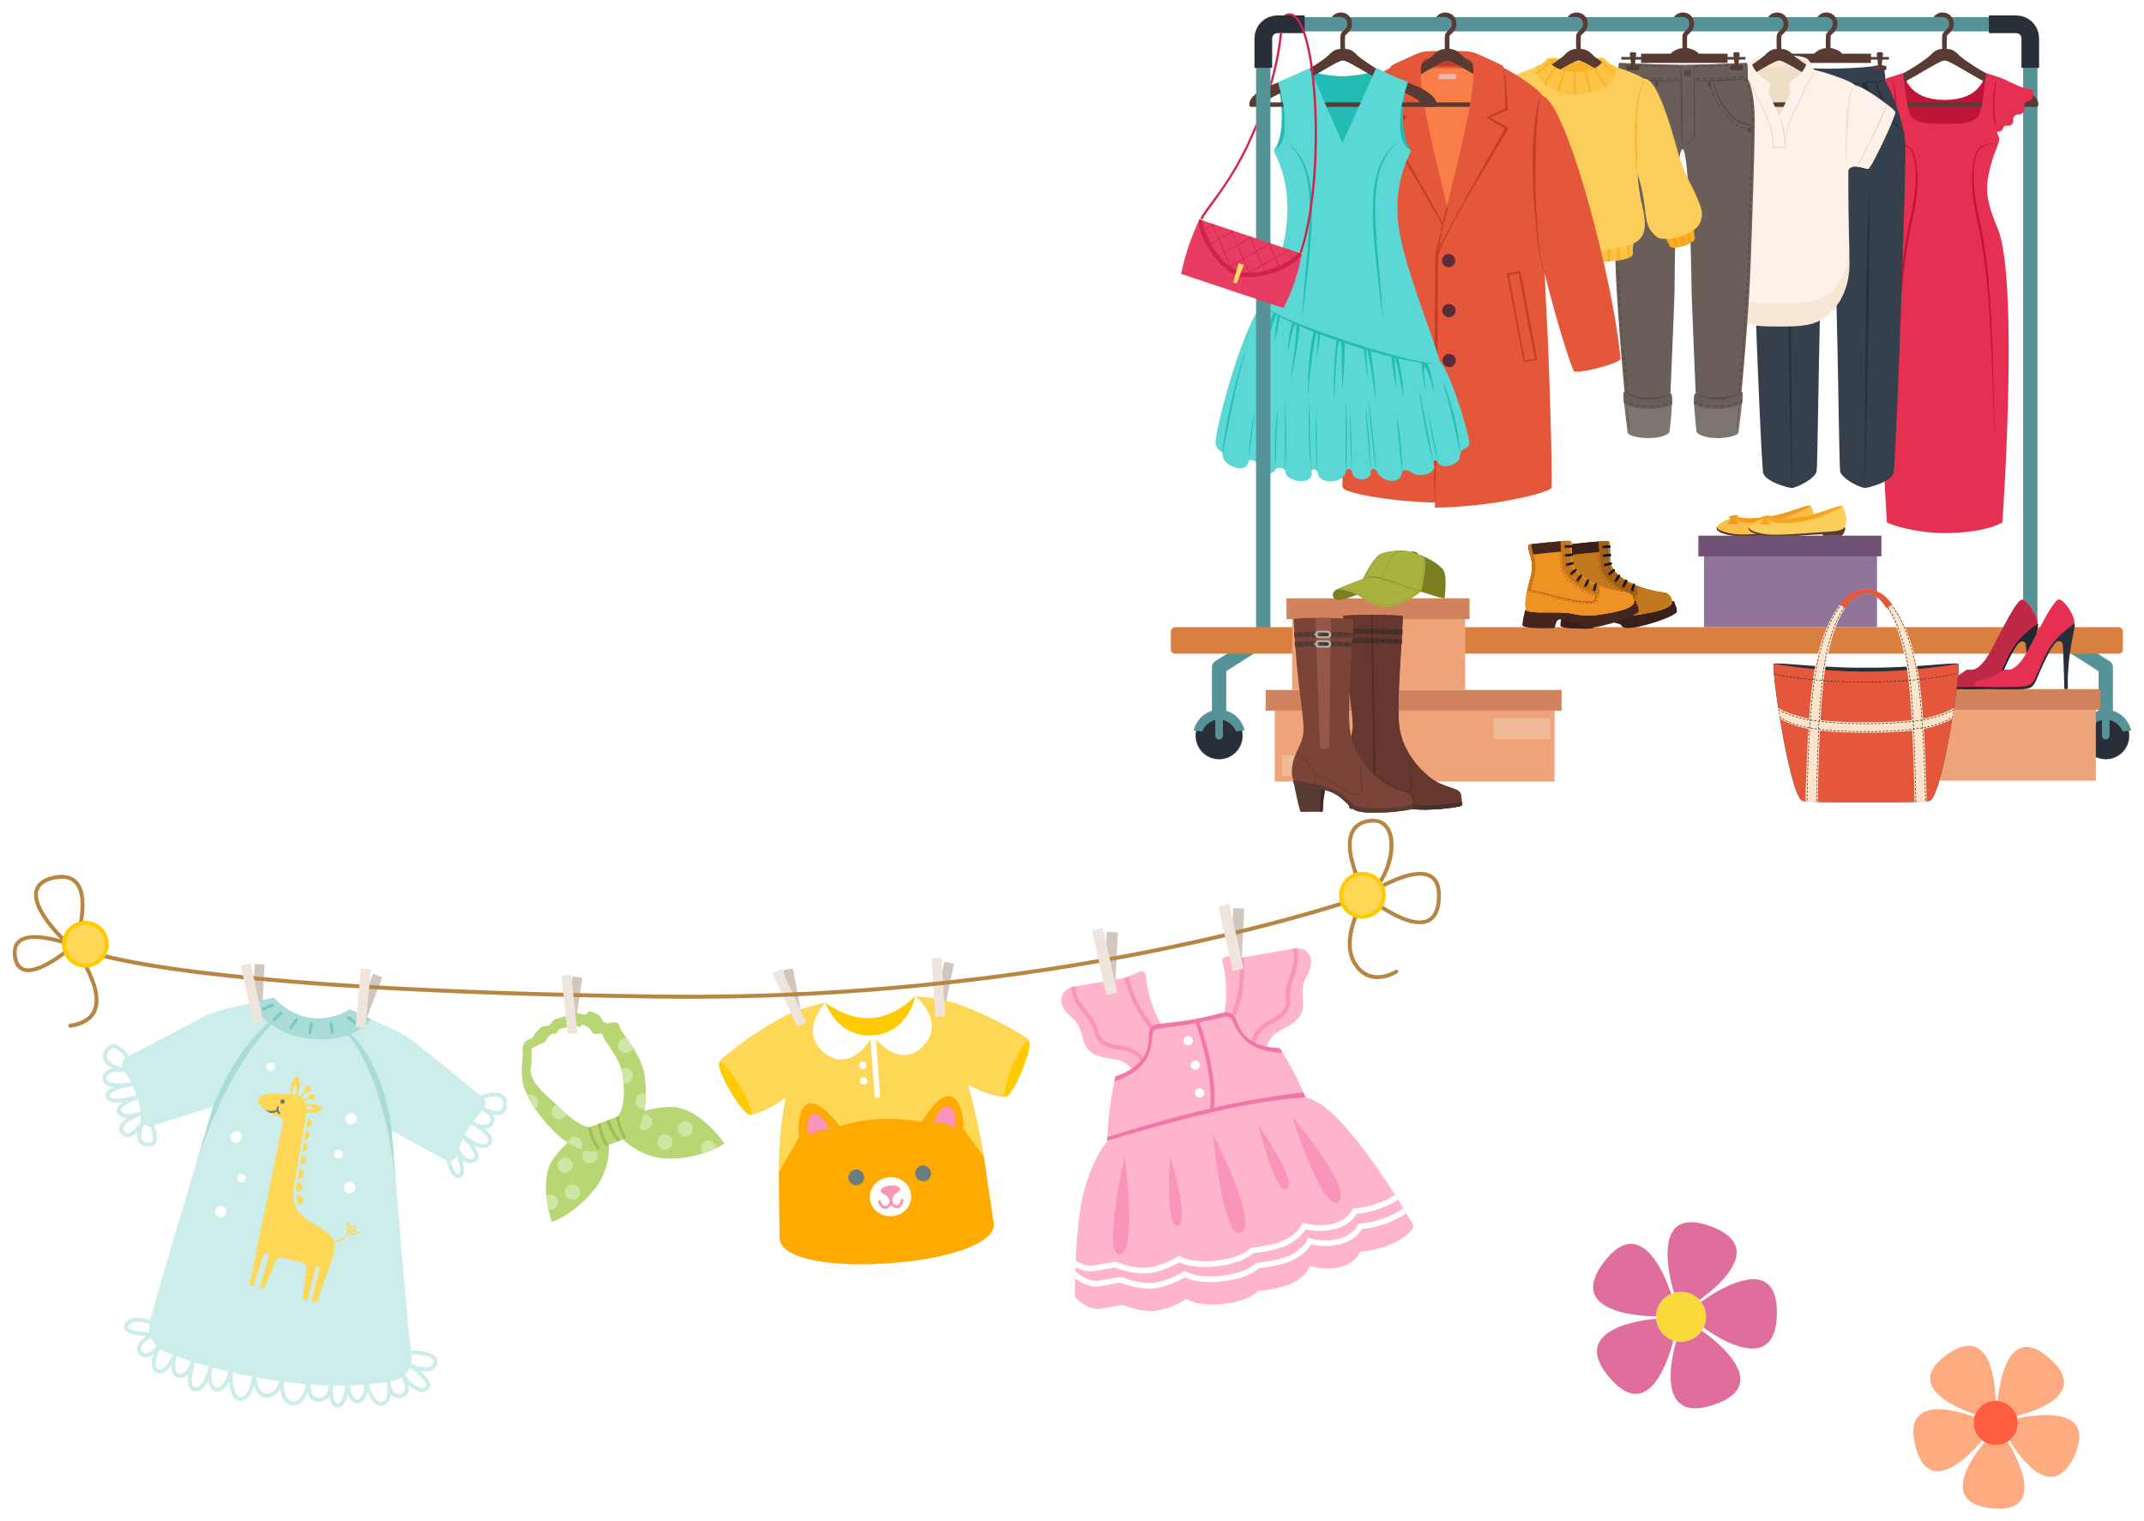
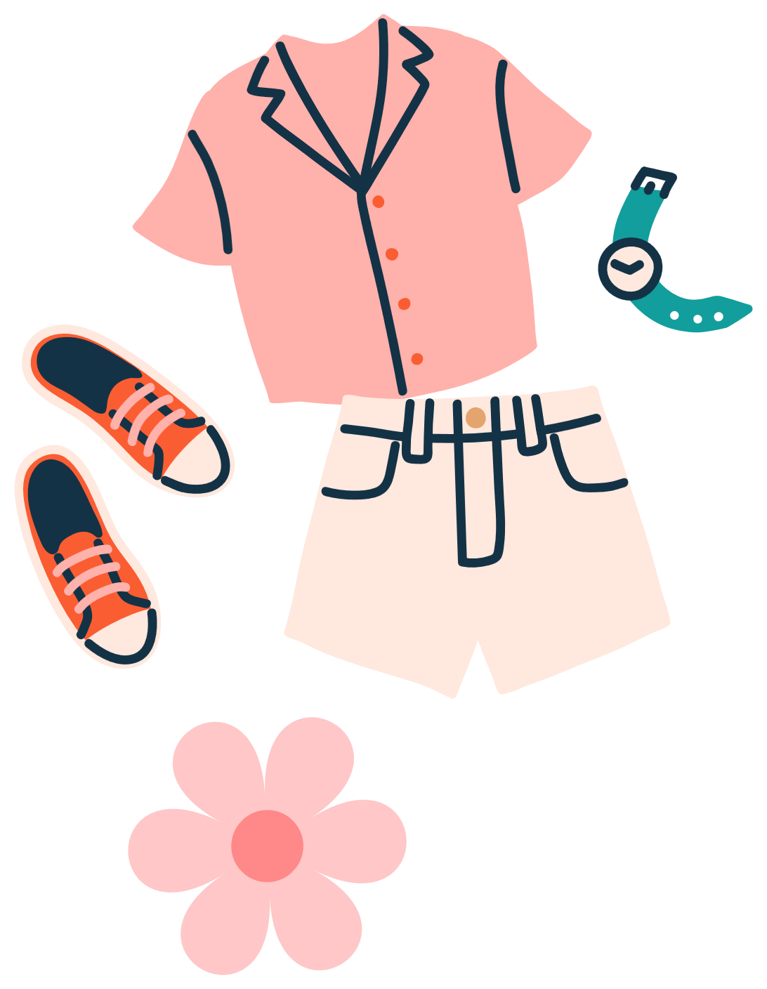

Clothes

Slide 2

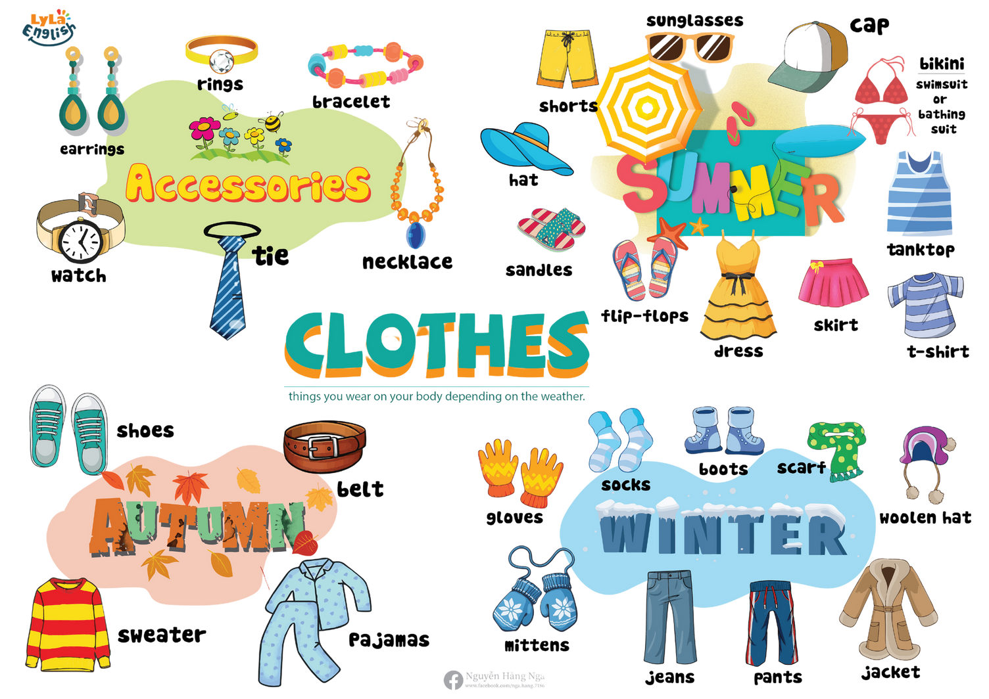

Slide 3

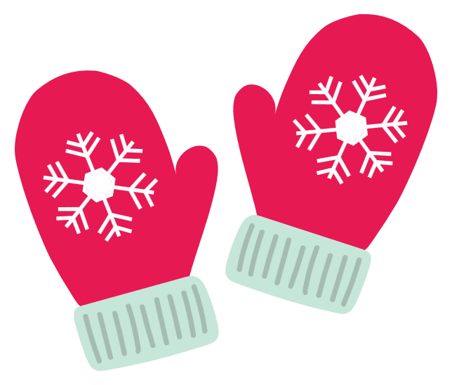
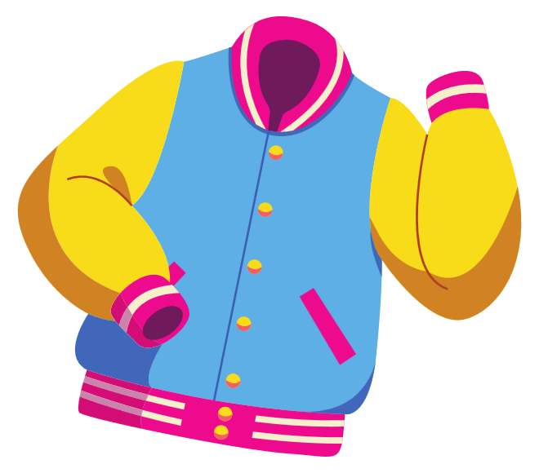
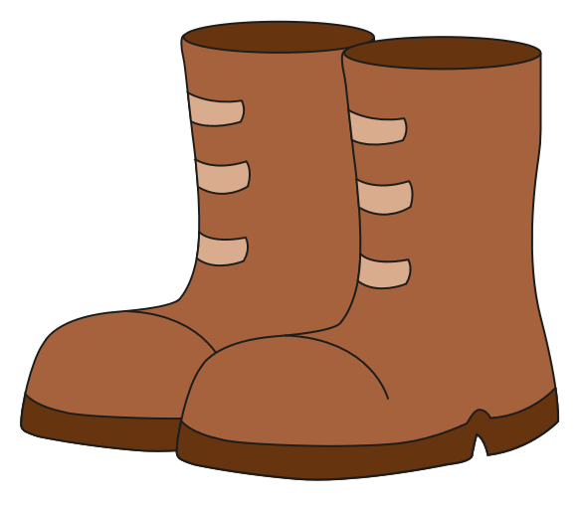
I. Questions
4. What do you wear when it’s sunny?
1. What is it?
I wear a .....
It is a...
2. What color is it?
It’s...
3. What are you wearing?
5. What do you wear when it’s snowy?
I wear a.....
I’m wearing.....

Slide 4


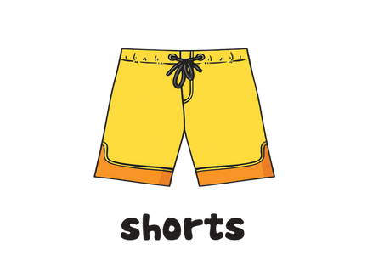

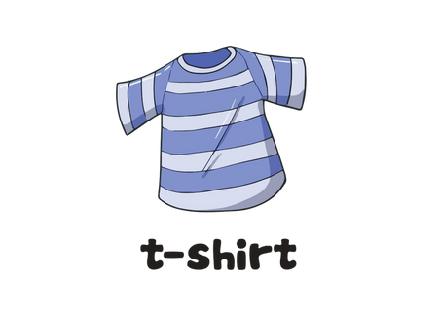

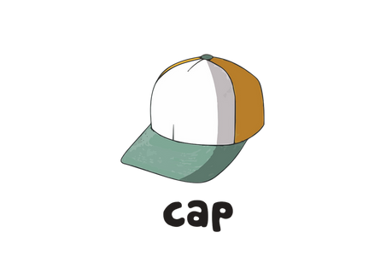


II. Vocabulary
shorts: ............................................................................................
T-shirt: ............................................................................................
cap: ................................................................................................
hat: ................................................................................................

Slide 5




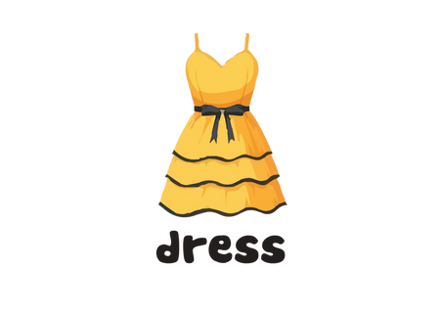

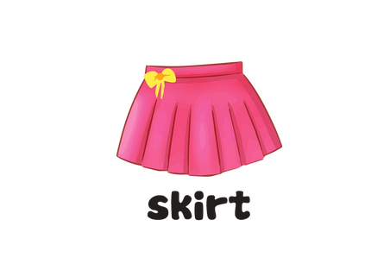

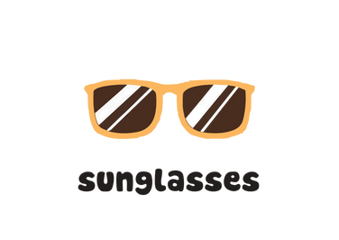
II. Vocabulary
tank top: ........................................................................................
dress: .............................................................................................
skirt: ..............................................................................................
sunglasses: ...................................................................................

Slide 6


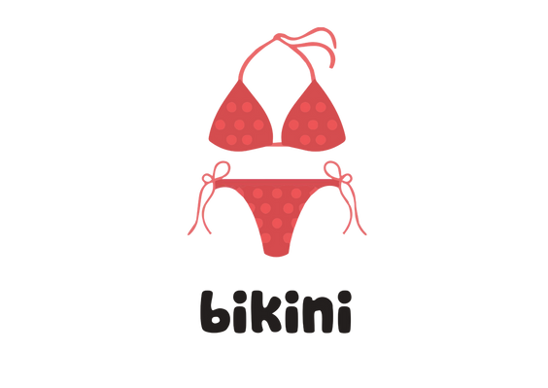

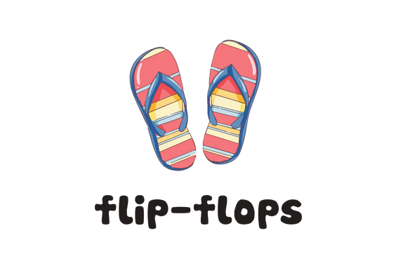

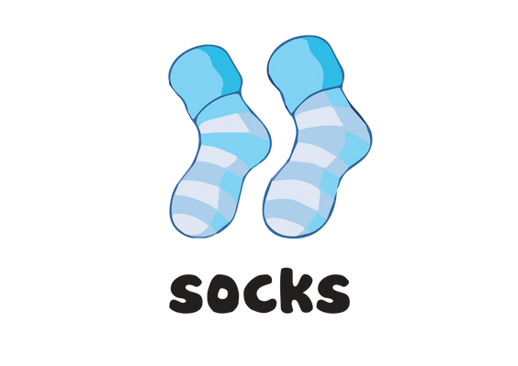

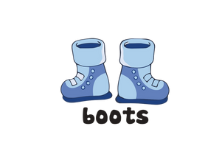
II. Vocabulary
bikini: .............................................................................................
flip-flops: .......................................................................................
socks: .............................................................................................
boots: .............................................................................................

Slide 7






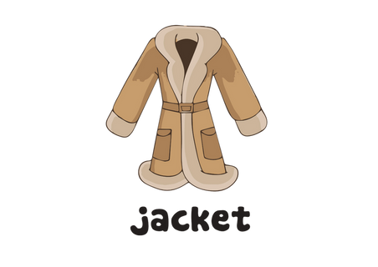


II. Vocabulary
woolen hat: ....................................................................................
scarf: ...............................................................................................
jacket: .............................................................................................
mittens: ..........................................................................................

Slide 8

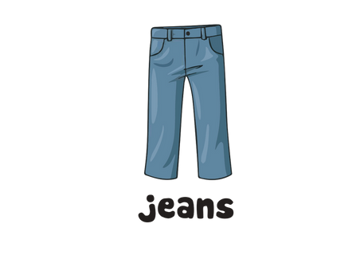

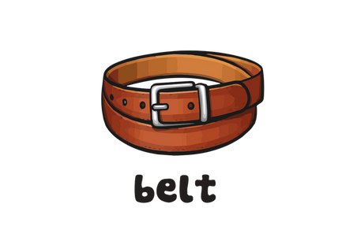

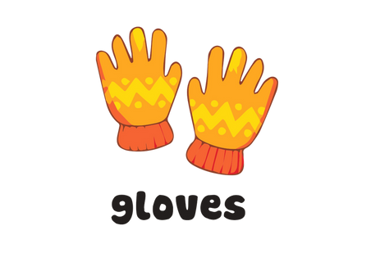

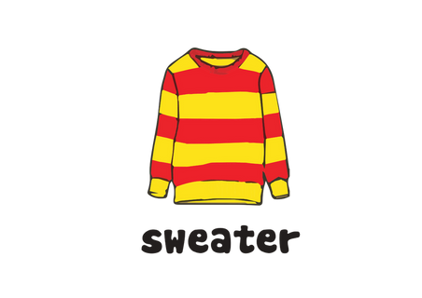
II. Vocabulary
jeans: ....................................................................................
belt: ...............................................................................................
gloves: ...........................................................................................
sweater: .........................................................................................

Slide 9

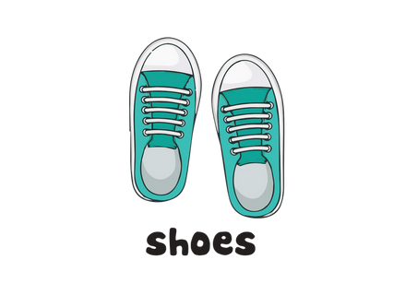

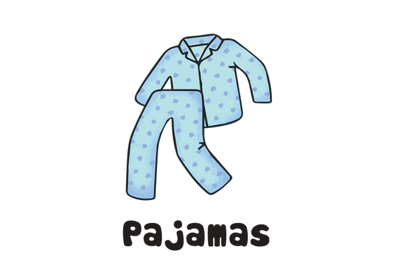

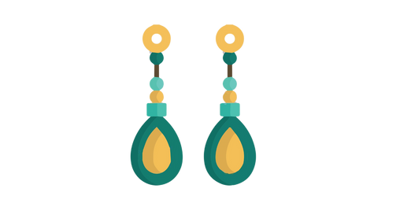

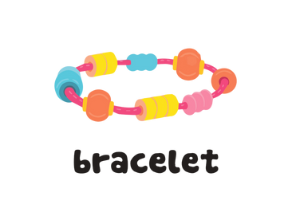
II. Vocabulary
shoes: ............................................................................................
pajamas: ........................................................................................
earings: ..........................................................................................
bracelet: .........................................................................................

Slide 10

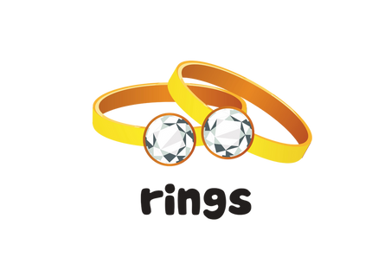

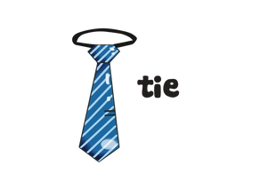

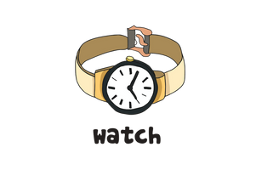

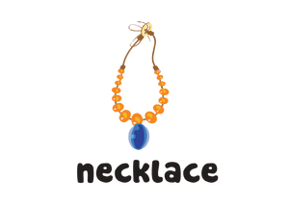
II. Vocabulary
rings: .............................................................................................
tie: .................................................................................................
watch: ...........................................................................................
necklace: ......................................................................................

Slide 11

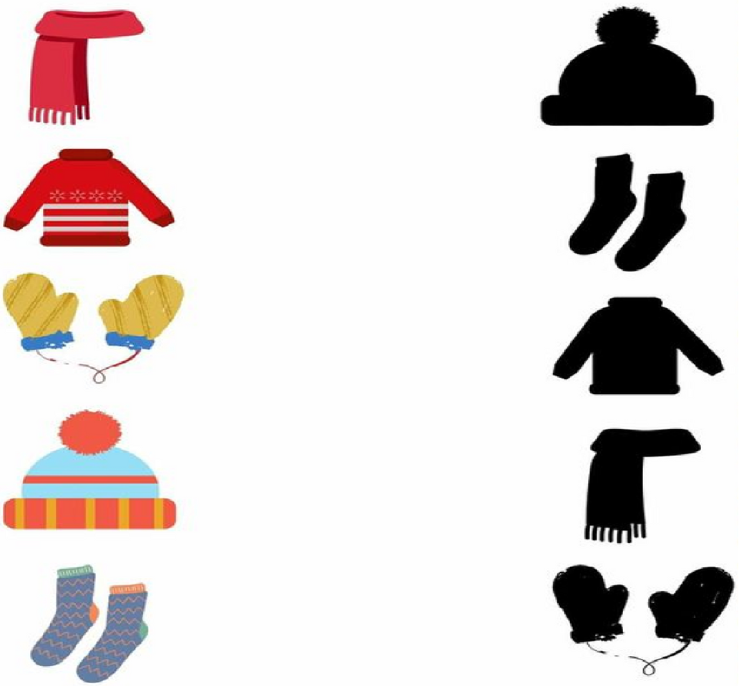
III. Exercise
1. Find the correct shadow

Slide 12
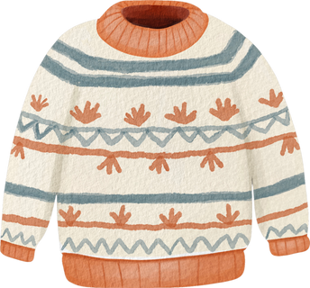
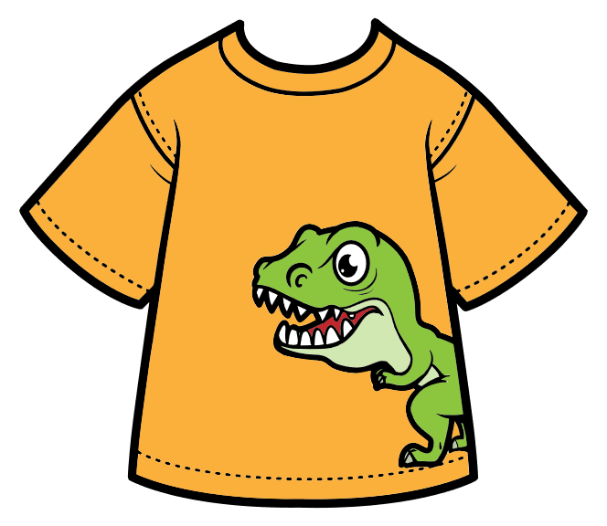
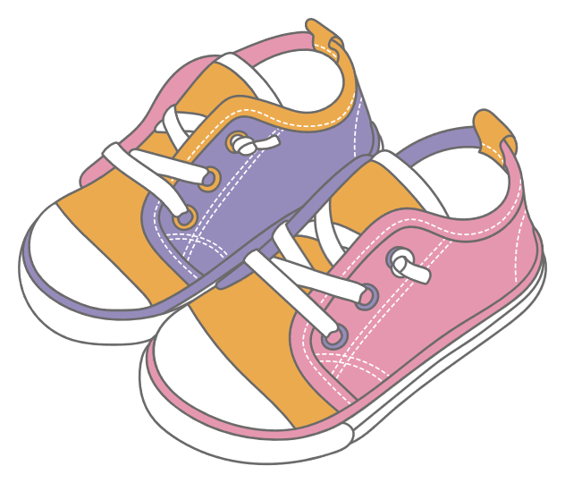
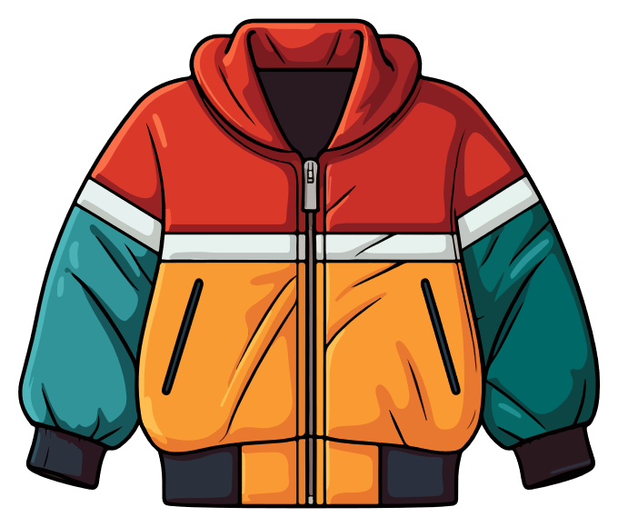
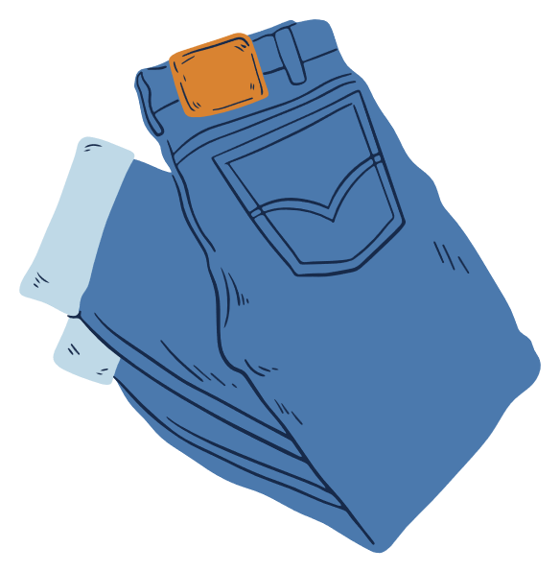
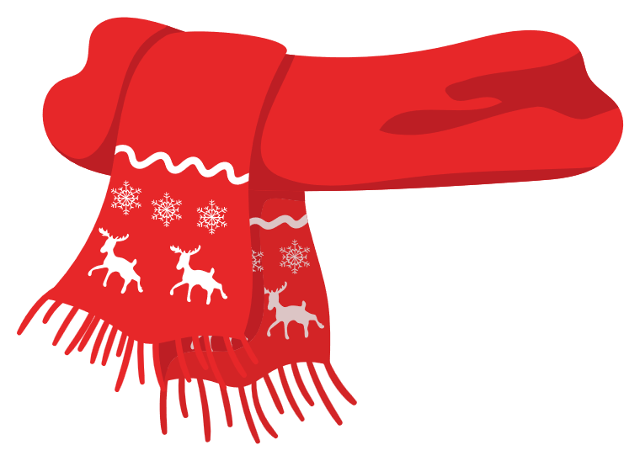
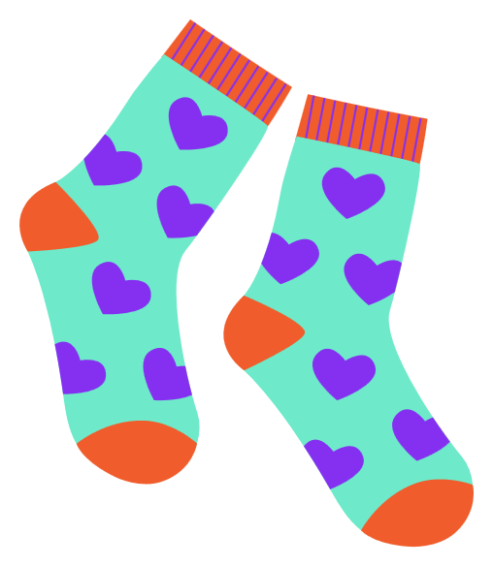
III. Excerise
2. Look and match
cap
T- shirt
jeans
jacket
socks
scarf
sweater
shoes

Slide 13
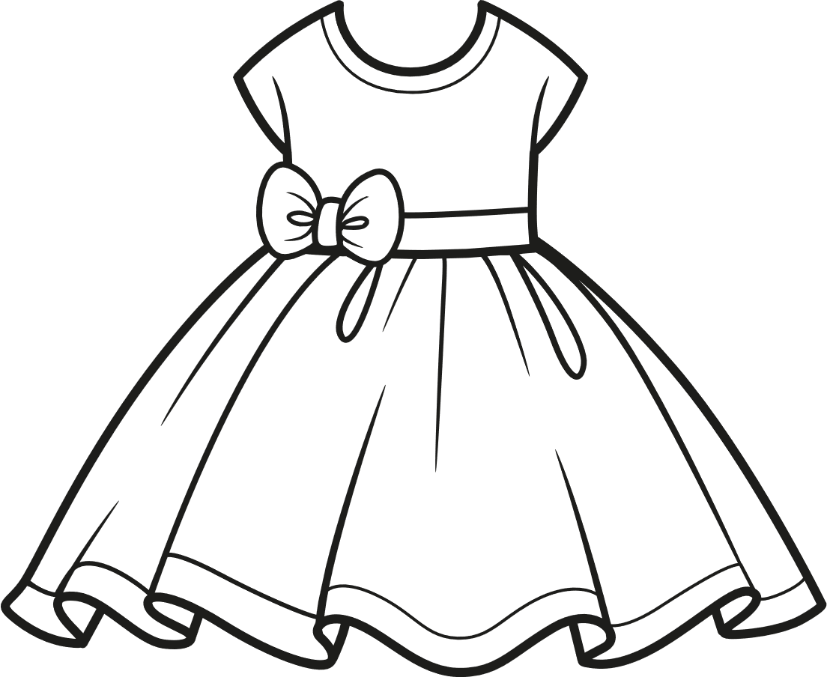
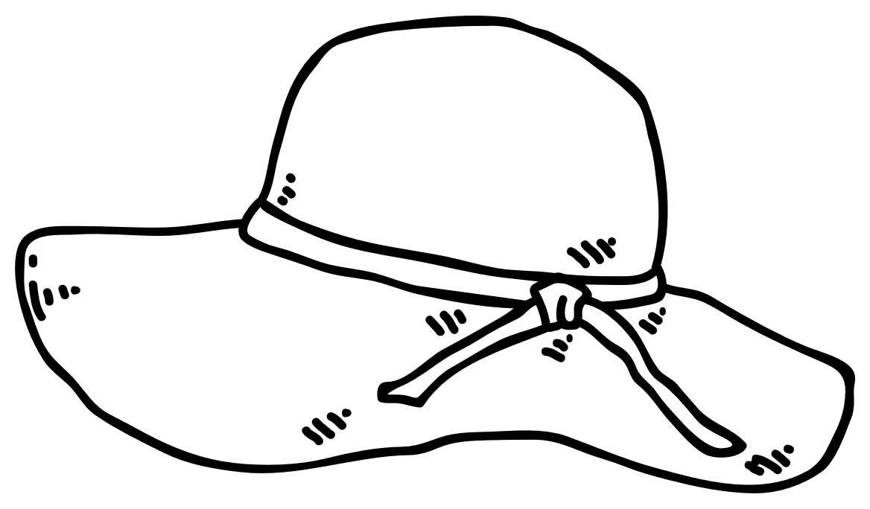
III. Excerise
3. Read and colour.
a blue hat
a red dress
a yellow ring
a pink skirt

Slide 14

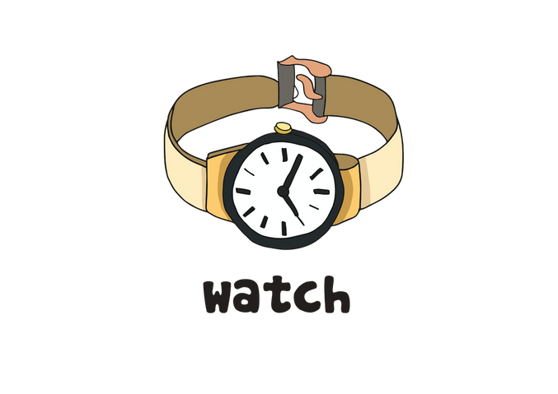
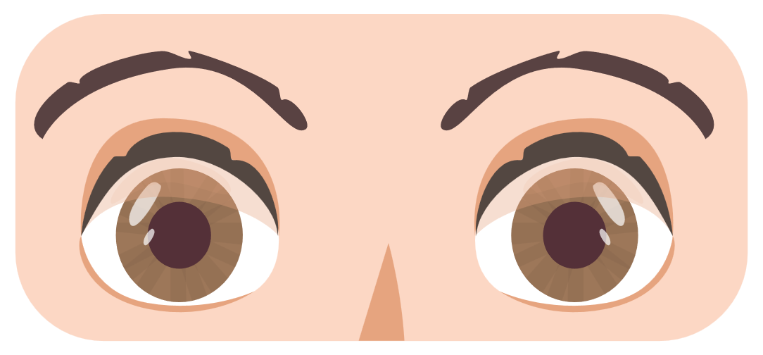
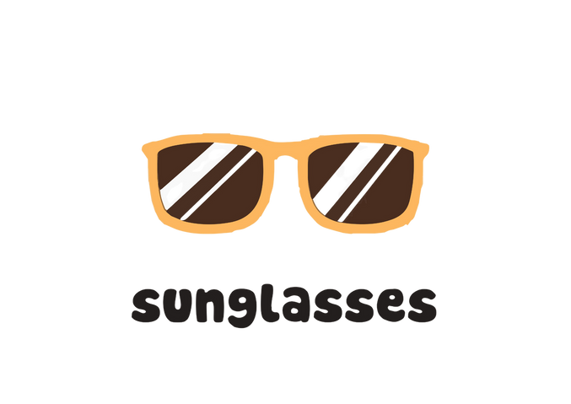
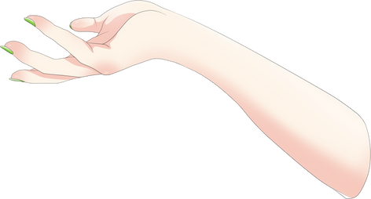
III. Exercise
7. Draw a line to match each clothing item to the correct body part.

Slide 15
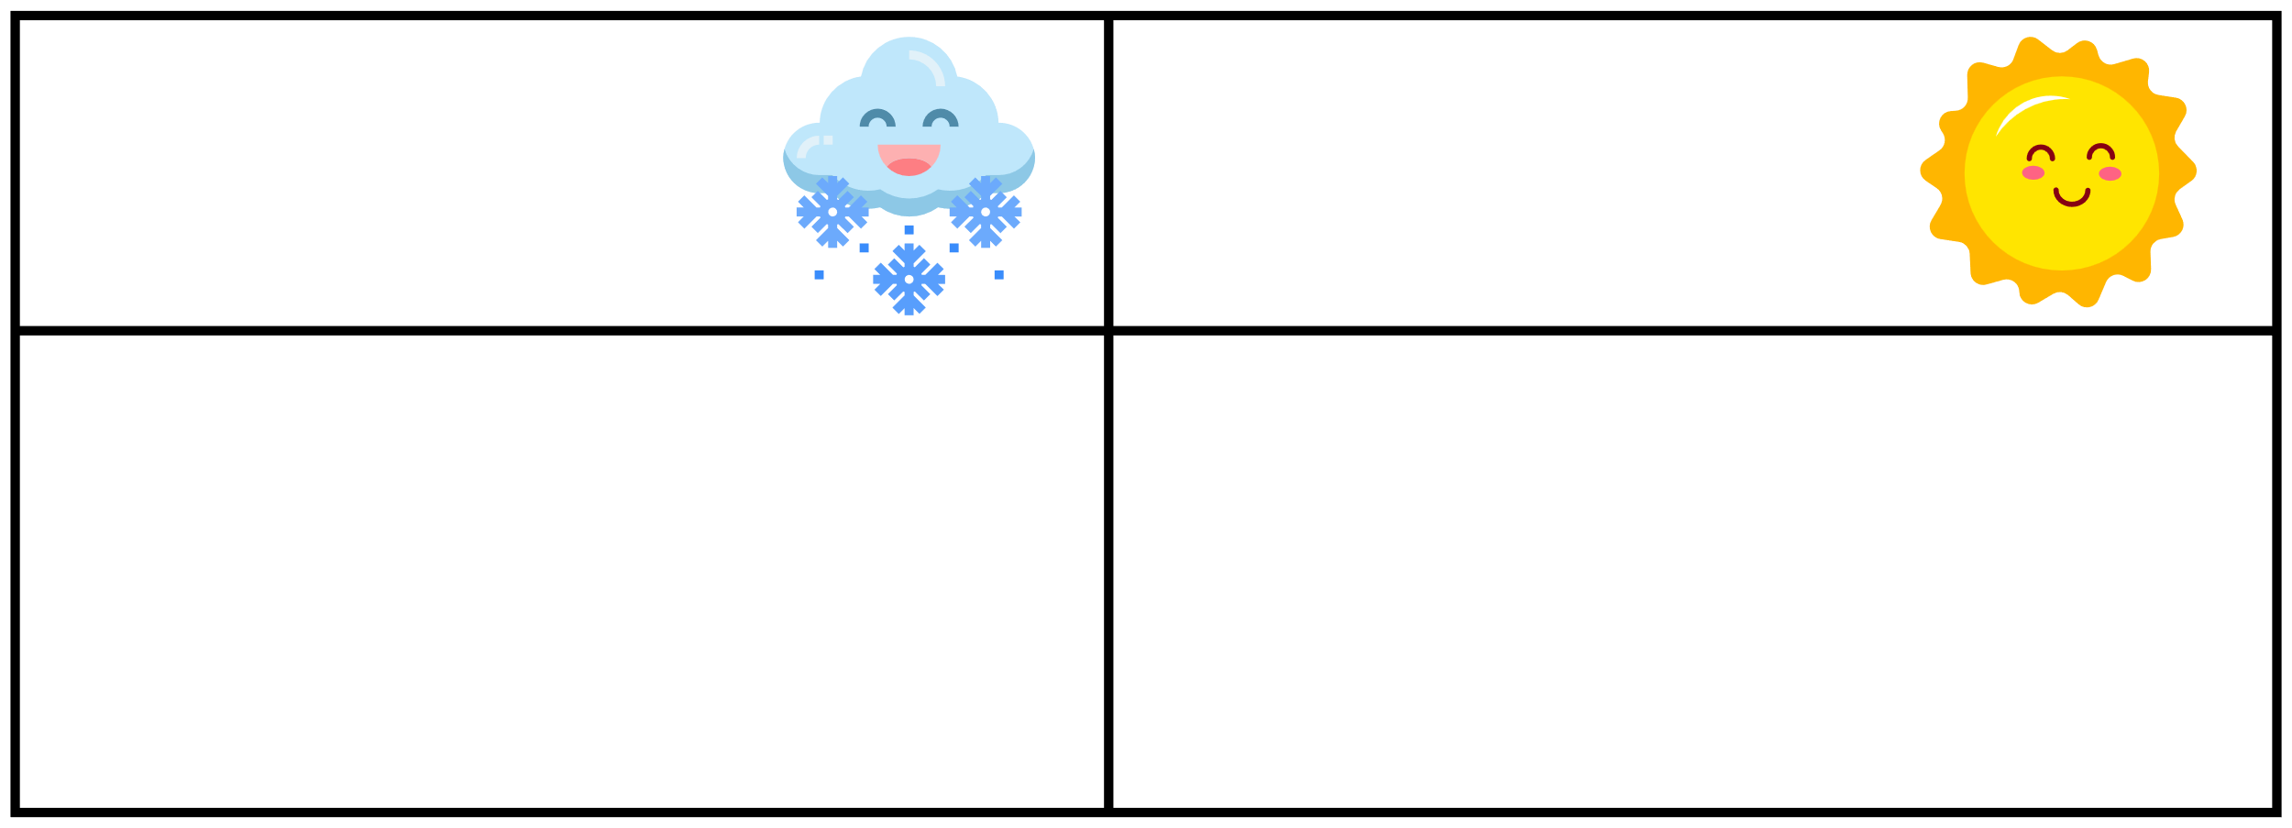






III. Exercise
4. Get dressed for the weather.
I put on my.......
I put on my.......

Slide 16
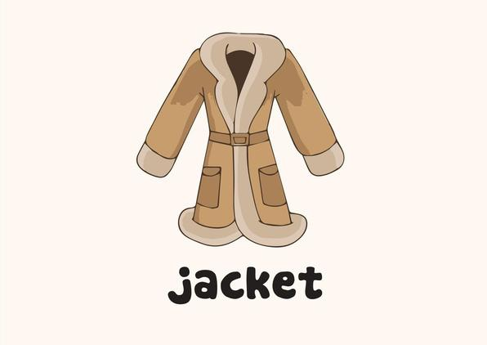
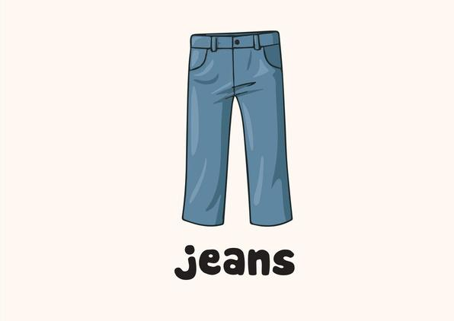

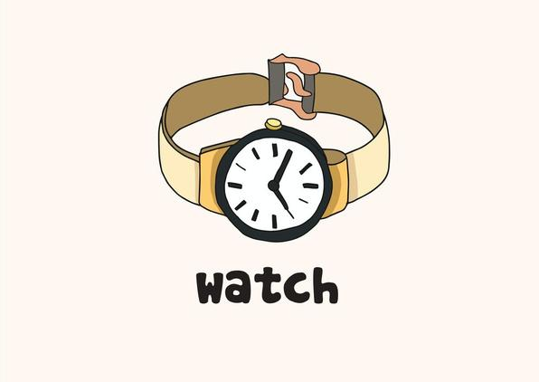


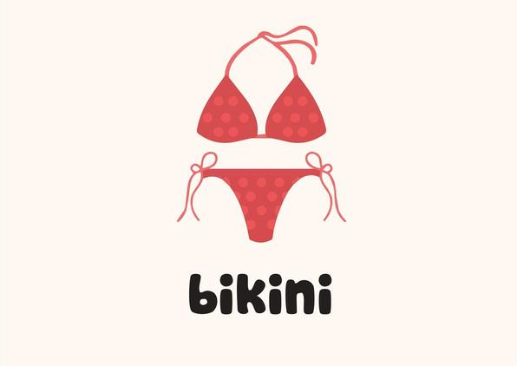
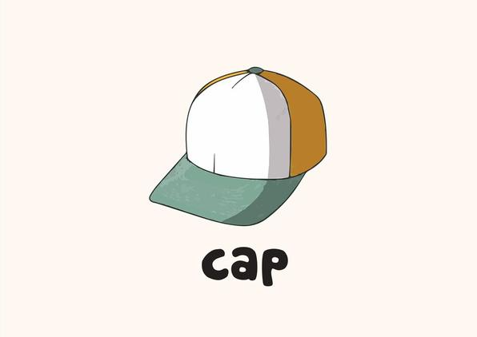

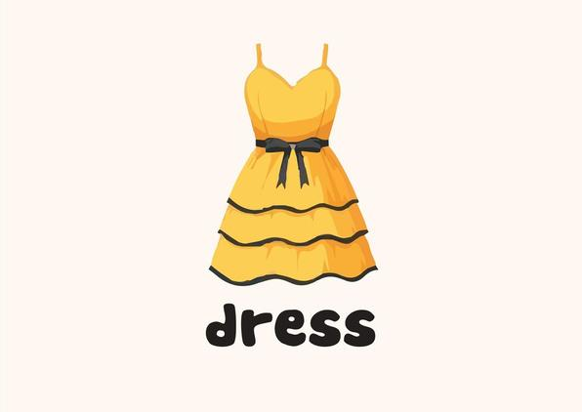

III. Exercise
5. Reoder the words
W/a/c/t/h
j/a/e/n/s
j/e/c/k/a/t
...................... d/r/e/s/e
...................... p/a/c
......................
b/i/n/i/k/i
......................
......................
......................

Slide 17






III. Exercise
6. Fill in the missing letters
sho_s
s_cks
sk_rt
tankt_p
sh_rts
sc_rf

Slide 18






III. Exercise
7. Draw a line to match each clothing item to the correct body part.

Slide 19

III. Exercise
8. Word search

