Slide 1



CHRISTMAS
CARD
GAME
AND A HAPPY NEW YEAR!
START

Slide 2

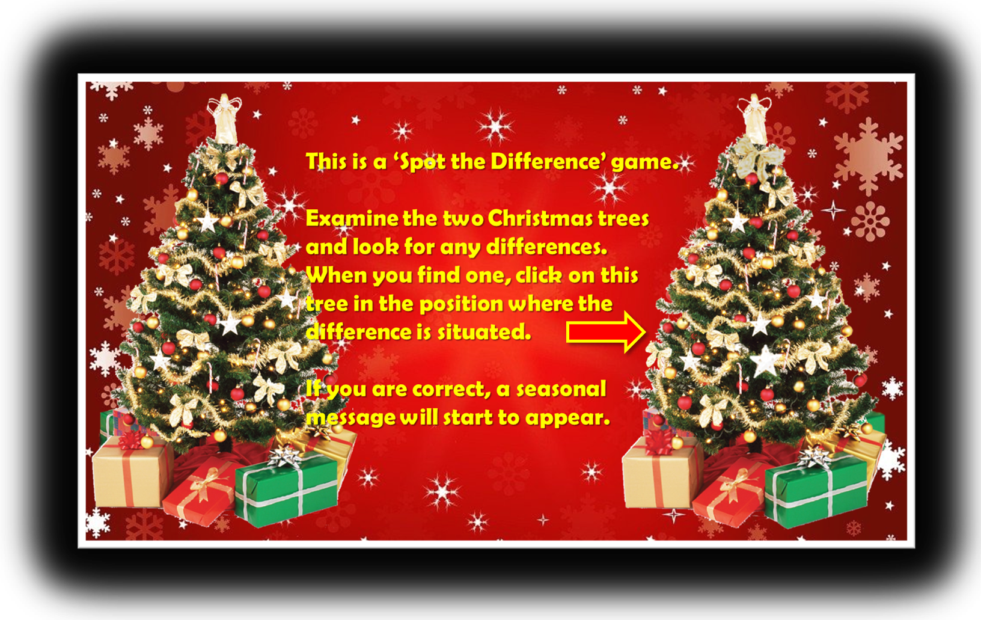

Y
R
R
S
E
A
M
M
T
S
I
R
H
C
AND A HAPPY NEW YEAR!

