Slide 1


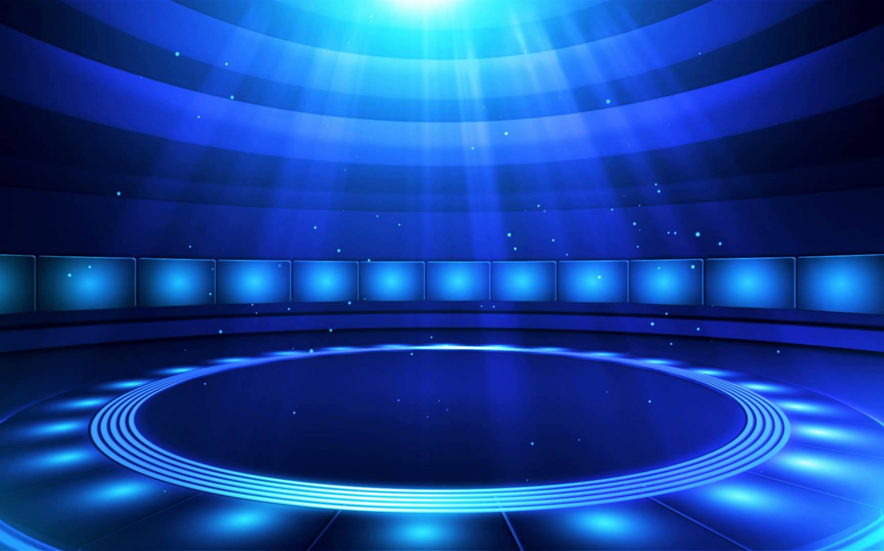




















Mỗi câu hỏi sẽ chỉ có 1 phút để suy nghĩ và đưa ra câu trả lời

Slide 2



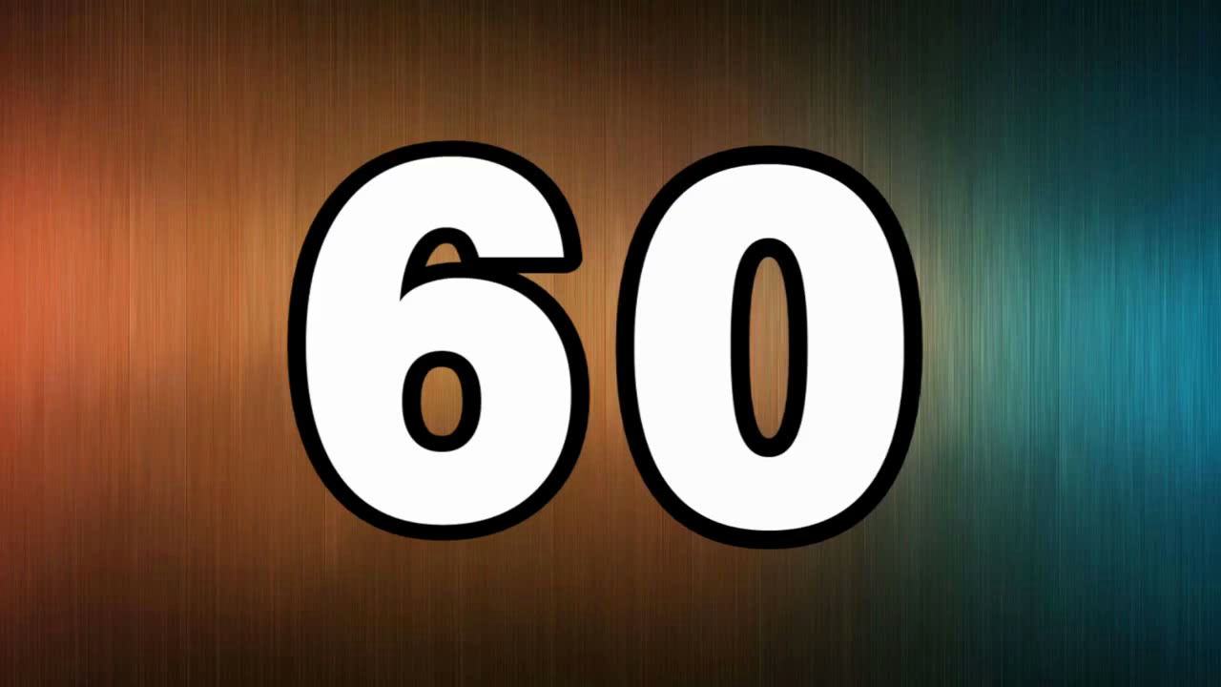

1
Sport
1. How many goals did Vietnamese U22 football Team concede (thủng lưới) in SEAGAMES 30?
A. 3 goals
B. 4 goals
C. 5 goals
D. 6 goals

Slide 3
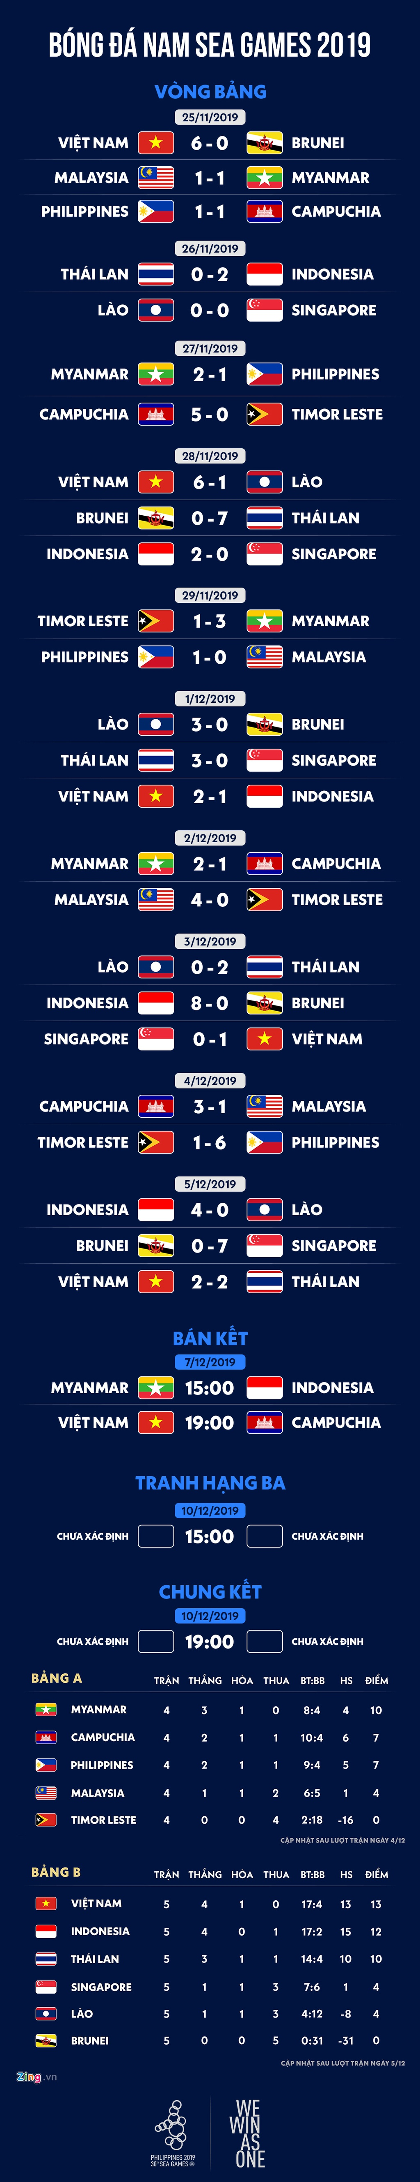
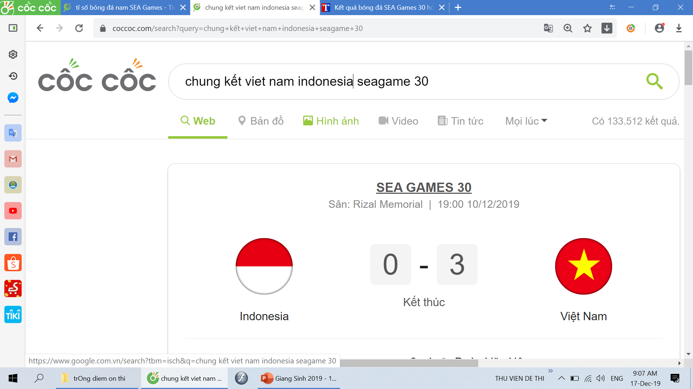
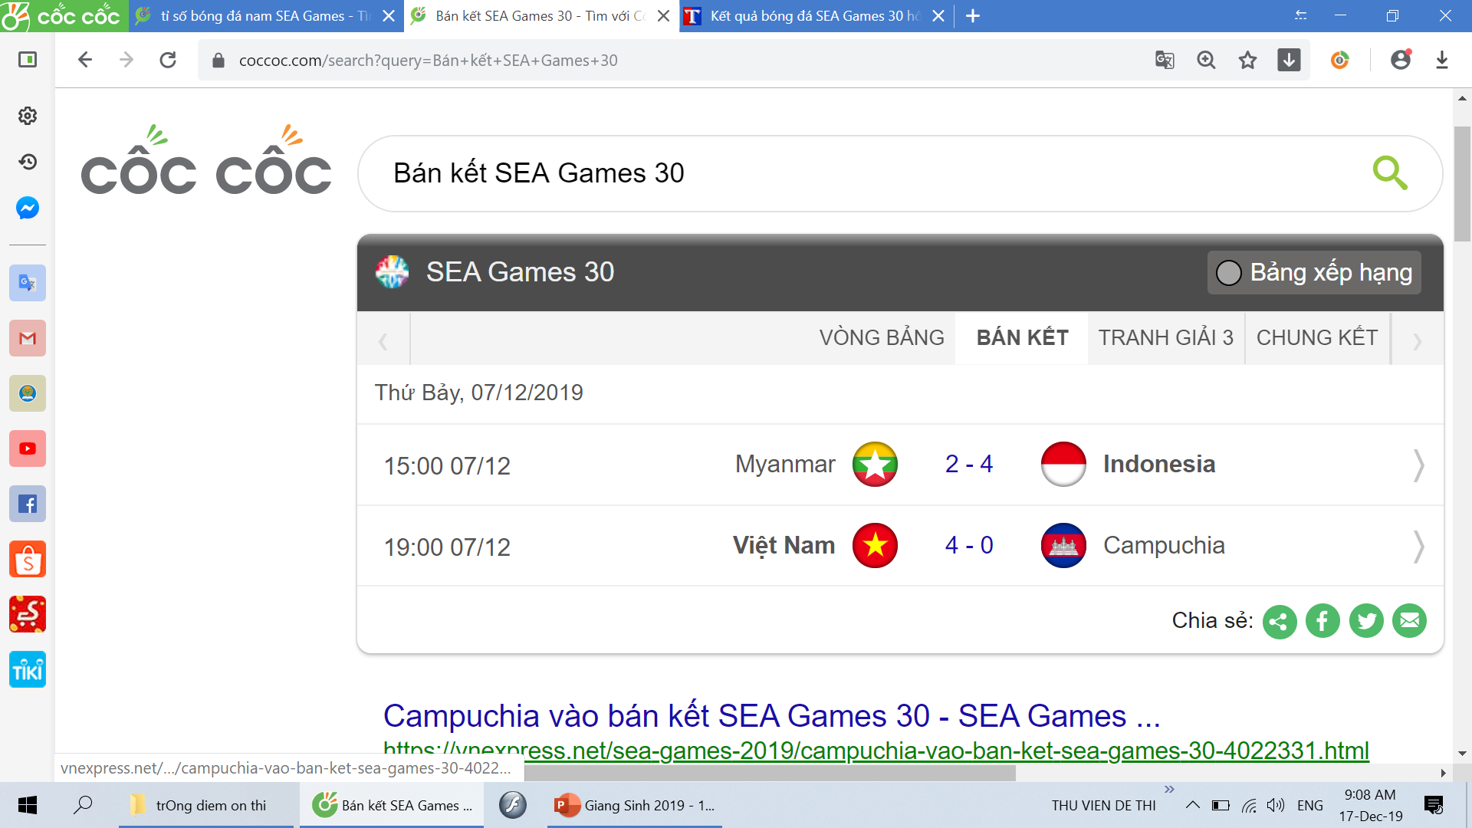

Slide 4
Teacher
2. What is Ms. Pretty’s favorite colour?
A. Red
B. Green
C. Blue
D. Black

Slide 5
Music
3. Who sang “ Last Christmas” the first?
A. WHAM
B. Taylor Swift
C. ABBA
D. Black Pink

Slide 6
4. Christmas
How many reindeers does Santa Claus ride?
A. 5 reindeers
B. 7 reindeers
C. 9 reindeers
D. 11 reindeers

Slide 7
5. Christmas
What is the real name of Santa Claus?
A. Jesus
B. Peter’s
C. Nicola
D.Nicholas

Slide 8
6. Christmas
What are the most things decorated in a Christmas tree?
A. 7 Stars
B. Eva’s apples
C. snowmen
D. Adam’s Bells

Slide 9
7. Sport
How does SEAGAME choose the host country?
A. According to the Alphabet
B. According to the ABCs
C. According to the GDP of that country
D. According to the population (dân số)

Slide 10
8. Teacher
Which song does Ms. Pretty like most?
A. Give it to me (Son Tung M-TP)
B. Color of the tear (Nguyen Tran Trung Quan)
C. Tu Tam (Nguyen Tran Trung Quan)
D. You of Yesterday (Son Tung M-TP)

Slide 11
9. Christmas
Where do children usually hang the sock?
A. At the door
B. At the bed’s head
C. At the fireplace and the door
D. At the fireplace

Slide 12
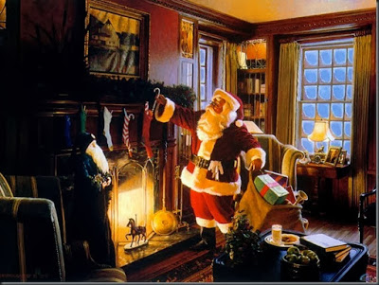

Slide 13
10. Christmas
What is the nose of the Snowman normally made from?
A. A stick
B. A tomato
C. A carrot
D. A stone

Slide 14

SƯU TẦM: ĐOÀN VĂN DOANH, NAM TRỰC, NAM ĐỊNH
LINK NHÓM DÀNH CHO GV BỘ MÔN VẬT LÝ TRAO ĐỔI TÀI LIỆU VÀ CHUYÊN MÔN CT 2018
https://www.facebook.com/groups/299257004355186

