Slide 1


Unit 5: INVENTIONS
Lesson 7: Communication And Culture/ Clil
Artificial intelligence

Slide 2

Unit
1
1
FAMILY LIFE
Family Life
Unit
OBJECTIVES
Practise making and respond to requests.
Know more information about computer hardware.

Slide 3
Table of contents
01
02
03
Warm-up
Everyday English
Clil
04
Consolidation

Slide 4
Warm-up
01
Card game

Slide 5

CARD GAMES
Select word cards about computer
Stick the cards on sheets of A1 paper.
Stick the sheets of A1 paper on the walls/ board.
Laptop Screen
Hardware Software
Speed Document
Display Battery
Light Weight
Size Brand
Program Memory
Data

Slide 6
Everyday English
02

Slide 7

EVERYDAY ENGLISH
1
Listen and complete the conversation.
A. can you let me know about
B. Can you please recommend
C. Certainly
D. Feel free to ask me if you need further information
E. Sure
Tim: Hello. I’m looking for a laptop. (1) ________ a good one to me?
Shop assistant: (2) ________, but (3) ______ your needs first?
Tim: (4) ________. I’m a student, so I’d like a cheap and light laptop.
Shop assistant: Then I think this laptop is the best one for you. You can take a look at it. (5) ________.
B
C
A
E
D

Slide 8
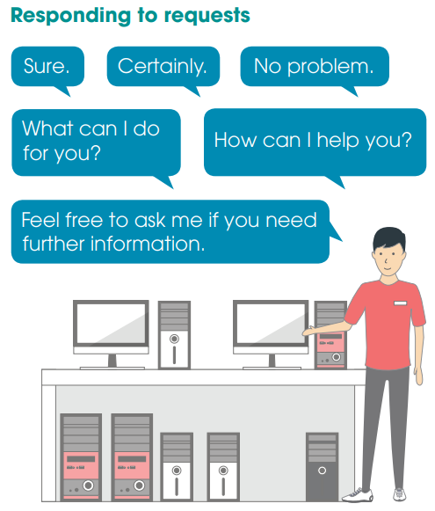
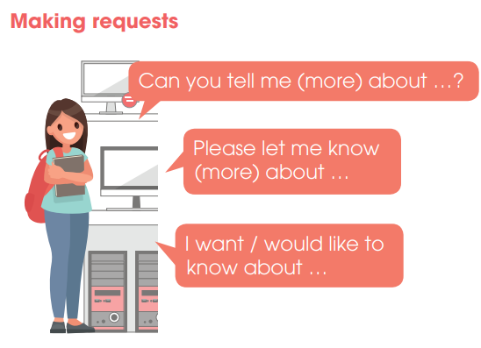
PRACTICE
2
Role-play

Slide 9
Clil
03

Slide 10


Slide 11



PLAY

Slide 12



the amount of information at computer can keep
store
storage space
NEXT

Slide 13
a type of computer memory
RAM
displayed
NEXT

Slide 14
the part of the computer that controls all other parts
RAM
processor
NEXT

Slide 15
shown
displayed
store
NEXT

Slide 16
to keep something and use it later
RAM
store

Slide 17
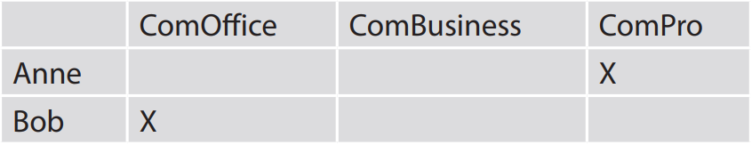
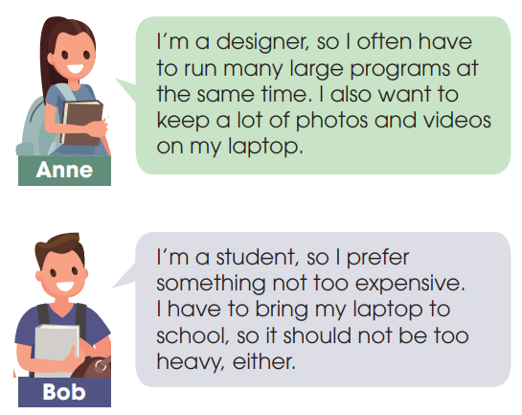
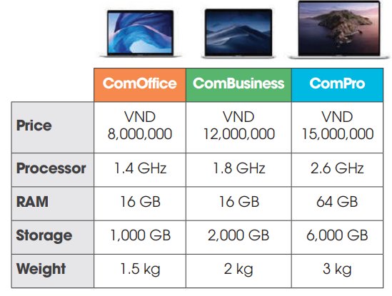
CLIL
2
Decide which one is most suitable for each person below.

Slide 18
Consolidation
04

Slide 19
CONSOLIDATION
1
Wrap-up
Know how to make and respond to requests.
Know more information about computer hardware.

Slide 20
CONSOLIDATION
2
Homework
1. Prepare for the next lesson: Unit 5 – Looking back and project
2. Do exercises in the workbook

Slide 21
SEE YOU NEXT TIME !!

