Slide 1


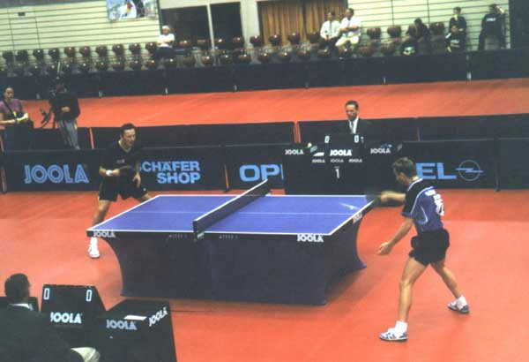
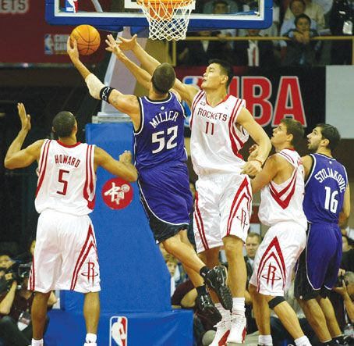
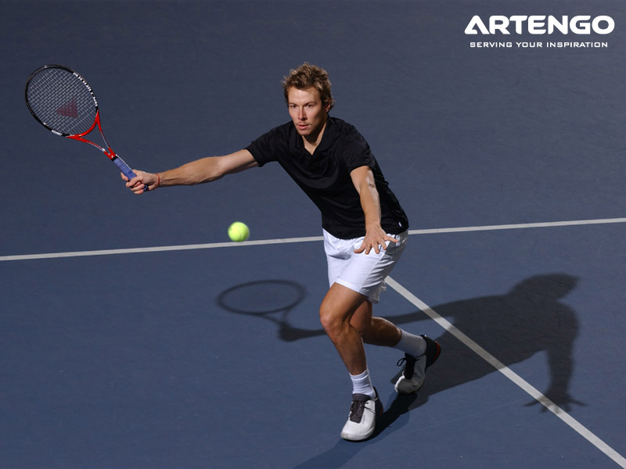
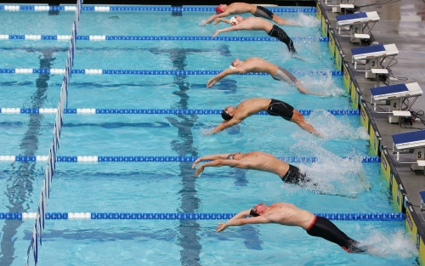
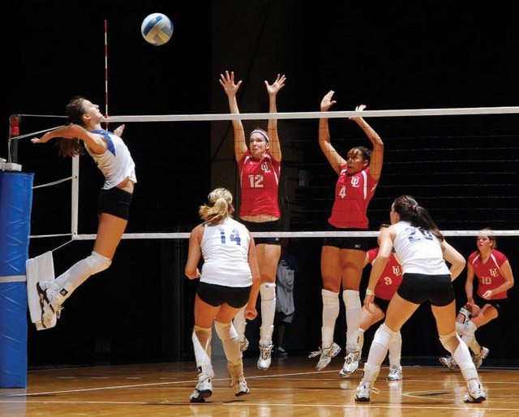
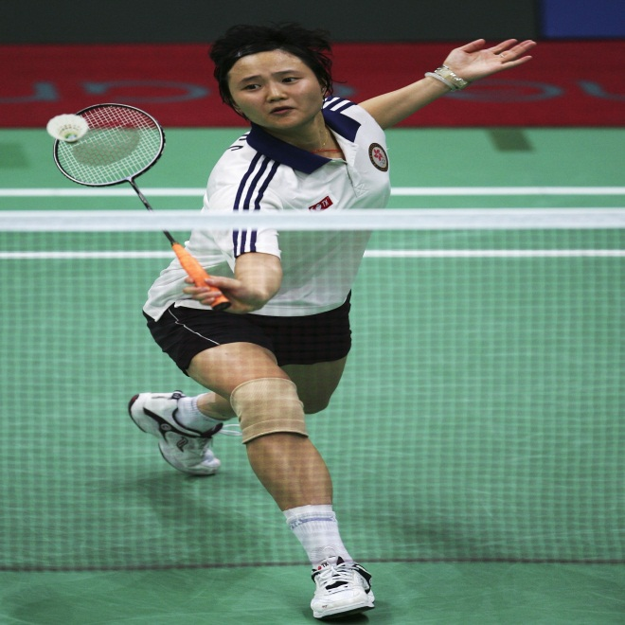
WARMER: “KIM’S GAME”
1
2
3
4
5
6

Slide 2

WARMER: “KIM’S GAME”
1
2
3
Table tennis
Basketball
Tennis
4
5
6
Swimming
Volleyball
Badminton

Slide 3

Wednesday, March 18th, 2015
Unit 13: Activities
Lesson 1: A1. P(129-130)

Slide 4



Unit 13 : Lesson 1 : A1
I. PRE-READING:
1.Vocabulary:
- skateboarding (n) :
trượt ván
- roller-skating (n) :
trượt patanh
(Sử dụng giầy trượt có bánh xe ở 4 góc)
- rollerblading (n) :
trượt patanh
( Sử dụng giầy trượt có bánh xe nằm dọc dưới đế giầy )
- baseball (n) :
bóng chày
- surprising (adj) :
đáng ngạc nhiên
→ surprisingly (adv)

Slide 5
Unit 13 : Lesson 1 : A1
2. Prediction: * Matching.
survey sự lựa chọn
result mặc dù
teenager sự khảo sát
choice kết quả
even though thanh thiếu niên

Slide 6
Unit 13 : Lesson 1 : A1
2.Prediction:
(Guess the position of the ten most popular sports in the USA.)
Sports | Guessing | Position
a. Volleyball
b. Tennis
c. Roller-skating
d. Football
e. Basketball
f. Swimming
g. Baseball
h. Skateboarding
i. Badminton
j. Roller-blading

Slide 7
Unit 13 : Lesson 1 : A1
II. WHILE-READING:
1.Reading and checking:
Sports | Guessing | Position
a. Volleyball
b. Tennis
c. Roller-skating
d. Soccer
e. Basketball
f. Swimming
g. Baseball
h. Skateboarding
i. Badminton
j. Roller-blading
Sports | Position
Baseball | First
Skateboarding | Second
Roller-skating | Third
Roller-blading | Fourth
Basketball | Fifth
Soccer | Sixth
Volleyball | Seventh
Tennis | Eighth
Badminton | Ninth
Swimming | Tenth
Seventh
Eighth
Third
Sixth
Fifth
Tenth
First
Second
Ninth
Fourth

Slide 8
Unit 13 : Lesson 1 : A1
II. WHILE-READING:
2. Gap - filling:
Fill in each blank with a suitable word :
teenagers
A recent survey of (1) ................. in the USA had some (2) .............. results. The survey was a simple one. It asked teenagers: “What sports do you like?”. These were the (3) ............. most popular sports. (4) ............. was the most popular choice even though it is not one of the world’s most popular games. Millions of people (5)............and (6) ............. it all around the world. (7) ….................., many teenagers said they liked (8) .......................
surprising
ten
Baseball
play
watch
Surprisingly
table tennis

Slide 9
Unit 13 : Lesson 1 : A1
II. WHILE-READING:
3. Comprehension questions:
a/ What is the most popular sport
in the USA?
- Baseball.
b/ What sport do many teenagers like?
- Table tennis.
*About you:
c/ Is baseball your favorite sport ? If not, what is your first choice?
- ......
d/ Do you like table tennis?
- ......

Slide 10

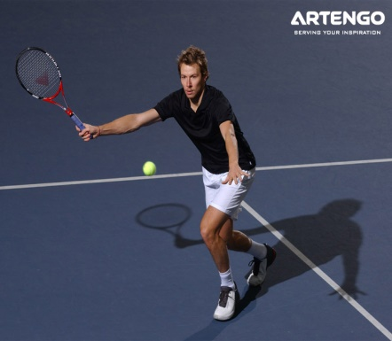


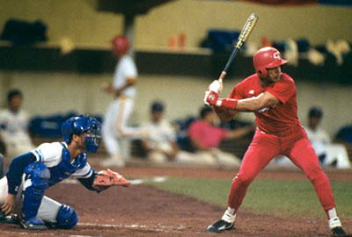
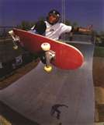
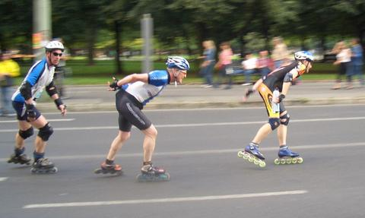
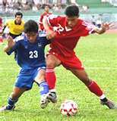
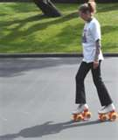
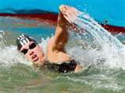
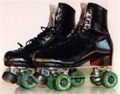
Unit 13 : Lesson 1 : A1
III. POST- READING:
1. Noughts and Crosses:
1
2
3
1 | 2 | 3
4 | 5 | 6
7 | 8 | 9
4
5
6
* Example :
7
8
9
S1:What sports do you like ?
S2: I like soccer.

Slide 11

Unit 13 : Lesson 1 : A1
2. Discussion:
“What sports do you think are the most popular for teenagers in Vietnam ?”

Slide 12

HOMEWORK
- Read the text again and learn the newwords by heart.
- Prepare A3,5 on pages 131-133 (textbook).

Slide 13


Thank You For Your Attention .
Goodbye !

