Slide 1

Unit 4: All things high-tech
Progress Check (Cont.)
Page 77

Slide 2
Lesson Outline
Warm-up
Reading
Everyday Eng.
Writing
Consolidation
Wrap-up

Slide 3
Objectives
By the end of this lesson, students will be able to…
- practise test-taking skills (Reading, Speaking).

Slide 4

WARM-UP

Slide 5
Choose the word whose main stress is placed differently from the others.
1. A. motorbike B. technician C. balcony D. festival
2. A. tower B. design C. hedgehog D. virus
3. A. rescue B. affect C. notice D. welcome
/ˈməʊtəbaɪk/
/tekˈnɪʃən/
/ˈbælkəni/
/ˈfestɪvəl/
/ ˈtaʊər/
/dɪˈzaɪn/
/ˈhedʒhɒɡ/
/ˈvaɪrəs/
/ˈreskjuː/
/əˈfekt/
/ˈnəʊtɪs/
/ˈwelkəm/

Slide 6
Choose the word whose underlined part is pronounced differently
from that of the other words.
1. A. click B. print C. think D. mind
2. A. prediction B. preference C. presenter D. computer
3. A. smartphone B. photo C. software D. notebook
/klɪk/
/prɪnt/
/θɪŋk/
/maɪnd/
/prɪˈdɪkʃən/
/ˈprefərəns/
/prɪˈzentər/
/kəmˈpjuːtər/
/ˈsmɑːtfəʊn/
/ˈfəʊtəʊ/
/ˈsɒftweər/
/ˈnəʊtbʊk/

Slide 7

It’s time to learn …

Slide 8

Everyday
English

Slide 9
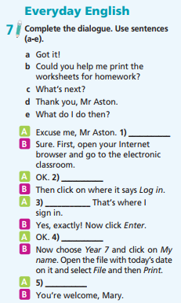
Who are there in the dialogue?
Mr. Atson and Mary.
What are you going to do?
Use sentences (a-e) to complete the dialogue.

Slide 10
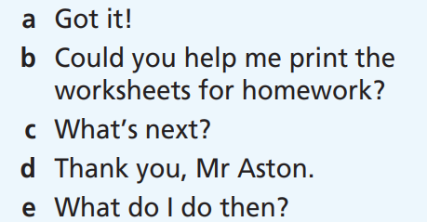
b
A: Excuse me, Mr Aston. (1) ___________
B: Sure. First, open your Internet browser and go to the electronic
classroom.
A: OK. (2) ___________
B: Then click on where it says Log in.
A: (3) ___________ That’s where I sign in.
B: Yes, exactly! Now click Enter.
A: OK. (4) ___________
B: Now choose Year 7 and click on My name. Open the file with today’s date on it and select File and then Print.
A: (5) ___________
B: You’re welcome, Mary.
e
a
c
d

Slide 11

Reading

Slide 12
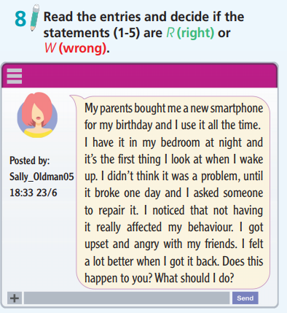
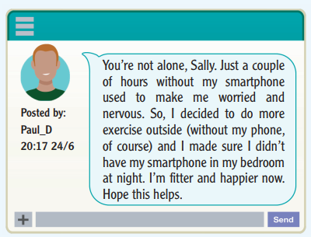
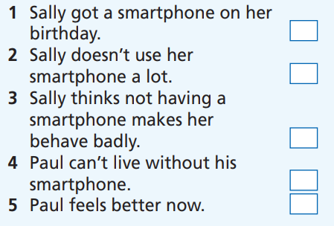
What are the pictures?
Sally and Paul’s entries.
What are you going to do?
Read the text and answer if the sentences
are R (right) or W (wrong).

Slide 13
8 Read the text and answer if the sentences are R (right) or W (wrong).
1. Sally got a smartphone on her birthday.
2. Sally doesn’t use her smartphone a lot.
3. Sally thinks not having a smartphone makes her behave badly.
4. Paul can’t live without his smartphone.
5. Paul feels better now.

Slide 14
Posted by: Sally_Oldman05 18:33 23/6
My parents bought me a new smartphone for my birthday and I use it all the time. I have it in my bedroom at night and it’s the first thing I look at when I wake up. I didn’t think it was a problem, until it broke one day and I asked someone to repair it. I noticed that not having it really affected my behaviour. I got upset and angry with my friends. I felt a lot better when I got it back. Does this happen to you? What should I do?
(1)
(2)
(3)

Slide 15
Posted by: Paul_D 20:17 24/6
You’re not alone, Sally. Just a couple of hours without my smartphone used to make me worried and nervous. So, I decided to do more exercise outside (without my phone, of course) and I made sure I didn’t have my smartphone in my bedroom at night. I’m fitter and happier now.
Hope this helps.
(4)
(5)

Slide 16
8 Read the text and answer if the sentences are R (right) or W (wrong).
1. Sally got a smartphone on her birthday.
2. Sally doesn’t use her smartphone a lot.
3. Sally thinks not having a smartphone makes her behave badly.
4. Paul can’t live without his smartphone.
5. Paul feels better now.
R
W
R
W
R

Slide 17

Writing

Slide 18
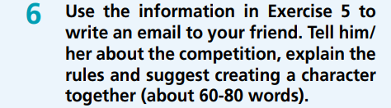
What are you going to write?
An email to my friend telling him/her about the competition.
How many words are there in the email?
About 60-80 words.

Slide 19
Writing tips: Editing your work
Always check your writing before you give it to your teacher. Check for any mistakes in spelling, punctuation, grammar, etc.

Slide 20
Useful Language
Opening remarks
• How are things? • How are you?
• Sorry I didn’t write to you earlier.
When & Where
• It’s on (date) at (place).
• It’s taking place at (place) on (date).
What you have to design
• You have to design … .
• The theme of the competition is … .

Slide 21
Useful Language
Rules
• You must/mustn’t ... .
• Your design has to ... .
How to participate
• You must apply online/ fill in a form.
• You don’t have to apply to participate./ You can just turn up.
Closing remarks
• Write back. • Talk to you later.
• Looking forward to hearing from you.

Slide 22
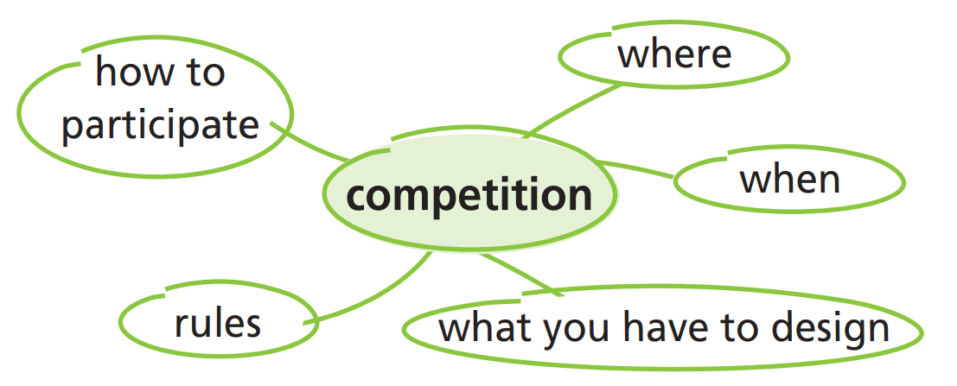

Slide 23
Suggested answer
Hi Tony,
I know you love reading DigiFan. Did you hear about the competition this month? You have to design a video game character and the winner will have the chance to have your character’s picture on the front of the magazine! The character can be anything you want, but it has to have a name and story, but it has to have a name and story, and it must be complete new. Do you want to design a character together? Let me know – we have to send our entries in by 31st July.
Write back.
Max

Slide 24

CONSOLIDATION

Slide 25

Work in pairs.
Practise the conversation
A: Excuse me, Mr Aston. Could you help me print the worksheets for homework?
B: Sure. First, open your Internet browser and go to the electronic
classroom.
A: OK. What do I do then?
B: Then click on where it says Log in.
A: Got it! That’s where I sign in.
B: Yes, exactly! Now click Enter.
A: OK. What’s next?
B: Now choose Year 7 and click on My name. Open the file with today’s date on it and select File and then Print.
A: Thank you, Mr Aston.
B: You’re welcome, Mary.

Slide 26

WRAP-UP

Slide 27
Today’s lesson
Reading: for specific information.
Speaking: practise everyday English.
Writing: practise writing an email of invitation.

Slide 28
Homework
Review all the vocabularies and grammar points in the unit.
Prepare the next lesson (page 78 SB).
Do Test 2 of Unit 4 in Bài Tập Bổ Trợ TA 7 Right on (pages 40 & 41).
Do the Speaking Test – Test 1 of Unit 4 in Bài Tập Bổ Trợ TA 7 Right on (page 81).

Slide 29

Have a nice day!

