Slide 1

Unit 4: Festivals and Free Time
Lesson 3.2:
Reading, Speaking & Writing
Page 37

Slide 2
Lesson Outline
Warm-up
Pre-Writing: Reading
Pre-Writing: Speaking
Writing
Consolidation
Wrap-up

Slide 3
Objectives
By the end of this lesson, students will be able to…
Know more about activities before and during a festival.
Write a message about a festival.
Talk about the festival they know.

Slide 4

WARM-UP

Slide 5


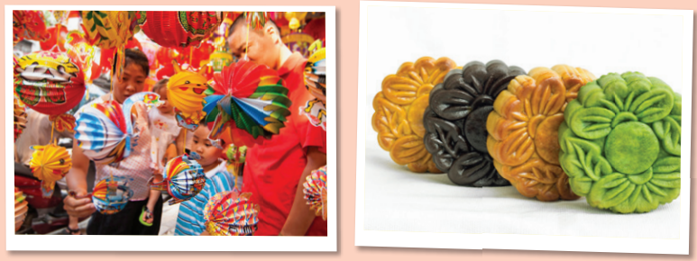
Work in pairs
Which festivals are they?
Which one do you like? Why?

Slide 6

Pre – writing Reading

Slide 7
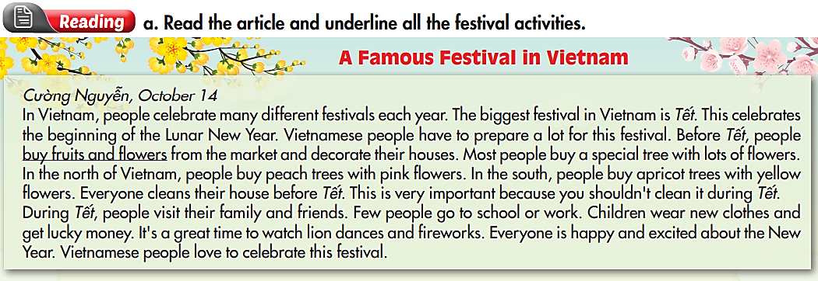

Slide 8

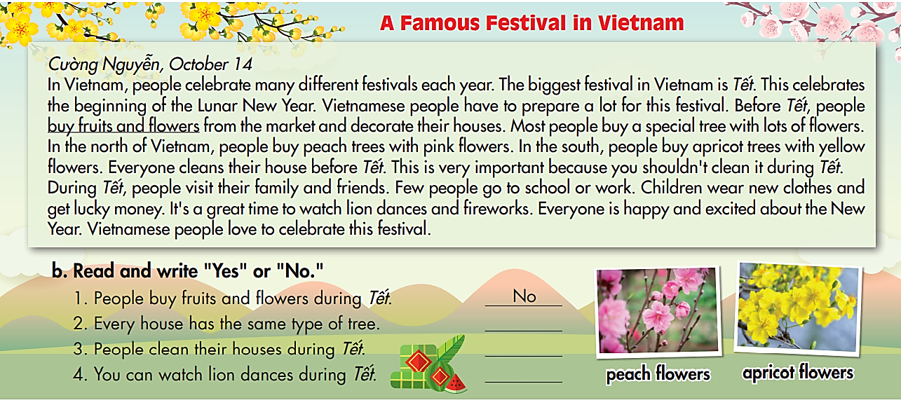
No
No
Yes

Slide 9

Pre-writing
Speaking

Slide 10
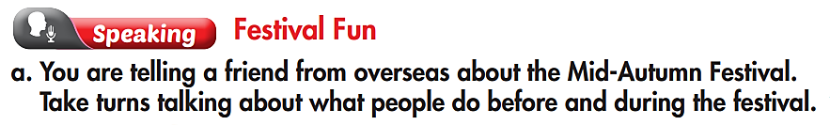
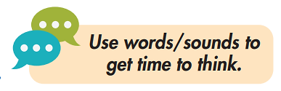

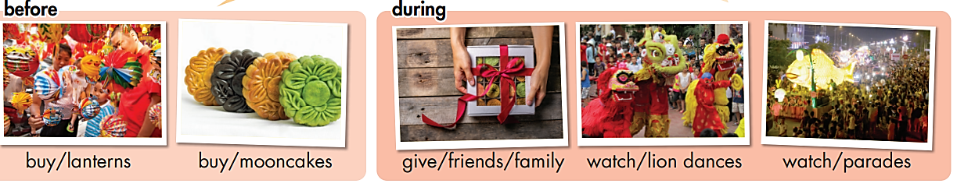
What do people do before the Mid-Autumn festival?
What do people do during the Mid-Autumn festival?

Slide 11

Name of the festival
Activities of the festival (before and during the festival)

Slide 12

Writing

Slide 13
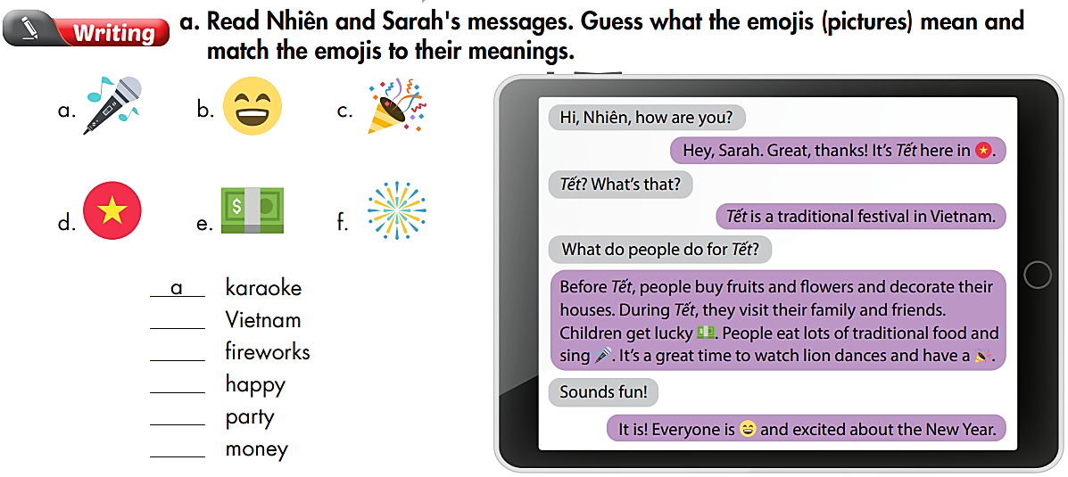
d
f
b
c
e

Slide 14
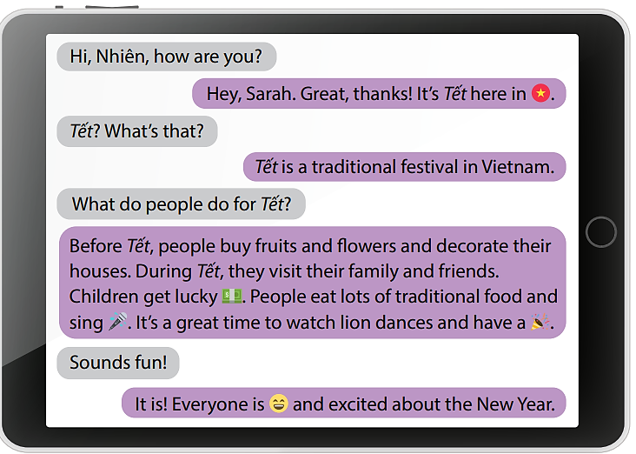
The outline
Greeting
Introducing the name of the festival
Explain what the festival is
Activities before and during the festival
Feeling

Slide 15
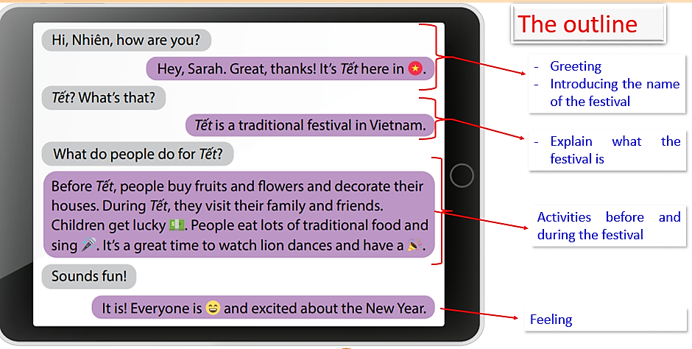

Slide 16

CONSOLIDATION

Slide 17
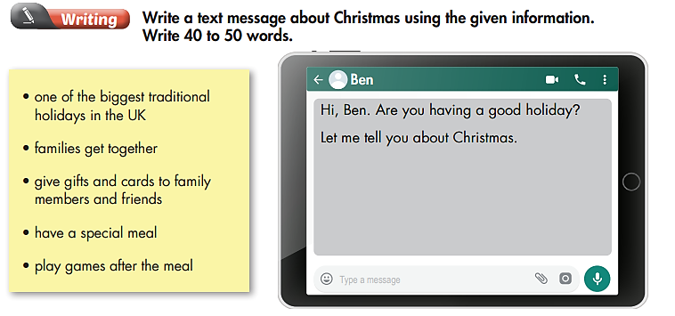
Extra Practice
WB page 25

Slide 18
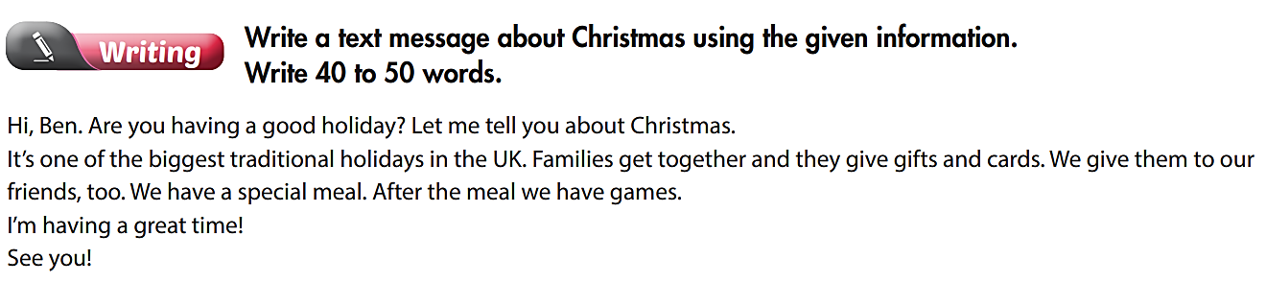

Slide 19

WRAP-UP

Slide 20
Today’s lesson
Writing:
- Know how to write a message
- Practice writing a message about festivals
Speaking:
- Talk about festivals and their activities
Reading:
- Read for specific information.

Slide 21
Homework
Do the exercises in Tiếng Anh 6 i-Learn Smart World Workbook (page 25).
Complete the writing notes in Tiếng Anh 6 i-Learn Smart World Notebook on page 25.
Prepare Review materials for Unit 4 (pages 92 & 93).
Play the consolidation games in Tiếng Anh 6 i-Learn Smart World DHA App on www.eduhome.com.vn.

Slide 22
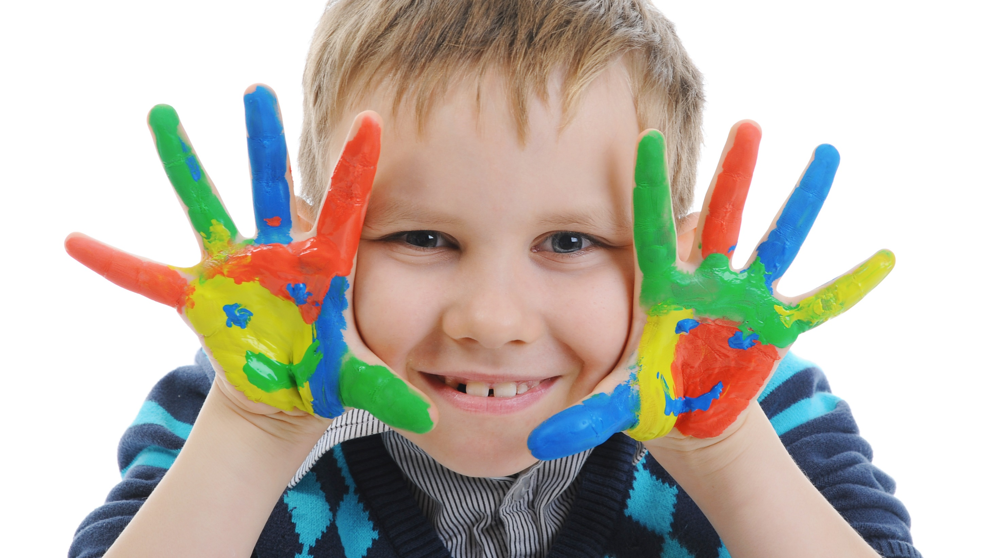
Enjoy your day!

