Slide 1
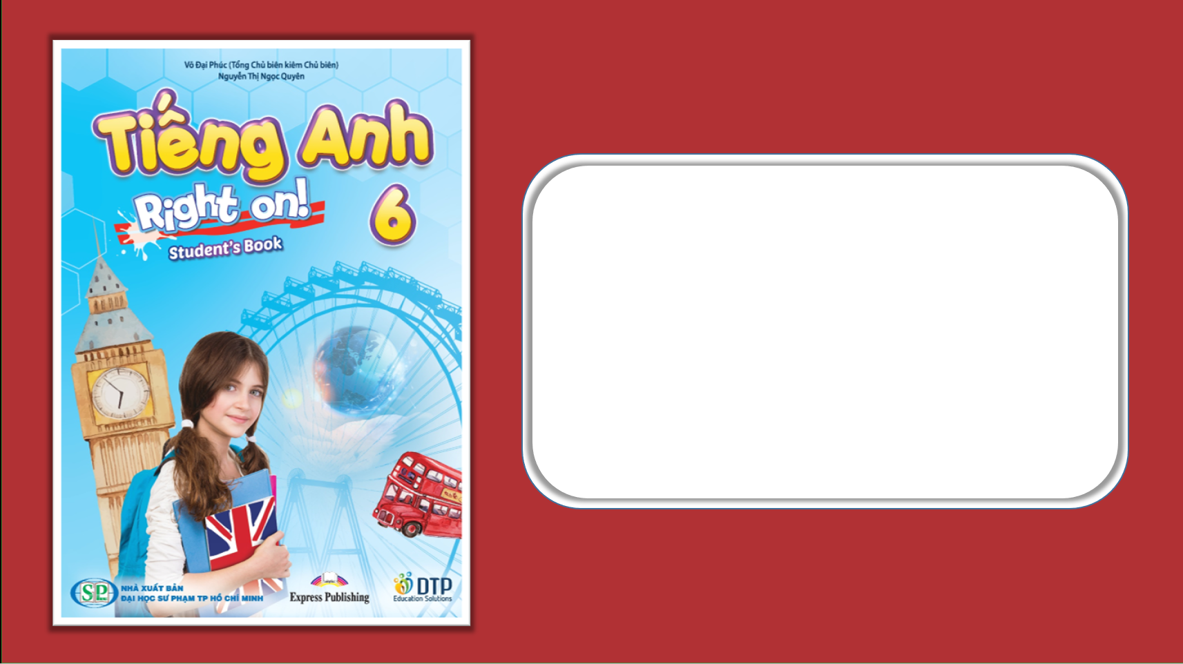
Unit 1: Home and Places
Lesson 1e: Grammar
Page 28

Slide 2
Lesson Outline
Warm-up
Vocabulary
Listening
Consolidation
Wrap-up

Slide 3
Objectives
By the end of this lesson, students will be able to…
Learn about a/an – some – any.
Learn the structure: there is/isn’t and there are/aren’t.
Learn possessive case ('s/ ‘).
Describe a picture and their room.

Slide 4

WARM UP

Slide 5
Choose the word whose underlined part is pronounced differently from that of the others.
1 A. window B. shower C. sofa D. pillow
/ˈʃaʊə/
/ˈsəʊfə/
/ˈpɪləʊ/
/ˈwɪndəʊ/
2 A. roof B. room C. food D. book
/ruːf/
/ruːm/
/fuːd/
/bʊk/
3 A. curtain B. uncle C. husband D. cupboard
/ˈkɜːtən/
/ˈʌŋkl/
/ˈhʌzbənd/
/ˈkʌbəd/

Slide 6
Arrange these words into meaningful sentences:
a/ there/ book/ is/.
books/ are/ some/ there/.
is/?/ there/ armchair/ an
there/ any/?/ are/ armchairs
There is a book.
There are some books.
Is there an armchair?
Are there any armchairs?

Slide 7

It’s time to learn …

Slide 8

Presentation 1

Slide 9

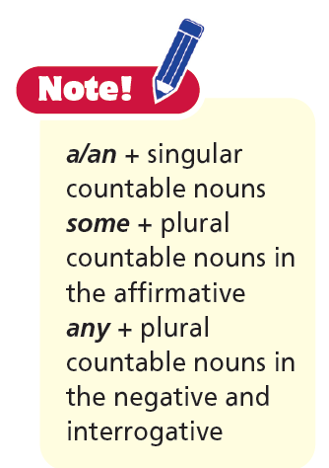
.
.
There are some books
in the bookcase.
There is a book on the table, too.

Slide 10
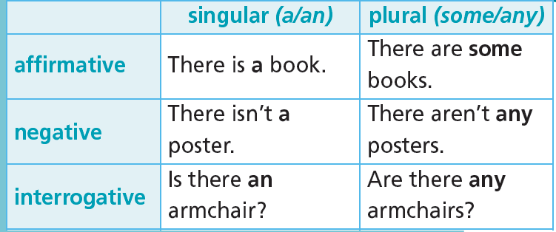

Slide 11

Practice

Slide 12
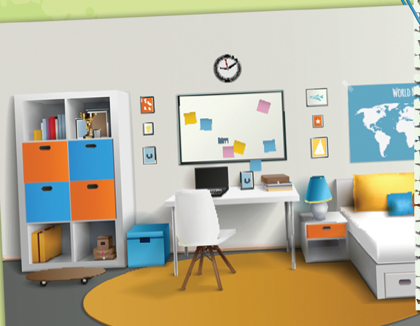
1. Look at the picture. Complete the sentences (1-10). Use There is, There isn’t, There are, There aren’t, Is there, Are there and a/an, some or any.
1 _________________ bed.
2 ______________________ windows.
3 _________________ wardrobe.
4 _________________ pillows on the bed?
5 _________________ armchair.
6 _________________ books in the bookcase.
7 ______________________ cupboards.
8 _________________ lamp.
9 _________________ tables.
10 _________________ desk?
There is a
There aren’t any
There isn’t a
Are there any
There isn’t an
There are some
There aren’t any
There is a
There aren’t any
Is there a

Slide 13
More Practice
WB p. 16
★ Circle the correct item.
There is a / an cooker in the kitchen.
There aren't some / any lamps in the bedroom.
There are some / any curtains in the living room.
There is a / an orange in the fridge.

Slide 14
More Practice
WB p. 16
★★ Complete the sentences with a/an, some or any.
There are _________ books in the bookcase.
There is _________ armchair in the living room.
There isn’t _________ sink in the bathroom.
There aren’t _________ chairs in the bedroom.
some
an
a
any

Slide 15
Grammar Bank
p. 65
Underline the correct item.
1 There is/are some cupboards in the kitchen.
2 Is there/Are there any books on the desk?
3 Are there some/any pillows on the bed?
Yes, there are/there aren’t.
4 There are some/any posters on the walls.
5 Is there a/any bookcase in the room?
6 There isn’t any/an armchair in my room.
7 Is there a/an wardrobe?
No, there is/ isn’t.
8 There aren’t some/any paintings in the living room.

Slide 16

Presentation 2

Slide 17
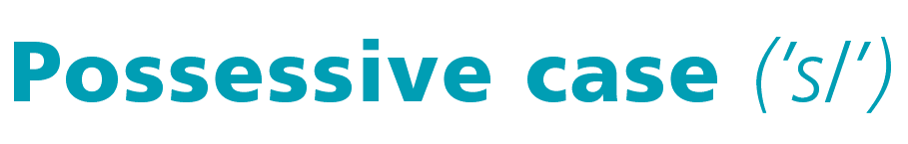
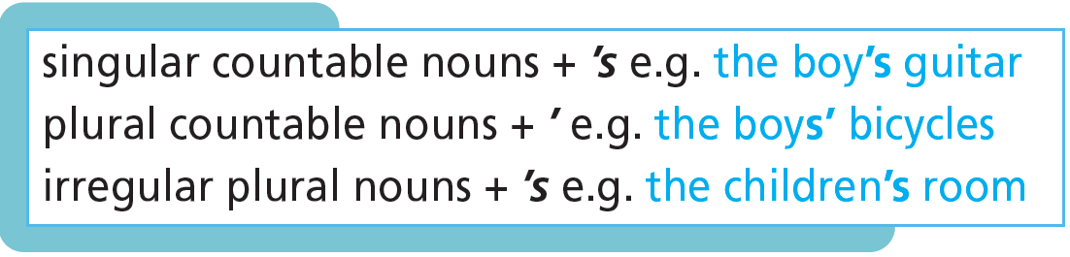

Slide 18

Practice

Slide 19
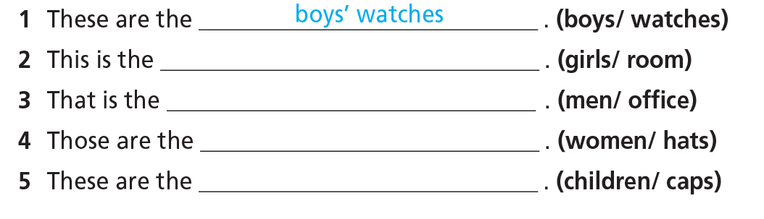
2. Use the words in brackets to complete the gaps as in the example.
girls’ room
men’s office
women’s hats
children’s caps

Slide 20
More Practice
WB p. 16
★ Underline the correct item.
1 These are the girls/girls’ bicycles.
2 Where is Ben and Anna’s/Ben's and Anna’s house?
3 Can you make the children’s/childrens’ dinner tonight?
4 This is my dads/dad’s car.

Slide 21
More Practice
GB p. 66
Underline the correct item.
1 That’s Charlies’/Charlie’s ball.
2 Are those Beth’s and Tom’s/Beth and Tom’s books?
3 What time is the men’s/mens’ basketball game?
4 This is my mums/mum’s bag.
5 The students'/students's bags are lovely.

Slide 22

Production

Slide 23
Describe the classroom using there is/isn’t or are/aren’t with a/an/some and any.
E.g. There are 25 desks in this classroom. There are some pictures on the wall………

Slide 24

CONSOLIDATION

Slide 25
Write a paragraph (about 40-60 words) to describe your classroom.

Slide 26

WRAP-UP

Slide 27
Today’s lesson
Grammar
a/an - some - any
Possessive case (‘s/’)

Slide 28
Homework
Practise the vocabularies and grammar and make sentences using them.
Do the exercises in TA 6 Right on WB (p. 16).
Complete the grammar notes in TA 6 Right on Notebook (p. 16).
Prepare the next lesson (p. 29 SB).

Slide 29

Enjoy your day!

