Slide 1

Unit 5: Travel & Transportation
Lesson 5f: Skills (Cont.)
Page 89

Slide 2
Lesson Outline
Warm-up
Vocabulary
Speaking
Listening
Writing
Wrap-up

Slide 3
Objectives
By the end of this lesson, students will be able to…
learn and use some vocabulary about wonders or the world: mausoleum, tomb, fortress, wonder.
listen for key information.
write a postcard.

Slide 4

WARM UP

Slide 5

Work in pairs.
Choose the word whose main stress is placed
differently from the others.
1. A. visit B. include C. agree D. receive
2. A. introduce B. discover C. disappear D. understand
3. A. mountain B. postcard C. penfriend D. exam
/ˈvɪzɪt/
/ɪnˈkluːd/
/əˈɡriː/
/rɪˈsiːv/
/ˌɪntrəˈduːs/
/dɪˈskʌvər/
/ˌdɪsəˈpɪr/
/ˌʌndərˈstænd/
/ˈmaʊntən/
/ˈpəʊstkɑːd/
/ˈpenfrend/
/ɪɡˈzæm/
Notes:
Celebration
gates bank
floor soon
great

Slide 6
Work in pairs.
Please name at least 6 famous tourist destinations in Vietnam.
E.g. Phong Nha Ke Bang National park, Ha Long Bay, Nha Trang Beach, Sa Pa, Vung Tau Beach, etc.

Slide 7

It’s time to learn …

Slide 8

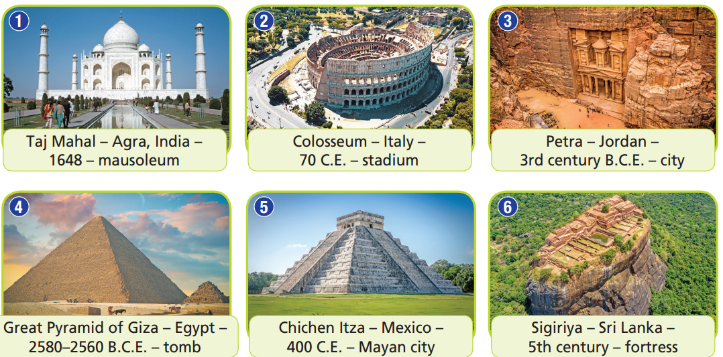
NOTICE:
- B.C.E stands for “Before the Common Era”.
- C.E. stands for “the Common Era” (C.E.).
- The 1st century included the years 1-100.
- When we say the 2nd century B.C.E., we are
referring to the years 200-101 B.C.E.
The Great Pyramid of Giza is the oldest.

Slide 9
Vocabulary
Listen and repeat.
mausoleum /ˌmɔːzəˈliːəm/ (n) lăng mộ, lăng tẩm
tomb /tuːm/ (n) mộ, nơi chôn cất
fortress /ˈfɔːtrəs/ (n) pháo đài
wonder /ˈwʌndər/ (n) kì quan

Slide 10
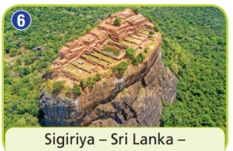
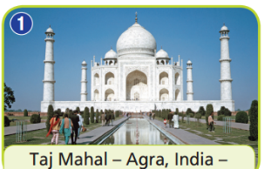
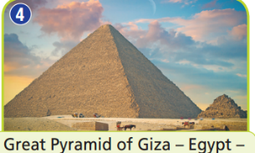
Fill in the boxes to write the name for each picture
Extra Practice
A
B
C
F | O | R | T | R | E | S | S
M | A | U | S | O | L | E | U | M
T | O | M | B
All of them are called _ _ _ _ _ _ .
W | O | N | D | E | R | S

Slide 11
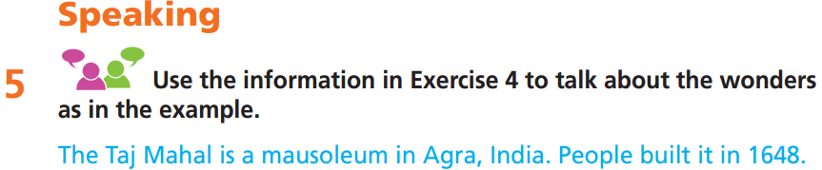
Work in pairs.
2. The Colosseum is an ancient stadium in Italy. People built it in 70 C.E.
3. Petra is an ancient city in Jordan. People built it in the 3rd century B.C.E.
4. The Great Pyramid of Giza is a tomb in Egypt. People built it from 2580 to 2560 B.C.E.
5. Chichen Itza is a Mayan city in Mexico. People built it in 400 C.E.
6. Sigiriya is a fortress in Sri Lanka. People built it in the 5th century.

Slide 12

Listening

Slide 13
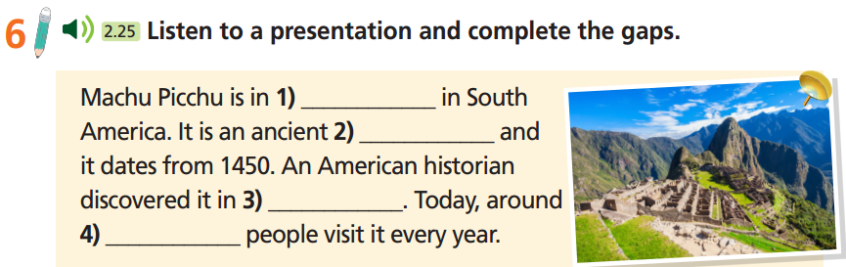
Pre-Listening
Read the instruction quickly. Underline the key words. What are we going to do?
Listen and complete the gaps.
Guess the answer. What’s missing? A verb? A noun?
An adjective? An adverb? A number? A date? etc. …?

Slide 14

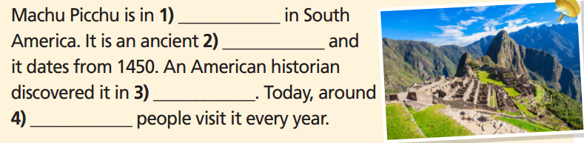
While-Listening
Now listen and write the correct answer.  FIRST TIME
☞ YOUR ANSWER?
Peru
city
1911
1.5 million
☞ WHY?

Slide 15
Now listen again and check.  SECOND TIME
Machu Picchu is in 1) _________ in South America.
It is an ancient 2) ____________ and it dates from 1450.
Machu Picchu is in Peru in South America. It is an ancient city and it dates from 1450.
Peru
city

Slide 16
Now listen again and check.  SECOND TIME
When the American historian Hiram Bingham discovered it in 1911, he said it was the ‘Lost City of the Incas’.
An American historian
discovered it in 3) ___________.
1911

Slide 17
Now listen again and check.  SECOND TIME
Today, the city is a UNESCO World Heritage site and around 1.5 million people visit it every year.
Today, around 4) ____________ people visit it every year
1.5 million

Slide 18
Extra practice
Listen again and decide whether the following statements are True, False, or Doesn’t say:
Machu Picchu dates from the 15th century.
Machu Picchu was discovered by an American businessman.
People left Machu Picchu after they built it because of war.
Machu Picchu is one natural wonder of the world.
More than one million people visit Machu Picchu every year.

Slide 19
Pre-Listening
Read the instruction quickly. Underline the key words. What are we going to do?
Listen again and decide whether the following statements are True, False, or Doesn’t say.
Machu Picchu dates from the 15th century.
Machu Picchu was discovered by an American businessman.
People left Machu Picchu after they built it because of war.
Machu Picchu is one natural wonder of the world.
More than one million people visit Machu Picchu every year.

Slide 20

While-Listening
Now listen and choose the correct answer.  THIRD TIME
☞ YOUR ANSWER?
Machu Picchu dates from the 15th century.
Machu Picchu was discovered by an American businessman.
People left Machu Picchu after they built it because of war.
Machu Picchu is one natural wonder of the world.
More than one million people visit Machu Picchu every year.
True
False
Doesn’t say
False
True
☞ WHY?

Slide 21
Now listen again and check.
Machu Picchu is in Peru in South America. It is an ancient city and it dates from 1450
Machu Picchu dates from the 15th century.
True

Slide 22
Now listen again and check.
When the American historian Hiram Bingham discovered it in 1911, he said it was the ‘Lost City of the Incas’.
2. Machu Picchu was discovered by an American businessman.
False

Slide 23
Now listen again and check.
People left it about 100 years after they built it. This is the
mystery. Why did they leave? We will never know.
3. People left Machu Picchu after they built it because of war.
Doesn’t say

Slide 24
Now listen again and check.
Today, the city is a UNESCO World Heritage site and around 1.5 million people visit it every year.
4. Machu Picchu is one natural wonder of the world.
5. More than one million people visit Machu Picchu every year.
False
True

Slide 25
Audio Scripts
Practise presenting the talk.
Good morning. Today I’m going to talk to you about one of my favourite wonders of the world – Machu Picchu.
Machu Picchu is in Peru in South America. It is an ancient city and it dates from 1450. The city is amazing. When the American historian Hiram Bingham discovered it in 1911, he said it was the ‘Lost City of the Incas’. But it wasn’t lost. People left it about 100 years after they built it. This is the mystery. Why did they leave? We will never know.
Today, the city is a UNESCO World Heritage site and around 1.5 million people visit it every year. I’d love to do it one day, too. How about you?

Slide 26

Post-Listening
Work in pairs
What’s your favourite wonder of the world?
One of my favourite wonders of the world is Colosseum, an ancient stadium in Italy. It is huge and wonderful. It shows the talent of ancient people.

Slide 27
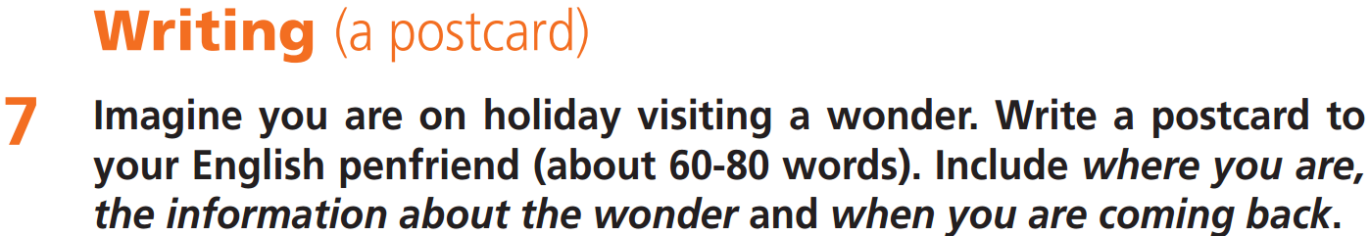
You should think about these things:
1. What are you going to write?
2. Who is going to read it?
3. What is it going to be about?
4. How many words are you going to write?
a postcard
my English penfriend
a wonder you are visiting on holiday
about 60-80 words

Slide 28
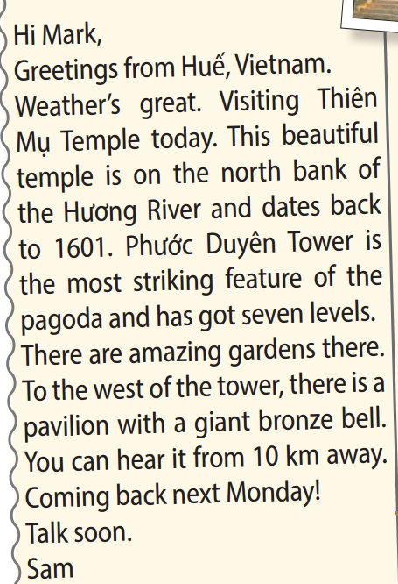
Read the model. Which adjectives does Sam use to describe:
• the temple?
• the gardens?
• the bell?
the temple: beautiful
the gardens: amazing
the bell: giant bronze

Slide 29
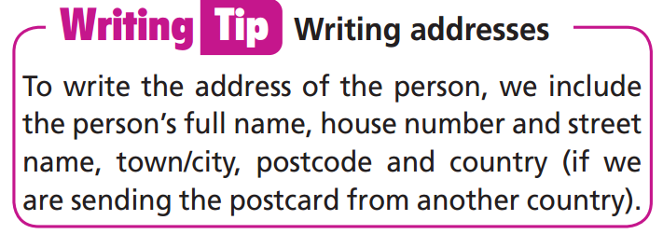

Slide 30
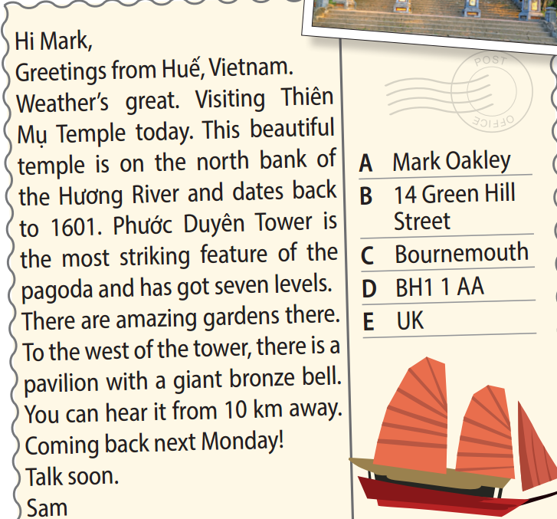
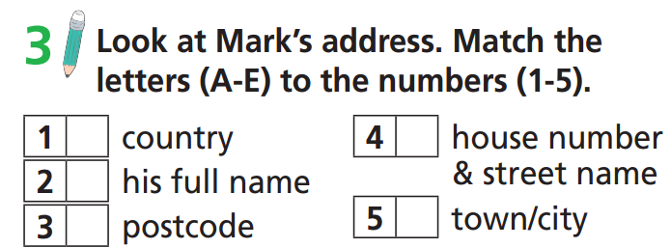
E
B
A
D
C

Slide 31
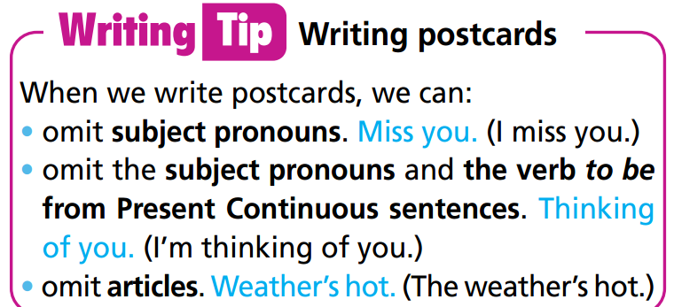

Slide 32
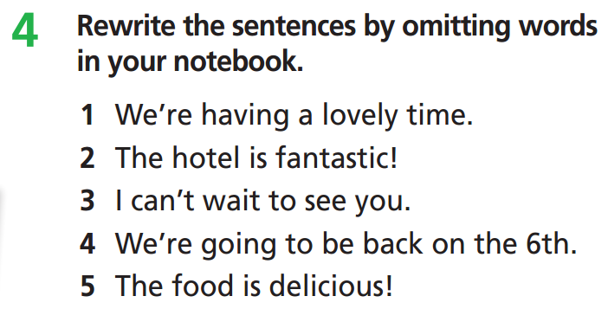
Having a lovely time.
Hotel’s fantastic!
Can’t wait to see you.
Going back on the 6th.
Food’s delicious!

Slide 33
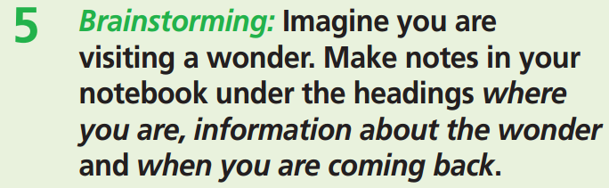
Where you are: Peru
Information about wonder: Machu Picchu, ancient temple, dates from 1450, granite buildings, stones have nothing holding them together but they stay strong
When are you coming back: next Saturday

Slide 34
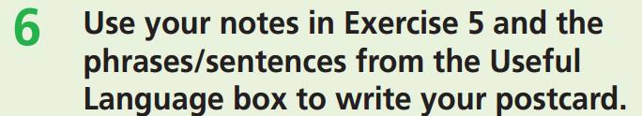
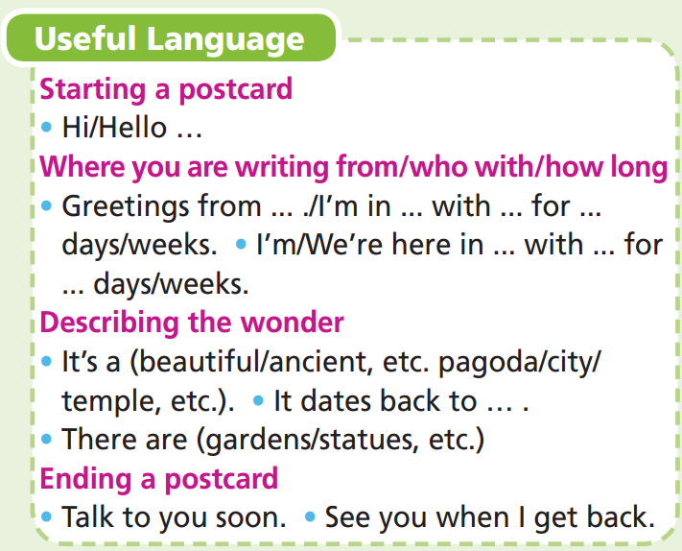

Slide 35
Hi Trang,
Greetings from Peru. Weather’s great! Today we’re visiting Machu Picchu. This ancient city dates from 1450. All the buildings are granite. The stones have nothing holding them together, but they stay strong because there are no spaces between the stones. To
reach it, we walked along the Inca Trail. It’s a difficult path, but it’s amazing. Can’t wait to show you photos.
Coming back next Saturday.
Jim

Slide 36

CONSOLIDATION

Slide 37
Write a paragraph (60-80 words) to describe your favourite wonder. You can use the following ideas:
Where is it?
Have you visited it?
What is special about it?
What activities can visitors do there?
E.g.
My favorite wonder is Sa Pa. I visited it 3 years ago. Sa Pa is high on the mountain, so the weather is cold. The view on the mountain is very beautiful. Visitors can climb to the top of the mountain or use cable car service to go there. Visitors can also go to villages of local people to find out their culture.

Slide 38

WRAP-UP

Slide 39
Today’s lesson
Vocabularies
mausoleum
tomb
fortress
wonder
Listening
Listen for key information
Writing
Write a postcard

Slide 40
Homework
Practise the vocabularies and make sentences using them.
Do the exercises in TA 7 Right on WB (page 47)
Prepare the next lesson (page 90 SB)
Do the exercise in TA 7 Right on Notebook (page 41)

Slide 41

Enjoy your day!

