Slide 1
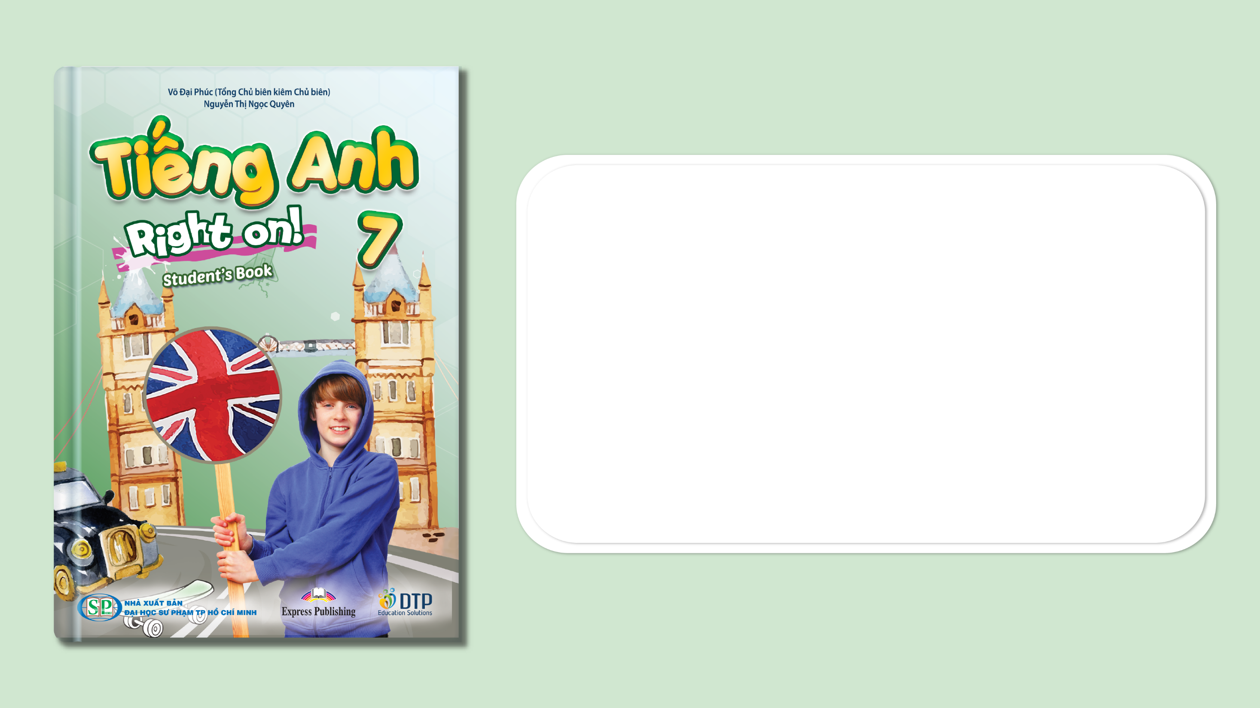
Unit 3: Arts and music
Lesson 3d: Everyday English
Page 51

Slide 2
Lesson Outline
Warm-up
Everyday Eng.
Pronunciation
Consolidation
Wrap-up

Slide 3
Objectives
By the end of this lesson, students will be able to…
- act out a dialogue about buying tickets for a performance.
- pronounce /ɪ/, /i:/, /əʊ/, /aʊ/.

Slide 4

WARM-UP

Slide 5

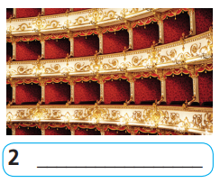
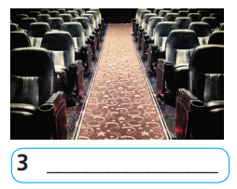
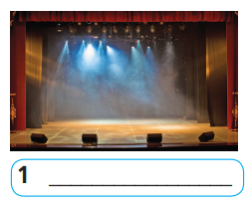
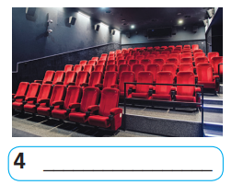
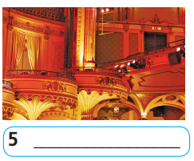
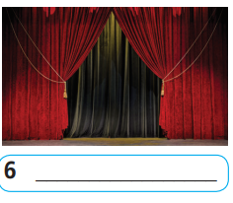
Name the pictures.
Work in pairs.
balcony
aisle
stage
box
curtain
row

Slide 6
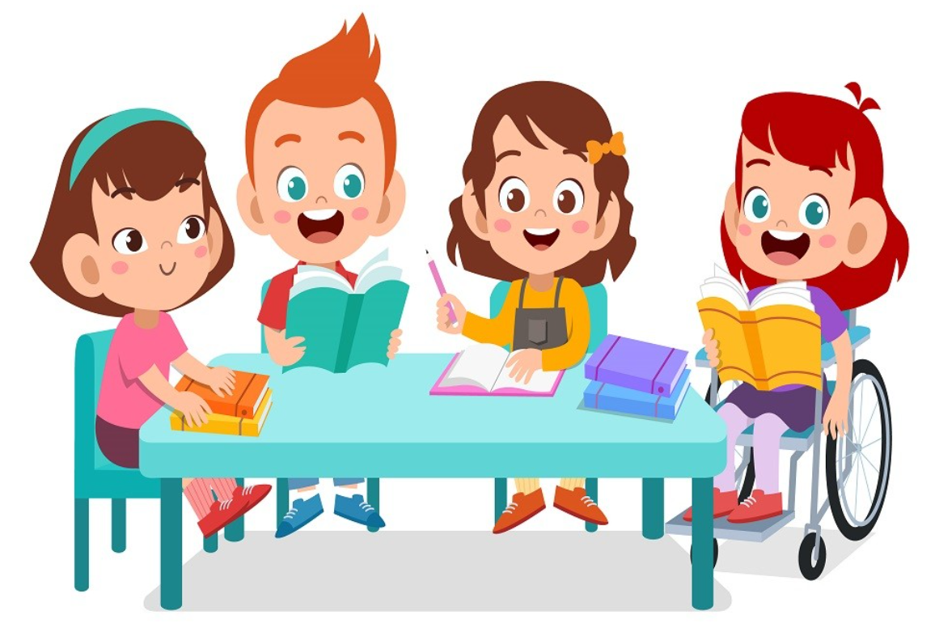
It’s time to learn …

Slide 7
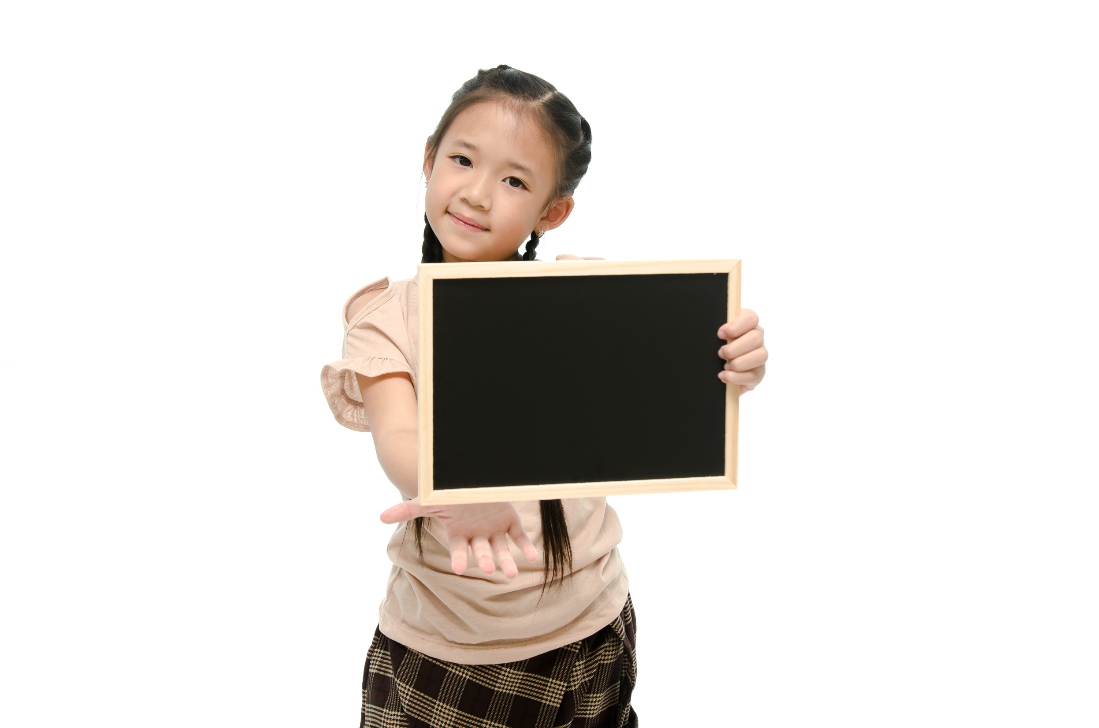
Speaking

Slide 8
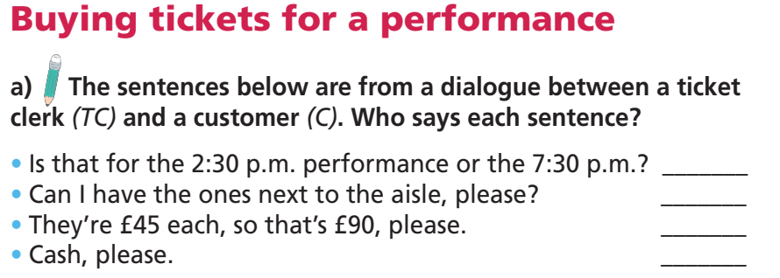
Pre - Speaking
What are the sentences from?
→ A dialogue between a ticket clerk and a customer.
What are you going to do?
Identify who says which sentence.

Slide 9
The sentences below are from a dialogue between a ticket clerk (TC) and a customer (C). Who says each sentence?
• Is that for the 2:30 p.m. performance or the 7:30 p.m.? _______
• Can I have the ones next to the aisle, please? _______
• They’re £45 each, so that’s £90, please. _______
• Cash, please. _______
TC
C
TC
C

Slide 10
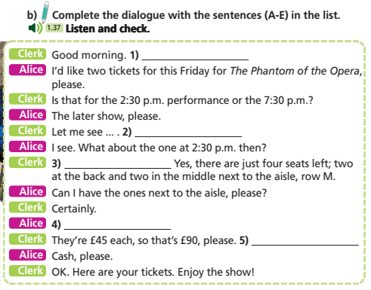
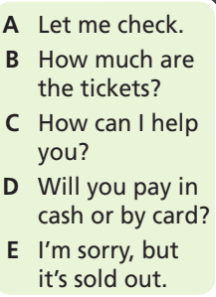
While - Speaking
What is this?
→ A dialogue.
And these?
→ Sentences to fill in the gaps in the dialogue.

Slide 11
Clerk: Good morning. (1) ______________________
Alice: I’d like two tickets for this Friday for The Phantom of the Opera, please.
Clerk: Is that for the 2:30 p.m. performance or the 7:30 p.m.?
Alice: The later show, please.
Clerk: Let me see ... . (2) ______________________
Alice: I see. What about the one at 2:30 p.m. then?
Clerk: (3) ______________________ Yes, there are just four seats left; two at the back and two in the middle next to the aisle, row M.
Alice: Can I have the ones next to the aisle, please?
Clerk: Certainly.
Alice: (4) ______________________
Clerk: They’re £45 each, so that’s £90, please. (5) ________________________
Alice: Cash, please.
Clerk: OK. Here are your tickets. Enjoy the show!
C How can I help you?
E I’m sorry, but it’s sold out.
A Let me check.
B How much are the tickets?
D Will you pay in cash or by card?

Slide 12
2 Read the dialogue again. What is Alice going to watch? Which performance and seats does she get tickets for?
Clerk: Good morning. How can I help you?
Alice: I’d like two tickets for this Friday for The Phantom of the Opera, please.
Clerk: Is that for the 2:30 p.m. performance or the 7:30 p.m.?
Alice: The later show, please.
Clerk: Let me see ... . I’m sorry, but it’s sold out.
Alice: I see. What about the one at 2:30 p.m. then?
Clerk: Let me check. Yes, there are just four seats left; two at the back and two in the middle next to the aisle, row M.
Alice: Can I have the ones next to the aisle, please?
Clerk: Certainly.
Alice: How much are the tickets?
Clerk: They’re £45 each, so that’s £90, please. Will you pay in cash or by card?
Alice: Cash, please.
Clerk: OK. Here are your tickets. Enjoy the show!

Slide 13
Read the instruction quickly. Underline the key words.
Read the dialogue again. What is Alice going to watch?
Which performance and seats does she get tickets for?

Slide 14
Skim the dialogue. Pay attention to key words.
Clerk: Good morning. How can I help you?
Alice: I’d like two tickets for this Friday for The Phantom of the Opera, please.
Clerk: Is that for the 2:30 p.m. performance or the 7:30 p.m.?
Alice: The later show, please.
Clerk: Let me see ... . I’m sorry, but it’s sold out.
Alice: I see. What about the one at 2:30 p.m. then?
Clerk: Let me check. Yes, there are just four seats left; two at the back and two in the middle next to the aisle, row M.
Alice: Can I have the ones next to the aisle, please?
Clerk: Certainly.
Alice: How much are the tickets?
Clerk: They’re £45 each, so that’s £90, please. Will you pay in cash or by card?
Alice: Cash, please.
Clerk: OK. Here are your tickets. Enjoy the show!

Slide 15
Answer key
Alice is going to watch ‘The Phantom of the Opera’.
She gets tickets for the 2:30 p.m. performance.
Her seats are in the middle next to the aisle, in row M.

Slide 16

Take roles and read the dialogue aloud.
Mind your intonation and rhythm.
Clerk: Good morning. How can I help you?
Alice: I’d like two tickets for this Friday for The Phantom of the Opera, please.
Clerk: Is that for the 2:30 p.m. performance or the 7:30 p.m.?
Alice: The later show, please.
Clerk: Let me see ... . I’m sorry, but it’s sold out.
Alice: I see. What about the one at 2:30 p.m. then?
Clerk: Let me check. Yes, there are just four seats left; two at the back and two in the middle next to the aisle, row M.

Slide 17
Take roles and read the dialogue aloud.
Mind your intonation and rhythm.
Alice: Can I have the ones next to the aisle, please?
Clerk: Certainly.
Alice: How much are the tickets?
Clerk: They’re £45 each, so that’s £90, please. Will you pay in cash or by card?
Alice: Cash, please.
Clerk: OK. Here are your tickets. Enjoy the show!

Slide 18

Post - Speaking
Imagine you want to attend the performance in the
poster. Act out a similar dialogue.

Slide 19
Suggested answer
A: Good morning. How can I help you?
B: I’d like two tickets for this Saturday for ‘School of Rock’, please.
A: Is that for the 4:00 p.m. performance or the 8:00 p.m.?
B: The later show, please.
A: Let me see... I’m sorry, but it’s sold out.
B: I see. What about the one at 4:00 p.m., then?
A: Let me check. Yes, there are just four seats left; two at the
front and two in the middle next to the aisle, row L.

Slide 20
Suggested answer
B: Can I have the ones at the front, please?
A: Certainly.
B: How much are the tickets?
A: They’re £50 each, so that’s £100, please. Will you pay in cash or by card?
B: Card, please.
A: OK. Here are your tickets. Enjoy the show!

Slide 21
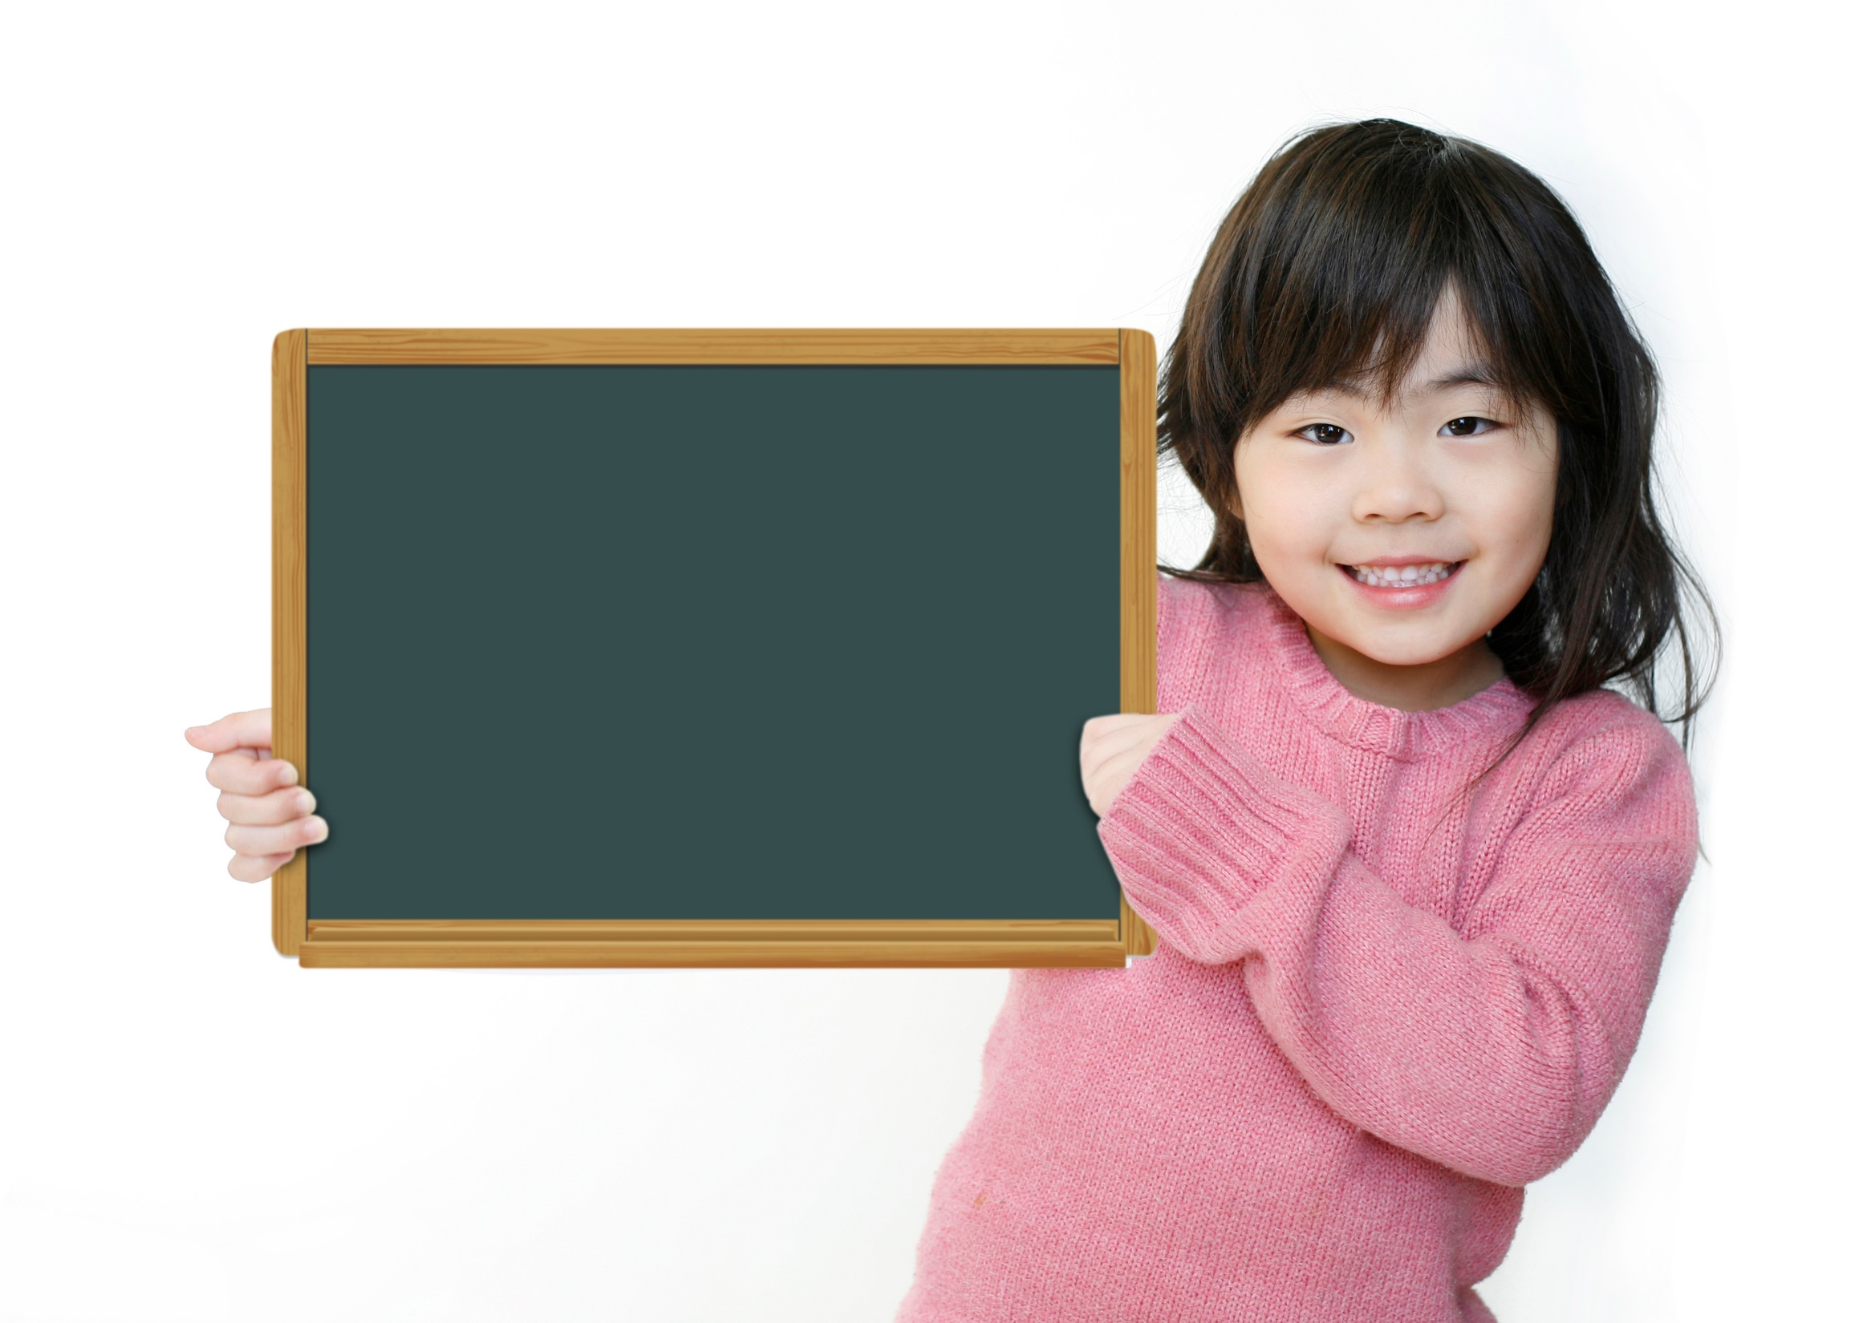
Pronunciation

Slide 22




Listen and repeat.

Slide 23
Think of more words with the same sounds. Practise saying them with a partner.
Suggested answer
/ɪ/: tick, kit
/iː/: meat, greet
/əʊ/: low, coat
/kaʊ/: cow, cloud

Slide 24
Choose the word whose main stress is placed differently
from the others.
Extra Practice
1. A. festival B. performance C. premiere D. acrobat
2. A. curtain B. hearing C. painting D. respect
3. A. honest B. cheerful C. curly D. alone
/ˈfestɪvəl/
/pəˈfɔːməns/
/ˈpremieər/
/ˈækrəbæt/
/ˈkɜːtən/
/ˈhɪərɪŋ/
/ˈpeɪntɪŋ/
/rɪˈspekt/
/ˈɒnɪst/
/ˈtʃɪəfəl/
/ˈkɜːli/
/əˈləʊn/

Slide 25
Choose the word whose underlined part is pronounced differently
from that of the other words.
A. art B. fame C. play D. grade
2. A. night B. film C. sight D. flight
3. A. box B. row C. pop D. hop
/ɑːt/
/feɪm/
/pleɪ/
/greɪd/
/naɪt/
/fɪlm/
/saɪt/
/flaɪt/
/bɒks/
/rəʊ/
/pɒp/
/hɒp/

Slide 26

CONSOLIDATION

Slide 27
Match the exchanges
1. Will you pay in cash or by card? | a. Let me check.
2. What about the one at 8:00 p.m., then? | b. I see.
3. Is that for the 3:30 p.m. performance or the 6:30 p.m.? | c. By card, please.
4. I’m sorry, but it’s sold out. | d. The later show, please.

Slide 28

WRAP-UP

Slide 29
Today’s lesson
- Act out a dialogue buying tickets for a performance.
- Pronounce /ɪ/, /i:/, /əʊ/, /aʊ/.

Slide 30
Homework
Practise pronouncing /ɪ/, /i:/, /əʊ/, /aʊ/.
Do the exercises in TA 7 Right on WB (page 29).
Prepare the next lesson (page 52 SB)

Slide 31

Lesson 3
Stay positive and have a nice day!

