Slide 1


Slide 2
BLACK CARBON AND GLOBAL
TEMPERATURE
Unit
5
GLOBAL WARMING
Unit
FAMILY LIFE
LESSON 5
LISTENING
Student Book – page 57

Slide 3
LESSON 5
LISTENING
WARM-UP
Climate change quiz
Task 1: Match the words with their meanings.
PRE-LISTENING
Task 2: Listen to a talk and choose the main idea.
Task 3: Choose the correct answers.
WHILE-LISTENING
POST-LISTENING
Task 4: Answer the questions.
CONSOLIDATION
Wrap-up
Homework

Slide 4
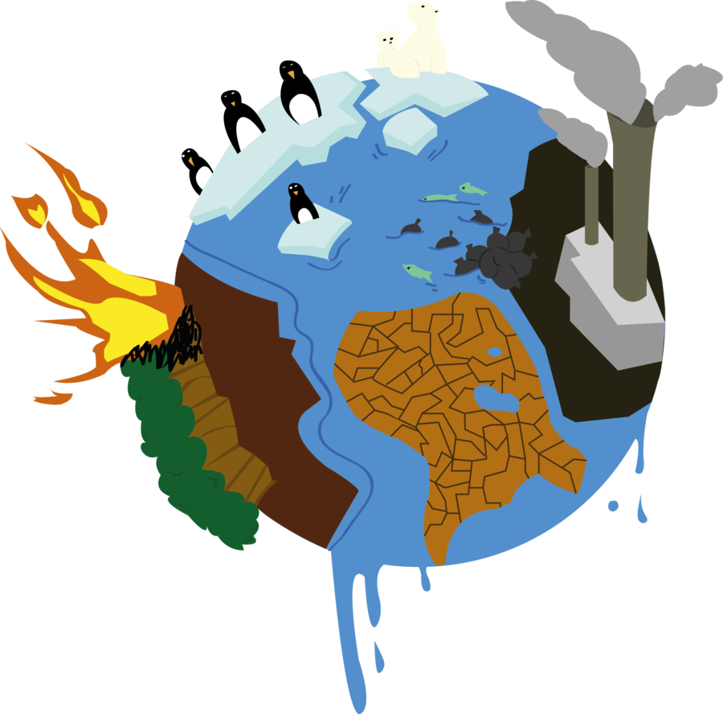
WARM-UP
Climate Change Quiz

Slide 5
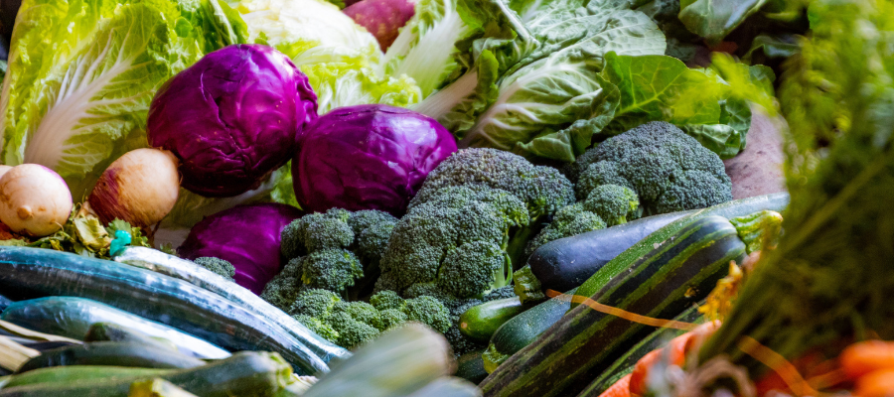

1/ True or False: Wasting less food is a way to reduce greenhouse gas emissions.
True
False

Slide 6
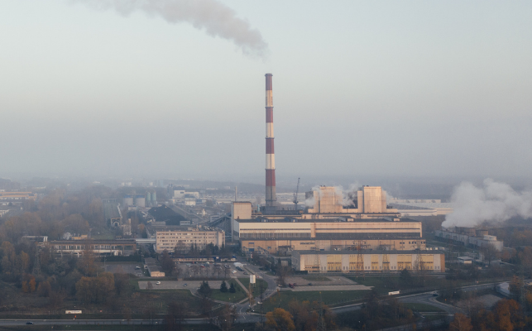
2/ Which of the following is a greenhouse gas?
CO2
CH4
Water Vapour
All of the above

Slide 7
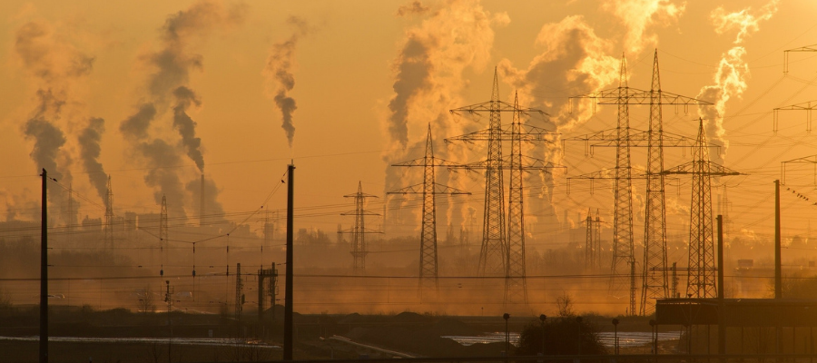
3/ What is the greenhouse effect?
When you paint your house green to become an environmentalist
When the gases in our atmosphere trap heat and block it from escaping our planet
The name of climate change legislation that was passed by Congress
When you build a green house

Slide 8
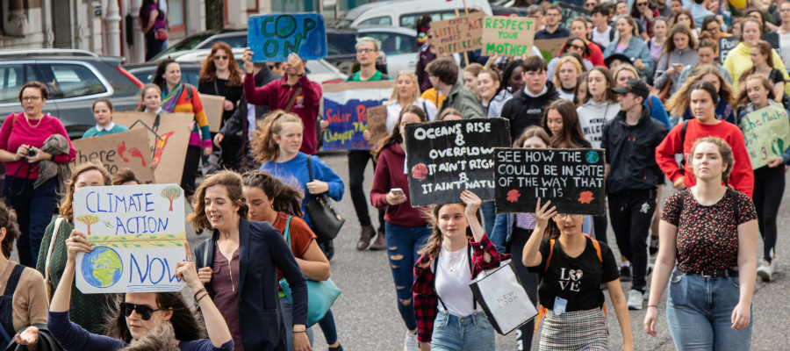
4/ What can you do to help fight climate change?
Divest from fossil fuel companies
Vote for political candidates who will advocate for climate-related legislation and policy improvements
Engage yourself in the science behind climate change
All of the above

Slide 9


PRE-LISTENING
soot (n)
/sʊt/
a black powder composed mainly of carbon, produced when coal, wood, etc. is burned

Slide 10

PRE-LISTENING
soil (n)
/sɔɪl/
the material on the surface of the ground in which plants grow; earth

Slide 11
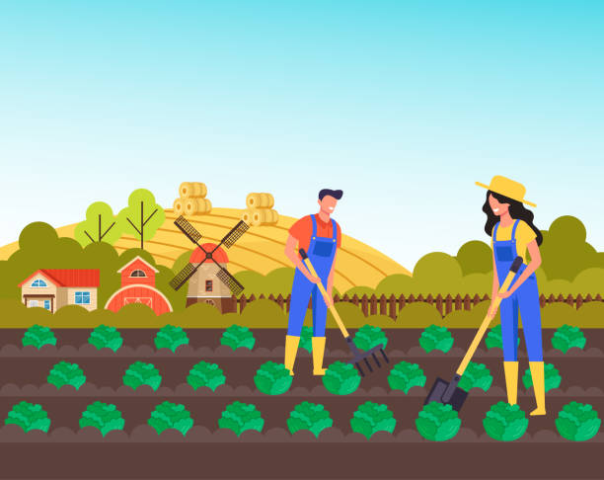
PRE-LISTENING
crop (n)
/krɒp/
a plant such as a grain, vegetable, or fruit grown in large amounts on a farm, or the total amount gathered of such a plant

Slide 12

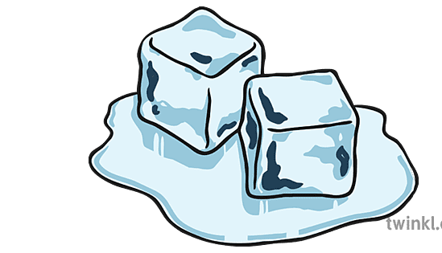
PRE-LISTENING
melt (v)
/melt/
to turn from something solid into something soft or liquid

Slide 13
PRE-LISTENING
Form | Pronunciation | Meaning
1. soot (n) | /sʊt/ | a black powder composed mainly of carbon, produced when coal, wood, etc. is burned
2. soil (n) | /sɔɪl/ | the material on the surface of the ground in which plants grow; earth
3. crop (n) | /krɒp/ | a plant such as a grain, vegetable, or fruit grown in large amounts on a farm, or the total amount gathered of such a plant
4. melt (v) | /melt/ | to turn from something solid into something soft or liquid

Slide 14
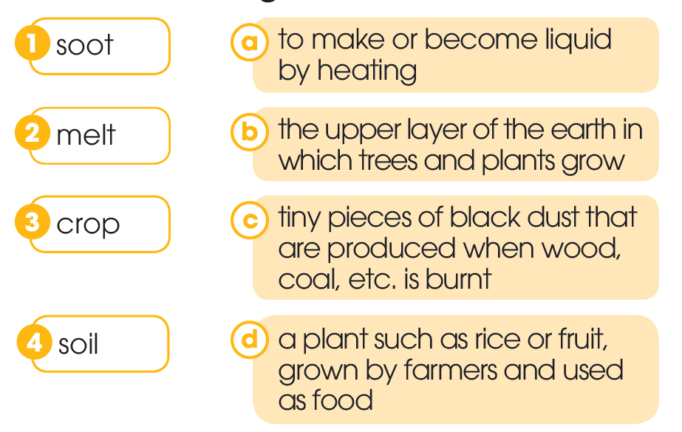
PRE-LISTENING
1
Work in pairs. Match the words with their meanings.

Slide 15
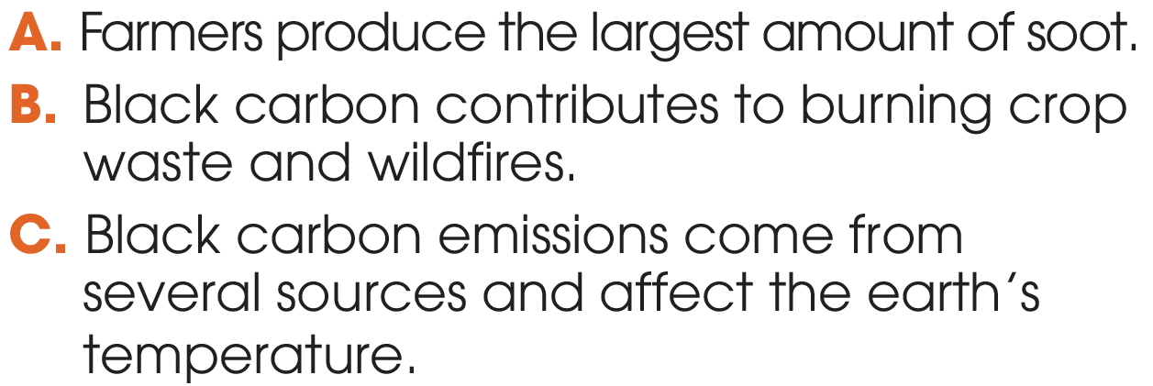
WHILE-LISTENING
2
Listen to a talk and choose the main idea.

Slide 16
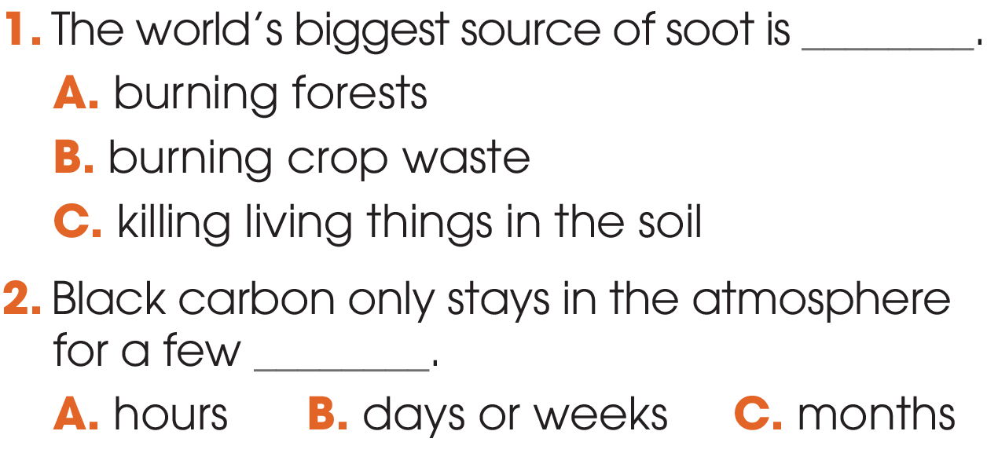
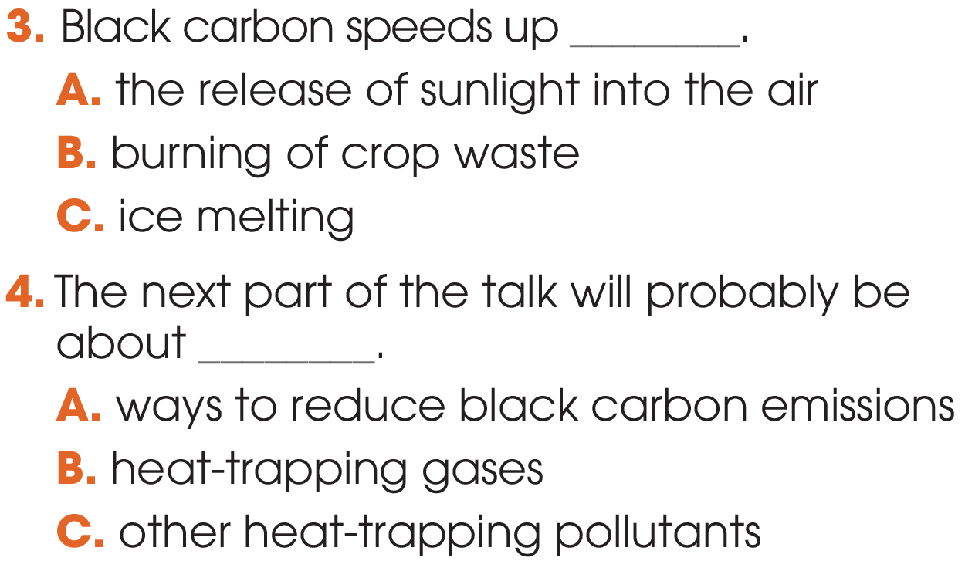
WHILE-LISTENING
3
Listen to the talk again. Choose the correct answers A, B, or C.

Slide 17
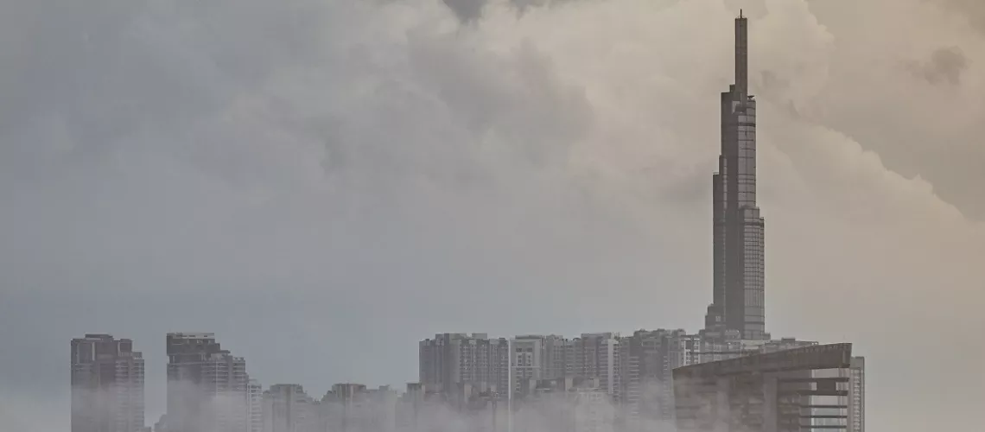
POST-LISTENING
4
Work in groups and answer the questions.
Is black carbon found in your city or neighbourhood?
If so, where does it come from?

Slide 18
CONSOLIDATION
1
Wrap-up
What have you learnt today?
New vocabulary
Listen for main ideas and specific information in a talk about black carbon and global temperature

Slide 19
CONSOLIDATION
2
Homework
Do exercises in the workbook.
Prepare for Lesson 6 - Unit 5.

Slide 20

Website: hoclieu.vn
Fanpage: facebook.com/www.tienganhglobalsuccess.vn/

