Slide 1

Hello 2
Pages 7 - 8 - 9

Slide 2
Lesson Outline
Warm-up
Grammar
Writing
Consolidation
Wrap-up

Slide 3
Objectives
By the end of this lesson, students will be able to…
- Revise vocabulary about sports and family members.
- Revise subject personal pronouns/possessive adjectives.
Revise the verb to be.
Practise writing a blog entry about yourself.

Slide 4

WARM-UP

Slide 5
Which sports do you usually play in your free time?

Slide 6

It’s time to learn …

Slide 7

Presentation

Slide 8

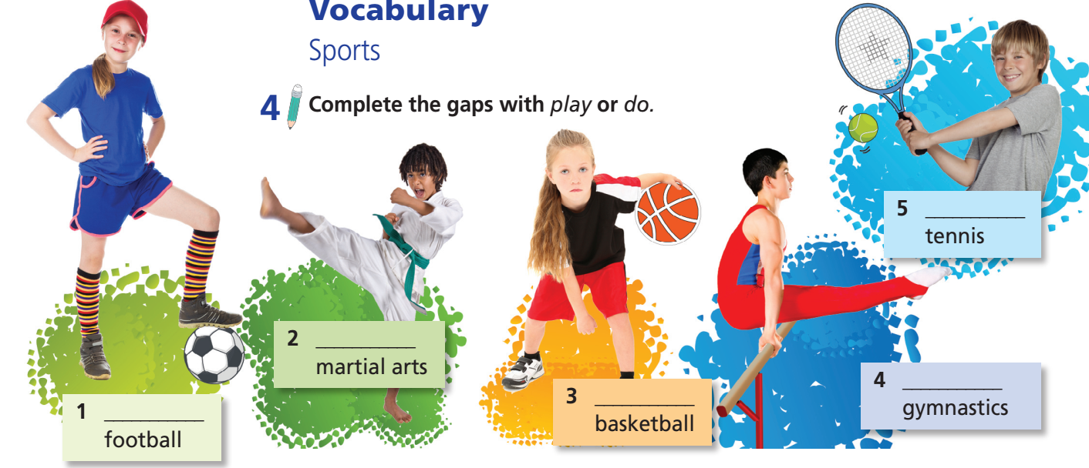
4 Complete the gaps with play or do.
Notes!
We use ‘play’ for team sports.
We use ‘do’ for individual sports.
play
do
do
play
play

Slide 9
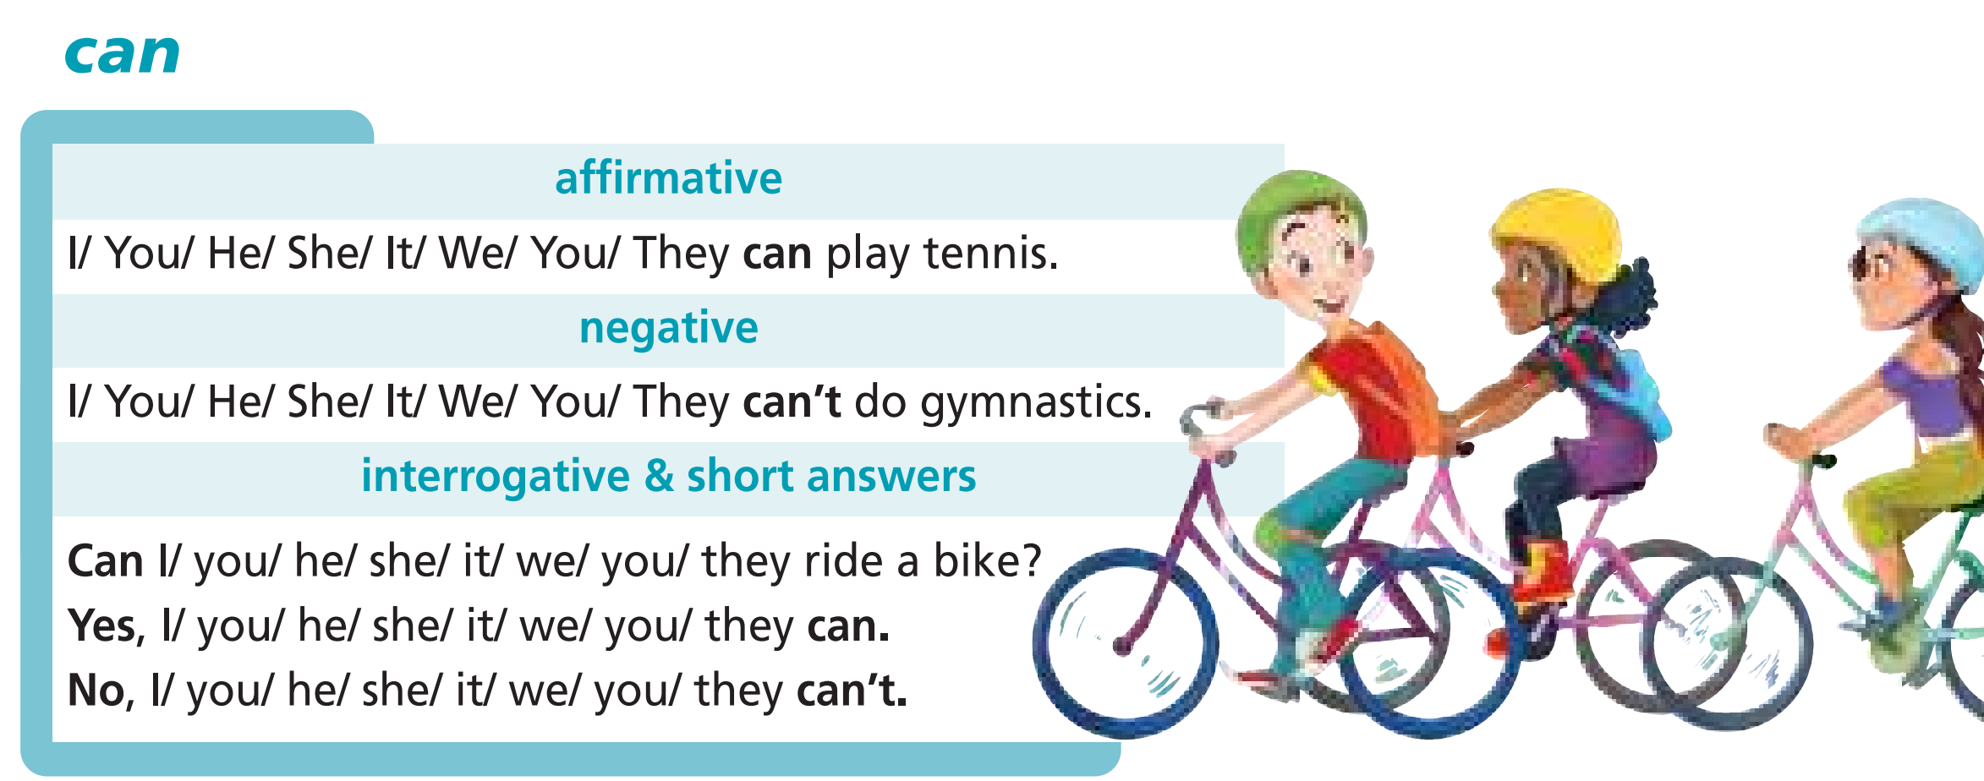
Read the theory box.

Slide 10

Practice

Slide 11
5 Ask and answer questions about the sports in Exercise 4.
do martial arts?
play basketball?
do gymnastics?
play tennis?
A: Can you play football?
B: Yes, I can./No, I can’t.

Slide 12

Production

Slide 13
6 Tell the class what your partner can/can’t do.
Example
Peter can play football, basketball, and tennis. He can’t do martial arts or gymnastics.

Slide 14

Writing

Slide 15
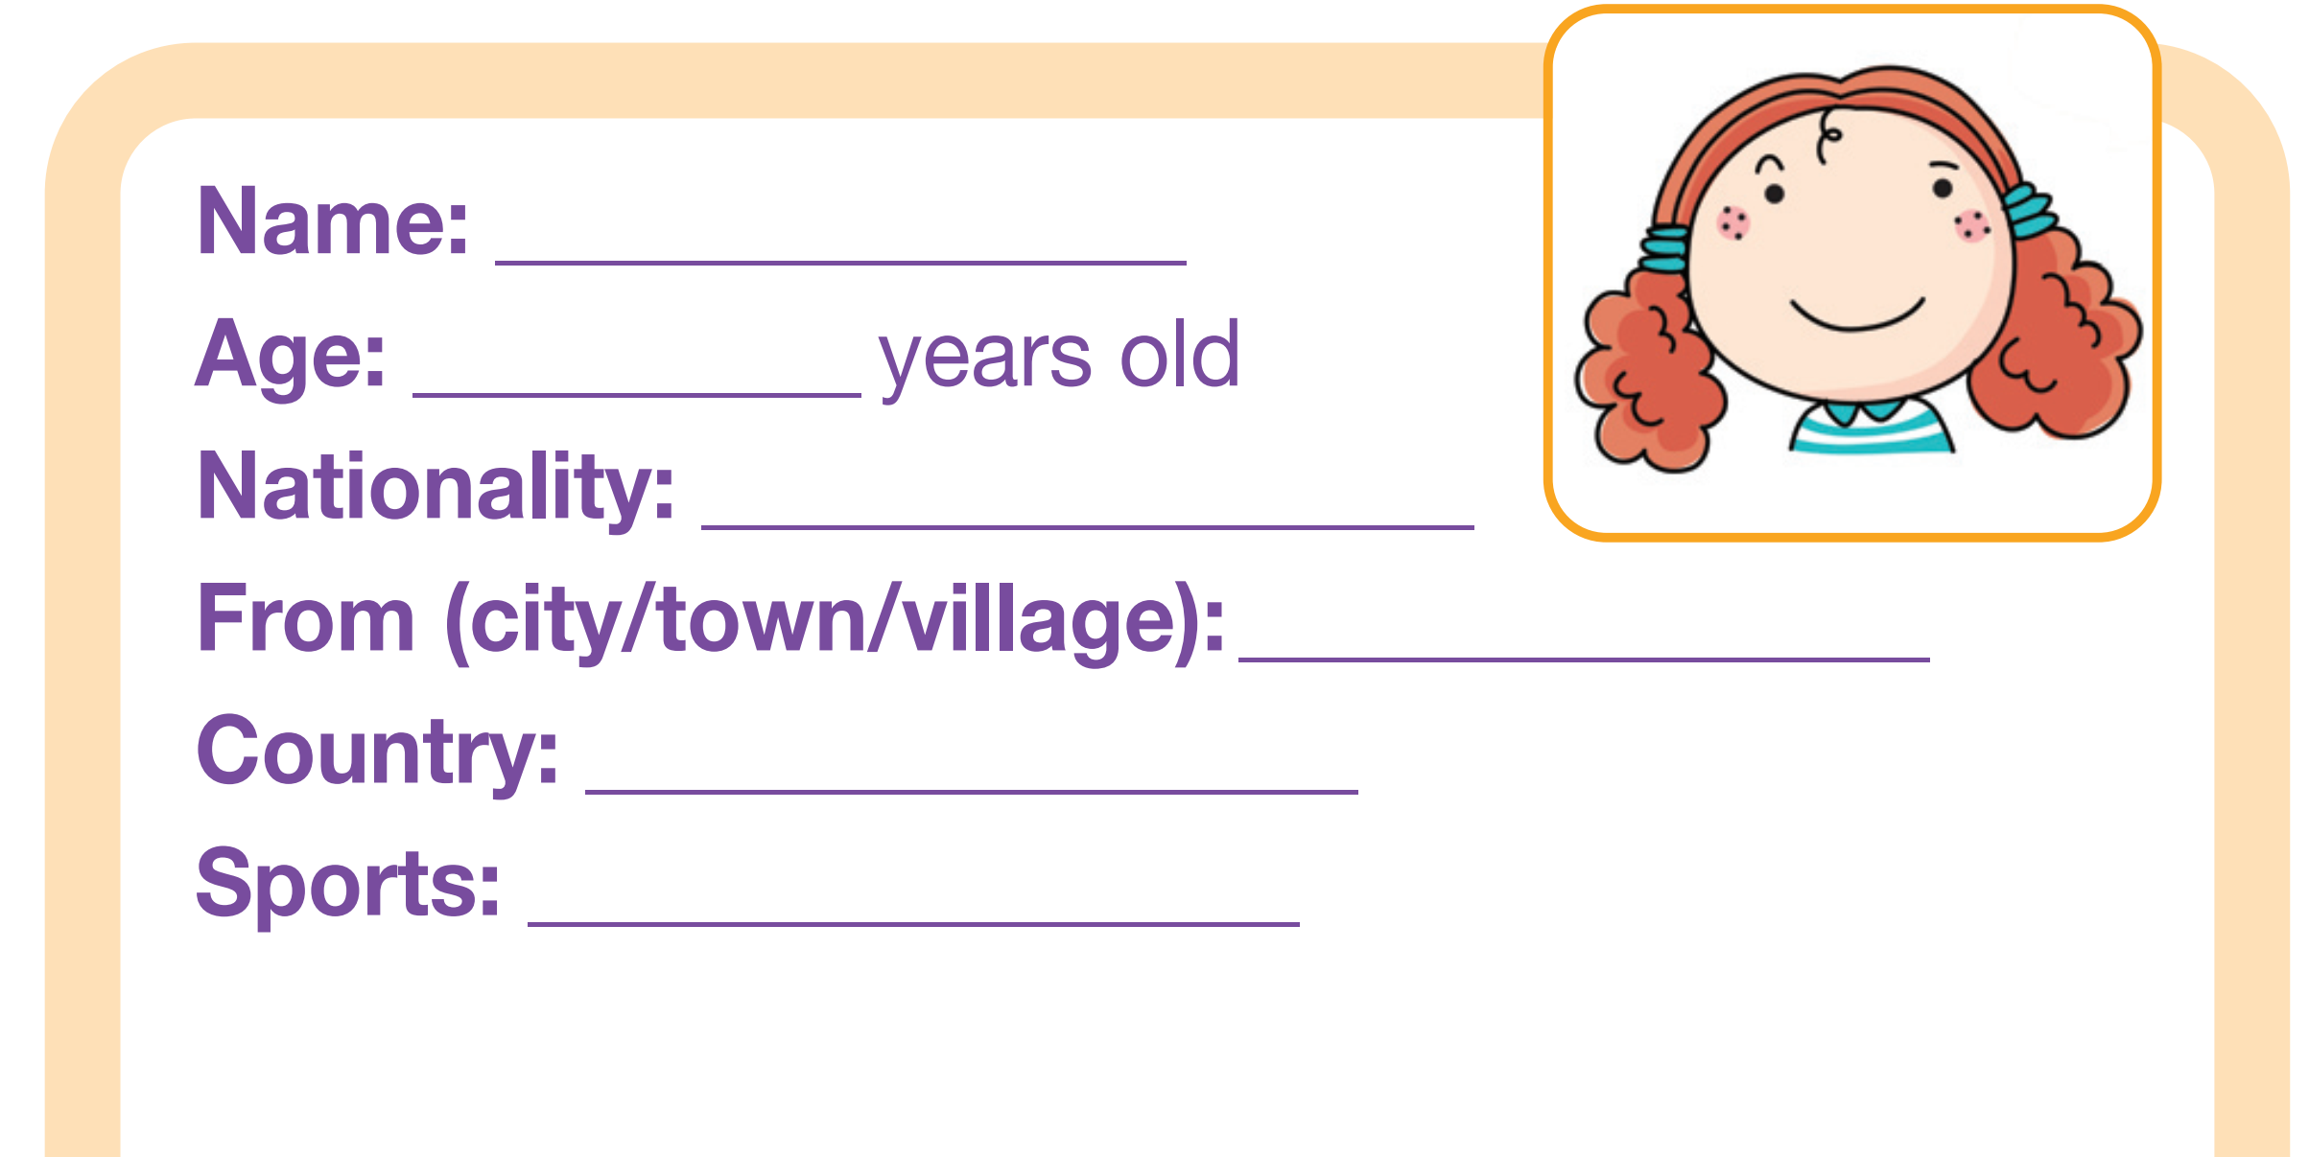
Pre-writing
7 Complete the profile about yourself.

Slide 16
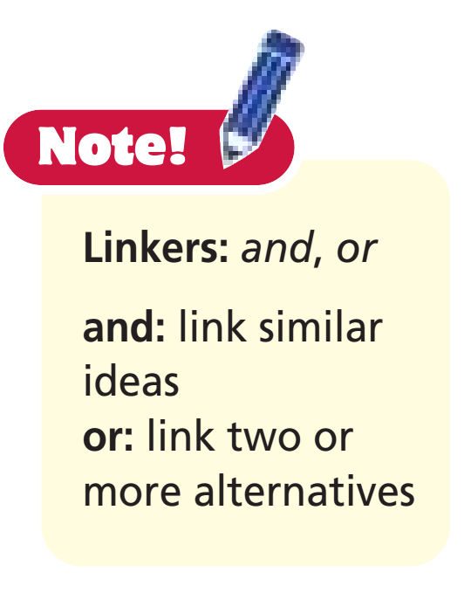
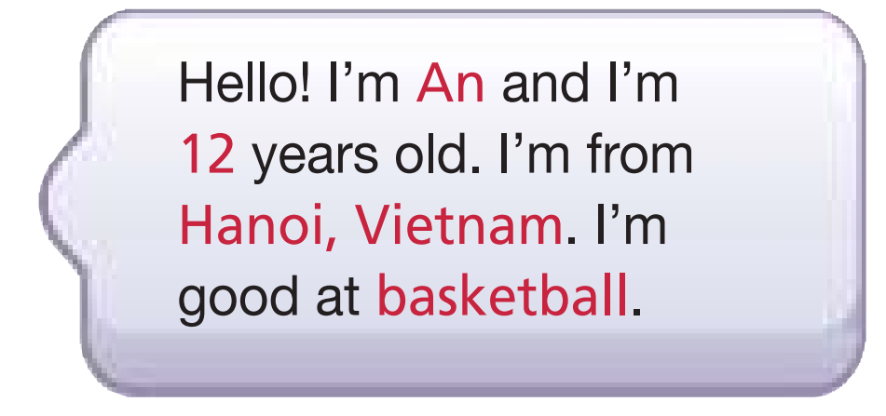
While-writing
Write a blog entry about yourself (about 30 words).
Example

Slide 17
Post-writing
Peer correction
Exchange your papers. Put a tick if your friend’s paper meets the criteria. Underline grammar mistakes. Circle spelling mistakes.
Criteria | Yes | No
Name
Age
City/town/village
Country
Sport
Spelling mistakes | Circle
Grammar mistakes | Underline

Slide 18
Grammar

Slide 19
Presentation

Slide 20
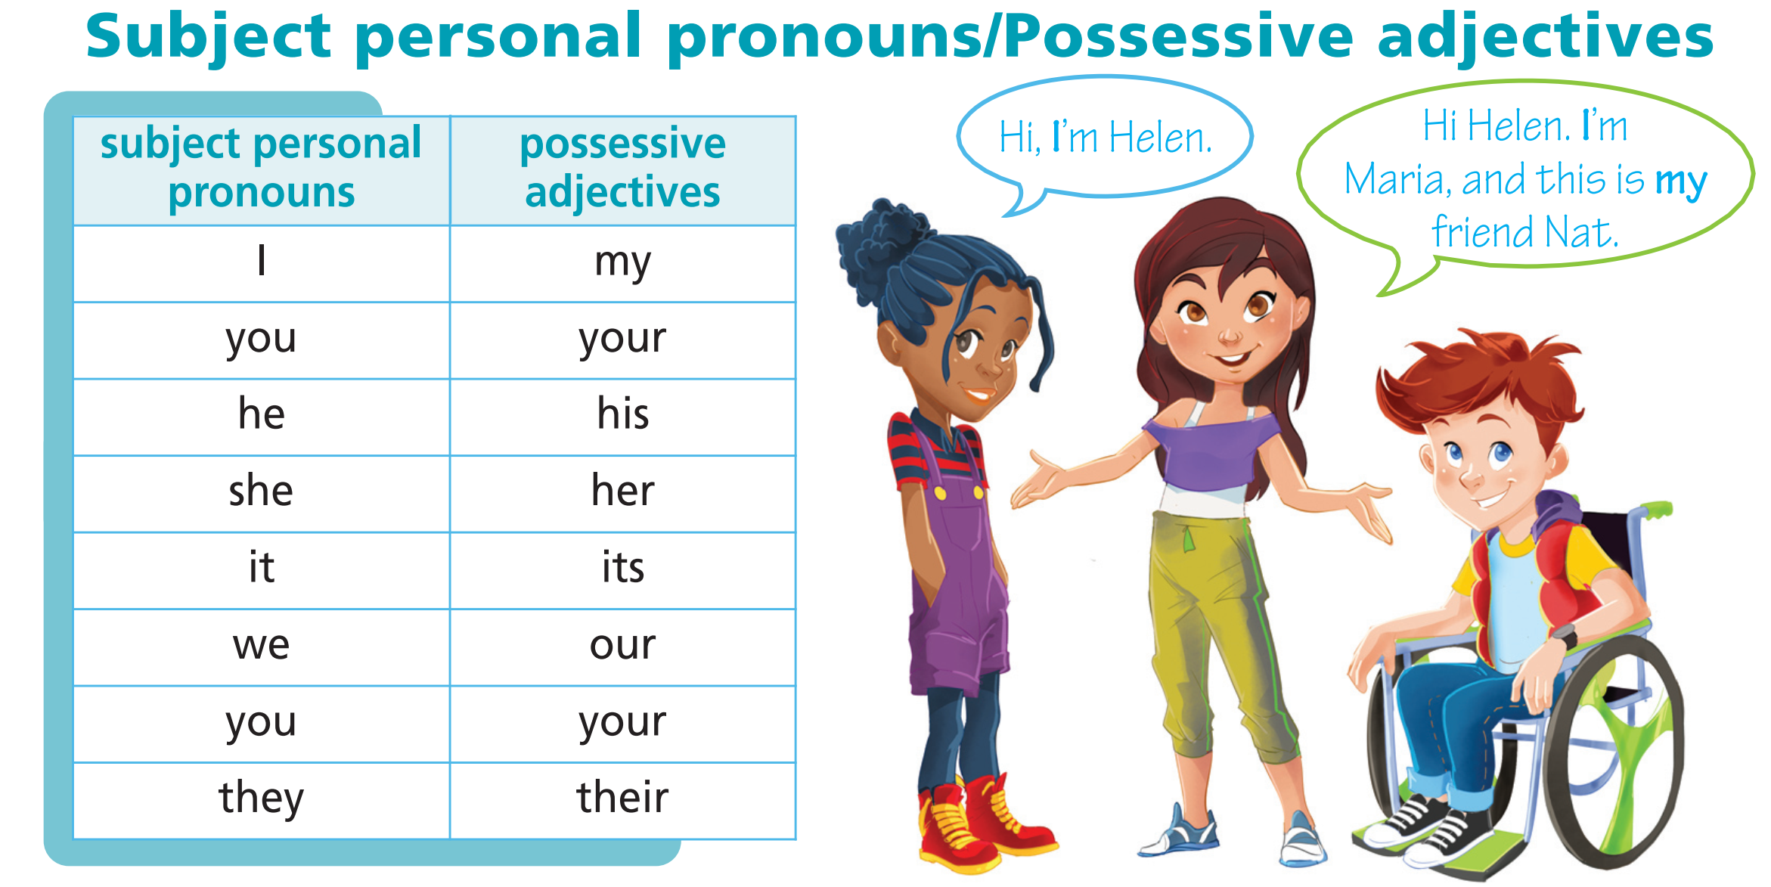
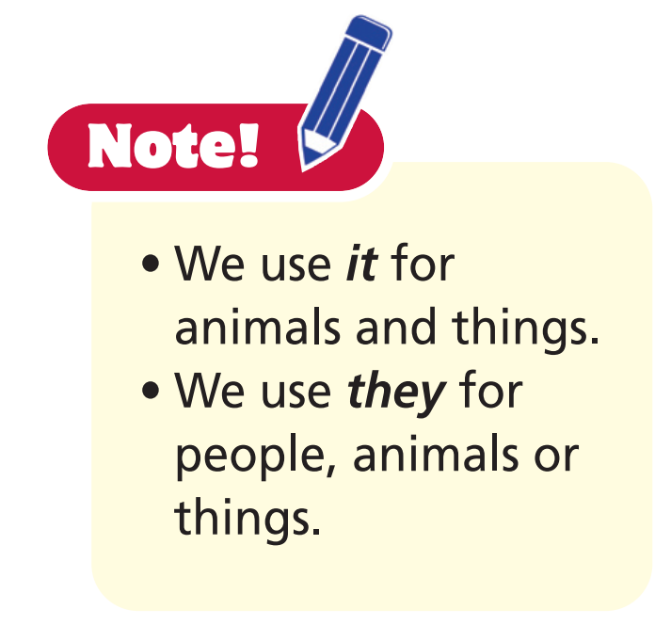

Slide 21
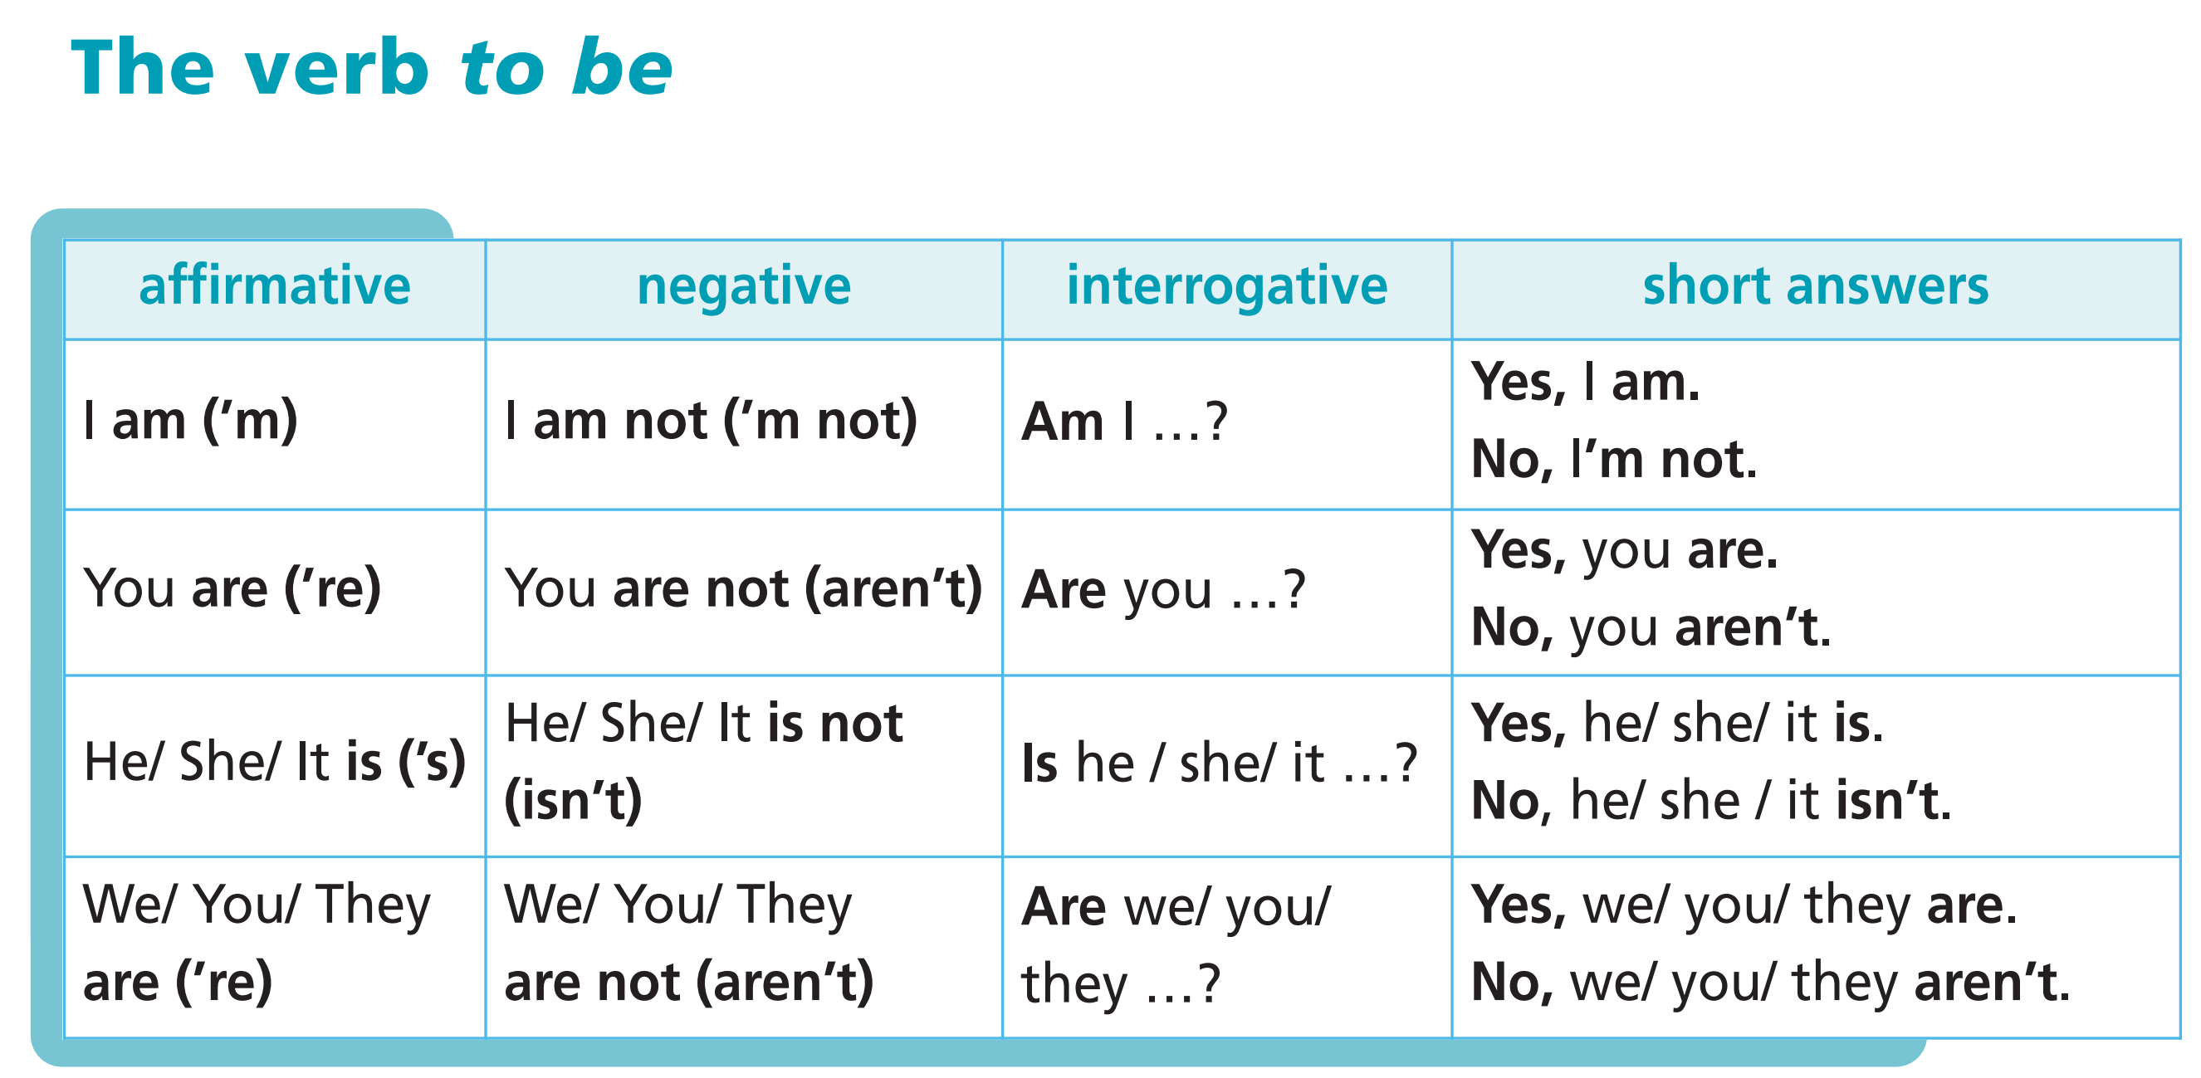
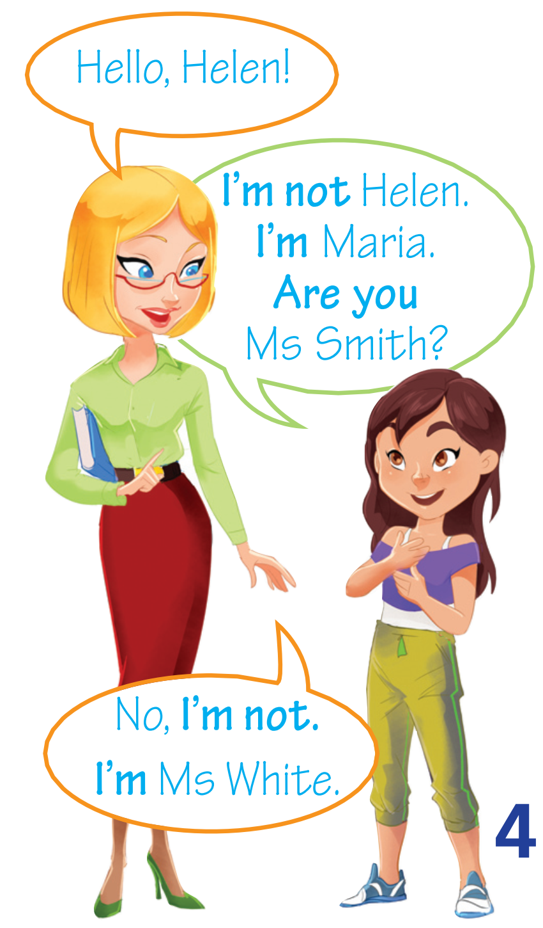

Slide 22
Practice

Slide 23
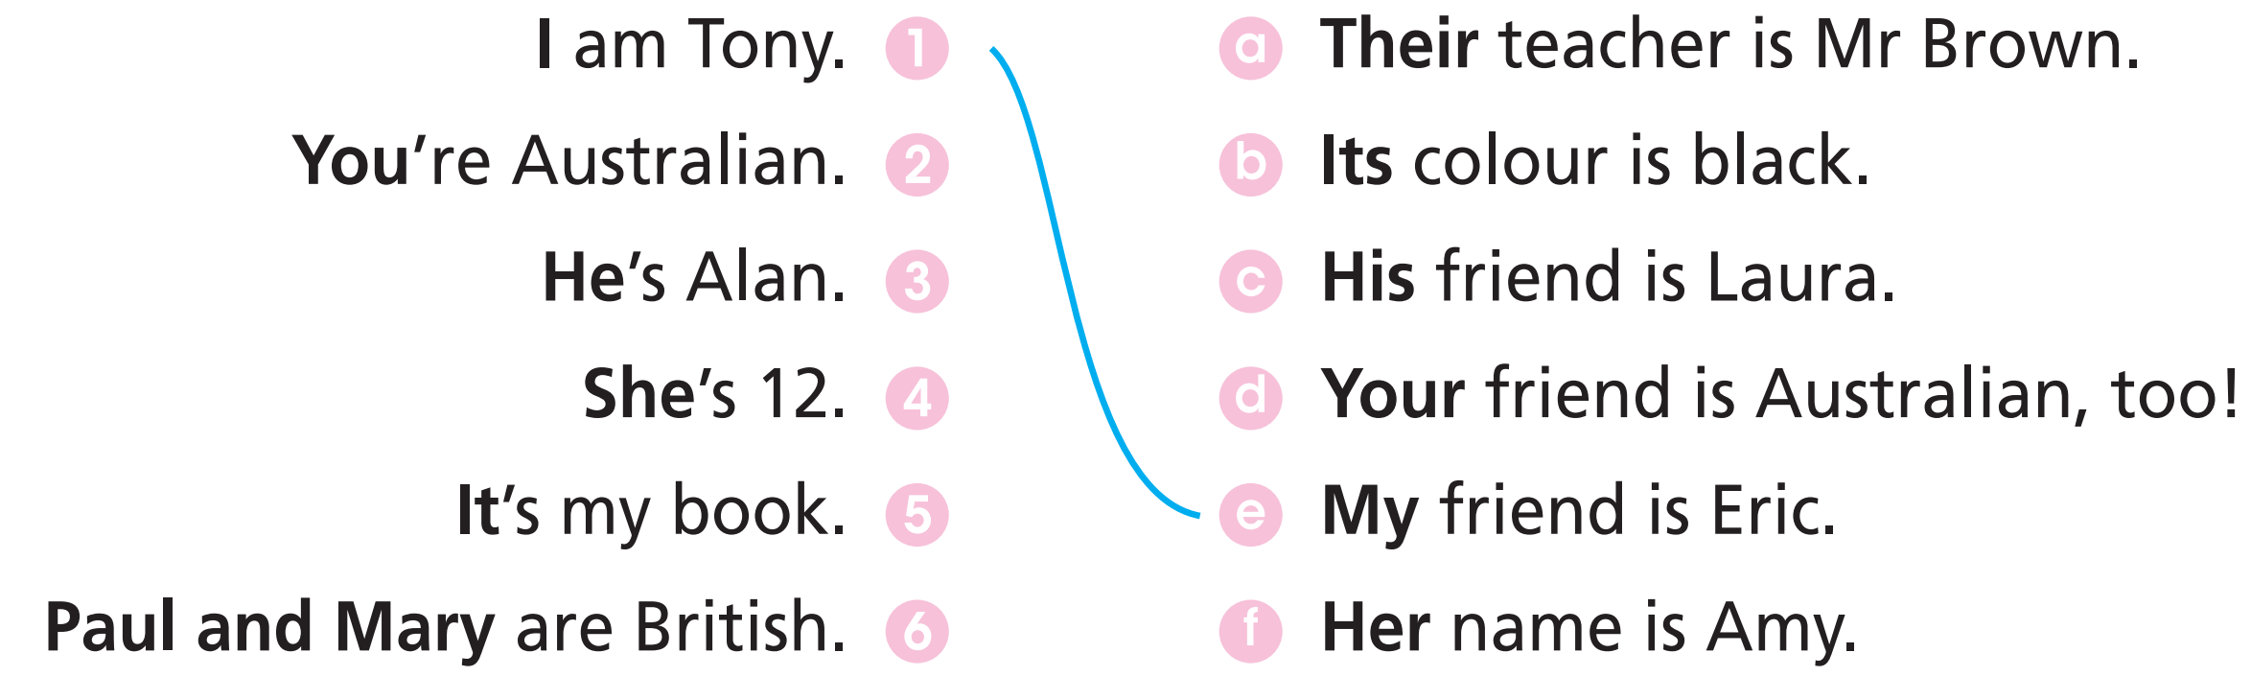
1 Match the sentences.

Slide 24
2 Complete the gaps with the correct subject pronoun or possessive adjective.
1 Julie and I are friends. ___________ home is in London.
2 This is Mario and Lyn. ____________ friend is Rosa.
3 We’re Greek. ____________ friends are Greek, too.
4 This is Tom. ______________ is from Canada.
5 Jane is from the UK. ____________ is 10 years old.
Our
Their
Our
He
She

Slide 25
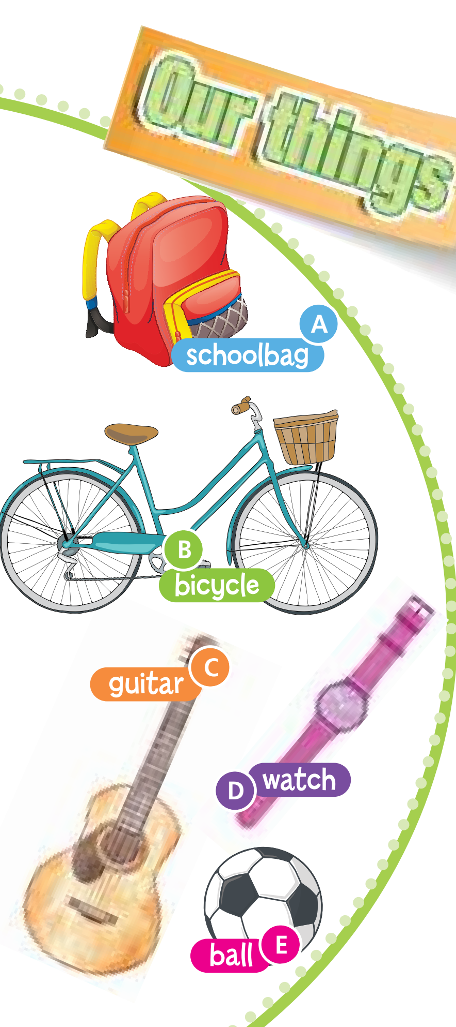

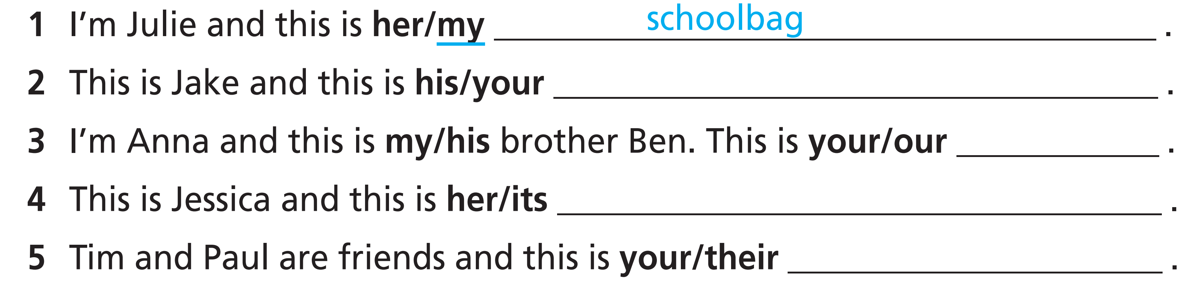
3 Look at the pictures. Read the sentences (1-5) and choose the correct item. Then complete the gaps with the correct words (A-E).
bicycle
guitar
watch
ball

Slide 26


4 Complete the gaps. Then match the sentences (1-6) to the sentences (a-f).
Pam ____________ 10 years old.
They ____________ Spanish.
I ____________ British.
We _____________ Russian.
London ___________ in the USA.
You ___________ 12 years old.
isn’t
We ___________ Australian.
I ___________ Canadian.
It ____________ in the UK.
She ____________ 12.
You ____________ 10.
They ____________ Brazilian.
aren’t (are)
are (aren’t)
‘m not (‘m)
‘m (‘m not)
is
are (aren’t)
is
isn’t
aren’t (are)
are (aren’t)
aren’t (are)

Slide 27
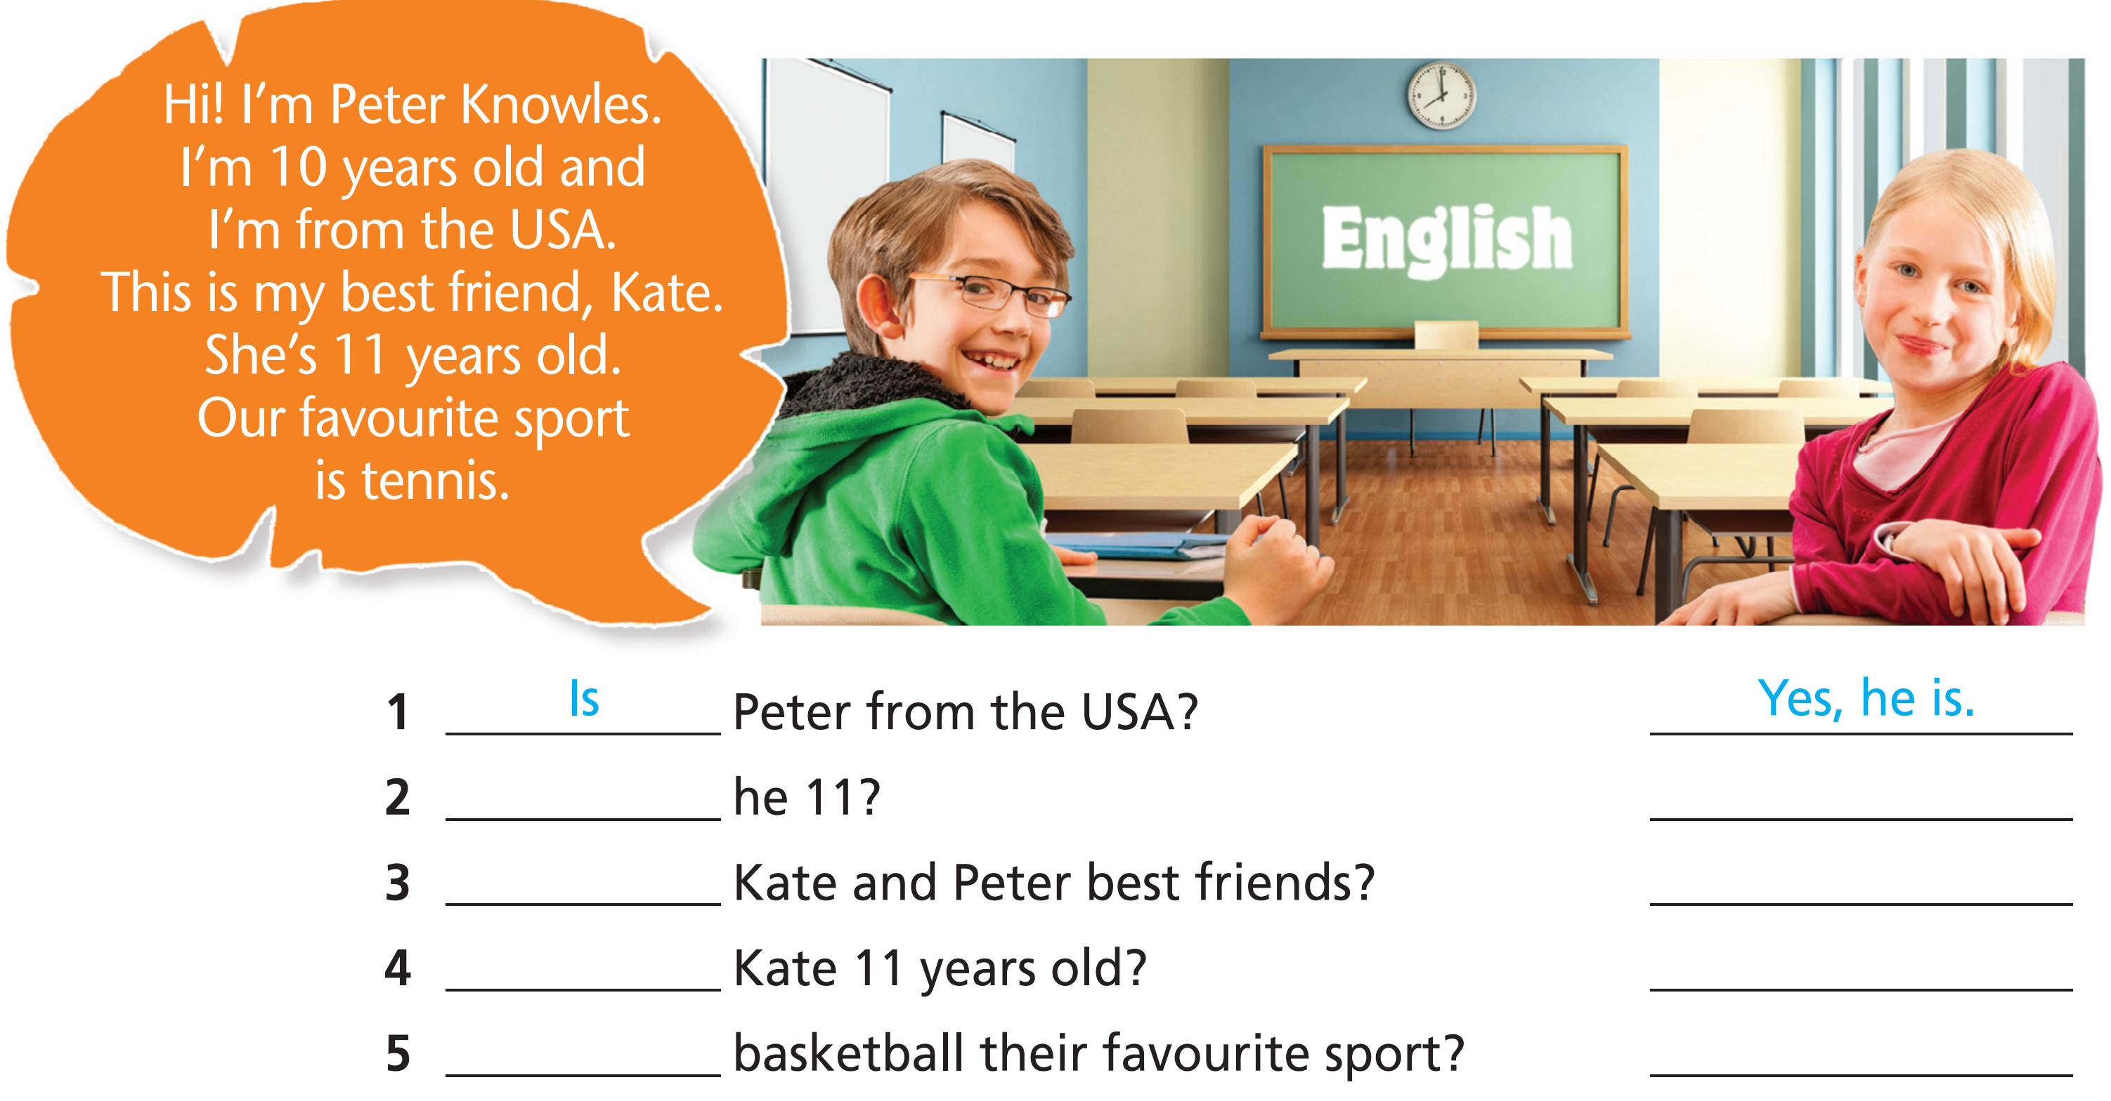
5 Read the text. Complete the questions, then answer them.
Is
No, he isn’t.
Are
Yes, they are.
Is
Yes, she is.
Is
No, it isn’t.

Slide 28
6 Make sentences that are true about you. Use the affirmative or negative.
1 I ____________________ 15 years old.
2 My best friend ____________________ from Greece.
3 My favourite sport ____________________ tennis.
4 My friends ____________________ 14 years old.
5 Our favourite colour ____________________ green.
6 I ____________________ good at tennis.
am/am not
is/isn’t
is/isn’t
are/aren’t
is/isn’t
am/am not

Slide 29
Production

Slide 30
Work in groups of four. Talk about yourself, use the information in Exercise 6.

Slide 31

CONSOLIDATION

Slide 32
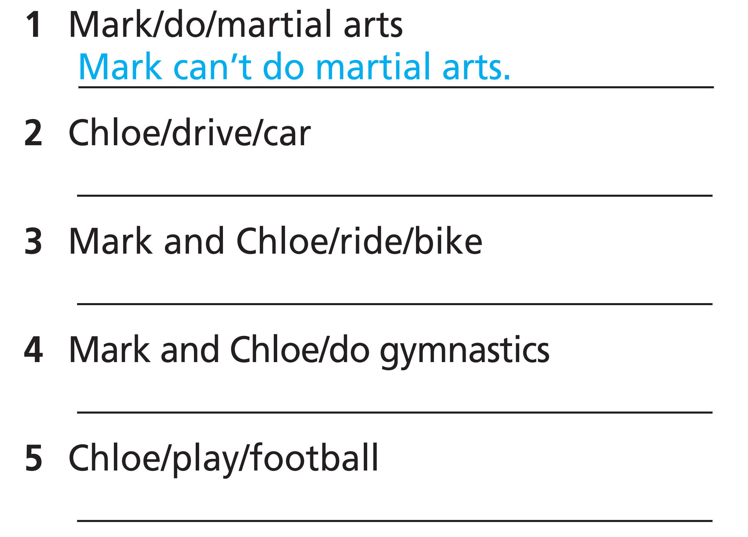
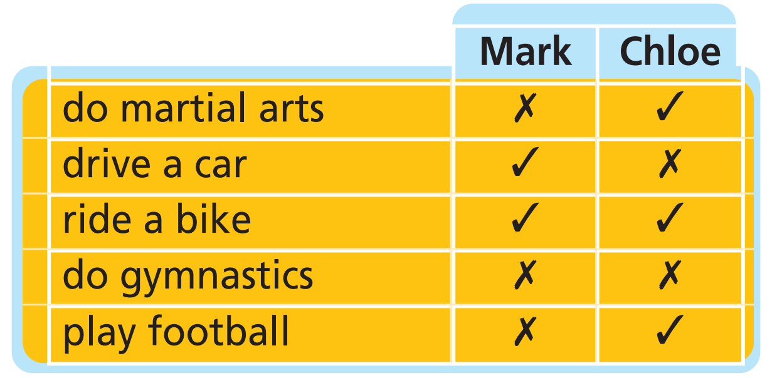
Look at the table. Complete the sentences.
Chloe can’t drive a car.
Mark and Chloe can ride a bike.
Mark and Chloe can't do gymnastics.
Chloe can play football.

Slide 33

WRAP-UP

Slide 34
Today’s lesson
Vocabularies
Sports
Grammar
Can
Subject personal pronouns/ Possessive adjectives
To be

Slide 35
Homework
Practise the vocabularies and grammar and make sentences using them.
Do the exercises in TA 6 Right on WB (pp. 4-5)
Do the exercises in TA 6 Right on Notebook (pp. 5-6)
Prepare the next lesson (pp. 10-11-12 SB)

Slide 36
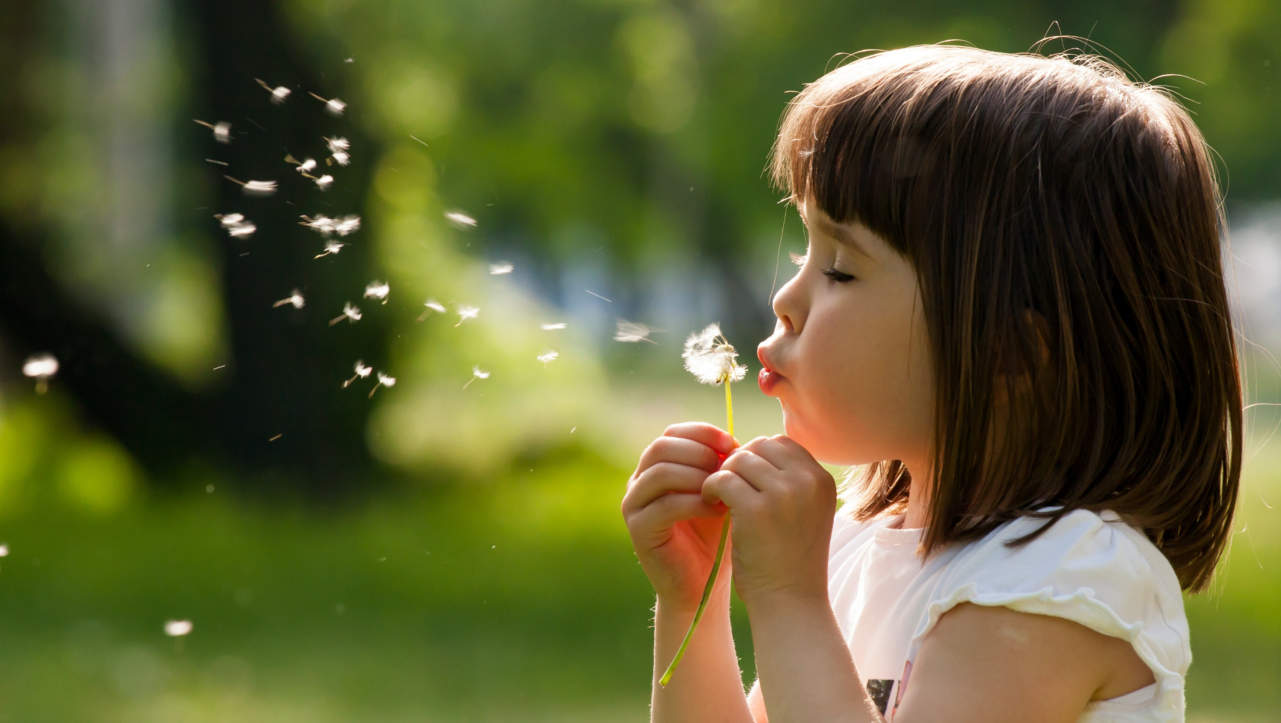
Enjoy your day!

