Slide 1





Slide 4


LET’S SING TOGETHER
Notes:
request all pupils to stand up and sing with TPR technique/ read the lesson plan for details

Slide 5
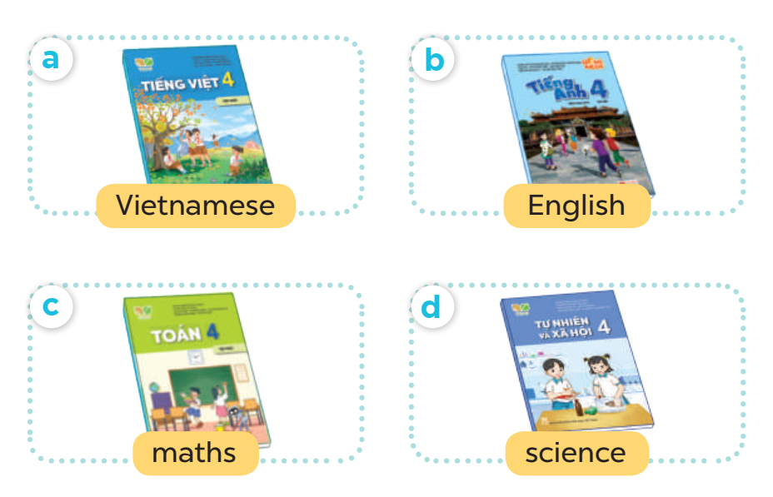
WHAT DO YOU HAVE TODAY?

Slide 6
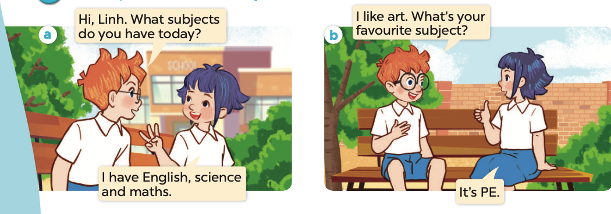

Slide 8
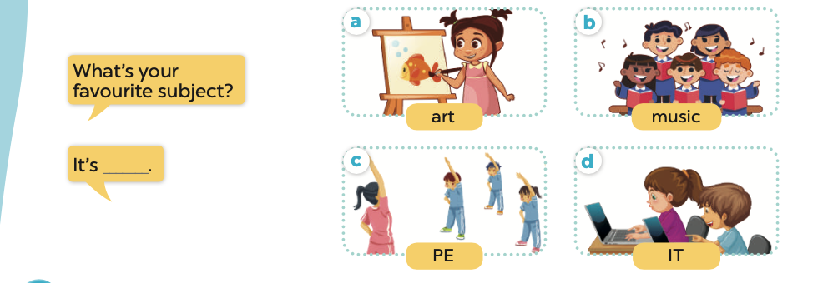

Slide 11


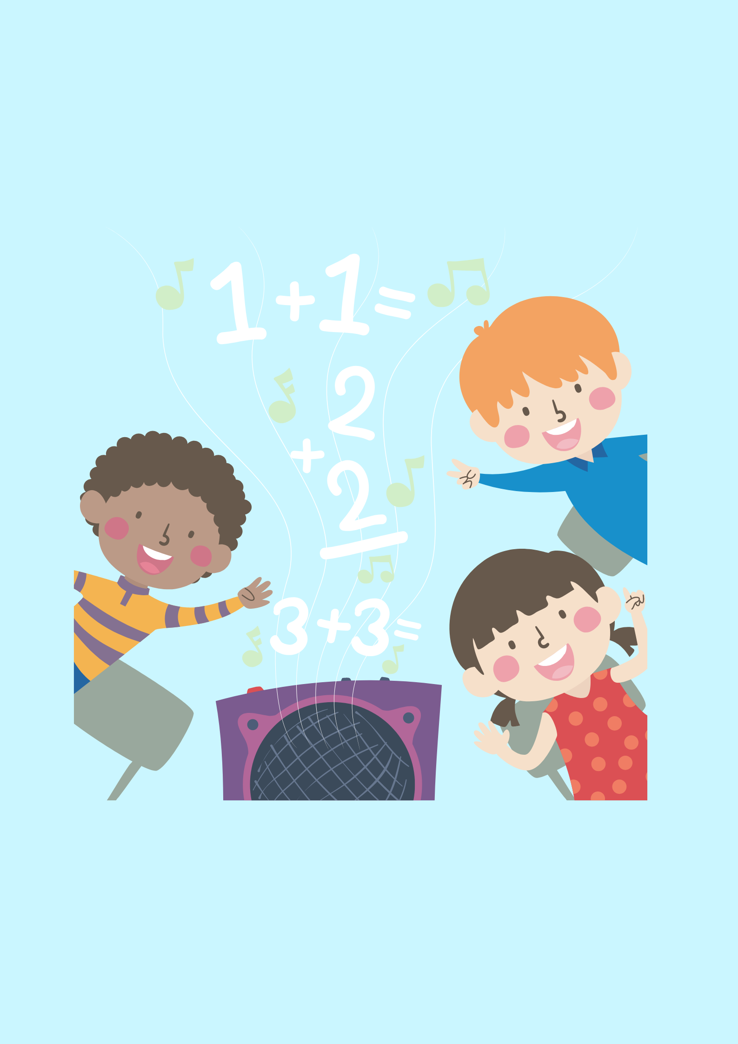

Slide 12




Slide 13
MATCH THE SUBJECT WITH THE PICTURE TO ANSWER THE QUESTION “ WHAT’S YOUR FAVOURITE SUBJECT?”

Slide 14





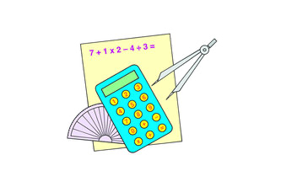


“ WHAT’S YOUR FAVOURITE SUBJECT?”
ART
MATHS
MUSIC
ENGLISH
SCIENCE
IT
PE
ART
Notes:
THIS GAME CAN BE PLAYED IN GROUPS OR TEAMS, FLASH THE CARDS THEN THE WORDS, TIME AND COUNT FOR PUPILS TO MATCH AFTER THE TEACHER SAYS THE SUBJECT IN ORDER,

Slide 15


