Slide 1

Unit 4: Holidays!
Lesson 4c: Vocabulary
Page 76

Slide 2
Lesson Outline
Warm-up
Vocabulary
Speaking
Consolidation
Wrap-up

Slide 3
Objectives
By the end of this lesson, students will be able to…
use words related to clothes, accessories, and footwear: belt, boots, cap, gloves, jacket, jeans, jumper, leggings, scarf, shirt, skirt, socks, T-shirt, trainers.
say what people are wearing.

Slide 4

WARM-UP

Slide 5

Work in pairs.
Choose the word whose underlined part is
pronounced differently from that of the other words.
1. A. wear B. teach C. eat D. dream
2. A. sound B. cloud C. mouse D. tour
3. A. hat B. hair C. hour D. house
/weə(r)/
/tiːtʃ/
/iːt/
/driːm/
/saʊnd/
/klaʊd/
/maʊs/
/tʊə(r)/
/hæt/
/heə(r)/
/ˈaʊə(r)/
/haʊs/

Slide 6
Work in pairs.
Discuss the following questions:
Who chooses the clothes for you to wear every day?
Do you like beautiful or comfortable clothes? Why?
Do you think it’s important to choose your clothes?
I often choose the clothes to wear every day.
I like comfortable clothes because I can do many things easily.
I think it’s important to choose your clothes because it makes you look good.

Slide 7

It’s time to learn …

Slide 8
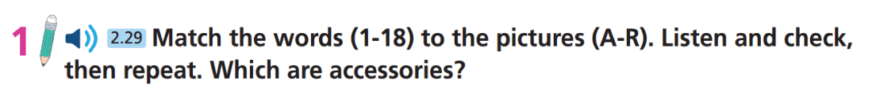
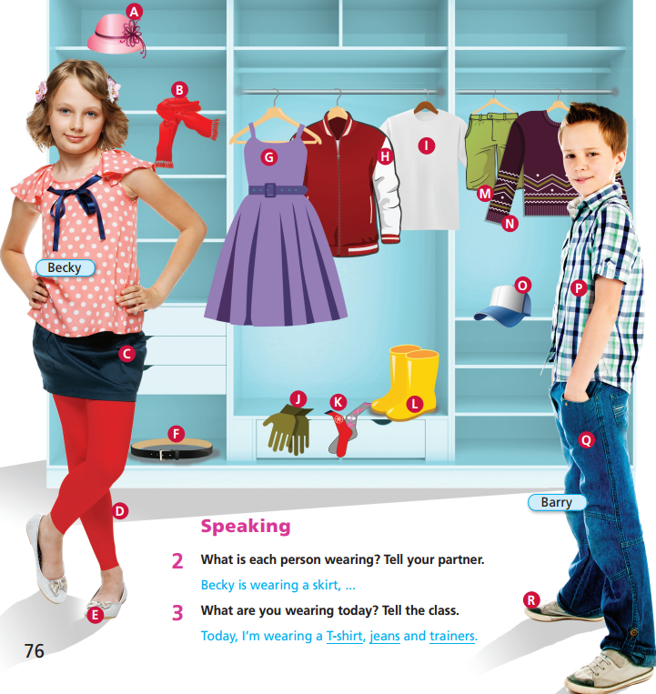
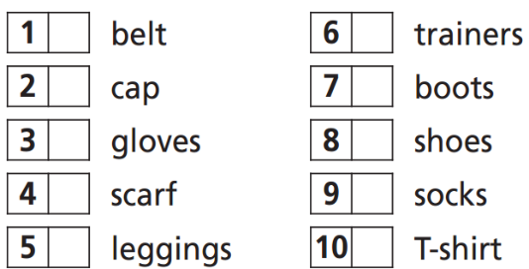
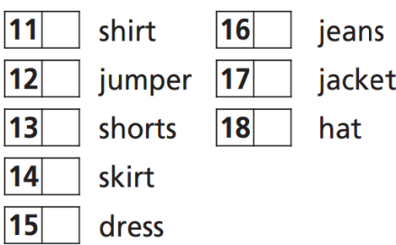

F
R
O
L
J
E
B
K
D
I
P
Q
N
H
M
A
C
G
Accessories:
belt, cap, gloves,
scarf, hat

Slide 9
Vocabulary
Listen and repeat.
belt /belt/ (n): thắt lưng
boots /bu:ts/ (pl n): đôi giày ống, đôi ủng
cap /kæp/ (n): mũ lưỡi trai
gloves /ɡlʌvz/ (pl n): đôi găng tay
jacket /ˈdʒækɪt/ (n): áo khoác
jeans /dʒiːnz/ (pl n): quần jeans, quần bò
jumper/ˈdʒʌmpə(r)/ (n): áo ngoài mặc chui đầu (của phụ nữ)

Slide 10
Vocabulary
Listen and repeat.
leggings /ˈleɡɪŋz/ (pl n): quần ôm sát chân
scarf /skɑːf/ (n): khăn quàng cổ
shirt /ʃɜːt/ (n): áo sơ mi
skirt /skɜːt/ (n): váy, chân váy
socks /sɒks/ (pl n): đôi tất, vớ
T-shirt /ˈtiː ʃɜːt/ (n): áo phông, áo thun ngắn tay
trainers /ˈtreɪnə(r)z/ (pl n): giày thể thao

Slide 11

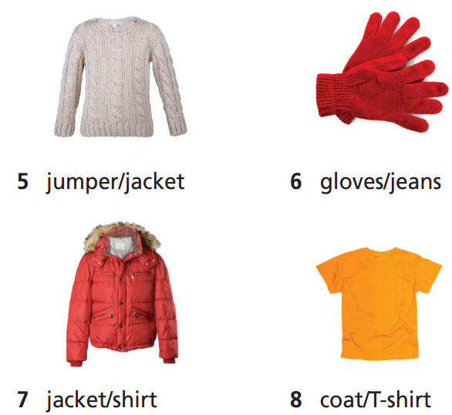
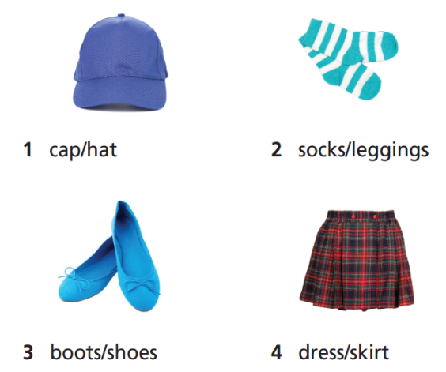
Extra Practice
WB page 40

Slide 12
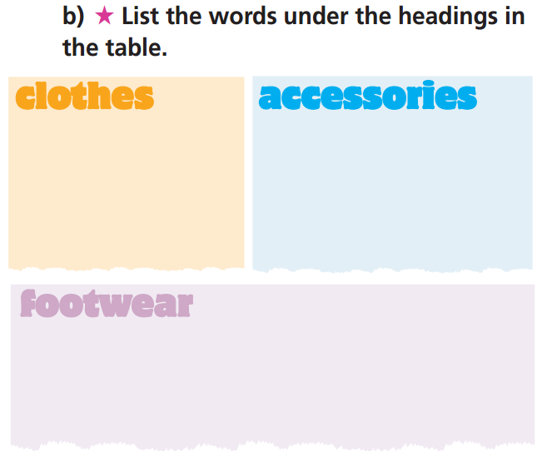
Extra Practice
WB page 40
socks, leggings,
skirt, dress, jumper,
jacket, jeans, shirt,
coat, T-shirt
cap, hat, gloves
shoes, boots

Slide 13
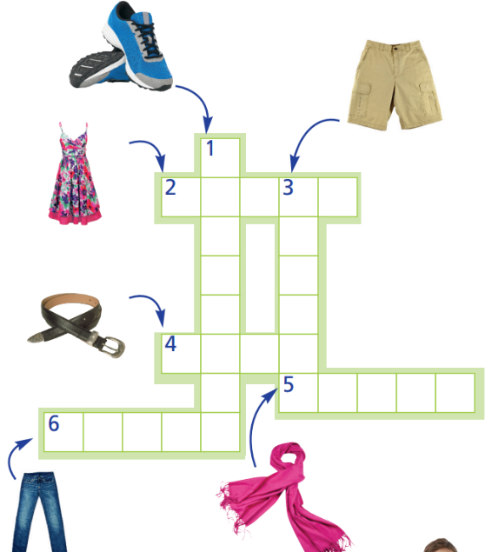

Extra Practice
WB page 40
T
D
R
E
S
S
A
H
I
O
N
R
B
E
L
T
R
S
C
A
R
F
J
E
A
N
S

Slide 14

Speaking

Slide 15
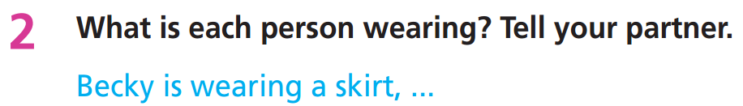
Work in pairs.
Becky is wearing a skirt, leggings, shoes and a T-shirt.
Barry is wearing a shirt, jeans and trainers.

Slide 16
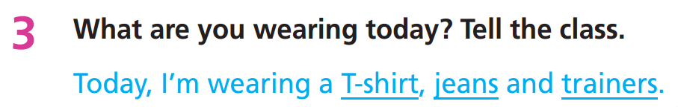
Today, I'm wearing a jumper, jeans and boots.

Slide 17
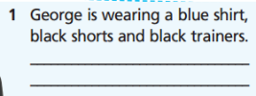
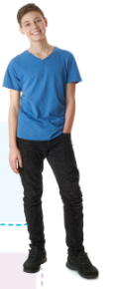


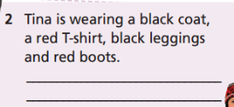
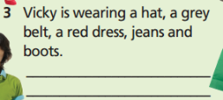
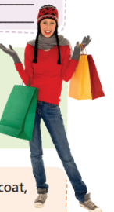

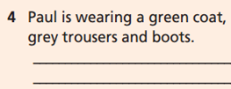
Extra Practice
WB page 40
George is wearing a blue T-shirt,
black trousers and black trainers.
Tina is wearing a black jacket, a red
T-shirt, black trousers and red shoes.
Vicky is wearing a hat, a grey scarf, a red jumper, jeans and trainers.
Paul is wearing a green T-shirt,
grey shorts and trainers.

Slide 18
Who’s that?
Extra Practice
The teacher asks each student to choose a person in the class and describes his/her clothes. The teacher calls randomly some students to describe in front of the class. The other students find out who the person is.

Slide 19

CONSOLIDATION

Slide 20
Think of a person you know. Write a paragraph (50-70 words) about what you often wear and what that person often wears. You can include the following information:
What do you often wear at school, at home, and when you go out?
Who is the person you know? / What’s your relationship with that person?
What kind of clothes does that person wear?
Do you like the way that person dresses?

Slide 21
Think of a person you know. Write a paragraph (50-70 words) about what you often wear and what that person often wears.
e.g.
I often wear a uniform at school. I wear a white shirt, a blue skirt, and shoes. At home, I wear a dress. When I go out, I wear jeans, a T-shirt, and trainers. The person I know is my mother. She often wears a dress and shoes to work. At home, she wears a T-shirt and shorts. I like the way she dresses because it is comfortable for her.

Slide 22

WRAP-UP

Slide 23
Today’s lesson
Vocabulary
belt
boots
cap
gloves
jacket
jeans
jumper
Speaking
say what people are wearing
leggings
scarf
shirt
skirt
socks
T-shirt
trainers

Slide 24
Homework
Practise the vocabulary and make sentences using them.
Do the exercises in TA 6 Right on WB (p. 40).
Do the exercises in TA 6 Right on Notebook (p. 41).
Prepare for the next lesson (p. 77 SB).

Slide 25
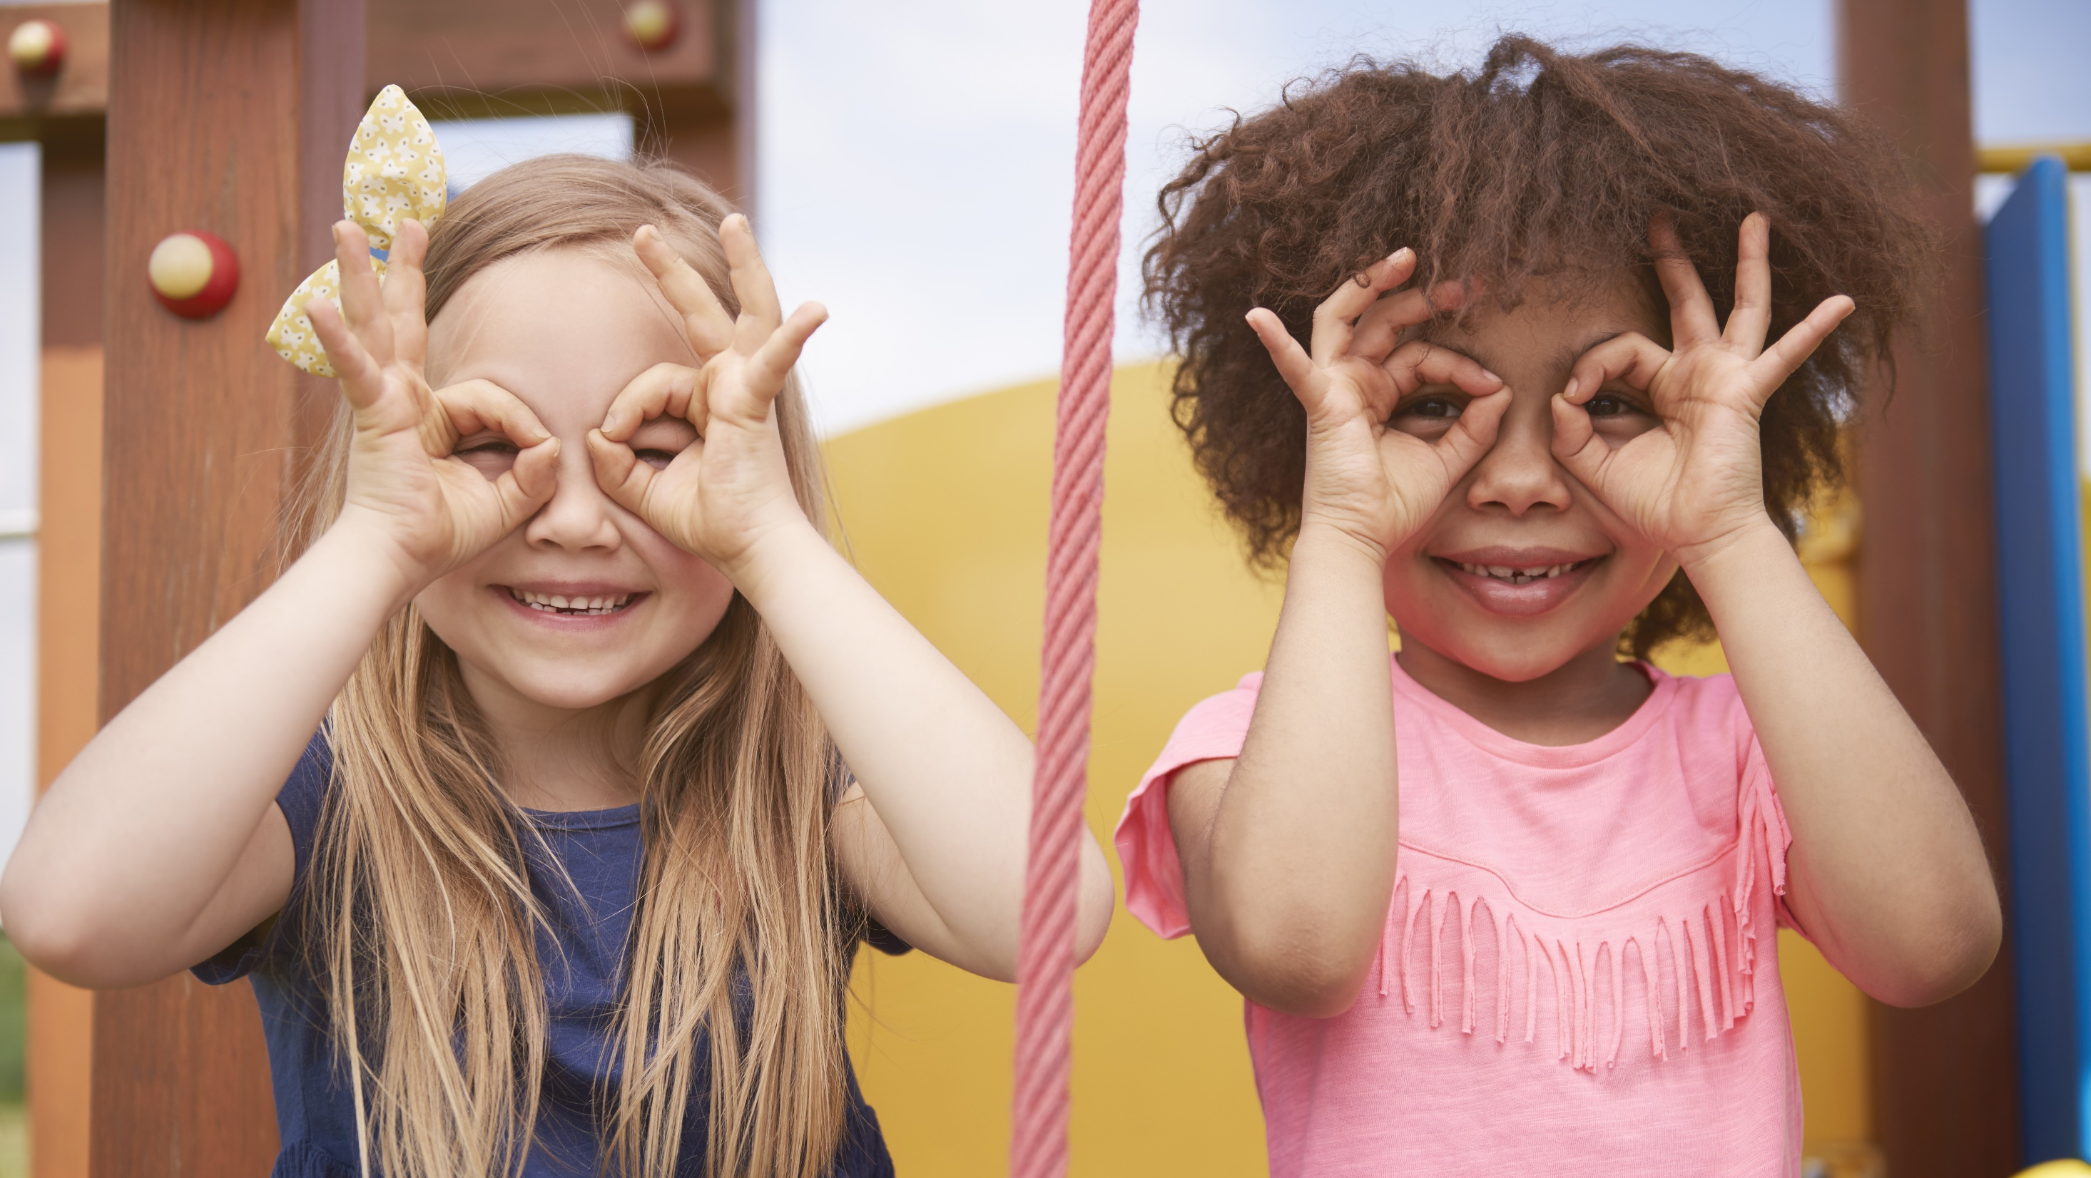
Enjoy your day!

