Slide 1

Unit 9: Houses in the Future
Lesson 2.3: Pronunciation & Speaking
Page 75

Slide 2
Lesson Outline
Warm-up
Pronunciation
Practice
Speaking
Consolidation
Wrap-up

Slide 3
Objectives
By the end of this lesson, students will be able to…
Pronounce the /t/ sounds.
Talk and write about the differences between homes now and homes in the future.

Slide 4

WARM-UP

Slide 5

Work in pairs.
Choose the word whose main stress is placed
differently from the others.
1 A. future B. printer C. device D. robot
/ˈfjuːtʃər/ /ˈprɪntər/ /dɪˈvaɪs/ /ˈroʊbɑːt/
2 A. discuss B. explain C. repeat D. practice
/dɪˈskʌs/ /ɪkˈspleɪn/ /rɪˈpiːt/ /ˈpræktɪs/
3 A. correct B. modern C. noisy D. crowded
/kəˈrekt/ /ˈmɑːdərn/ /ˈnɔɪzi/ /ˈkraʊdɪd/

Slide 6
Work in pairs.
Choose the word whose underlined part is
pronounced differently from that of the other words.
A. battle B. battery C. village D. flashlight
2. A. kicked B. cried C. moved D. played
3. A. station B. question C. forest D. student
/ˈbætl/
/ˈbætəri/
/ ˈvɪlɪdʒ/
/ˈflæʃlaɪt/
/kɪkt/
/kraɪd/
/muːvd/
/pleɪd/
/ˈsteɪʃən/
/ˈkwestʃən/
/ˈfɔːrɪst/
/ˈstuːdənt/

Slide 7
Work in pairs.
Talk about yourselves in the future.
Be creative!
What do you think you will do in the future?
What will you be like in the future?
I will probably ….
I think I might ….
I might not ….

Slide 8


Presentation

Slide 9









Slide 10





Slide 11
Listen and repeat the words.
Pay attention to the sounds: /t/ and /d/.
/t/ | /d/

yard
short


island
west

forest
sad



Slide 12

Practice

Slide 13

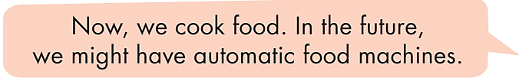

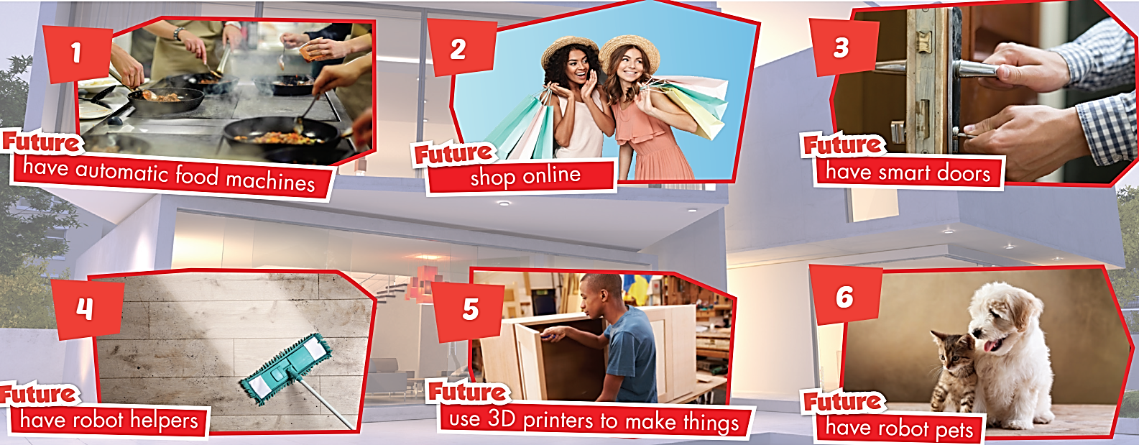

Slide 14

What will __________ like in the future?
Be creative!
I think ……… might ………
I think…….. might not ………

Slide 15

Speaking

Slide 16

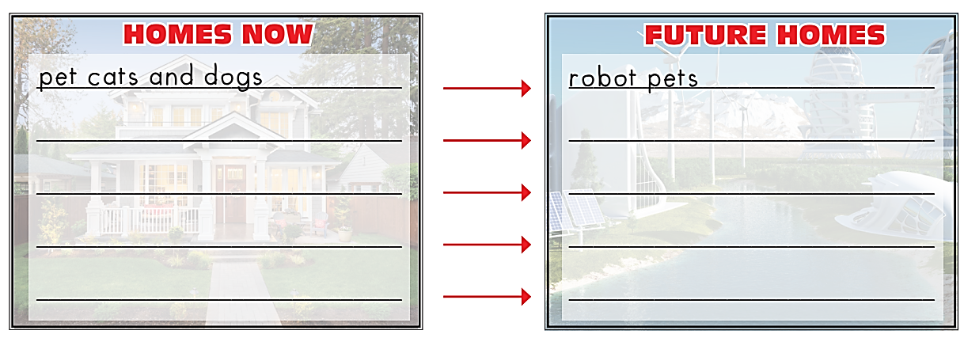
Pre-Speaking
Work alone.
Write four differences between homes now and homes in the future.
Note them below.

Slide 17
While-Speaking
a. You're planning an article for Teen World Magazine on how homes will be different in the future.
Discuss with a partner and choose four differences you want to write about. Note them below.

Slide 18
While-Speaking
b. Compare your answers with another pair. Did you choose the same things?

Slide 19
Post-Speaking
Tell the class ONE difference between homes now and homes in the future.

Slide 20

CONSOLIDATION

Slide 21

Write TWO differences between homes now and homes in the future.
For example:
- Now, we have pet cats and dogs. In the future, we might have robot pets.
1. ________________________________________________
2. ________________________________________________

Slide 22

WRAP-UP

Slide 23
Today’s lesson
Pronunciation
Final sounds /t/
Speaking
The differences between homes now and homes in the future.

Slide 24
Homework
Practice saying words with the sound /t/.
Practice writing sentences about the differences between homes now and those in the future.
Prepare the next lesson (page 76, SB)
Play the consolidation games in Tiếng Anh 6 i-Learn Smart World DHA App on www.eduhome.com.vn

Slide 25

Enjoy your day!

