Slide 1
Launch Product Crowdfunding Pitch Deck
Infographics
Here is where this template begins

Slide 2
Launch product crowdfunding infographics
This template contains an assortment of complementary infographic resources for the Launch Product Crowdfunding Pitch Deck presentation.
These infographics are adapted to the style of the aforementioned presentation, so you can insert them easily and have them completely integrated at once. You just need to do the following:
  Select the element that you want to copy
  Right-click and choose “Copy”
  Go to the slide where you want the element to appear
  Right-click and choose “Paste”

Slide 3
Launch product crowdfunding infographics
Mars
Venus
It's full of iron oxide dust, which gives the planet its reddish cast
Venus has a beautiful name and is the second planet from the Sun
Saturn
Jupiter
Saturn was named after the Roman god of wealth and agriculture
Jupiter is the fourth-brightest object in the night sky

Slide 4
Launch product crowdfunding infographics
Awareness
Mercury is the closest planet to the Sun and the smallest one
Interest
Venus is the second planet from the Sun and it is very hot
Decision
Saturn is a gas giant, composed mostly of hydrogen and helium
Purchase
Jupiter is the biggest planet in the Solar System. It’s a gas giant

Slide 5
Launch product crowdfunding infographics
Goals
Short term
Long term
Venus
Jupiter
Mercury
Earth
Venus has a beautiful name
It’s the biggest planet of them all
It’s the closest planet to the Sun
Earth is the third planet from the Sun

Slide 6
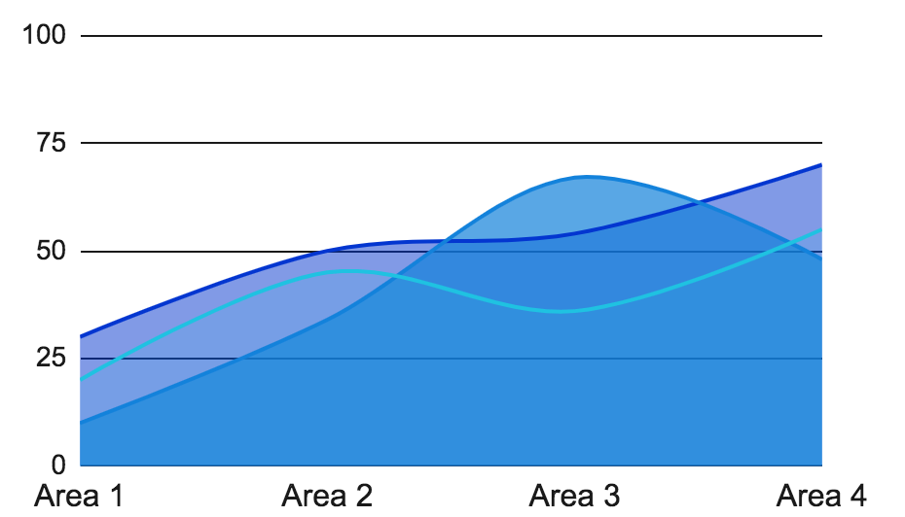
Launch product crowdfunding infographics
Jupiter
It is the biggest planet in the Solar System
Neptune
Neptune is the farthest planet from the Sun
Mars
Despite being red, Mars is a cold place
Follow the link in the graph to modify its data and then paste the new one here. For more info, click here

Slide 7
Launch product crowdfunding infographics
Neptune
Venus
Neptune is the farthest planet from the Sun
Venus has a beautiful name, but it is hot
Saturn
Sun
Mercury
Saturn is a gas giant and has several rings
Mercury is the closest planet to the Sun
Jupiter
Mars
Jupiter is a gas giant and the biggest planet
Despite being red, Mars is a cold place

Slide 8
Launch product crowdfunding infographics
Saturn
Saturn has beautiful rings
Jupiter
Jupiter is the biggest planet
Mercury
Mercury is a small planet

Slide 9
Launch product crowdfunding infographics
Budget
Mercury | Mars | Jupiter | Neptune
$300,000 | $500,000 | $560,000 | $220,000
Mercury is the smallest planet | Despite being red, Mars is a cold place | Jupiter is the biggest planet of them all | Neptune is very far from the Sun

Slide 10
Launch product crowdfunding infographics
Outreach
Compliance rate
65%
30%
55%
85%
Saturn
Earth
It is a gas giant
We all live on planet Earth
Jupiter
23%
It is a big planet
Venus
Mercury
Venus has a beautiful name
It’s a small planet

Slide 11
Launch product crowdfunding infographics
A
Mercury
Mercury is the closest planet to the Sun
B
Venus
Venus is the second planet from the Sun
C
Jupiter
It’s the biggest planet in the Solar System
Sun
D
Saturn
Saturn is composed mostly of hydrogen

Slide 12
Launch product crowdfunding infographics
Actions | Definition | Progress | Timeline | Date
Action 1 | Mercury is the closest planet to the Sun | 30% |  | 17 Feb
Action 2 | Venus is the second planet from the Sun | 55% |  | 21 Mar
Action 3 | Earth is the third planet from the Sun | 80% |  | 14 Jun

Slide 13
Launch product crowdfunding infographics
Neptune is the farthest planet from the Sun
Earth is the third planet from the Sun
Competitor 1
Competitor 2
Competitors analysis
Competitor 4
Competitor 3
Jupiter is the biggest planet of them all
Mercury is the closest planet to the Sun

Slide 14
Launch product crowdfunding infographics
Jupiter
Jupiter is the biggest planet in the Solar System
80%
Mars
Despite being red, Mars is actually a very cold place
60%
Venus
Venus is the second planet from the Sun and it is hot
40%

Slide 15
Launch product crowdfunding infographics
01
01
02
03
Jupiter
Venus
Saturn
02
Jupiter is a gas giant and the biggest planet in the Solar System. It was named after the Roman god of the skies and lightning
Venus has a beautiful name and is the second planet from the Sun. It’s the second-brightest natural object in the night sky
Saturn is a gas giant and has several rings. It's composed mostly of hydrogen and helium. It’s the sixth planet from the Sun
03

Slide 16
Launch product crowdfunding infographics
25%
30%
20%
25%
Jupiter
Venus
Mars
Saturn
It's the biggest planet of them all
It has extremely high temperatures
Mars is actually a very cold place
It’s a gas giant with several rings

Slide 17
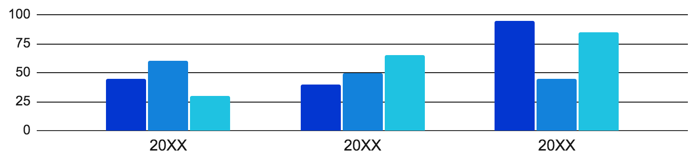
Launch product crowdfunding infographics
150,000
21,000
39,000
Mercury
Jupiter
Mars
Mercury is a small planet
Jupiter is a gas giant
Mars is a cold planet
Follow the link in the graph to modify its data and then paste the new one here. For more info, click here

Slide 18
Launch product crowdfunding infographics
Jan | Feb | Mar | Apr | May | Jun | Jul | Aug | Sep | Oct | Nov | Dec
Jupiter is the biggest planet of them all
Saturn is a gas giant with several rings
Venus has extremely high temperatures
Mercury is the smallest planet
Mars is actually a very cold place

Slide 19
Launch product crowdfunding infographics
Mercury
Mars is a very cold place
A
It’s the closest planet to the Sun
Neptune is far away from us
Venus
The Moon is our satellite
B
Venus is the second planet from the Sun
Mars is full of iron oxide
Jupiter
Saturn is a gas giant
C
Jupiter is the biggest planet of them all
Earth is where we all live

Slide 20
Launch product crowdfunding infographics
01
Awareness
Jupiter is the biggest planet of them all
02
Consideration
03
Despite being red, Mars is a cold place
Decision
Mercury is the closest planet to the Sun

Slide 21
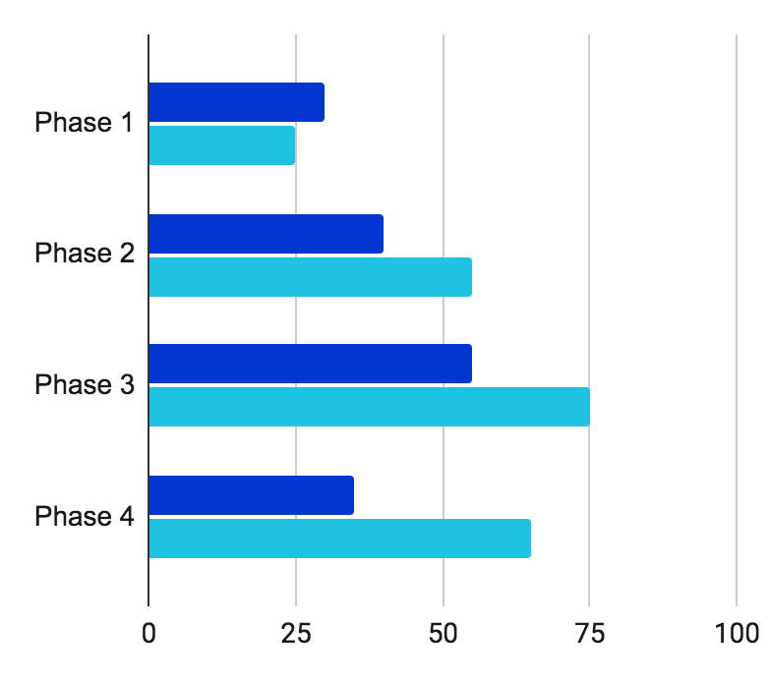
Launch product crowdfunding infographics
Expected growth
70%
Despite being red, Mars is actually a cold place
Mercury
Venus
Mercury is a small planet
Venus has a beautiful name
Follow the link in the graph to modify its data and then paste the new one here. For more info, click here

Slide 22
Launch product crowdfunding infographics
Checklist
01 | You can list all the activities you would like to try here
02 | You can list all the activities you would like to try here
03 | You can list all the activities you would like to try here
04 | You can list all the activities you would like to try here
05 | You can list all the activities you would like to try here

Slide 23
Launch product crowdfunding infographics
Venus
01
04
Saturn
Venus has a beautiful name
Saturn is a gas giant and has rings
02
Jupiter
Mercury
05
Jupiter is a gas giant and it is big
Mercury is a very small planet
Neptune
03
06
Earth
Neptune is far away from the Sun
Earth is the planet where we all live

Slide 24
Launch product crowdfunding infographics
Info
Occupation
Age: | 30 years old
Location: | U.S.A.
Studies: | Business
Gender: | Female
Job: | Pastry chef
Company: | Jean Bakery
Salary: | $4,000+
Position: | Medium
Personality
Hobbies
Curious
Patient
Efficient
Creative
Proactive
Worker
Productive
Friendly
25%
50%
70%

Slide 25
Launch product crowdfunding infographics
Time | Mon | Tue | Wed | Thu | Fri
9:00 | Jupiter
10:00 |  |  | Mars | Mercury
11:00 |  | Venus |  |  | Neptune
12:00 | Venus |  |  | Mars
13:00 |  | Neptune | Mercury |  | Venus
14:00

Slide 26
Launch product crowdfunding infographics
Sun
01
02
03
Mercury
Venus
Mars
Mercury is the closest planet to the Sun and the smallest one
Venus has a beautiful name and is the second planet from the Sun
Despite being red, Mars is actually a cold place. It’s made of basalt

Slide 27
Launch product crowdfunding infographics
Mercury
Mars
Venus
It’s the closest planet to the Sun
Mars is actually a very cold place
Venus has extremely high temperatures
Jupiter
Neptune
Jupiter is the biggest planet of them all
Neptune is very far away from us

Slide 28
Launch product crowdfunding infographics
Mercury
Venus
Mercury is the closest planet to the Sun and the smallest one in the entire Solar System
This planet's name has nothing to do with the liquid metal, since Mercury was named after the Roman messenger god
Venus has a beautiful name and is the second planet from the Sun. It’s terribly hot, hotter than Mercury, and has a toxic atmosphere
Venus is the second-brightest object we can see in the night sky, surpassed only by the Moon

Slide 29
Launch product crowdfunding infographics
Concept 01
Concept 02
Concept 03
Concept 04

Slide 30
Launch product crowdfunding infographics
Neptune
Venus
Neptune is the farthest planet from the Sun
It's the second planet from the Sun
Mercury
Jupiter
Team 1
Team 2
Mercury is the closest planet to the Sun
It’s the biggest planet in the Solar System
Saturn
Mars
Saturn is a gas giant and has several rings
Despite being red, Mars is actually a cold place

Slide 31
Launch product crowdfunding infographics
Personal data
Interests
Age | 30 years old
Gender | Male
Studies | Advertising
Job | Designer
Salary | $1,500- $2,000
Location | U.S.A.
80%
60%
75%
Goals
Jupiter very big
Saturn has rings
Mercury is small
Mars is red

Slide 32
Launch product crowdfunding infographics
Mon | Tue | Wed | Thu | Fri | Sat | Sun
1 | 2 | 3 | 4 | 5 | 6 | 7
8 | 9 | 10 | 11 | 12 | 13 | 14
15 | 16 | 17 | 18 | 19 | 20 | 21
22 | 23 | 24 | 25 | 26 | 27 | 28
29 | 30 | 31
Mercury
Mercury is the closest planet to the Sun
Venus
Venus is the second planet from the Sun
Mars
Despite being red, Mars is actually a cold place

Slide 33
Instructions for use
If you have a free account, in order to use this template, you must credit Slidesgo in your final presentation. Please refer to the next slide to read the instructions for premium users.
As a Free user, you are allowed to:
- Modify this template.
- Use it for both personal and commercial projects.
You are not allowed to:
- Sublicense, sell or rent any of Slidesgo Content (or a modified version of Slidesgo Content).
- Distribute Slidesgo Content unless it has been expressly authorized by Slidesgo.
- Include Slidesgo Content in an online or offline database or file.
- Offer Slidesgo templates (or modified versions of Slidesgo templates) for download.
- Acquire the copyright of Slidesgo Content.
For more information about editing slides, please read our FAQs or visit our blog:
https://slidesgo.com/faqs and https://slidesgo.com/slidesgo-school

Slide 34
Instructions for use (premium users)
As a Premium user, you can use this template without attributing Slidesgo.
You are allowed to:
Modify this template.
Use it for both personal and commercial purposes.
Share this template in an editable format with people who are not part of your team.
You are not allowed to:
Sublicense, sell or rent this Slidesgo Template (or a modified version of this Slidesgo Template).
Distribute this Slidesgo Template (or a modified version of this Slidesgo Template) or include it in a database or in any other product or service that offers downloadable images, icons or presentations that may be subject to distribution or resale.
Use any of the elements that are part of this Slidesgo Template in an isolated and separated way from this Template.
Register any of the elements that are part of this template as a trademark or logo, or register it as a work in an intellectual property registry or similar.
For more information about editing slides, please read our FAQs or visit our blog:
https://slidesgo.com/faqs and https://slidesgo.com/slidesgo-school

Slide 35
Infographics
You can add and edit some infographics to your presentation to present your data in a visual way.
Choose your favourite infographic and insert it in your presentation using Ctrl C + Ctrl V or Cmd C + Cmd V in Mac.
Select one of the parts and ungroup it by right-clicking and choosing “Ungroup”.
Change the color by clicking on the paint bucket.
Then resize the element by clicking and dragging one of the square-shaped points of its bounding box (the cursor should look like a double-headed arrow). Remember to hold Shift while dragging to keep the proportions.
Group the elements again by selecting them, right-clicking and choosing “Group”.
Repeat the steps above with the other parts and when you’re done editing, copy the end result and paste it into your presentation.
Remember to choose the “Keep source formatting” option so that it keeps the design. For more info, please visit our blog.

