Slide 1
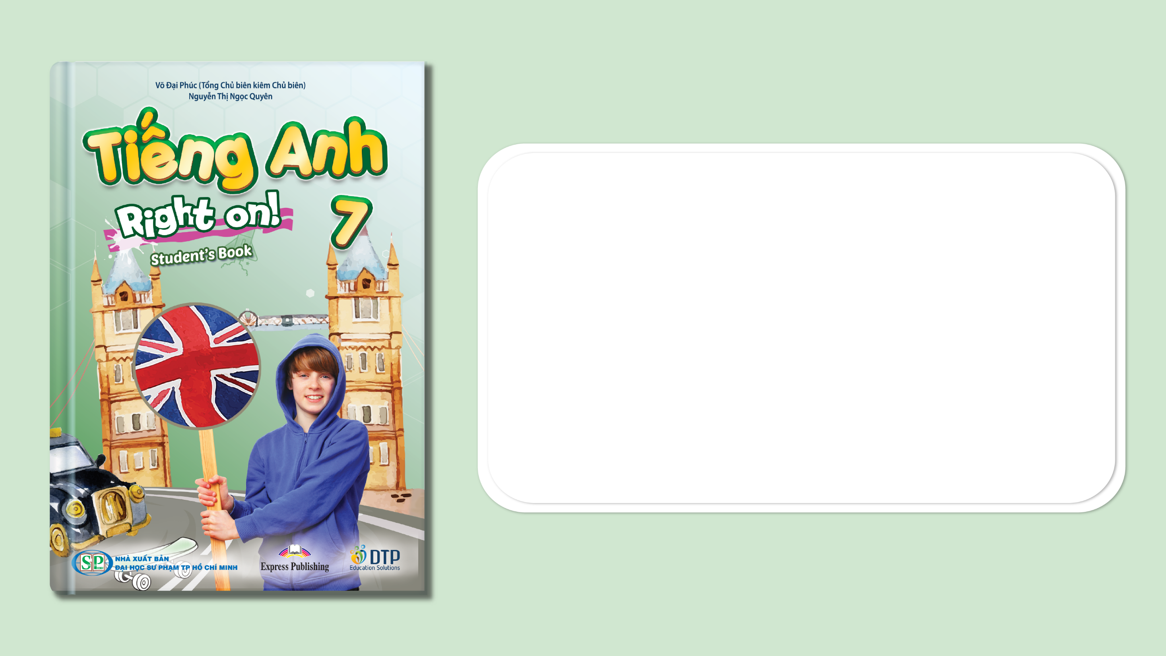
Unit 3: Arts and Music
Lesson 3e: Grammar
Page 52

Slide 2
Lesson Outline
Warm-up
Grammar
Consolidation
Wrap-up

Slide 3
Objectives
By the end of this lesson, students will be able to…
- use Conditional (type 1) correctly.
- make offers and promises.

Slide 4

WARM-UP

Slide 5

Work in pairs.
JUMBLED WORDS
Rearrange the letters to make meaningful words.
1. Pefmaorncer
2. Ailse
3. Csah
4. Sowh
5. Tiektc

Slide 6
JUMBLED WORDS
Rearrange the letters to make meaningful words.
1. Pefmaorncer
2. Ailse
3. Csah
4. Sowh
5. Tiektc
1. Performance
2. Aisle
3. Cash
4. Show
5. Ticket
ANSWER

Slide 7

It’s time to learn …

Slide 8

Presentation

Slide 9
Example
1. If the weather is nice, I’ll go to the Hay Festival with you.

Slide 10
Lead in
1. What grammar point do we use in sentence 1?
Conditional type 1.
2. What do we use will for?
For something real or likely to happen in the present or future.
To make offers and promises.

Slide 11
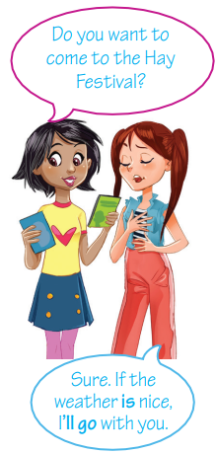
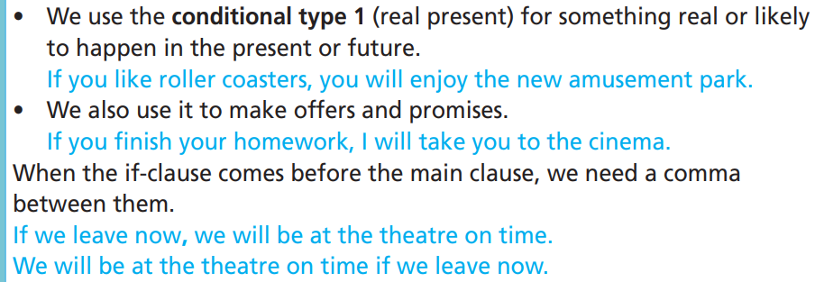
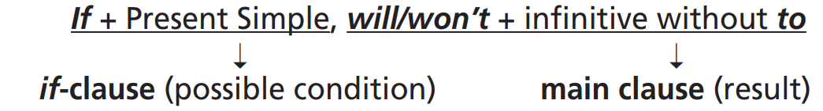
Structure:

Slide 12
NOTES:
Unless = If… not… (Trừ phi/ Nếu… không)
Ex: If you don’t study hard, you won’t get good marks.
Unless you study hard, you won’t get good marks.

Slide 13
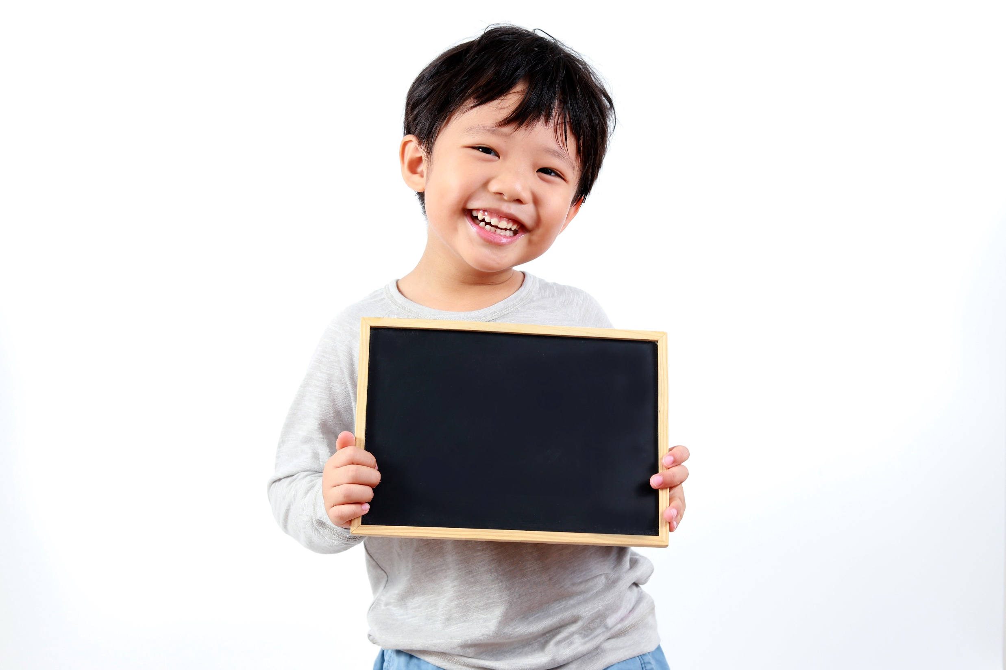
Practice

Slide 14
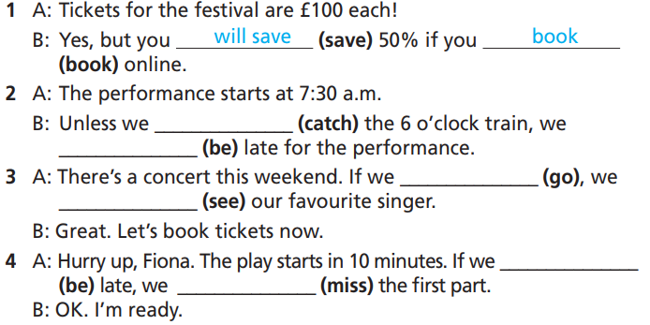
Practice
1 Complete the sentences with the correct form of the verbs in brackets.
How many sentences are there?
→ There are 4.
What are you going to do?
Complete the sentences with
the correct form of the verbs.

Slide 15
Practice
1 Complete the sentences with the correct form of the verbs in brackets.
1. A: Tickets for the festival are £100 each!
B: Yes, but you ___________ (save) 50% if you book _________ (book) online.
2. A: The performance starts at 7:30 a.m.
B: Unless we ___________ (catch) the 6 o’clock train, we
___________ (be) late for the performance.
will save
book
catch
will be

Slide 16
Practice
1 Complete the sentences with the correct form of the verbs in brackets.
3. A: There’s a concert this weekend. If we ______ (go), we __________ (see) our favourite singer.
B: Great. Let’s book tickets now.
4. A: Hurry up, Fiona. The play starts in 10 minutes. If we _____ (be) late, we ___________ (miss) the first part.
B: OK. I’m ready.
go
will see
are
will miss

Slide 17
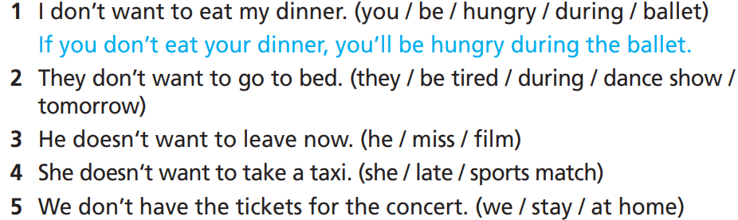
Practice
2 Read the statements and use the phrases in brackets to make type 1 conditional sentences in your notebook.
How many sentences are there?
→ 4.
What are you going to do?
Use the phrases in brackets to make type 1 conditional sentences.

Slide 18
Practice
2 Read the statements and use the phrases in brackets to make type 1 conditional sentences in your notebook.
1. I don’t want to eat my dinner. (you/ be/ hungry/ during/ ballet)
If you don’t eat your dinner, you’ll be hungry during the ballet.
2. They don’t want to go to bed. (they/ be tired/ during/ dance show/ tomorrow)
If they don’t go to bed, they’ll be tired during the dance show tomorrow.

Slide 19
Practice
2 Read the statements and use the phrases in brackets to make type 1 conditional sentences in your notebook.
3. He doesn’t want to leave now. (he/ miss/ film)
If he doesn’t leave now, he’ll miss the film.
4. She doesn’t want to take a taxi. (she/ late/ sports match)
If she doesn’t take a taxi, she’ll be late for the sports match.
5. We don’t have the tickets for the concert. (we/ stay/ at home)
If we don’t have the tickets for the concert, we’ll stay at home.

Slide 20
Practice
3 Rewrite the sentences in Exercise 2 into your notebook
using unless.
1. If you don’t eat your dinner, you’ll be hungry during the ballet.
→ Unless you eat your dinner, you’ll be hungry during the ballet.
What are you going to do?
Rewrite the sentences using unless.

Slide 21
Practice
3 Rewrite the sentences in Exercise 2 into your notebook
using unless.
2. If they don’t go to bed, they’ll be tired during the dance show tomorrow.
→ Unless they go to bed, they’ll be tired during the dance show tomorrow.
3. If he doesn’t leave now, he’ll miss the film.
→ Unless he leaves now, he’ll miss the film.

Slide 22
Practice
3 Rewrite the sentences in Exercise 2 into your notebook
using unless.
4. If she doesn’t take a taxi, she’ll be late for the sports match.
→ Unless she takes a taxi, she’ll be late for the sports match.
5. If we don’t have the tickets for the concert, we’ll stay at home.
→ Unless we have the tickets for the concert, we’ll stay at home.

Slide 23
Extra Practice
WB, page 30
Choose the correct option.
1. If you go to Hanoi, you see/will see the Ho Chi Minh Mausoleum.
2. If we will have/have free time, we will go to the fashion show.
3. Liam will call/call us if he finishes early.
4. Jane won’t come if she doesn’t finish/won’t finish her homework.
5. Minh will show/shows us the way to the theatre if he comes with us.

Slide 24
Extra Practice
Grammar Bank, page 70
Put the verbs in brackets into the Present Simple or the Future Simple.
1. If we are late, we _____________ (catch) a taxi home.
2. Unless you donate money, you _____________ (not/receive) a free T-shirt.
3. If it _____________ (get) warm, we’ll go to the beach.
4. If they cut down the trees, animals__________ (lose) their home.
will catch
won’t receive
gets
will lose

Slide 25
Extra Practice 44
Grammar Bank, page 70
Put the verbs in brackets into the Present Simple or the Future Simple.
5. He’ll come to the clean-up day if he_______ (have) free time.
6. If she is tired, she _____________ (go) home.
7. If you ______ (join) the gardening class, I will come with you.
8. We’ll give you a puppy if you _________ (want) a dog so much.
has
will go
join
want

Slide 26

Production

Slide 27

Continue the story
A: If I have some free time, I’ll listen to music.
B: If I listen to music, I’ll feel relaxed.
A: If I feel relaxed,...
Suggested Answer Keys
A: If I feel relaxed, I will study better.
B: If I study better, I will get good marks.

Slide 28

CONSOLIDATION

Slide 29
Extra Practice
WB, page 30
Complete the sentences to make type 1 conditional sentences.
1. Unless John ____________ (hurry), he ____________ (miss) the concert.
2. Kathy ____________ (not/go) to the festival if the tickets
__________ (be) expensive.
3. If Steve _____________ (visit) us, we _____________ (order) pizza for dinner.
hurries
will miss
won’t go
are
visits
will order

Slide 30
Extra Practice
WB, page 30
Complete the sentences to make type 1 conditional sentences.
4. If it ______________ (not/rain), we ____________ (go) to the exhibition centre tomorrow.
5. You ____________ (love) Cosmo World in Japan if you _________ (like) extreme roller coasters.
doesn’t rain
will go
will love
like

Slide 31

WRAP-UP

Slide 32
Today’s lesson
Grammar: Practise and use Conditional (type 1) correctly.

Slide 33
Homework
Practise the grammar point and make sentences using them.
Do the exercises in TA 7 Right on WB (page30).
Prepare the next lesson (page 53 SB).
Complete the grammar notes in TA 7 Right on Notebook (page 24).

Slide 34
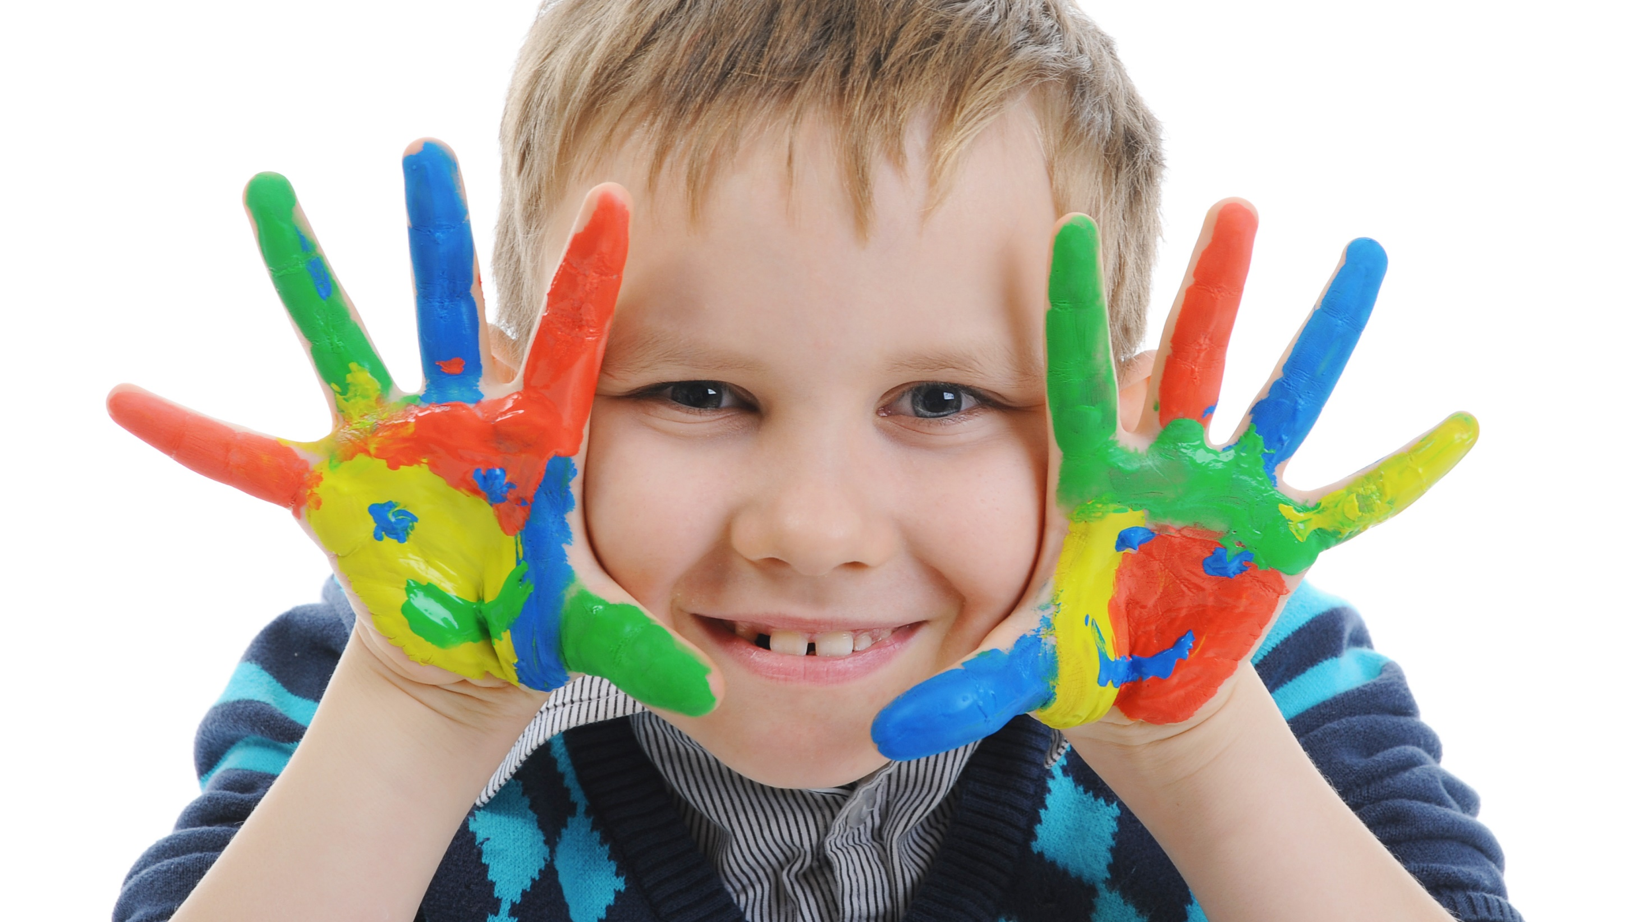
Enjoy your day!

